Slide 1
Eta Sigma Phi Bacchanalia
May 12, 2007
Home of Steve & Rhonda Reece

Slide 2
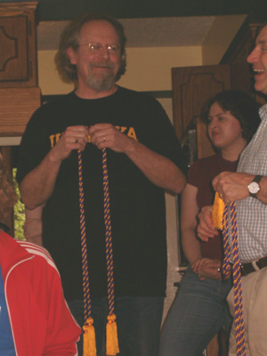
Let the cording begin!

Slide 3
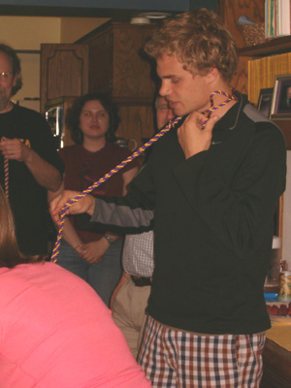
Jacob Anderson reels in his line.

Slide 4
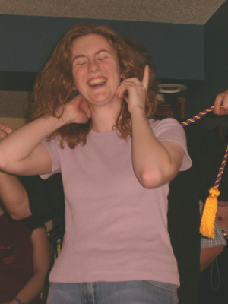
Elizabeth Beerman is tickled pink.

Slide 5
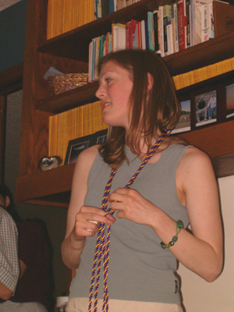
Holly Browskowski ties a knot.

Slide 6
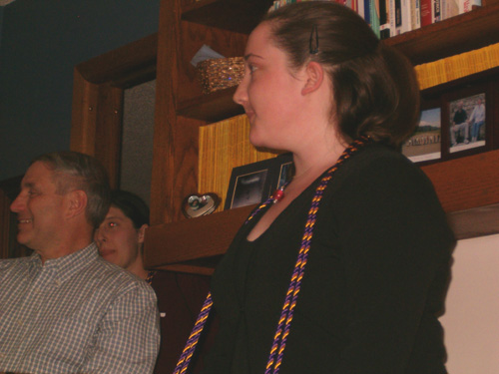
Emelie Heltsley meditates.

Slide 7
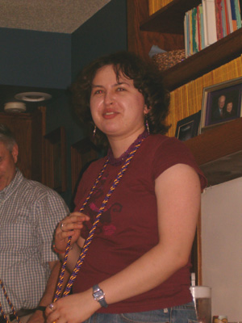
Andrea Horbinski expatiates.

Slide 8
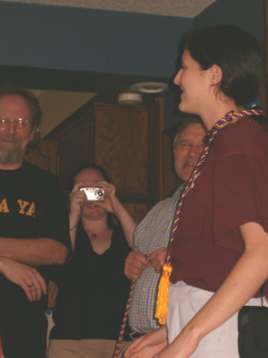
Jennifer Starkey stands on her toes.

Slide 9
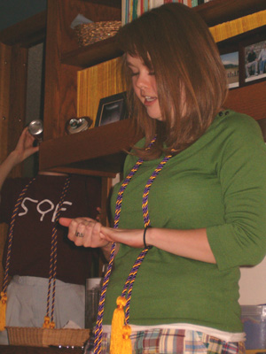
Let's see, what else to add?

Slide 10
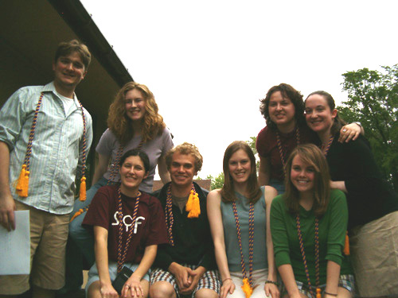
The seniors are re-cord-ed for posterity.

