Slide 1
Eta Sigma Phi Bacchanalia
May 9, 2009
Home of Steve & Rhonda Reece

Slide 2
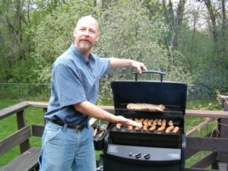
It's a suovetaurilia--with just the su-!

Slide 3
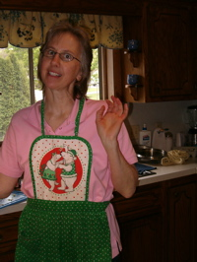
Wanna help?

Slide 4
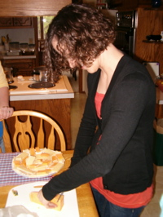
Yummy cheese!

Slide 5
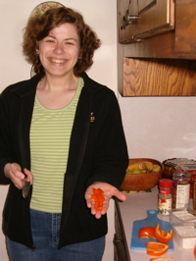
Yummy tomatoes!

Slide 6
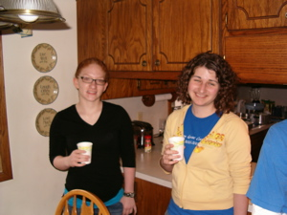
Is it more fun inside or...

Slide 7
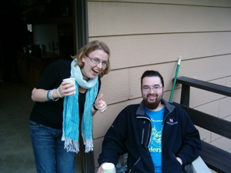
outside?

Slide 8
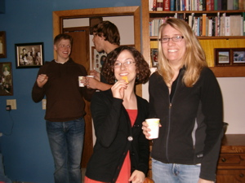
Inside or...

Slide 9
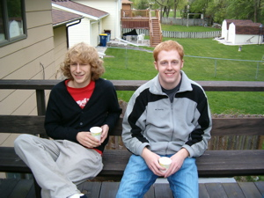
outside?

Slide 10
outside?

Slide 11
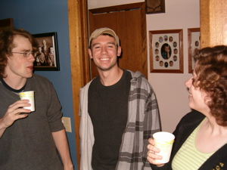
Inside or...

Slide 12
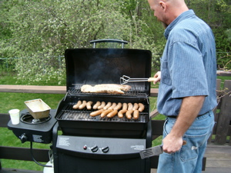
outside?

Slide 13
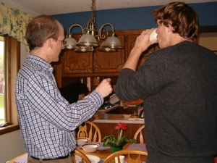
Inside or...

Slide 14
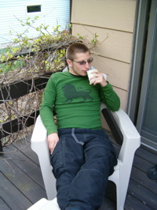
outside?

Slide 15
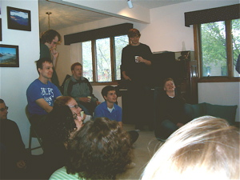
No more arguing: it's time for awards.

Slide 16
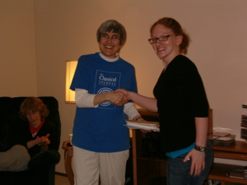
Is that a secret handshake?

Slide 17
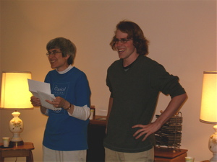
No one knows for sure.

Slide 18
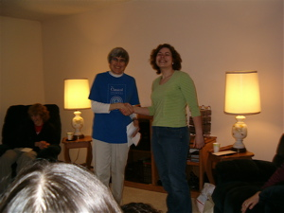
Everyone seems happy, though.

Slide 19
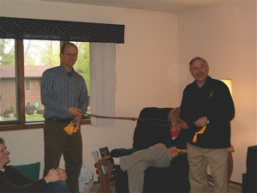
Come and get your honor cord!

Slide 20
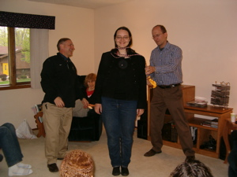
Professors first!

Slide 21
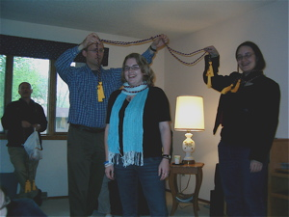
This is easy!

Slide 22
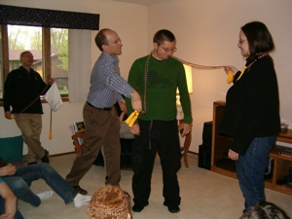
Well, maybe not...

Slide 23
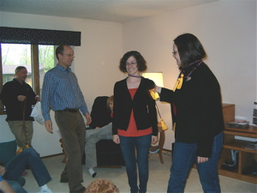
Still doesn't seem quite right...

Slide 24
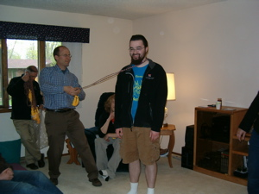
Whoa, what's going on here?

Slide 25
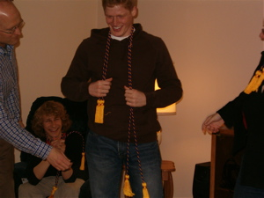
Finally! That's the way to do it.

Slide 26
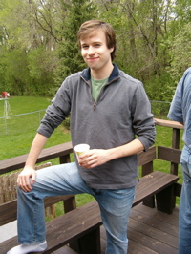
See you next year!

