Slide 1
Eta Sigma Phi Bacchanalia
May 15, 2010
Home of Steve & Rhonda Reece

Slide 2
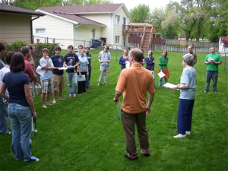
We've given out all the prizes. Now what?
.

Slide 3
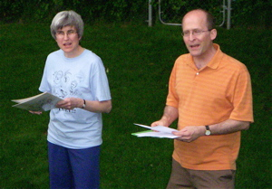
Why not sing a tune from the Mikado?
.

Slide 4
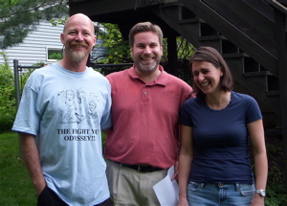
What awful puns on that t-shirt!
.

Slide 5
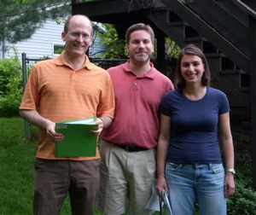
Let's be more serious this time.
.

Slide 6
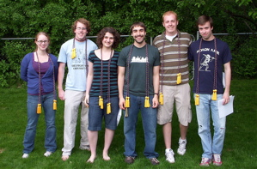
Get in line, seniors!
.

