Slide 1
Eta Sigma Phi Bacchanalia
May 14, 2011
Home of Steve & Rhonda Reece

Slide 2
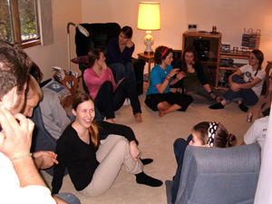
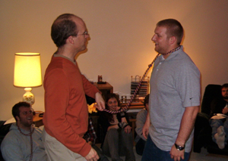
FUN AT THE REECES' HOUSE
Graduating members are corded.

Slide 3
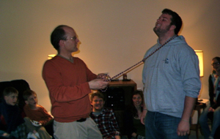
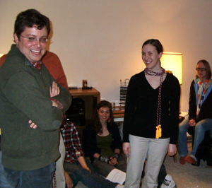
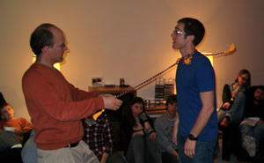
Prof. Myer can't help smiling...

Slide 4
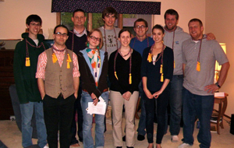
Seniors (L-R): Martin Shedd, Jason Chance, Pierce Devol, Jennifer Stanull, Samuel Willodson, Katherine Crawford, Kevin Farrar, Kathryn Weaver, Will Erickson, Justin Luthey
Absent seniors: Ben Binder, Jordan Bleth, Henry Frank, Matt Friedrichsen, Morgan Harden, Addison Larrow, Cole Nyquist, Laura Ritchie, Andrew White, Conner Westby

