Slide 1
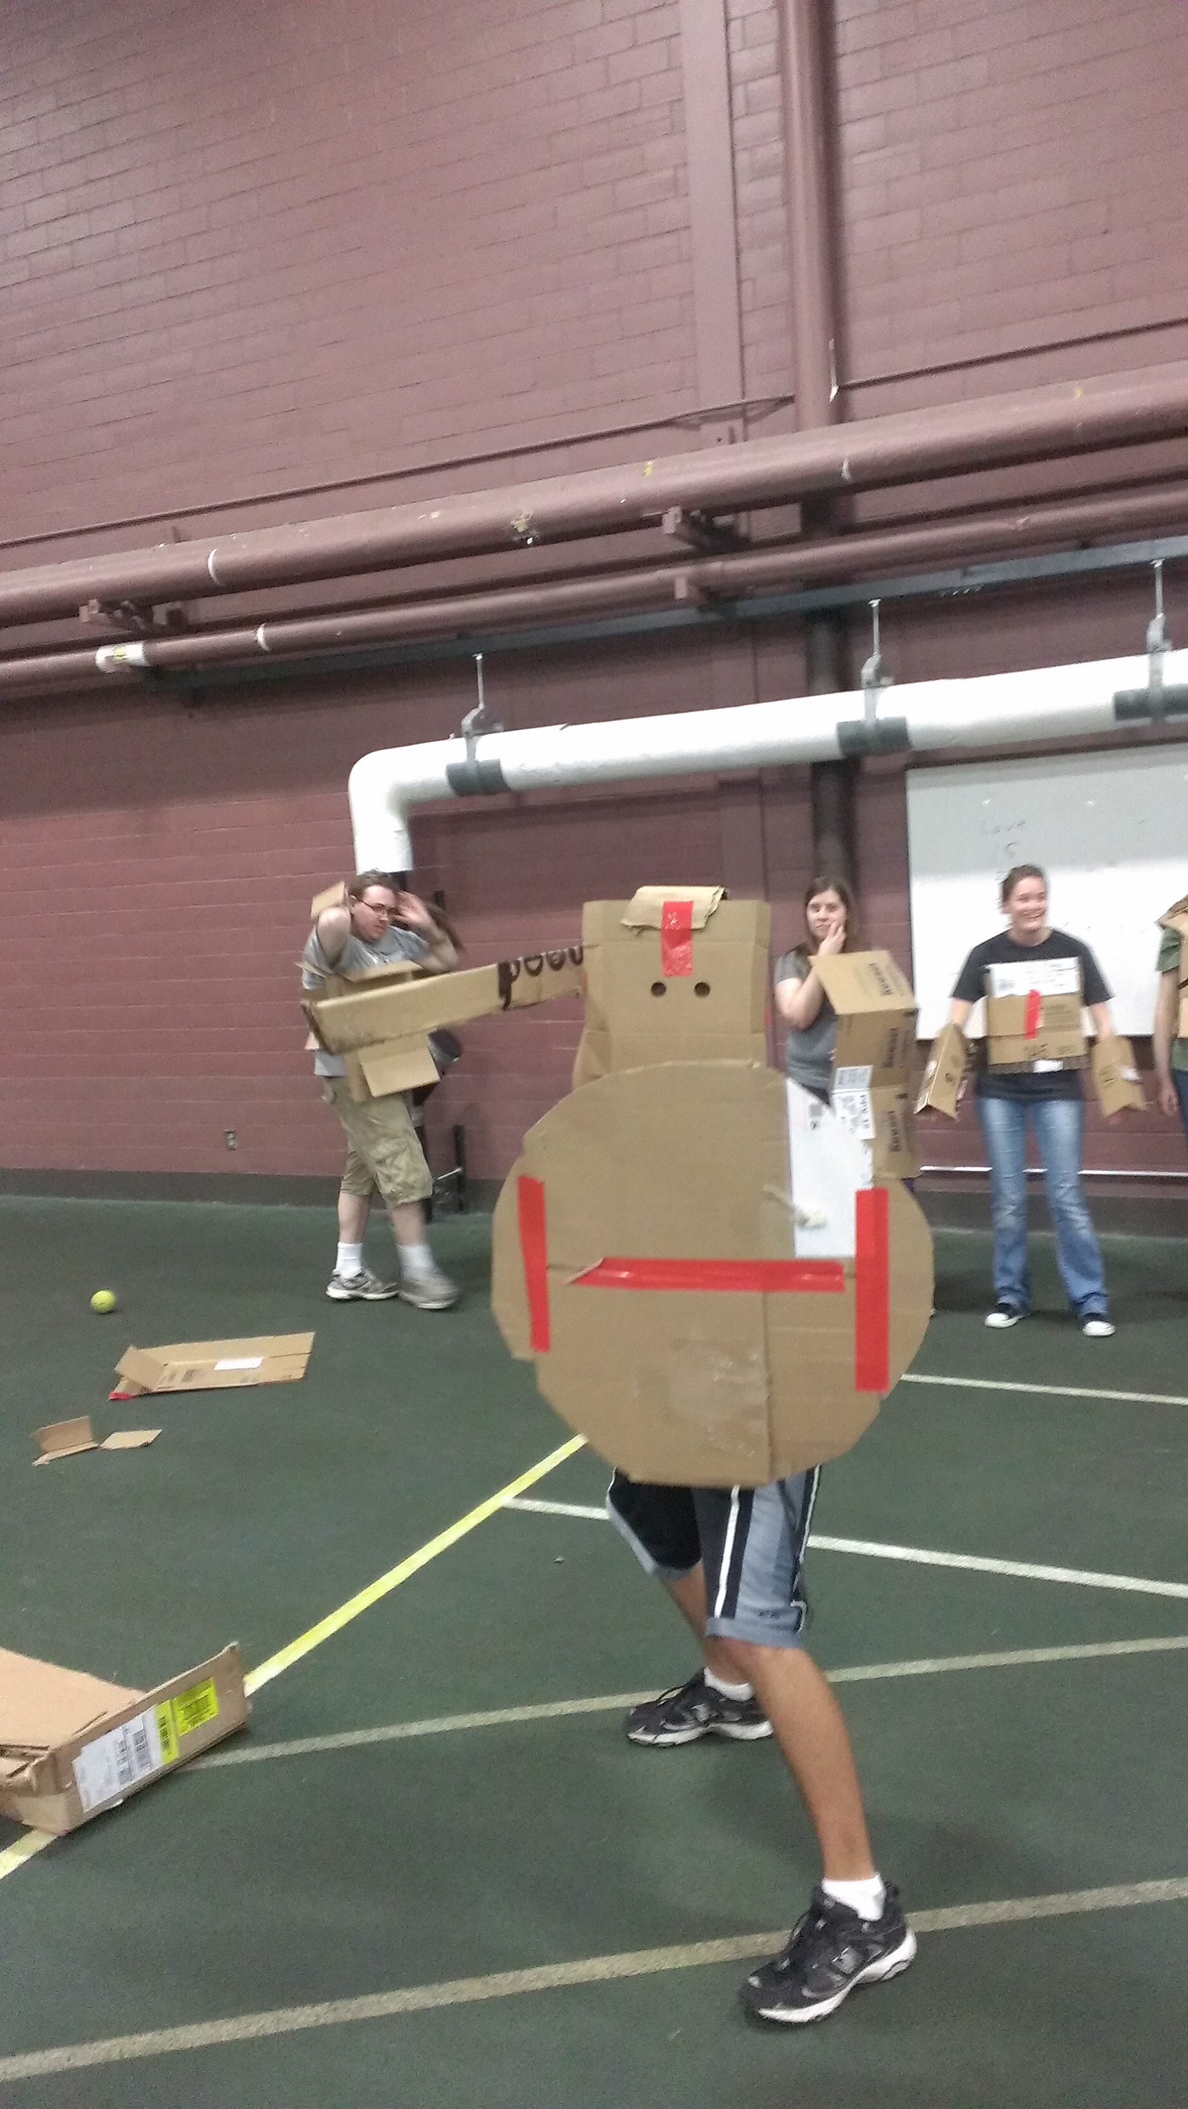
Photos from the 8th Annual St. Olaf Olympics
September 28, 2013
(co-sponsored by the Society for Ancient History
and the Delta Chi chapter of Eta Sigma Phi)
Rainy weather forced the Olympics to be held
in Skoglund Fieldhouse.
The photos (taken by Jason Menard) offer a glimpse of the hoplite race
and of the feasting (on a blue replica of the Hellespont) that followed.

