Slide 1
Writing Workshops
Spring 2016
“Revision Tips and Tricks”
Notes:
This workshop is called “Revision Tips and Tricks,” and the presentation is full of tips and tricks. However, that title makes revision seem quick and easy.
Maybe you think that spellcheck and a quick proofread is the last step, and then you’re done.
In fact, revision is a significant part of the writing process, and it shouldn’t just take place at the end. Revision is an opportunity for you to look at your paper again, reconsider your ideas, evaluate and think more deeply about what you’ve written. It happens at the level of ideas, but also at the paragraph level, sentence level and word level. It involves what you say and how you say it. You can do it by yourself or with others.
Revision is something that takes time, but a paper that’s been examined thoughtfully will be stronger than one that hasn’t.

Slide 2
Four tips for the revision process:
Leave time to revise!
Consult with “allies.”
Start global.
Focus the proofreading.
Notes:
This presentation covers four aspects of the revision process, so these are the four big tips:
-Leave time to revise!
-Consult with “allies.”
-Start global.
-Focus the proofreading

Slide 3
Four tips for the revision process:
Leave time to revise!
Consult with “allies.”
Start global.
Focus the proofreading.
Notes:
Let’s start with the first tip: leave time to revise.

Slide 4
Leave time to revise:
Make a plan.
Frontload the work.
Consult with “allies.”
Notes:
In the workshop called “Time Management for Writing,” we put a lot of emphasis on beginning the writing process by making a plan. The first step was to read the instructions carefully, get a good sense for the content and scope of the paper, and determine what it’s going to take to do this paper well.
We recommended that you frontload the work and that you schedule in time to work with your allies, who can help you revise.

Slide 5
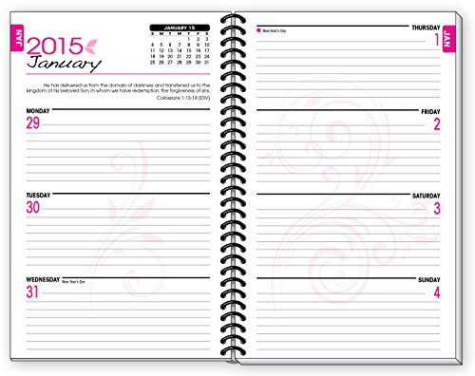
Leave time to revise:
Read assignment sheet
Make plan
Begin reading/research
Paper due tomorrow!
Notes:
So, here’s an example. Let’s say your professor hands out the instructions for a writing assignment on Monday and tells you it is due in one week.
Of course, you need to think through the process and give yourself time to read, take notes, brainstorm, outline, write, and print. But, you also need to give yourself time to get some feedback from a reader. And you need time to put your paper down and for a while and come back to it with fresh eyes. These two steps will help you see your paper from a new perspective, and that will help you know if it says what you want it to say.

Slide 6
Leave time to revise:
WD appt. for early feedback
Continue writing, complete draft
Check in with classmate
Read assignment sheet Revise draft, check formatting
Make plan, schedule WD appts.
Begin reading/research
Make tentative outline
Read/research more as needed
Prepare citations if necessary
Begin writing WD appt. final editing
Talk to prof, confirm approach
Discuss ideas with classmate Print tonight!
Paper due tomorrow!
Notes:
This plan allows for revision.
First, although the paper is due on Monday, the first complete draft is finished on Thursday, which allows enough time to put the paper down, work on something else, and go back and take a fresh look at what you wrote. Do the ideas still make sense? Do you see now something that you left out? There is time to make changes.
Second, there are two Writing Desk appointments and two discussions with a classmate, and one meeting with the professor, which means five opportunities to talk about your ideas with someone else.
And this is the second big tip. Talk about your ideas!

Slide 7
Four tips for the revision process:
Leave time to revise!
Consult with “allies.”
writing tutors, classmates, writing partners
Start global.
Focus the proofreading.
Notes:
In the other workshops in this series, we talked extensively about consulting with your allies.
Your allies are your professor, your classmates, Writing Desk tutors, and writing partners. You can talk to all of these people about different pieces of the process. For example, after you have read the assignment instructions and started to gather ideas, talk to your professor to see if you are on the right track. Or, talk to a classmate to share ideas about the purpose of the assignment within the context of the course. Or, talk to a writing partner about your ideas and see whether you are expressing yourself in a way that your partner can understand. Let your partner’s questions show you what pieces aren’t clear. Or, talk to a writing tutor about different ways to organize your information.
During every interaction, think for yourself about your topic, your argument, your support. Is that really what you think? Is that really what you want to say?
Your papers are a reflection of you. You want them to represent you well, so THINK deeply throughout the whole process, and put that thought into your writing.

Slide 8
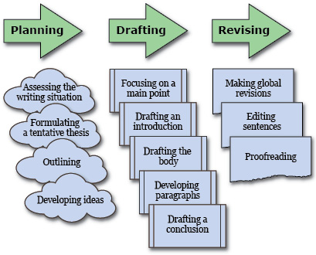
The Writing Process:
“Composing and Revising.” Chart. Writer’s Help. Bedford/St. Martins, 2011. Web. 2 Mar. 2016.
Notes:
This chart is a visual representation of the writing process.
There is an overall flow of left to right and top to bottom, but there is some back and forth as well. For example, after outlining, you might decide to make some big changes. Or, you might edit some sentences in the body of the paper before you ever write the introduction.
Notice, though, that the chart puts “making global revisions” before “editing sentences” and “proofreading.” This is good advice.
If you get hung up on the wording of your first sentence before you’ve made a plan for the whole paper, it might keep you from making good progress quickly.
So,…

Slide 9
Four tips for the revision process:
Leave time to revise!
Consult with “allies.”
writing tutors, classmates, writing partners
Start global.
Focus the proofreading.
Notes:
The third big tip is to start global.

Slide 10
Start global
Review the instructions
Does your paper do what it’s supposed to do?
TIP: Grade your own paper.
Imagine your reader
Is your argument easy to follow?
Will your points be clear?
TIP: Listen to your own paper.
Notes:
What does it mean to do “global” revisions?
It means to think about your whole paper -- the purpose of the paper, the context of the paper, your argument and the path you take to lead your reader through it.
One way to think about these big ideas is to review the instructions. After you have done some work and put together some ideas, go back and reread the instructions. Does your paper do what it is supposed to do? Does it inform, persuade, entertain, compare? Was that the assignment?
Here’s a TRICK that might help: Imagine you are the professor. How would you assess this assignment? What would your rubric look like? Based on your rubric, what feedback would you give your own paper? What grade would you give?
Another way to think about these big ideas is to imagine your reader. Will your argument make sense? Will it be easy to follow? Will your points be clear? Does your reader have all the background knowledge he needs to understand your paper? Have you done enough to catch his interest?
Try to put yourself in your reader’s shoes by imagining that you are a specific person as you read your paper. Or, here’s a TRICK: Get someone to read your paper out loud to you.

Slide 11
Start global
Reconsider the content
Are your ideas developed?
Are they reasonable?
TIP: Find an interrogator.
Look at the discourse structure
Do the necessary elements appear?
Are they in the right place?
Do they take the correct shape?
TIP: Make a checklist.
Notes:
Global revision also means reconsidering the content.
Reconsider the content by asking yourself questions about your ideas. For example, if you are writing an argument-driven essay, does your essay have an argument? What is it? Where is it? Have you expressed it in a way that your reader will understand? Have you supported it? Have you provided explanations and examples? Have you considered counter-arguments? Have you included them? Will your essay satisfy a skeptical reader who keeps saying “Really?”
Here’s a TRICK that might help: Find an interrogator who can challenge you as you read your paper out loud. See if you can defend your ideas and decide whether you need to revise what you wrote.
Another way to reconsider the content is to look for the required elements of the paper. Do you have an introduction? Does it look like an introduction? Does it do what an introduction should do? Is it effective? Do you have a thesis? Is each paragraph unified around a central idea? Are there logical transitions between ideas?
A simple TRICK is to make a checklist.

Slide 12
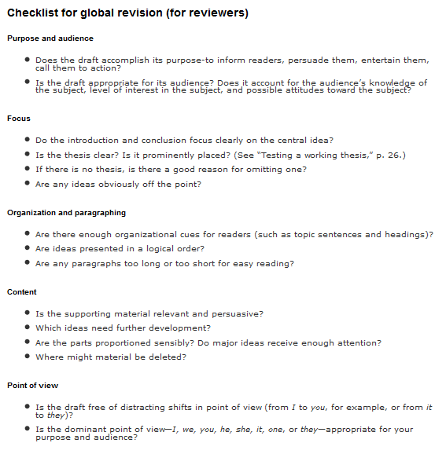
Use a checklist:
✓
✓
✓
✓
✓
Hacker, Diana. “Checklist for global revision (for reviewers).” Writer’s Help. Bedford/St. Martins, 2011. Web. 2 Mar. 2016.
Notes:
This is an example of a checklist, but you can make your own based on your course, the assignment, and what your professor specifies in the instructions.

Slide 13
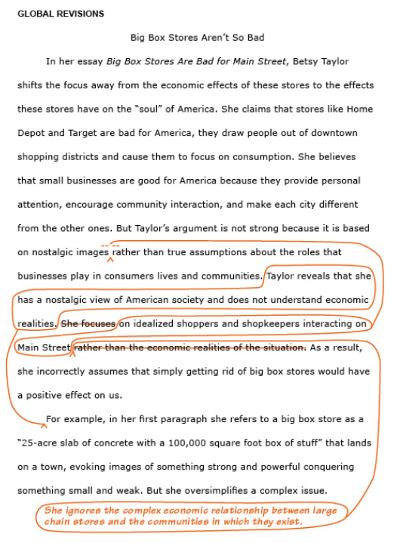
Global revisions:
Hacker, Diana. “Example of Global Revision.” Writer’s Help. Bedford/St. Martins, 2011. Web. 2 Mar. 2016.
Notes:
Global revisions might look like this.

Slide 14
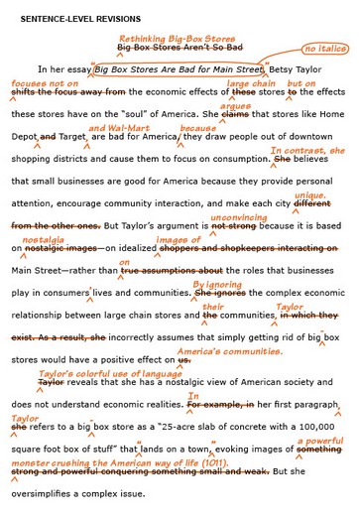
Focused proofreading:
Hacker, Diana. “Example of Sentence-level Revisions.” Writer’s Help. Bedford/St. Martins, 2011. Web. 2 Mar. 2016.
Notes:
And that is very different from focused proofreading.

Slide 15
Four tips for the revision process:
Leave time to revise!
Consult with “allies.”
Start global.
Focus the proofreading.
Notes:
The last big tip is to focus the proofreading.
When it is time to look at the sentence-level grammar, and the precision of your word choice, and your spelling and format, it is helpful to focus on one thing at a time.

Slide 16
Focus the proofreading:
Sentence structure
(parallelism, fragments, run-ons)
Grammar (agreement, tense)
Word choice (style, formality, homophones)
Punctuation
(commas and semi-colons, apostrophes)
Spelling, typos
Citation format
TIP: Pay attention to teacher feedback, and learn now for next time.
Notes:
It is very difficult to proofread your own writing. The voice in your head knows what the text should say, and if that’s not what the text does say, you might not catch it.
If you focus your proofreading on one specific thing, you will be more likely to find it.
The following are some of the most common errors that you can look for when proofreading.
-Sentence structure (parallelism, fragments, run-ons)
-Grammar (agreement, tense)
-Word choice (style, formality, homophones)
-Punctuation (commas and semi-colons, apostrophes)
-Spelling, typos
-Citation format
Here’s a TRICK: Pay attention to teacher feedback! Going through your paper after you’ve turned it in and gotten it back is one of the best ways to learn about your own writing. Keep track of what your teachers say, and learn to look for those things in future papers.

Slide 17
TIPS for proofreading:
Print out and read on paper
Read slowly and carefully
Read each word
Use a pencil to follow along
Change size of type
Read out loud
Take breaks
Read isolated sentences
Read your paper bottom to top
Notes:
Here are a few more tips for proofreading:
-Print out and read on paper
-Read slowly and carefully
-Read each word
-Use a pencil to follow along
-Change size of type
-Read out loud
-Take breaks
-Read isolated sentences
-Read your paper bottom to top
And remember, tutors at the Writing Desk won’t proofread FOR you, but they can proofread WITH you!

Slide 18
Purdue OWL – Proofreading
Tips for Revising and Editing (GBCNV handout)
Revising Drafts (The Writing Center and UNC-Chapel Hill)
Notes:
For more advice related to revising, editing and proofreading, check out these great websites!

