Slide 1
Writing Workshops
Spring 2016
“Time Management for Writing”
Notes:
Have you ever waited until a day or two before a paper was due and then tried to pull it together at the last minute?
Have you ever sat at your desk staring at your paper or your computer screen not being able to complete a single paragraph?
Have you ever gotten a low grade on a paper and had to admit that you deserved that grade?
Writing is not easy. Even the best writers sometimes struggle. But it is not impossible.
You have to take the time and do the work, but if you do, your effort will be reflected in your writing.
This workshop suggests a way to approach your writing assignments that will help you do your best.

Slide 2
Four keys to managing writing:
Start immediately.
Consult frequently.
Optimize your worktime.
Make a plan and stick to it.
Notes:
The four keys to managing writing are these…

Slide 3
Start working immediately:
Is the assignment on the syllabus?
Is there an assignment sheet? Are there written instructions?
Does the professor explain the assignment in class?
Notes:
If writing assignments stress you out, it may be because you are focusing on the writing, but the first step in writing a paper is NOT writing.
The first step is much easier than that; it’s simply reading the instructions and understanding the assignment.
This is a small but important task, and it is not scary, so do it immediately.
You have your class syllabus right now. Is the assignment on the syllabus? If so, you can get started today.
As soon as the professor assigns the paper, start to think ahead.

Slide 4
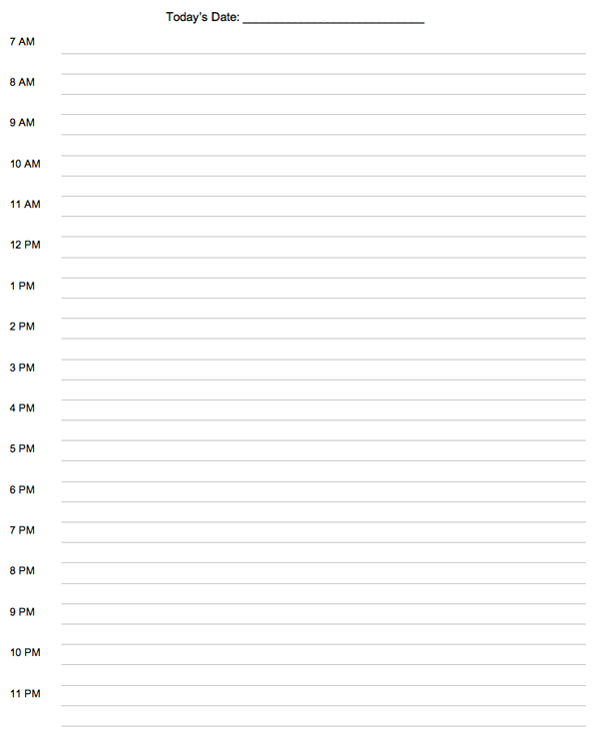
Start working immediately:
Make time to…
Read the assignment sheet
Identify your questions
Start to plan
Put in on your schedule!
Wednesday, February 3rd
Review notes
Review notes
→ Read instructions for Religion paper, questions?, make plan
Read for SOAN
Religion 121
Chemistry 126
Rehearsal
Notes:
This is an example of a daily planner.
Let’s say that on Wednesday, February 3rd, you have Religion class at 9am, and on that day, your professor hands out the instructions for your first paper. On that very day, make time to read the assignment sheet, make note of any questions that you have about it, and start to make a plan.
Since reading the instructions is SO important, put it on your “to do” list, and make sure you do it.
Starting immediately makes the whole process easier and more manageable.

Slide 5
Consult with “allies” frequently:
When you get the assignment…
For questions about process/product
For questions about prof’s expectations
Talk to a classmate or your professor
When you start to make your plan…
For feedback on ideas/scope
For advice about the process
Talk to a Writing Desk tutor or classmate
Notes:
The second key to managing writing is consulting with your “allies” frequently.
As a student on this campus, you are not alone.
You have classmates, professors, tutors and friends. Connecting with all of those people at different stages of the process is one way of managing writing assignments.
So, for example,…

Slide 6
Consult with “allies” frequently:
While you are reading…
To confirm your understanding
To expand your ideas
Talk to a Writing Desk tutor, a classmate or your professor
While you’re outlining…
For advice about organizing your ideas
For help expressing your ideas
Talk to a Writing Desk tutor, classmate, or writing partner
Notes:
…
A writing partner is someone who may or may not be in your class, but who, like you, is working on different writing assignments and needs someone to bounce ideas off of and give feedback.

Slide 7
Consult with “allies” frequently:
When you have a draft…
For feedback on the clarity and effectiveness of your writing
For feedback on the strength of your argument
Talk to a Writing Desk tutor, a writing partner or maybe your professor
When you have a full, final draft…
For help editing and proofreading
Talk to a Writing Desk tutor

Slide 8
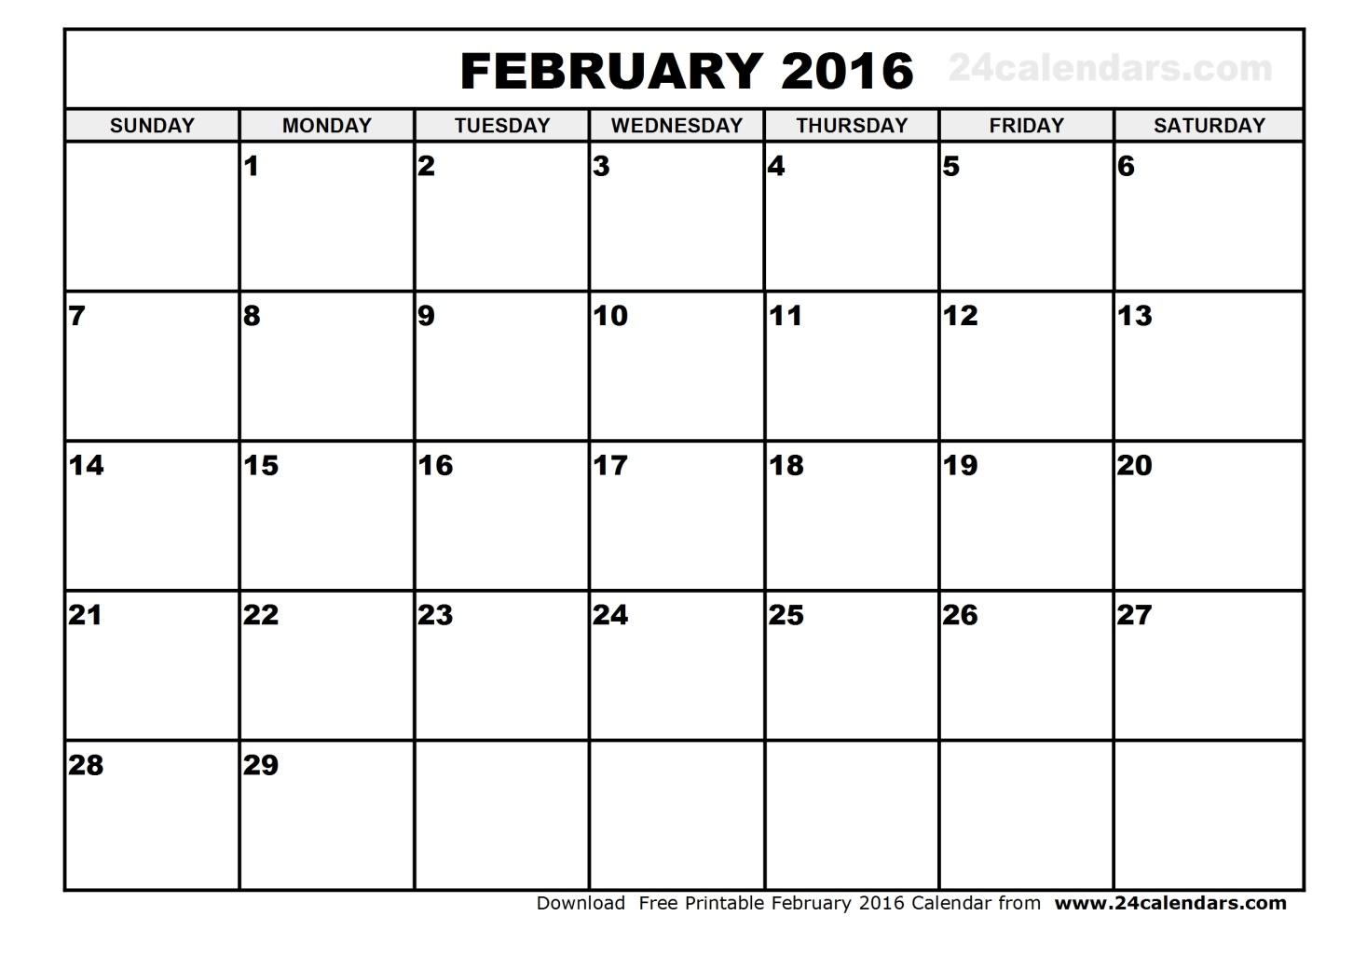
Consult with “allies” frequently:
Religion
paper
assn.
Religion
paper
DUE
Notes:
This is an example of a month-at-a-glance calendar.
Let’s say that the Religion paper that your professor assigned on Wednesday, February 3rd, is due on Monday, February 29.
At what point in the writing process do you think you might benefit from consulting with someone?
…

Slide 9
Consult with “allies” frequently:
Religion meet
paper prof after
assn. class
Writing Find check in
Desk classmate/ with
(plan) partner partner
Writing check in meet prof
Desk with after class
(outline) partner
Writing check in
Desk with
(draft) parter
Writing Religion
Desk paper
(final proof) DUE
Notes:
Consider this plan.
On Wednesday, the 3rd, I’m going to read the assignment sheet and be ready with questions in class on Friday. If I can ask my questions during class, I will because then other students can hear the answers, and other students might have questions that I didn’t think of. If there’s no chance in class, I’m going to try to talk to the professor after class, definitely before the weekend.
A month seems like a long time to write a paper, but I know from experience that it will go by fast, so I want to find a way to discipline myself and make a little progress each week. If I set up four appointments at the Writing Desk, maybe with the same tutor, it will force me to work. I will need to be prepared for each visit. But notice, the first appointment is just to talk about a plan. And the second is just to talk about an outline. By the time I’ve taken those small steps, working on a draft for the third visit won’t be as scary. And it’s just a draft. I still have time to make changes if I need to before my last visit.
I’ve also scheduled some times here to talk to a classmate or a writing partner. These are just 5-10 minutes check-in meetings, where I share my ideas and progress, and get a little feedback and maybe some helpful tips.
Finally, AFTER I have done some real work and thinking on my own, I can meet with my professor to make sure that I am on the right track.
Throughout the whole month, I’m talking about my ideas. Talking is a great way to work out how to express your ideas so that others understand, and it happens when you consult with your allies.
YOU have to do your own work, but you do not have to do it in isolation.

Slide 10
Optimize your work time:
Why are you here?
To learn?
To get good grades?
What’s the best way to do that?
Notes:
The third key to managing writing is optimizing your work time.
Before going on, stop for a minute and think about these questions: Why are you here? There are probably many reasons, but is one of them to learn? To learn about your areas of interest? To learn how to think and create and produce? Is it important to get good grades? What’s the most effective way to achieve that?
Reflect on these questions because optimizing your work time takes discipline and conviction. Your purpose here can inspire you if you know what it is.

Slide 11
Optimize your work time:
Get enough sleep.
Know yourself.
Are you more alert in the am or pm?
Can you focus better in silence or with white noise?
Are you more disciplined when you are alone or with study partners?
Do you prefer a pen or a keyboard?
Avoid a stressful approach.
Notes:
Three of the ways to optimize your work time are…
…to get enough sleep. Your brain works more efficiently when you’ve had enough sleep. You remember more and you are more creative, when you get enough sleep. You are not as distracted by hunger when you’ve gotten enough sleep. This is crucial, and you know it’s true. Get enough sleep.
…to know yourself and what works best for you. Are you… … … … Don’t sabotage your paper by trying to write at 10pm if you know that you do your best work in the morning. Don’t try to write in a lounge if you are easily distracted by people coming and going. Set yourself up to succeed.
…to avoid a stressful approach. Some people say that they need the pressure of waiting until the last minute. Pressure will make you DO the work, but it won’t help you do it well. The things you say, the things you write, the homework you turn in, everything that you produce – it represents you, so it should represent you well, and reflect your best effort.

Slide 12
Make a plan and stick to it:
List everything you need to do from start to finish.
Break the work into small chunks.
Frontload the prep work.
Allow extra time.
Work backwards from the due date.
Notes:
The last key to managing writing, which will help you make your best effort, is making a plan.
Some of the earlier slides gave examples of planning that can help you manage your writing, but here are some more suggestions.
First, list… Right on the back of the assignment sheet, as you’re reading the instructions, think about what you will need to do to complete the writing task and make a detailed “to do” list: Is there reading or research involved? Will you need an abstract, a lit review, a works cited page? Do you need to set up meetings with anyone? Will you need to print this or upload it to Moodle?
Break the work into small chunks and think about how long each step will take.
Frontload… In other words, do as much as you can as soon as you can because it will usually take longer than you think.
Allow…
Finally, work backwards… If you have to turn it in on Friday at 8am, you should print on Thursday night. If you have to print on Thursday night, you should do your final proofreading on Thursday afternoon. If you need an appointment at the Writing Desk for that final once-over on Thursday, you should plan to revise your draft on Wednesday. Etc.

Slide 13
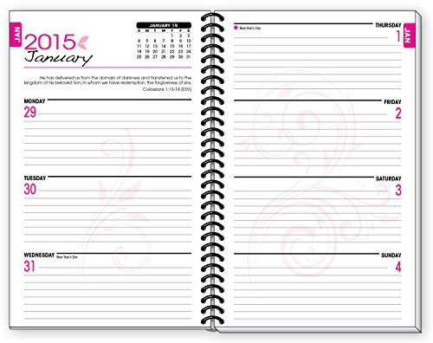
Make a plan and stick to it:
Read assignment sheet
Make plan
Begin reading/research
Paper due tomorrow!
Notes:
This is an example of a week-at-a-glance planner.
Let’s say your professor hands out the instructions for a writing assignment on Monday and tells you it is due in one week.
What are all of the tasks that you need to accomplish before you can turn in your paper? How can you fit them into your week so that you are not doing everything at the last minute?
…
You can start by reading the assignment sheet and making a plan. Just that on the first day. No pressure, just a few minutes to start thinking and make a plan.

Slide 14
Make a plan and stick to it:
WD appt. for early feedback
Continue writing, complete draft
Check in with classmate
Read assignment sheet Revise draft, check formatting
Make plan, schedule WD appts.
Begin reading/research
Make tentative outline
Read/research more as needed
Prepare citations if necessary
Begin writing WD appt. final editing
Talk to prof, confirm approach
Discuss ideas with classmate Print tonight!
Paper due tomorrow!
Notes:
Taking a little time to think about the assignment might lead you to set up a plan like this.
…
Writing a paper does take work and it does take time, but I broke the work down into small chunks that I can fit into my busy schedule – because I have other classes, too! I frontloaded the work because that way I can be thinking long before I start writing. I let extra time in case the work takes longer than expected or I get stuck or distracted by something else. And I thought through the backwards as well as forwards so that I can be sure it’s ready to turn in on time.
If you’re thinking, “Okay, I have a plan, that’s not the hard part, it’s the writing that’s hard,” come to the next workshop on “Getting Started.” Meanwhile, two suggestions are writing at a Write-In. Sometimes having people around you who are working is helpful. And, try the 30-10-30-10-30 system. You only have to write for 30 minutes, and then you can take a break for 10, etc. You don’t have to sit there all night until you’re finished; it’s just 30 minutes.

Slide 15
Managing a larger writing project:
Start immediately.
Consult frequently.
Optimize your worktime.
Make a plan and stick to it.
Notes:
When the assignment is a 20-page research paper, following all of this advice is the same, but it’s even more important.
“Write a 20-page paper” seems like a huge undertaking, but you don’t have to write a 20-page paper tonight.
What do you have to do tonight? … Read and understand the assignment, break it down into smaller pieces, and make a plan and a schedule that includes consulting with allies and working little by little at times when you can do your best.
(Show semester-at-a-glance calendar on paper) This is an example of a semester-at-a-glance calendar, and it is really useful when you have a project that you need to work on over a longer period of time. Especially if it shows the other major assignments that are coming up in all of your classes.
Writing is not easy, and big projects are even more challenging, but if you face forward and get started right away, discipline and motivate yourself with allies and a plan, and work at times when you are fresh and focused, you’ll have a good chance of success.

Slide 16
Campus Resources
Academic Coaching is for students who wish to learn more about time management, learning styles or strategies, study skills or strategies, accountability, test taking strategies, note taking strategies, and more.
Academic Writing Support at the Writing Desk helps St. Olaf students write clearly, critically, and convincingly to effectively engage in academic conversations.
Both services are free and available to all St. Olaf students

