Slide 1
2014
SUMMER
INSTITUTE
ST. OLAF
COLLEGE
IT & LIBRARY
Presentation Design

Slide 2
A GOOD PRESENTATION WILL
convey information clearly
illuminate a topic
interest your audience
evoke emotion
engage your intellect
be shared with others
and
live on in your memory

Slide 3
A GOOD STORY WILL
convey information clearly
illuminate a topic
interest your audience
evoke emotion
engage your intellect
be shared with others
and
live on in your memory

Slide 4
“If history were taught in the form of stories, it would never be forgotten”
- Rudyard Kipling, The Collected Works

Slide 5
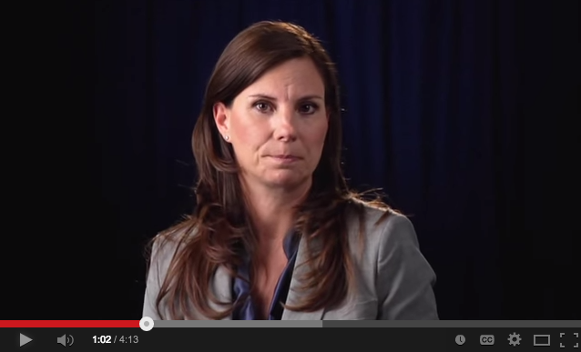
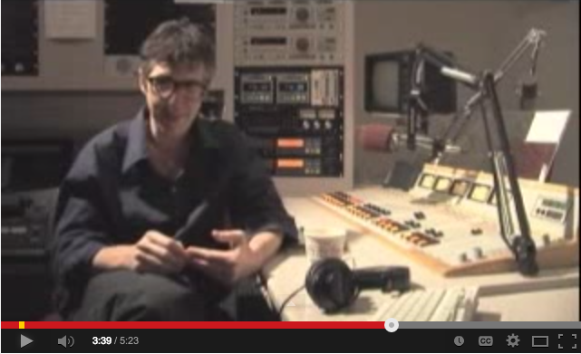
Two Storytellers Approaches
Nancy Duarte,
Writer, Designer, Presentation Guru
Ira Glass, Radio Producer and Host of This American Life

Slide 6
Consider time-tested techniques for effective storytelling when crafting a presentation.

Slide 7
Hook Your Audience From the Start
Make them think about what they’re seeing.
Withhold some information for a moment, generating suspense, curiosity.
Stun them.
Discuss Design Without Losing Your Mind

Slide 8
Show Don’t Tell
Few things are more loathsome than seeing a powerpoint slide jam-packed with text.
Don’t do that.

Slide 9
Set the Stage
Give the audience an idea of what’s in store.
Let them know what the plot is about.

Slide 10
Create a Mood
Use color, graphics, language and media to establish a tone appropriate to the subject, and let that unify your story.

Slide 11
Use Foreshadowing and Hooks
Consider how each aspect of your presentation is leading into the next.
Flow is important.

Slide 12
Provide Resolution
Can the ending reference your starting point and reflect on the journey?

Slide 13
You’ve Written the Story, Now What?
CONTENT
DESIGN

Slide 14
A Visual Medium is more effective when it is visually appealing.

Slide 15
Principles of Design
Know your CRAP
Contrast Repetition Alignment Proximity

Slide 16
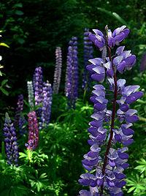
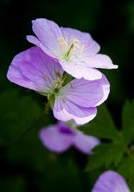
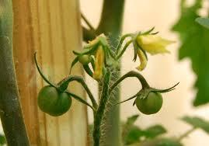
Native Plants
Native plant is a term to describe plants endemic (indigenous) or naturalized to a given area in geologic time.
This includes plants that have developed, occur naturally, or existed for many years in an area (e.g. trees,flowers, grasses, and other plants). In North America a plant is often deemed native if it was present before colonization.
Some native plants have adapted to very limited, unusual environments or very harsh climates or exceptional soilconditions. Although some types of plants for these reasons exist only within a very limited range (endemism), others can live in diverse areas or by adaptation to different surroundings.

Slide 17
Native Plants
Native plant is a term to describe plants endemic (indigenous) or naturalized to a given area in geologic time.
This includes plants that have developed, occur naturally, or existed for many years in an area (e.g. trees,flowers, grasses, and other plants). In North America a plant is often deemed native if it was present before colonization.
Some native plants have adapted to very limited, unusual environments or very harsh climates or exceptional soil conditions. Although some types of plants for these reasons exist only within a very limited range (endemism), others can live in diverse areas or by adaptation to different surroundings.

Slide 18
Set the Tone with Typography & Color
Repetition involves repeating design elements like color and type throughout the presentation.
Settle on 1-3 fonts (one for titles, one-two for body text)
Limit color schemes to complimentary colors. Try online color picker sites like Adobe Kuler to assist with color palette selection.
If using templates, try to customize them to your subject to avoid a stock template look.

Slide 19
Consider the Tool
Powerpoint - The standard. Accessible and easily transferrable.
Keynote - Not as available, but offers easier some advantages in animation and media integration.
Google Presentation - Great for collaboration, but more limited in tools.
Prezi - can add really interesting, or vomit-inducing motion, depending on how its used. Good for showing overview/connections.

Slide 20
Activity
OPTION 1
Look at an example or two of online presentations at slideshare.net (or your own if you have one with you).
How are storytelling techniques utilized?
How does it abide by principles of design?
OPTION 2
Develop or revise an outline for a presentation of your own.
What is the overarching narrative of this presentation?
How can you draw your audience in from the start?
How might you incorporate anecdotes?
What design elements (color, type, graphics) could you use?
Get feedback from others!

