Slide 1
Scheduling Appointments
There are several applications that can make scheduling appointments much easier for both students and advisors. One free web based program is You Can Book Me. The ASC is using this program and likes it. The website has good instructions and it is easy to set up.
You Can Book Me
https://youcanbook.me/
Another excellent program that is available to all of us at St. Olaf is Appointment Slots in Google Calendar. Instructions are below.
Use Google Calendar
Go to an open “block” of time on your google calendar.
Choose “Appointment Slots” when the window opens. Look for the arrow at the top of the screen shot on next page. Normally, you would be in the “Event” feature of Google calendar.
See next slide for screen view.

Slide 2
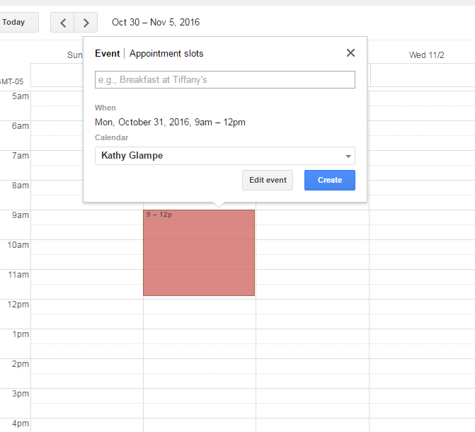
Appointment Slots View

Slide 3
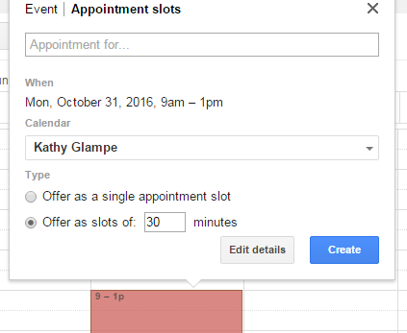
Scheduling Appointments
Name the Slot—i.e. Registration Advising, General Advising, etc.
Select either a single slot or slots of XX minutes.

Slide 4
Repeating Events and Creating a Link
You can set up the time block to repeat under “Edit Details”. (Screen shot on next page.)
The arrow indicates where the repeat button is.

Slide 5
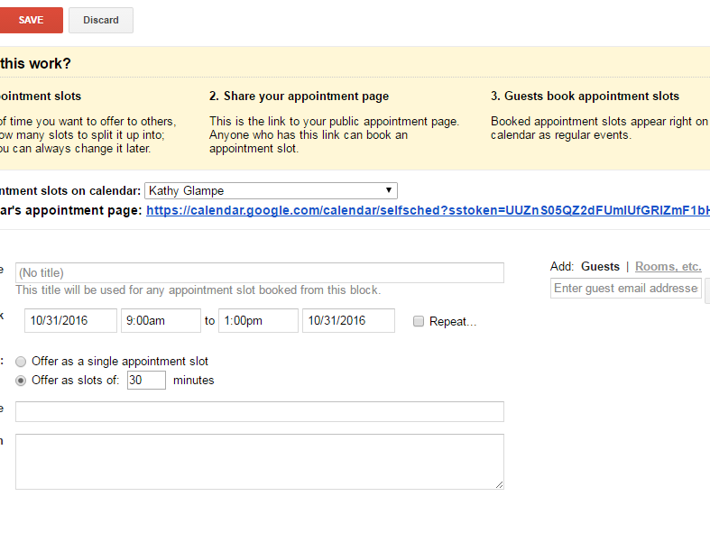
Scheduling Appointments

Slide 6
Using Your Unique “Link”
Get your unique “URL” in the “Edit Details” see screenshot on previous slide.
You can re-name this link when sending an e-mail to students.
When composing an e-mail, use the “insert” link button along the bottom of the e-mail “compose” window (see arrow on screen shot on next slide).
You can then put this link in your signature on your e-mail, post on your website, e-mail it to students, etc.

Slide 7
Link in Gmail Compose Screen Using the link button by the arrow below, you can re-name and insert a link into your e-mail.

