Slide 1
Autism Goes to College
Elizabeth Reeve MD
HealthPartners Medical Group
Regions Hospital

Slide 2
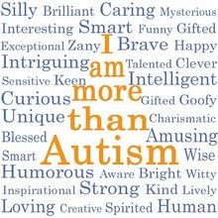

Slide 3

E-mail
Elizabeth.A.Reeve@Healthpartners.com

Slide 4
There is a Lack of Literature.
Gelbar et al May 2014 J of Autism Dev Disorders
  Only 20 published articles in peer reviewed journals describing collegiate experiences and/or supports for adults with ASD
  Collectively only 69 participants in those 20 articles
  Anxiety, loneliness, and depression were the most common first hand experiences reported

Slide 5
Autism Goes to College
Current estimates suggest that 0.7 to 1.8% of college students have an autism spectrum disorder
About a third of ASD students choose a STEM major (science, technology, engineering or math)
Only a third of the high school students identified as ASD ever attend a 2 or 4 year college

Slide 6
Autism Goes to College
80% of students with ASD who go from high school directly to a four year college do not complete college
Attending a two year college and then transitioning to a four year school markedly increases the chances of graduating

Slide 7
A Comprehensive Survey of Current and Former College Students with ASD
Gelbar et al;Yale J of Biology and Medicine 2015 Mar
  35 individuals surveyed online
  82% reported academic success but only 41% felt they had the social skills to be successful
  71% were satisfied with disability services but only 21% happy with career services

Slide 8
A Comprehensive Survey of Current and Former College Students with ASD
  Anxiety, depression, and loneliness were the most common challenges at 71%, 53% and 47%
  60% received formal academic support and 45% received non-academic supports

Slide 9
What is Autism?
Autism is a syndrome of atypical neural development characterized by significant dysfunction in social interaction, communication, range of interests and repetitive behaviors.
It is a cluster of different symptoms which may range from mild to severe, many to few, and is variable from person to person

Slide 10
Autism
Originally described by Kanner in 1943
  Report of 11 cases
  “Autistic disturbances of affective contact”
  Believed children were born with the inability to produce “enzymes” for psychologically processing social cues

Slide 11
What Causes Autism
No one knows
Autism “runs in families”
  It is “genetic”
  No specific gene has been located
About 20% of cases are related to specific disorders
  Fragile X syndrome, Tuberous Sclerosis, other genetic abnormalities

Slide 12
What Causes Autism
Most common theory involves inheriting a genetic risk of some level which is then “turned on” by some type of environmental stress
  Toxins, birth trauma, viral illness
If your genetic risk is very high, the environmental stress needed may be minor

Slide 13
Epidemiology
Lack of diagnostic consistency makes it difficult to determine how many people have autism
Recent estimates are about 1 in a 68 persons are “on the spectrum”
It is now considered a “common” disorder by the CDC

Slide 14
Epidemiology
Male/female ratio
  More males then females
Many persons who have an autism spectrum disorder do not have intellectual impairment
  Old estimates were that 70% were cognitively disabled
  New estimates are that 70% are NOT cognitively disabled

Slide 15
Cognitively Disabled
Refers to your “IQ” score on standardized tests
You can have a “normal” IQ and still have serious day to day functional impairments

Slide 16
Autism Spectrum Disorders
An ASD is characterized by abnormalities in:
  Reciprocal social interactions
  Communication skills
  Stereotypic behavior, interests, activities

Slide 17
Triad of Impairments
social
interests
language

Slide 18
Autism
Social Interactions
  Marked impairment in the use of nonverbal behavior
    eye contact, facial expression
    body posture
    social regulation
  Lack of age appropriate peers
  Lack of spontaneous (age appropriate) seeking to share enjoyments or interests
  Lack of (appropriate) social or emotional reciprocity

Slide 19
Autism
Communications
  Delay or lack of development of language
  Impairment in the ability to sustain or initiate (appropriate) conversation
  Stereotypic or repetitive use of language
    example: inability to use pronouns
    “canned” or overly intelligent sounding speech
    echolalia, delayed or immediate
  Lack of varied or spontaneous make believe or imitative play

Slide 20
Autism
Repetitive behaviors
  Preoccupation with one or more stereotyped and restricted patterns of interest that is abnormal in intensity or focus
  Inflexible adherence to nonfunctional routines or rituals
  Repetitive motor mannerisms
  Preoccupation with parts of objects

Slide 21
Autism Does Not Mean….
Nonverbal
Unemotional
Intellectually impaired
Unattached
“Savant” or genius
Unsocial

Slide 22
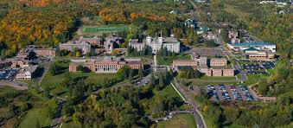

Slide 23
How Does Autism Impact the Classroom
Neuropsychological deficits
  Attention span
  Processing
  Filtering
Social reciprocity
  Eye contact
  Use of language
  Body language

Slide 24
How Does Autism Impact the Classroom
Anxiety, rigidity and repetitive behaviors
Life skills
  Sleeping and eating
  Time management
  Hygiene

Slide 25
Neuropsychological Deficits
Attention span
  Not due to a lack of attention but rather a mismatch between the task and the correct amount of attention
    Can result in over focus on some things and under focus on others
Processing speed
  Think of it as band width or modem speed
  It is the limiting step in learning

Slide 26
Neuropsychological Deficits
Filtering
  All stimuli have equal value
    Inability to filter extraneous noise, light, movement causes significant problems focusing
  All tasks are equally important
    The 10 point quiz in chemistry is just as important as the 20 page English paper
      Prioritizing and time allotment are often very difficult
  No ability to "turn off or tune out" the input leads to exhaustion

Slide 27
Deficits in Social Reciprocity
Eye contact
  Decreased eye contact makes it difficult to know if the student is listening/engaged
  Eye contact tends to be better when the student with autism is the speaker and worse when they are listening

Slide 28
Deficits in Social Reciprocity
Use of language
  Often may be verbally intrusive or overly quiet
  Does not pick up on cues to be quiet or change topics
  May over estimate understanding of concepts
    "I know"
    Always ask the student to repeat the problem/solution or demonstrate knowledge

Slide 29

Deficits in Social Reciprocity
Use of language
  Persons with ASD are literal and concrete thinkers
    "The paper is due on Friday"
    "Class is cancelled"

Slide 30
Deficits in Social Reciprocity
Body Language
  May sit too close
  May have exaggerated or diminished gestures
  May not understand your body language

Slide 31
Anxiety, Rigidity, and Repetitive Behaviors
Routine is important and may be both a blessing and a curse
  Once a routine is learned the student does well
  Change in routine can cause significant anxiety
    Change is class venue, change in due date
      Provide advance notice, use multiple modes of communication
        Email, text, verbal

Slide 32
Life Skills
Time management
  Often there are deficits in understanding how much time to allocate to a task
  Mismatch between time needed and time available
    Leads to unintended procrastination
      If a paper is due in 2 weeks there is no need to start now

Slide 33
Life Skills
Eating
  May have limited food choices
  May forget to eat
  Eating may be the most social contact they get
Sleeping
  Very poor self regulation
    Easily falls into a habit of day/night confusion

Slide 34
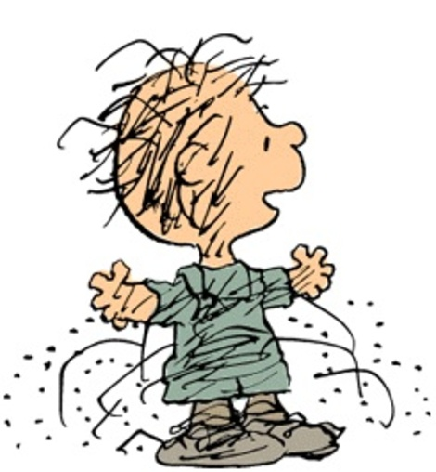
Life Skills
Hygiene
  Poor hygiene can impact the classroom
    Alienates students from their peers
  Can be a distraction to other students

Slide 35
How to Help
Make sure students are aware of disability services
  Be aware though that many students may not need the academic support of disability services
Be willing to communicate with the student’s parents/caregivers if the student or family requests
Be proactive in letting the student/advisor/family/Dean know if the student is struggling

Slide 36
How to Help
Students with ASD are often lonely
  Tell them about yourself
  Ask questions about activities outside of school
  Encourage them to join club/organization
  Suggest specific events/ideas
  Follow-up with them after suggestions are made

Slide 37
Autism and Looking For A Job
Despite academic success finding a job is a great hurdle
Many employers cannot look beyond the “autism”
  Phone interviews
  Face to face interviews
Students may struggle with the decision to “disclose” their disability to a potential employer

Slide 38
Autism and Looking For a Job
Emails
  Offers a chance for the person with ASD to think and process at their own speed
  May provide too much or too little information, hard to interpret the boundaries
Transportation
  May not drive

Slide 39
Why Hire Someone With Autism
Very conscientious about rules
  On time to work
  Low absenteeism
Uniquely suited for jobs that require detail or repetition
Thrive on consistency
May have fewer “social” issues
  Drugs and alcohol
Loyal employees

Slide 40
How Can You Help With Employment?
Use your personal connections
  Let potential employers know that the student performed well at school despite the autism
    Appropriate consent needed
Work cooperatively with other resources the student may be using such as vocational rehab

Slide 41
What Does a Student With ASD Give to This Community
Unending enthusiasm
A unique and unbiased perspective
An openness to accept others and try new things that other students may not have

Slide 42
Questions

Slide 43
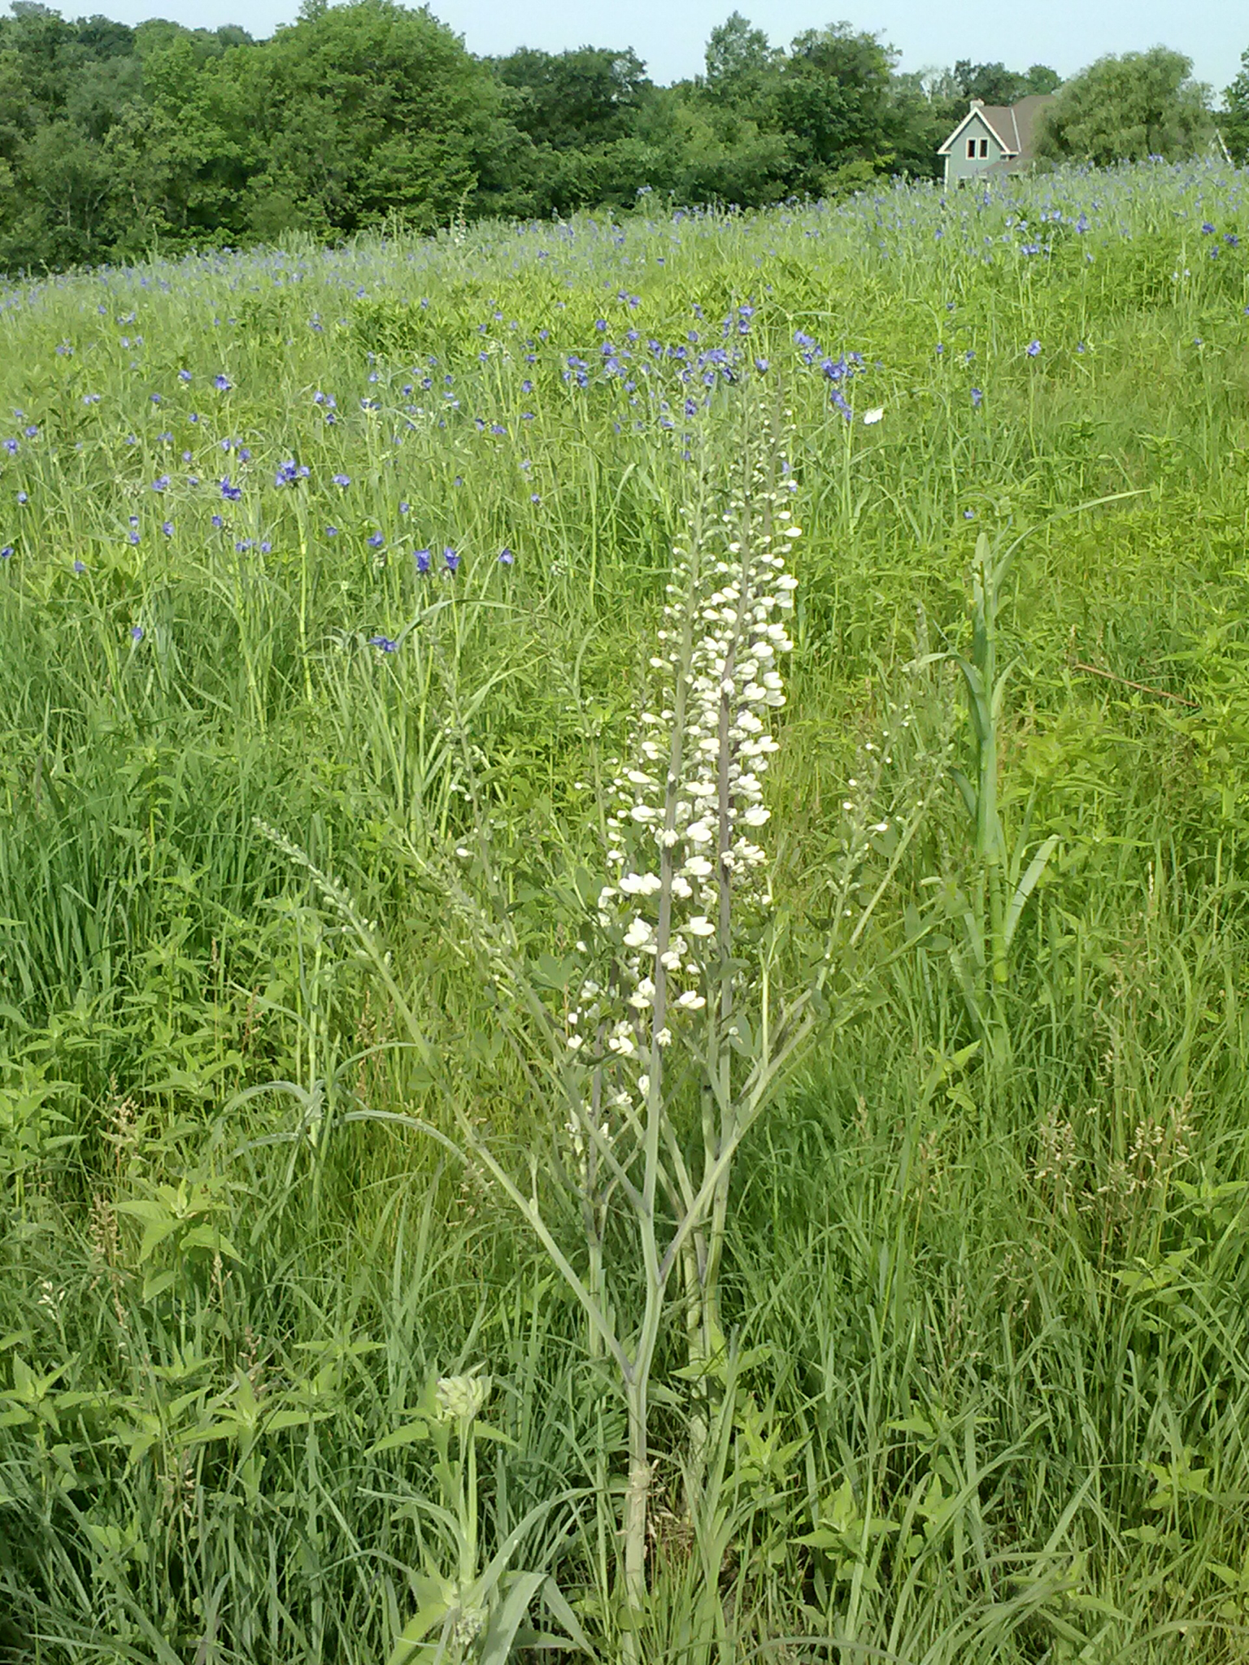
The End

