Slide 1
Eta Sigma Phi Bacchanalia
May 12, 2008
Home of Steve & Rhonda Reece

Slide 2
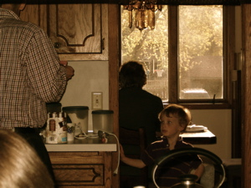
Julian Brunelle explores the Reeces' kitchen.

Slide 3
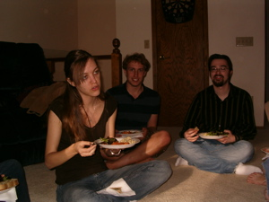
Deep discussion begins...

Slide 4
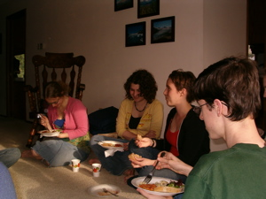
and continues over lasagna.

Slide 5
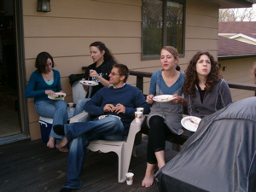
It's more casual on the porch.

Slide 6
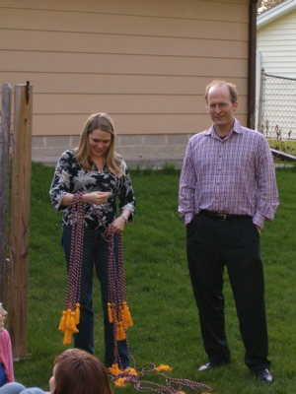
“Which is which?” asks Prof. McCarter.

Slide 7
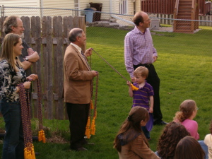
Julian gets attached to Prof. May

Slide 8
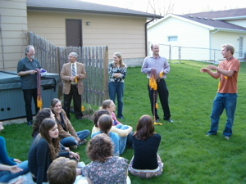
How exactly is this going to work?

Slide 9
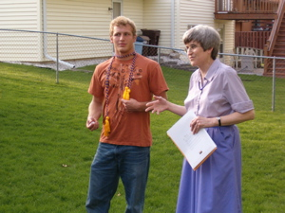
Steve Alexander is still dubious.

Slide 10
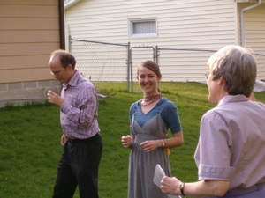
Alaina Burkard is happy with her new look.

Slide 11
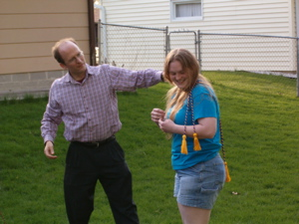
Karin Gilje finds herself in knots,

Slide 12
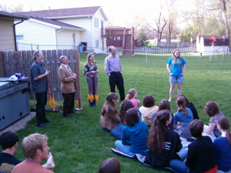
then imagines a future in Physics.

Slide 13
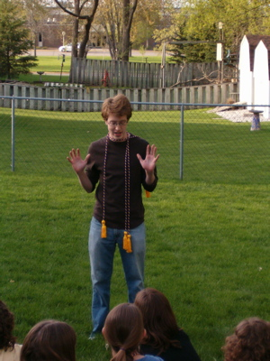
Mike Gulden cries, "I give up!"

Slide 14
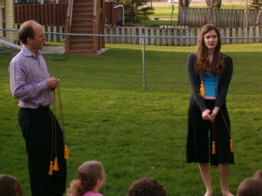
Emily Holm keeps her poise.

Slide 15
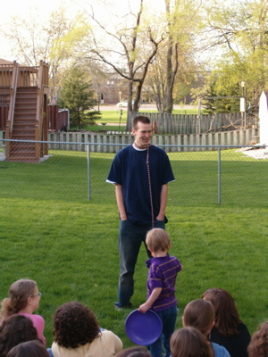
Kevin Moore towers above Julian.

Slide 16
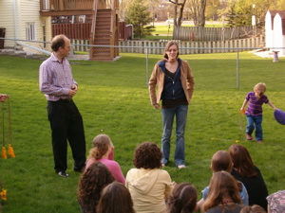
Kayla Rasmussen looks ahead to History.

Slide 17
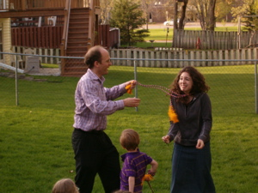
Alex Sprano tries to be brave.

Slide 18
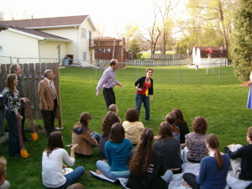
Ann Stanton swerves but can't escape.

Slide 19
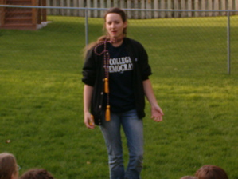
Erin VanBurkleo is mad about marimbas.

Slide 20
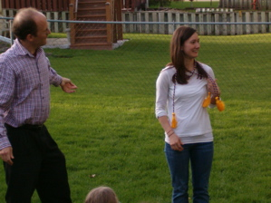
Laura Whallon nearly ends the alphabet.

Slide 21
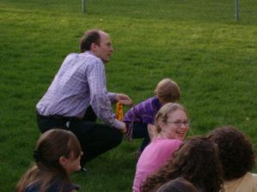
"This is fun!" exclaims Anna Johnson.

Slide 22
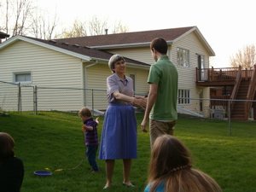
Prof. Groton congratulates Thomas Halvorsen.

Slide 23
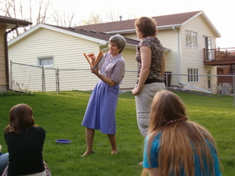
Hilary Bouxsein waits patiently for her prize.

Slide 24
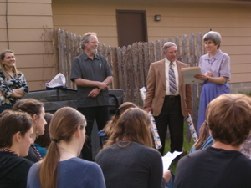
Prof. Brunelle's farewell songs for Profs. McCarter and Gustafson are crowd-pleasers.

Slide 25
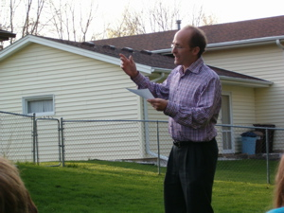
It helps to have a professional director.

Slide 26
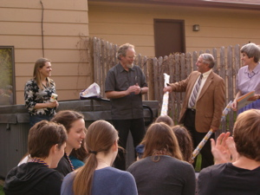
What could be inside those packages?

Slide 27
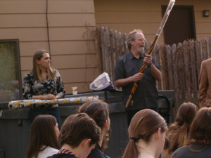
St. Olaf umbrellas, of course!

Slide 28
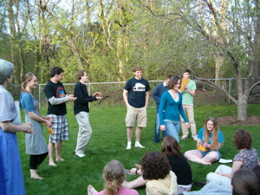
Next year's officers are elected fast,

Slide 29
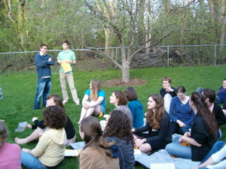
leaving time for hot-fudge sundaes!

Slide 30
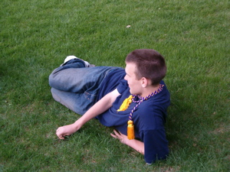
Kevin Moore reclines and takes it all in.

