Slide 1
Eta Sigma Phi Bacchanalia
May 17, 2014
Home of Jim & Donna May

Slide 2
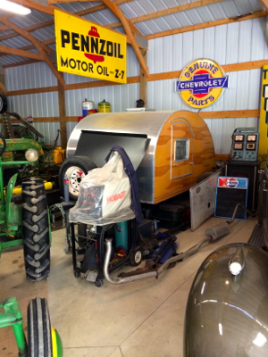

Slide 4
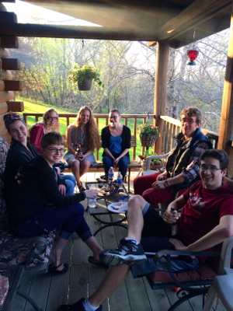

Slide 5
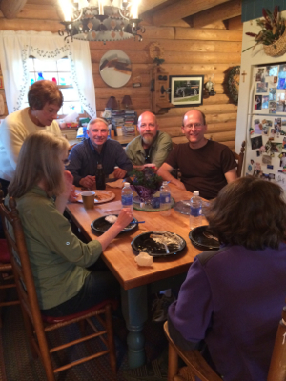

Slide 6
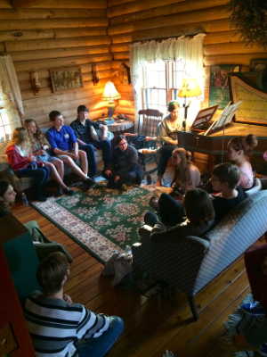

Slide 7
