Slide 1
Eta Sigma Phi Initiation
March 14, 2011 Heritage Room, Buntrock Commons

Slide 2
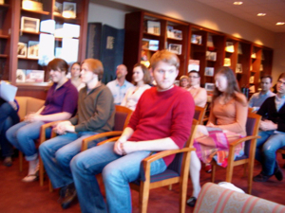
Initiates wait nervously in their seats.

Slide 3
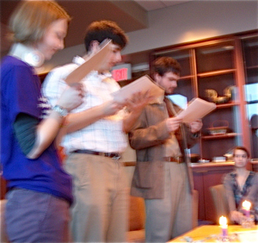
Officers read the ritual with gravity.

Slide 4
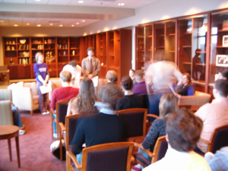
Initiates come forward to sign the roll book.

Slide 5
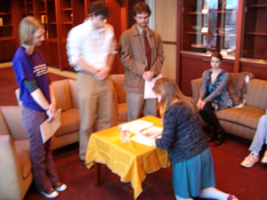
Kneeling is strictly optional.

Slide 6
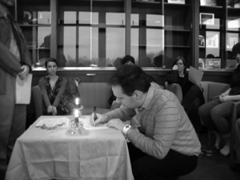
Prof. Caldesi-Valeri shows how it's done in Italy.

Slide 7
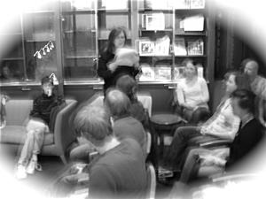
Stephanie Simione '92 reads the voice of Vergil
as the shadows fall.

