Slide 1
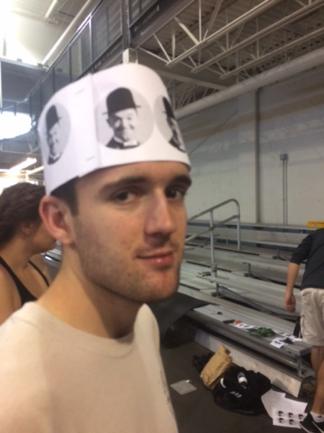
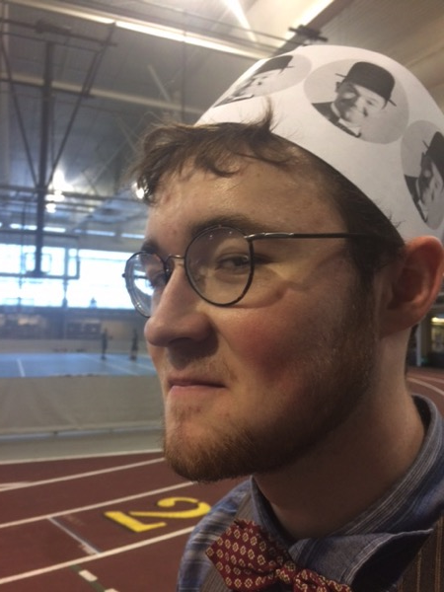
Photos from the 11th Annual St. Olaf Olympics
November 4, 2016
(co-sponsored by the Society for Ancient History
and the Delta Chi chapter of Eta Sigma Phi)

Slide 2
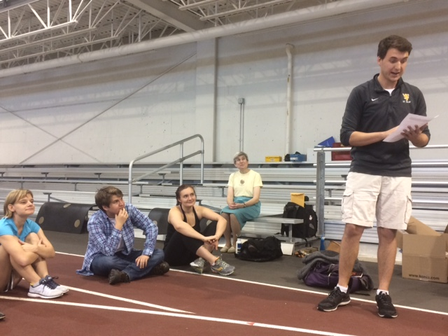
Prose Declamation Contest (Lysias)

Slide 3
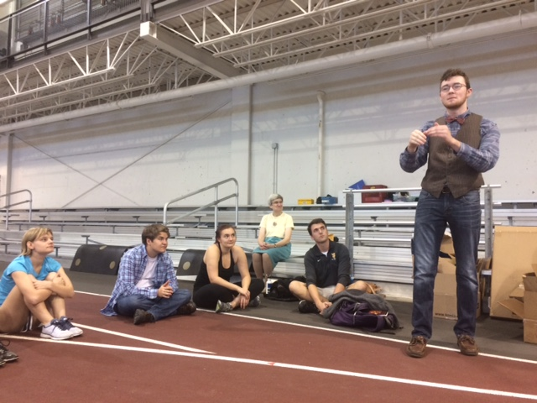
Poetry Declamation Contest (Catullus)

Slide 4
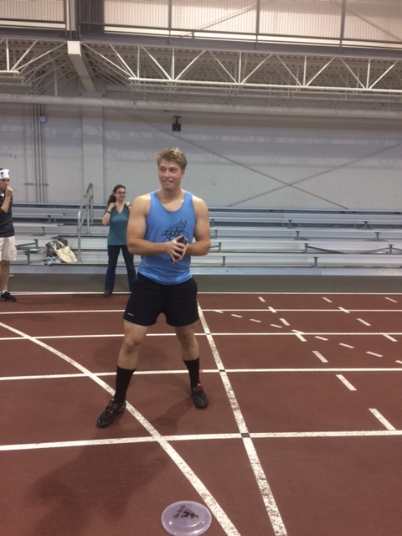
Bona Fide Discus Throw

Slide 5
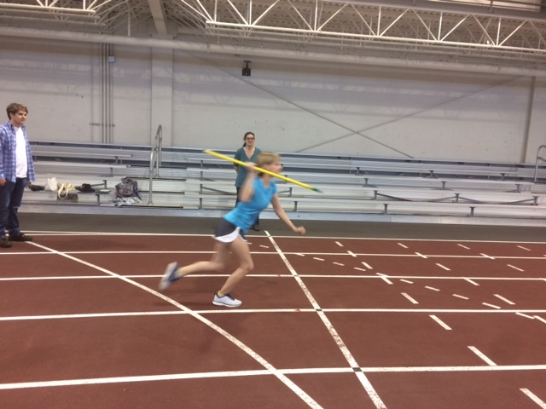
Javelin Throw — “white shoe” division

Slide 6
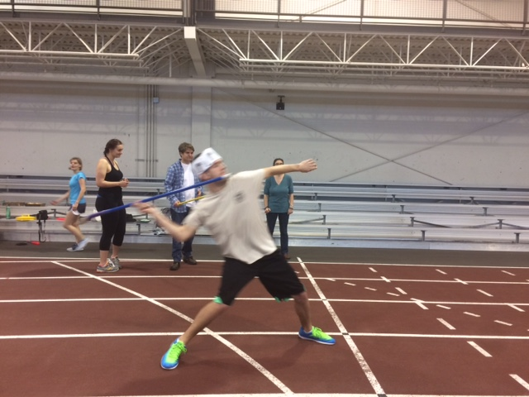
Javelin Throw — “green shoe” division

Slide 7
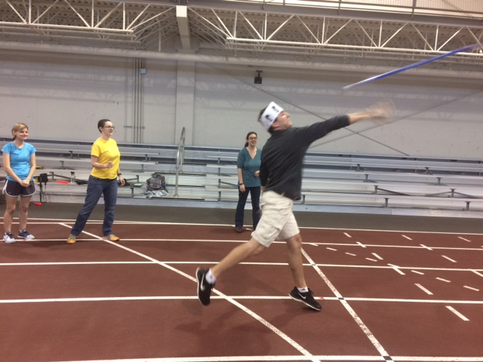
Javelin Throw — “black shoe” division

Slide 8
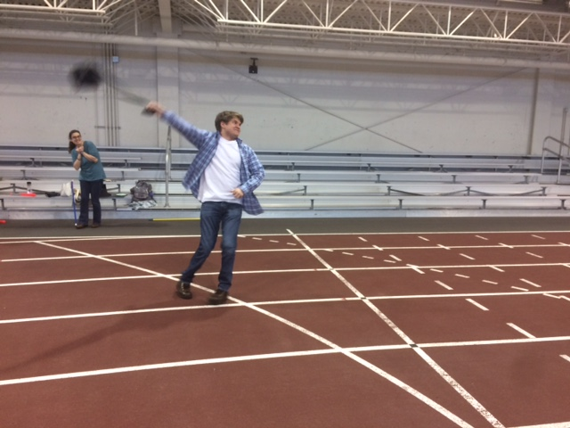
Camera Case Throw

Slide 9
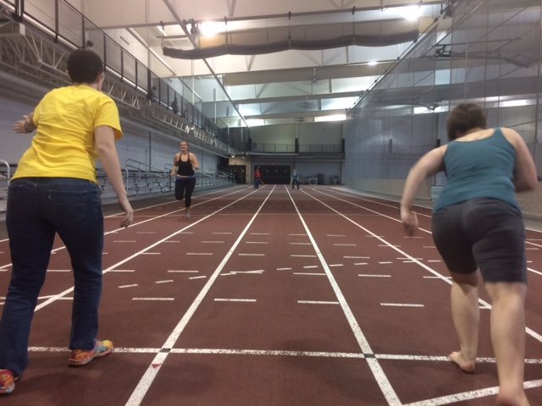
Spartan (“grab the mints”) Relay Race

Slide 10
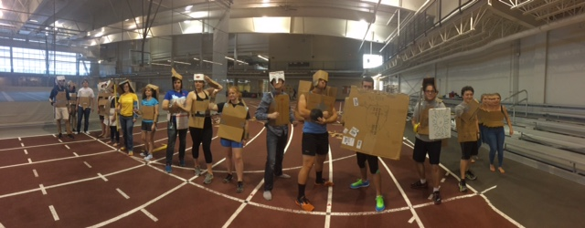
Stylish Suits of Armor in 3-D

Slide 11
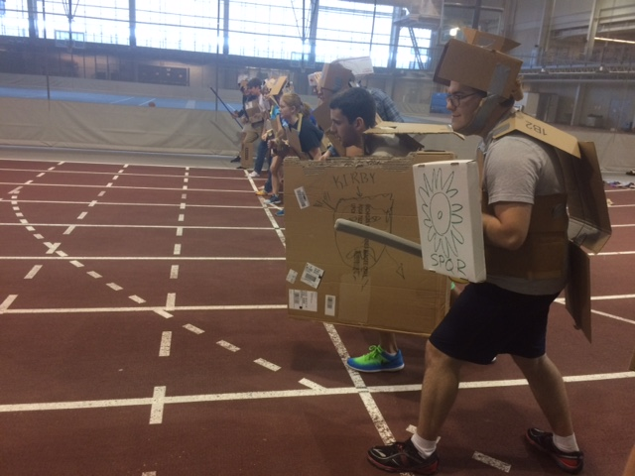
Hoplites Ready To Rumble

Slide 12
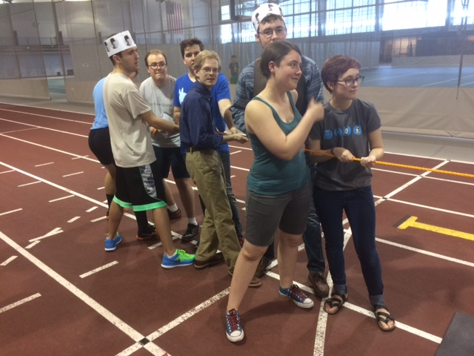
Classicists Tugging to the Left

Slide 13
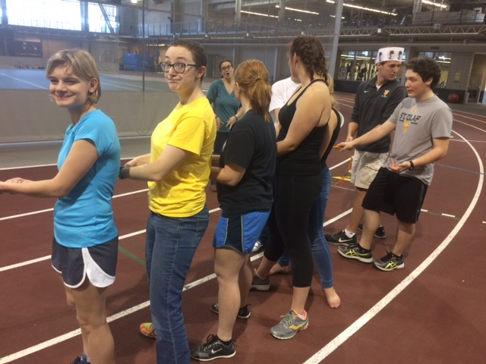
Ancient Historians Tugging to the Right

Slide 14
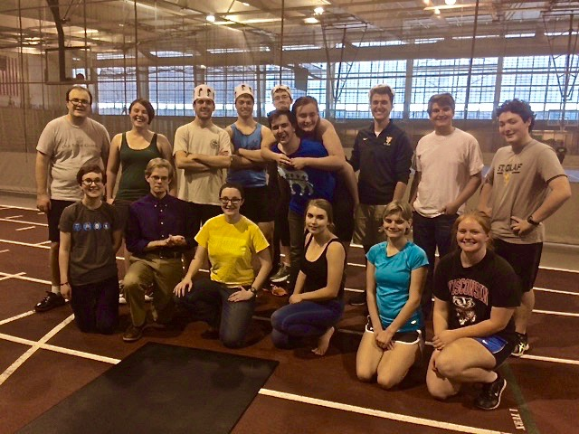
Happy at the Hellespont (the classicists won!)

Slide 15
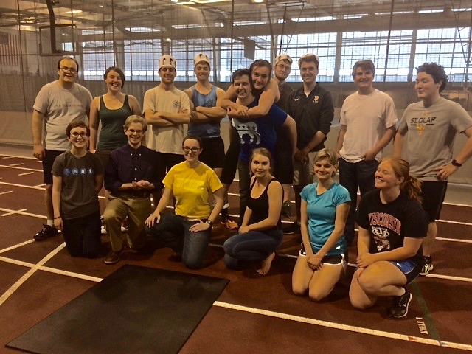
Even Happier at the Hellespont (there’s always next year!}

Slide 16
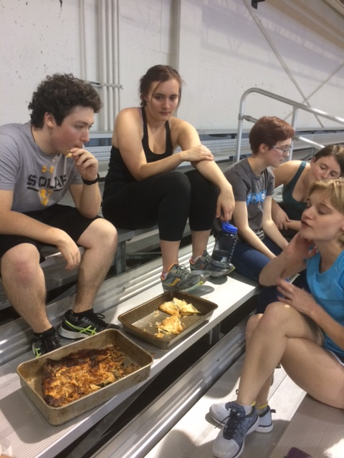
Time To Eat Spanikopita and Tiropita!

