Slide 1
Photos from the Eleventh
Annual Softball Game
Greek Students vs. Latin Students
October 1, 2016
Mabel Shirley Field, St. Olaf College

Slide 2
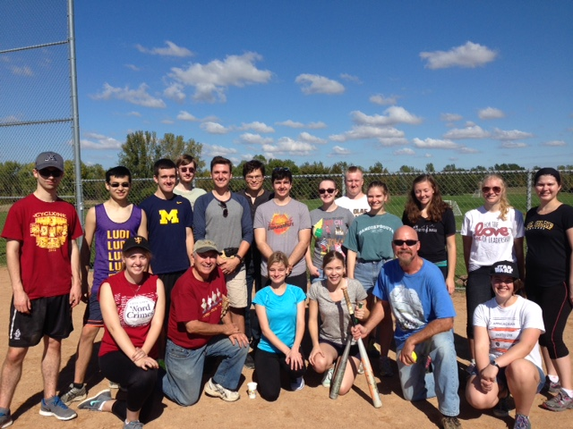

Slide 3
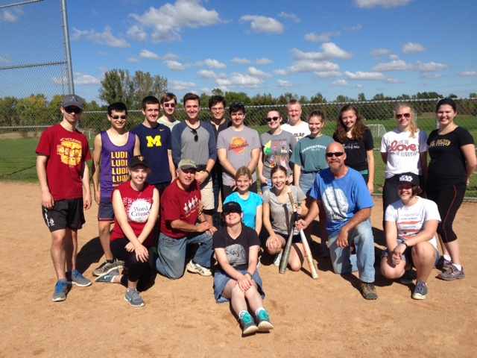

Slide 4
