Slide 1
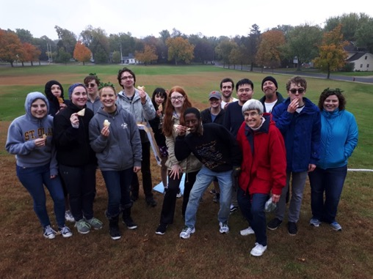
Photos from the 13th Annual St. Olaf Olympics October 7, 2018
(co-sponsored by the Society for Ancient History and the Delta Chi chapter of Eta Sigma Phi)

Slide 2
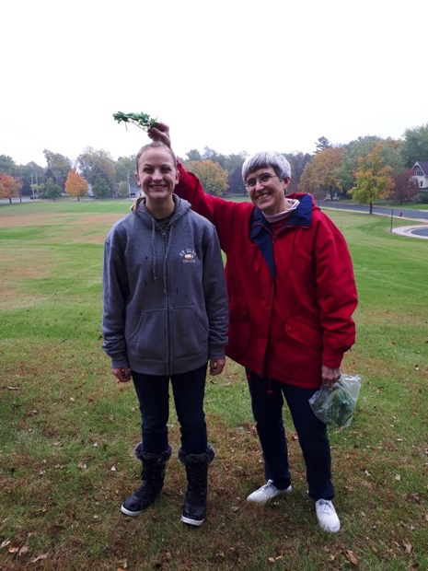

Slide 3
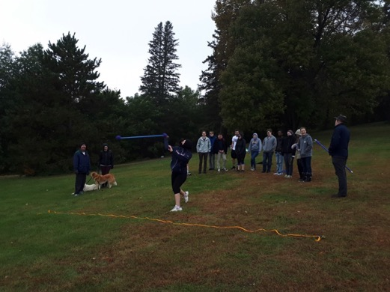

Slide 4
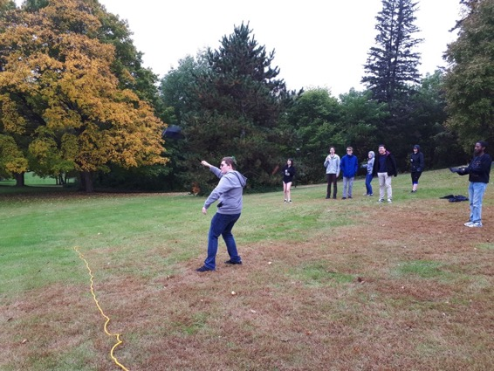

Slide 5
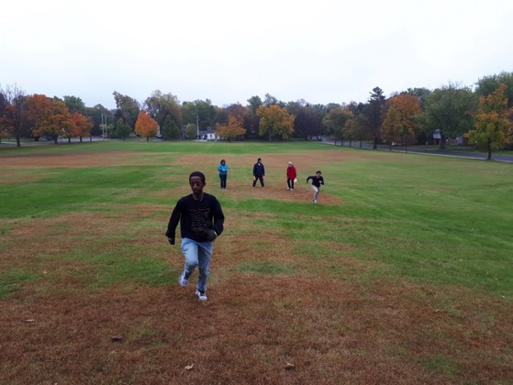

Slide 6
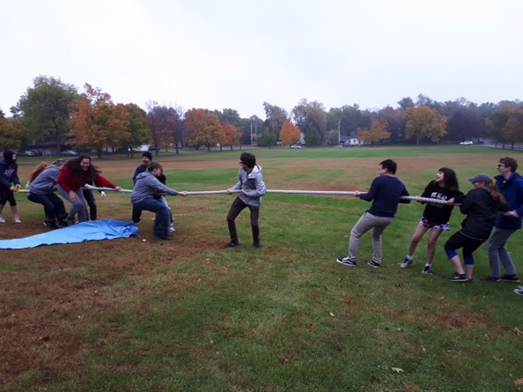

Slide 8
