Slide 1
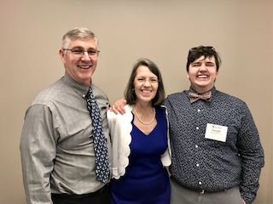
Commencement Day Reception – May 26, 2019

Slide 2
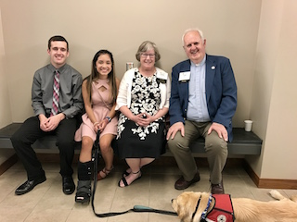
Devin Ames & family

Slide 3
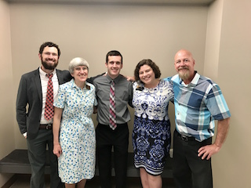
Devin Ames & professors

Slide 4
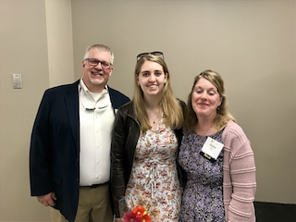
Emy Bess & family

Slide 5
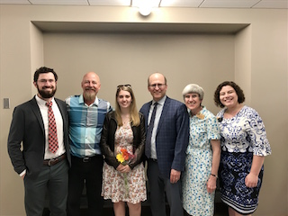
Emy Bess & professors

Slide 6
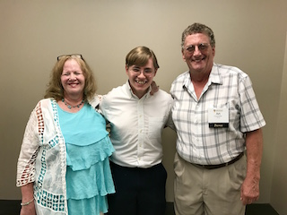
Alex Cavender & family

Slide 7
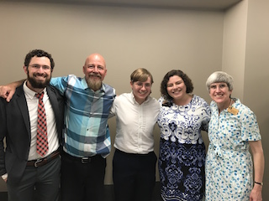
Alex Cavender & professors

Slide 8
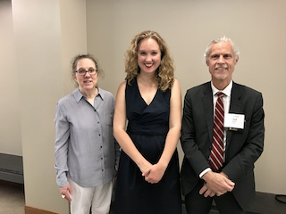
Emma dePaulo Reid & family

Slide 9
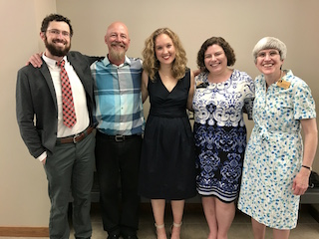
Emma dePaulo Reid & professors

Slide 10
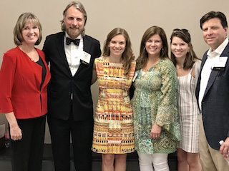
Mary Landis Gaston & family

Slide 11
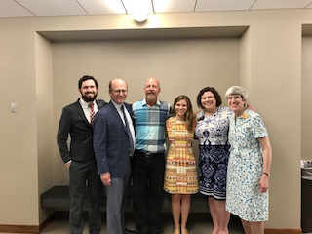
Mary Landis Gaston & professors

Slide 12
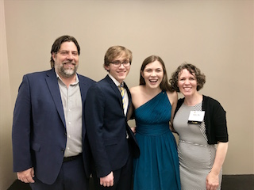
Sophie Rossiter & family

Slide 13
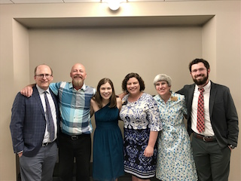
Sophie Rossiter & professors

Slide 14
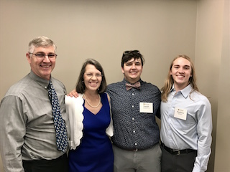
Joseph Spellman & family

Slide 15
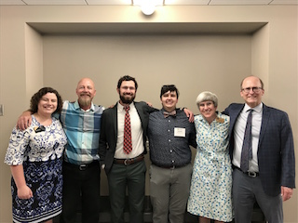
Joseph Spellman & professors

Slide 16
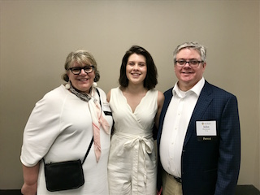
Macy Stormont & family

Slide 17
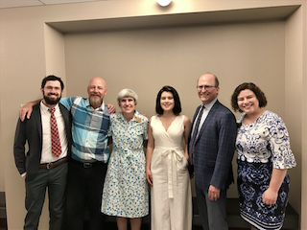
Macy Stormont & professors

Slide 18
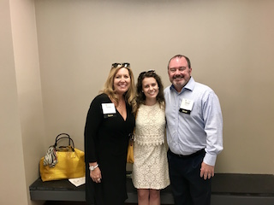
Amanda Westcott & family

Slide 19
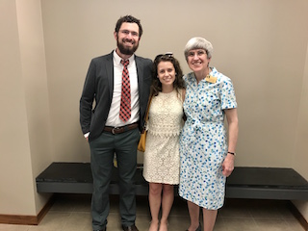
Amanda Westcott & professors

