Slide 1
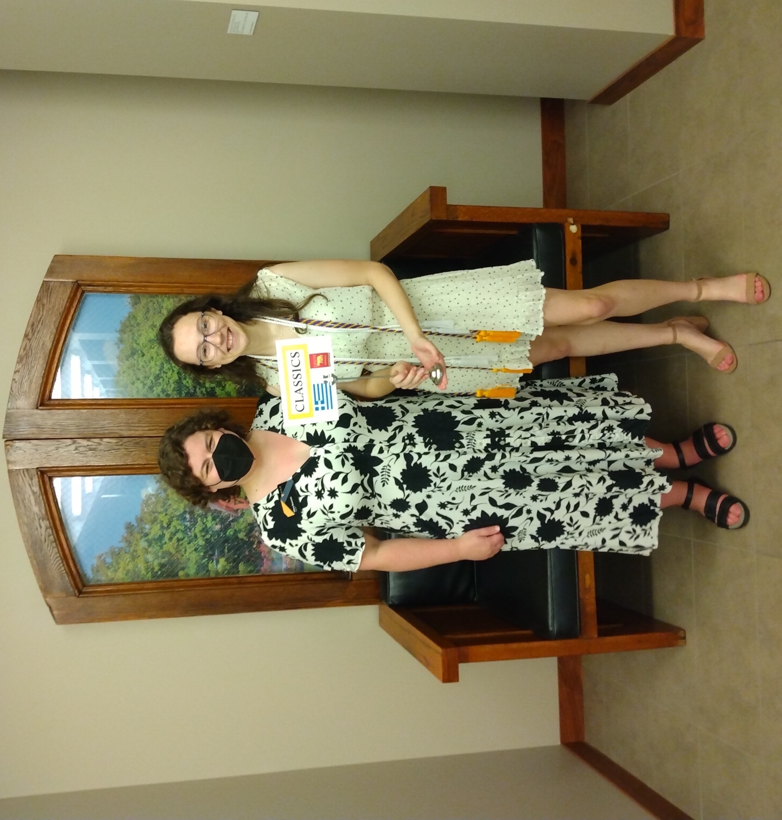
Prof. Hilary Bouxsein & Laura Shea
Commencement Day Reception – May 29, 2022
Tomson Hall Atrium

Slide 2
Evan Aho & family

Slide 3
Dylan Boorsma Bergerud & family

Slide 4
Madeline Everett & family

Slide 5
Madeline Everett & Profs. Groton & Helms

Slide 6
Katie Johnson & family

Slide 7
Emily Knuths & family

Slide 8
Anson Martin & family

Slide 9
Abbey McFarland & family

Slide 10
Tor Nelson & family

Slide 11
Ellie Rabe & family

Slide 12
Brigitte Rein & family

Slide 13
John Reynolds

Slide 14
Ryan Sasse & family

Slide 15
Laura Shea & family

Slide 16
Jason Tan & family

Slide 17
Matt Vinton & family

Slide 18
Jean Zerwas & family

Slide 19
In absentia: Alexander Famous (at left in green shirt)

