Slide 1
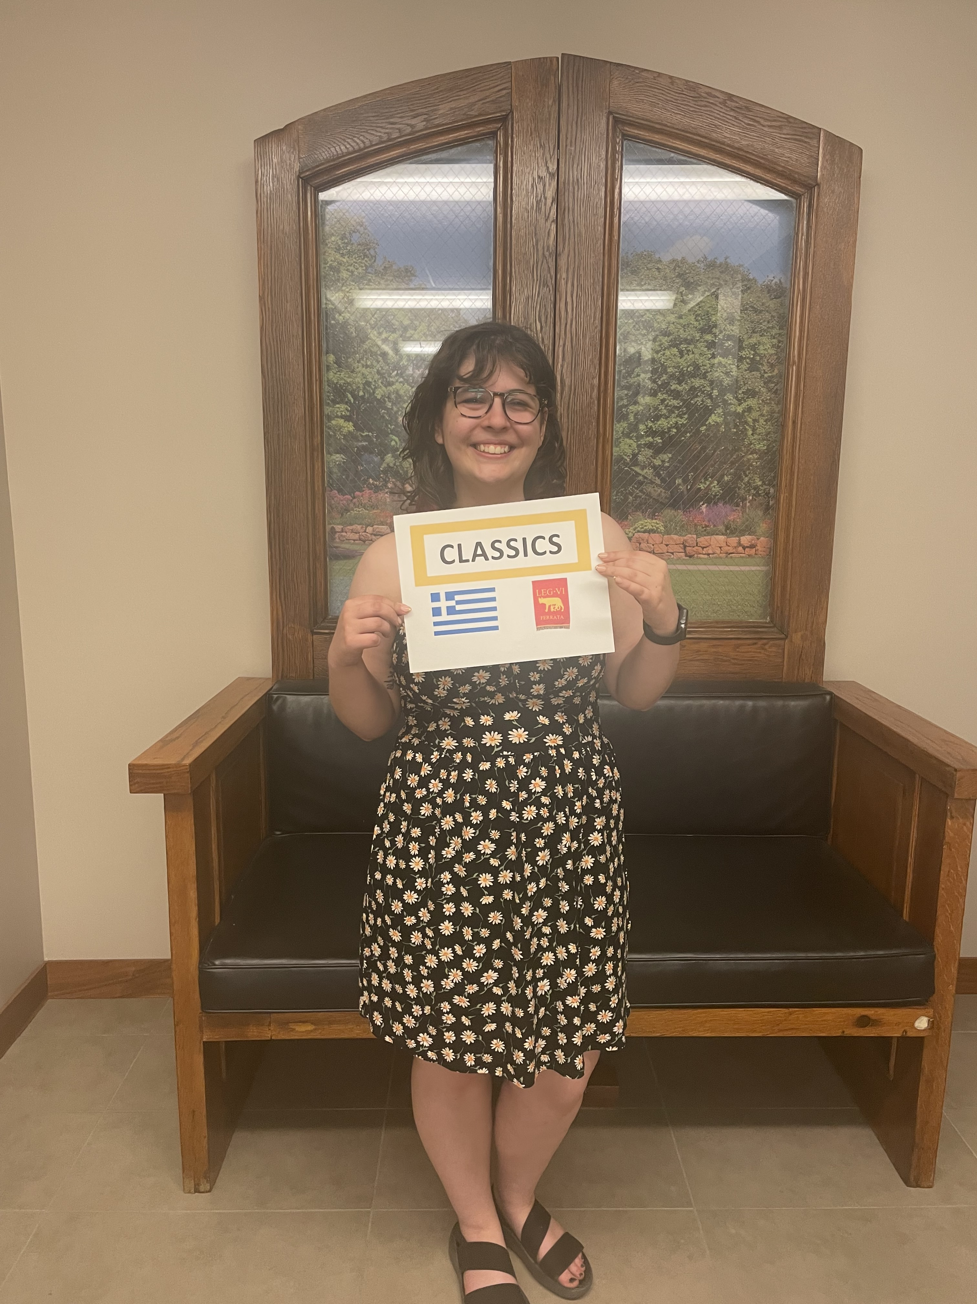
Commencement Day Reception – May 28, 2023
Tomson Hall Atrium
Melina Canas

Slide 2
Audrey Hoehner with Profs. Helms, Reece, and Groton

Slide 3
Payton Jorgensen with Profs. Reece, Groton, and Helms

Slide 4
Olivia Simonson with Profs. Reece, Helms, and Groton

Slide 5
Melina Canas with Profs. Helms and Groton

Slide 6
Prof. Helms in Tomson 366

