Slide 1
News from Alumni

Slide 2
Sister Cecilia Maria (Kirstine Wynn ’06) has taken her final vows as a Passionist Nun at St. Joseph Monastery in Whitesviile, Kentucky. Meanwhile Nicoletta (Sydney) Freedman ’09 is a Georgian Orthodox sister at the Sacred Monastery of St. Nina in Union Bridge, Maryland, and Matthew Steenberg ’01 is now the Rt. Rev. Dr. Irenei, Bishop of London and Western Europe, in the Russian Orthodox Church Outside of Russia!

Slide 3
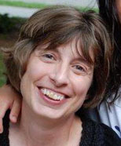
Gwendolyn Compton-Engle ’92 Professor of Classics at John Carroll University, has published Costume in the Comedies of Aristophanes (Cambridge U. Press, 2015). Read this news feature on Kris Coffman ’13, Ph.D. student in Classical and Near Eastern Languages at the University of Minnesota.

Slide 4
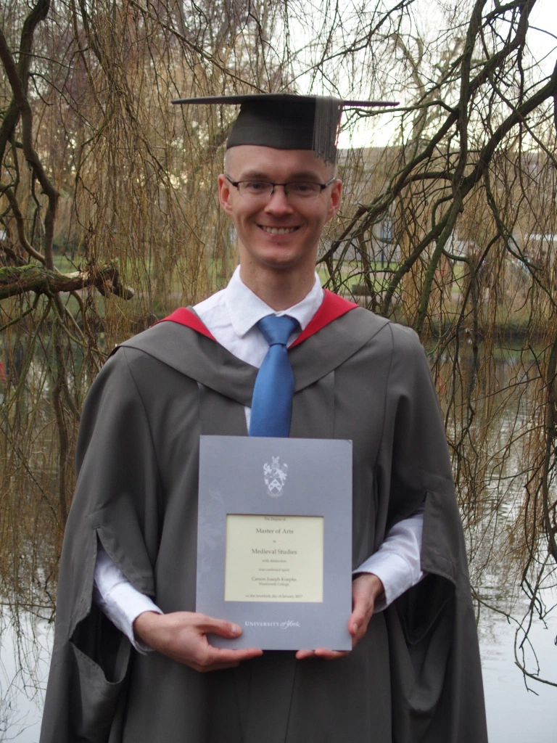
Carson Koepke ’14 (shown in the photo) has received his Master of Arts in Medieval Studies from the University of York.
Hilary Lehmann ’04 has earned her Ph.D. in Classics at UCLA (dissertation: “Feeling Home: House and Ideology in the Attic Orators”), and Martin Shedd ’11 has earned his Ph.D. in Classical Studies from Indiana University (dissertation: “Inventing Free Speech: Authority and Genre in the Historia Augusta”).

Slide 5
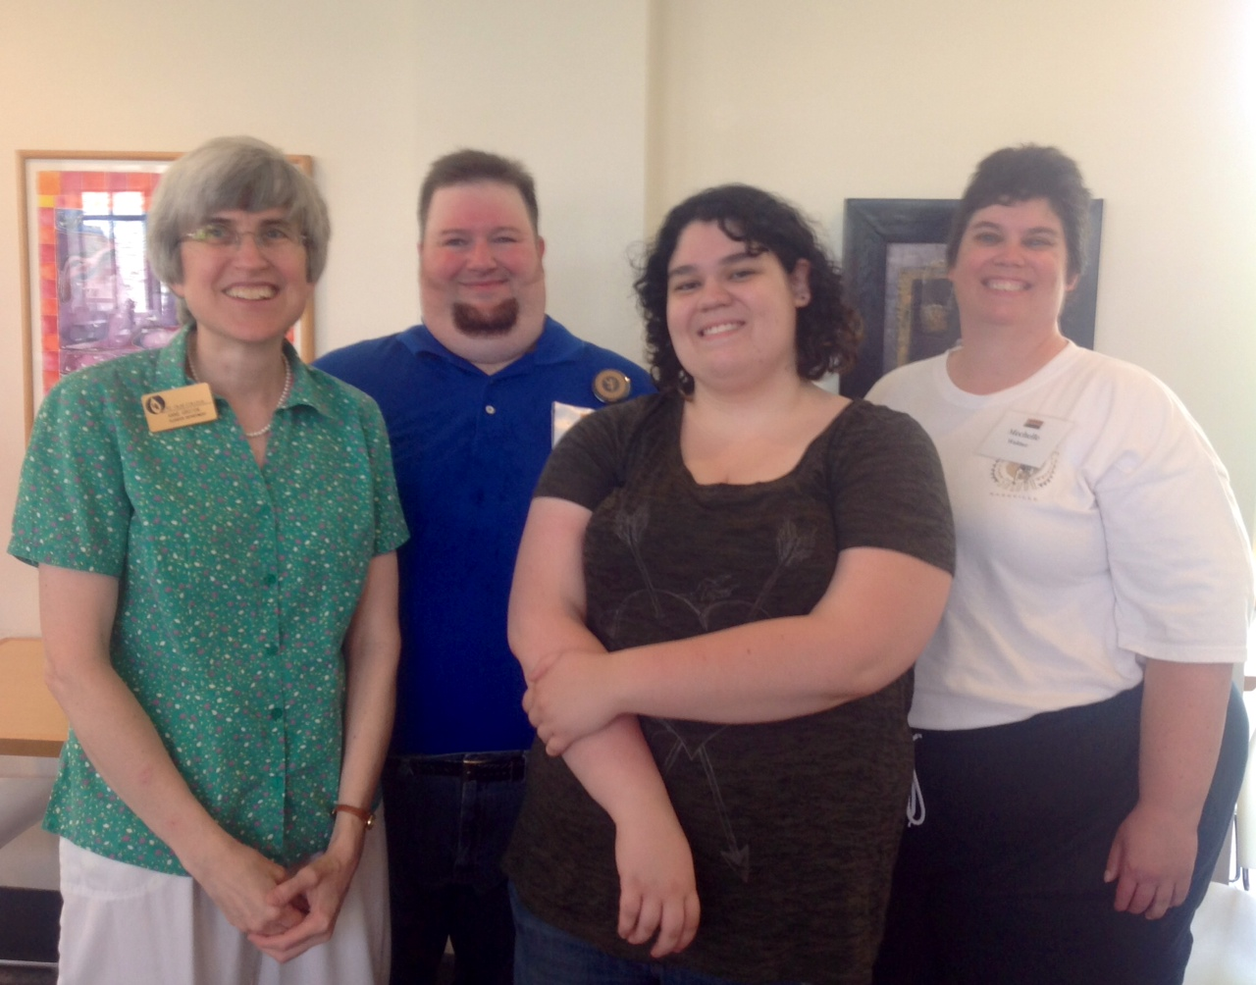
Reunion Weekend, May 31, 2014: Prof. Groton reminisces with Wally Waltner ’94, his wife Mechelle, and their daughter Melissa.

Slide 6
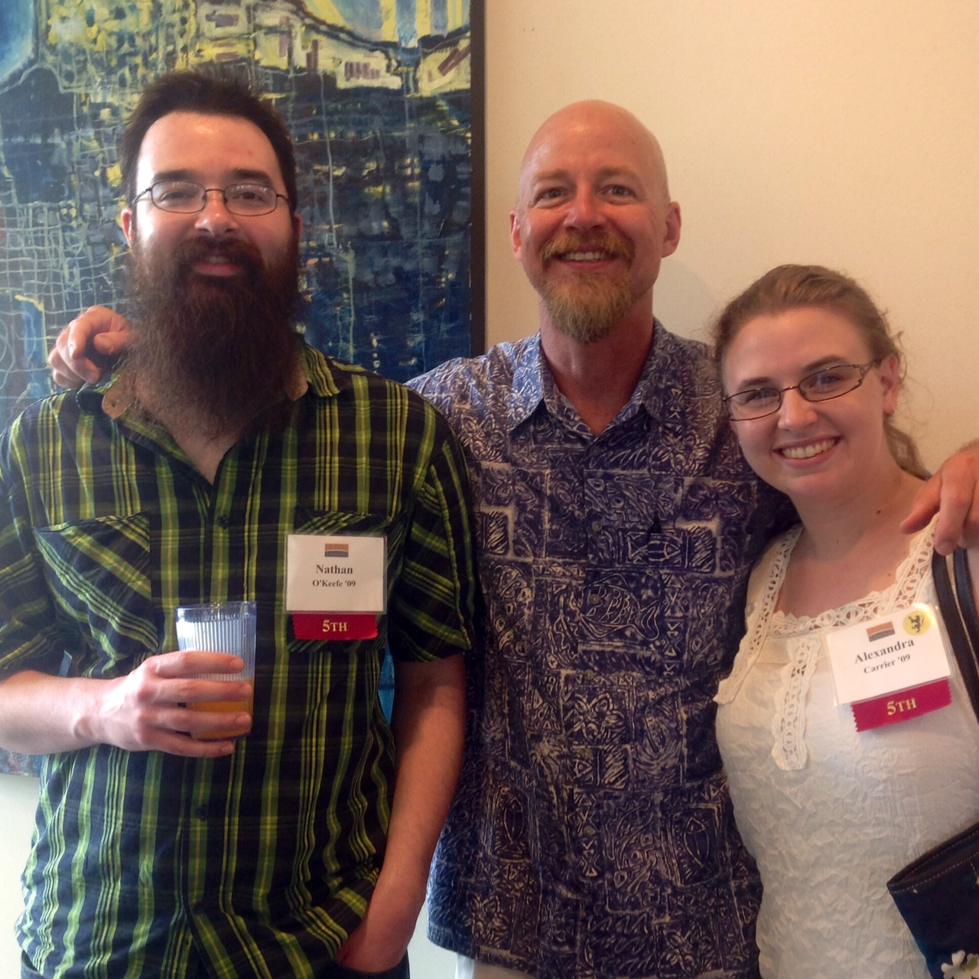
Reunion Weekend, May 31, 2014: Prof. Reece chats with Nathan O’Keefe ‘09 and Alex Carrier ‘09.

Slide 7
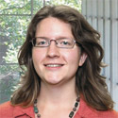
News from Dorothy (Dot) Porter '98 (Medieval Studies major):
In April, 2013, I started a new job at the University of Pennsylvania - Curator, Digital Research Services, in the Schoenberg Institute for Manuscript Studies division of the Kislak Center for Special Collections, Rare Books and Manuscripts in the UPenn Libraries. I work with Penn scholars (faculty and students) in exploring new methods of research in the humanities, particularly the application of digital technologies to textual analysis and the electronic dissemination of humanities research. (Mostly I play with digitized medieval manuscripts.)
After graduating from St. Olaf I received an MA in Medieval Studies from Western Michigan University (2000), and an MS in Library Science from UNC Chapel Hill (2001). Since then I've worked in a variety of positions in the digital humanities and digital libraries, always with some foot in the door of medieval studies or classics. At the moment I am co-Director of the Mellon Foundation-funded Medieval Electronic Scholarly Alliance (MESA, http://mesa-medieval.org), and I was just elected Vice President of the Association for Computers and the Humanities.

Slide 8
News from Katherine Crawford ’11 (Latin, Medieval Studies major):
I recently completed my MA in Classical Archaeology at the University of British Columbia, where my research focused on the cult of Isis within Roman Macedonia. During this time I had supervisory positions on excavations in Stobi, Macedonia; Tel Megiddo, Israel; Tel Jezreel, Israel; and Tel Kabri, Israel. (The photo is from Caesarea Maritima, Israel.)

Slide 9
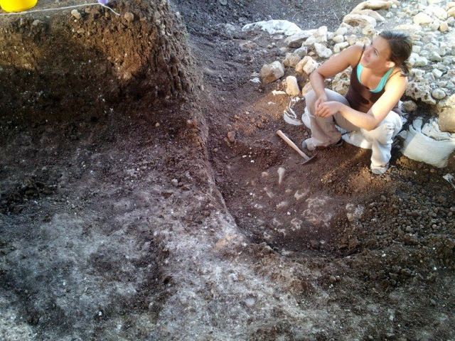
Katherine Crawford’s news, p. 2
I am continuing my studies this fall with a second MA in Maritime Civilizations: underwater archaeology at the University of Haifa in Israel.
Then in the fall of 2014 I will be starting my PhD in Roman Archaeology at the University of Southampton, where I will be studying how people came into contact with religious structures in Ostia by tracking ancient pedestrian patterns and undertaking visual analysis of select temples.
In addition to all my studies and continuous travel around the world, I continue to be a competitive ballroom dancer.
Katherine digging at Tel Kabri (summer, 2013)

Slide 10
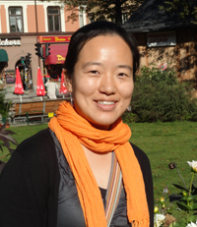
News from Esther Lee '03 (Ancient Studies major):
After finishing her Ph.D. in anthropology at SUNY-Binghamton in 2009, Esther headed a lab at the University of Kiel in Germany, doing genetic analysis of Neolithic human remains around Central Europe. In the fall of 2013 she started teaching at Texas Tech University as a Visiting Assistant Professor in Physical Anthropology. Her areas of specialization are molecular anthropology, ancient DNA, and population genetics.

Slide 11
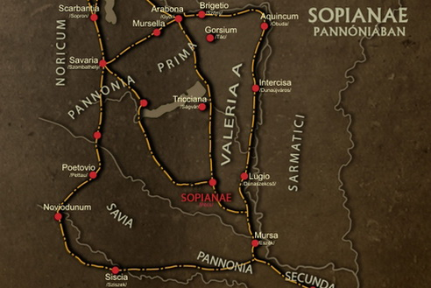
News from John Voelker '82 (Classics major, now Pastor of Trinity Lutheran Church in Thief River Falls, MN, and a summertime visitor to Hungary)
In the summer of 2012 I spent time doing research with medieval Latin manuscripts at a 900-year-old Benedictine monastery at Mellecenium, in the Roman province of Noricum. Then I was down in Pannonia province
in the town of
Sopianae (see the map), doing research at the Early Christian necropolis excavations. The province is a gastronomic and viticultural paradise, very much like Tuscany, only much better! Most of my time was spent in Pannonia Prima and Pannonia Valeria provinces. This past summer (2013) I returned to the same area to do manuscript research at the 1,000-year-old abbey at Monte Pannoniae.

Slide 12
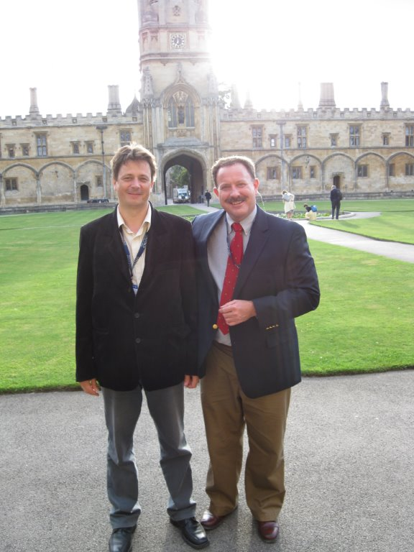
John Voelker’s news, p. 2
I continue doing scholarship on my specialty of Marius Victorinus, and am preparing a paper on his knowledge of Gnostic commentaries for the next international Patristics gathering at Oxford University.
The photo (from 2011) shows me with my colleague Heidl György. He teaches Patristics at the University of Pécs (founded 1367) in southern Hungary. We’re standing in the quad of Christ Church college of Oxford University. The tower in the background is Tom Tower, where the bell named ‘Great Tom’ rings 101 times each evening at 9:00, in a centuries-old tradition to tell the undergrads that the gates are closing for the night.

Slide 13
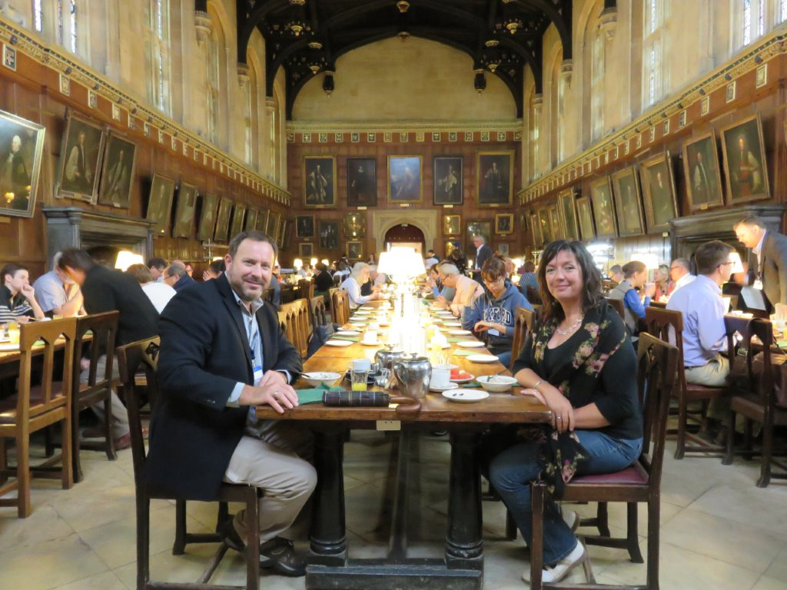
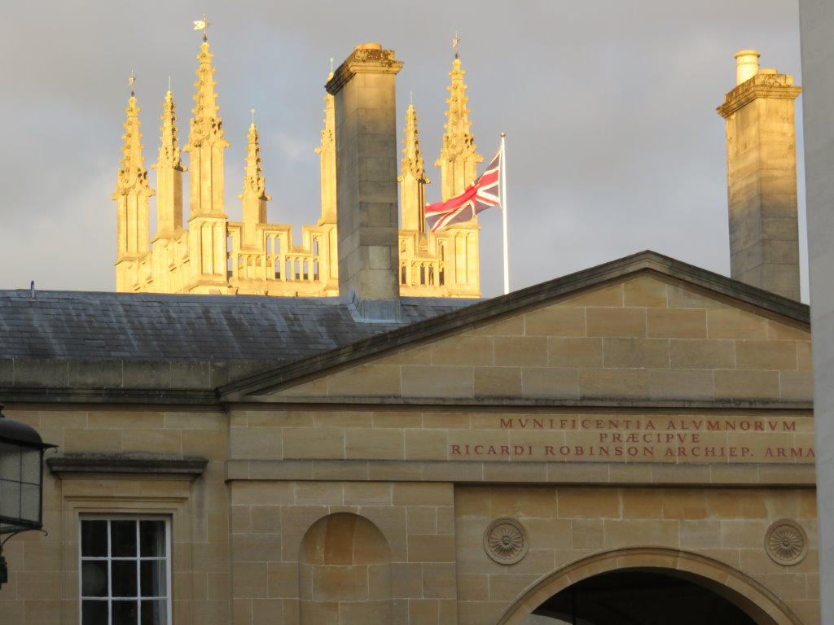
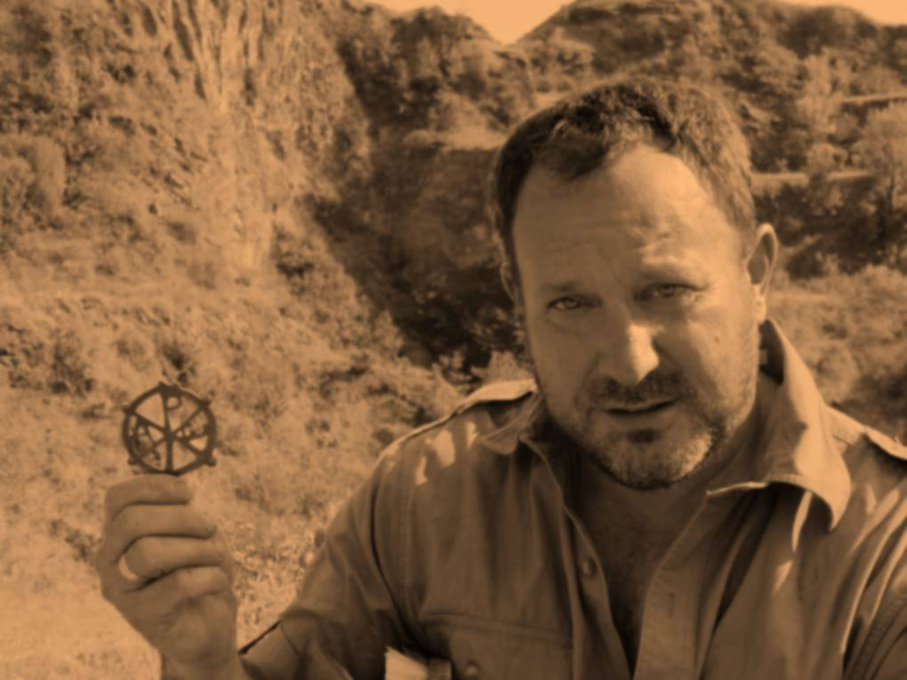
John Voelker’s news, p. 3
John’s paper on Victorinus’ Gnostic commentary will be published in Studia Patristica. Congrats! He is visiting Germany, Croatia, and Pannonia again this summer (2016).
The photos (from 2015) show John digging in Pannonia and enjoying Oxford, both inside and out.

Slide 14
Here are Gwen Compton-Engle '92 (Classics major), Tron Compton-Engle '92 (Ancient Studies major), and daughter Mia (4th grade), visiting the Frank Lloyd Wright house Fallingwater (summer, 2013). Gwen has finished a 3-year term as director of the Core Curriculum at John Carroll University, where she is Associate Professor of Classics. Tron is still director of IT for the Case Western University School of Law. “Life is good.”

Slide 15
When Ashley Elston '02 (Medieval Studies and history major) visited on Oct. 3, 2008, she had already received her M.A. (2005) in art history from the University of Kansas; she went on to earn a Ph.D. in 2011. Her specialty is Italian Renaissance art and architecture. After teaching at the Kansas City Art Institute, Emporia State University, and Rollins College, she started a tenure-track job at Berea College in 2013. Ashley loves teaching abroad and hopes to come across some Oles the next time she's having class in Italy!

Slide 16
Look who dropped by the office on June 1, 2007: Andrea Gatzke '05 (Classics and history major). Six years later she completed her Ph.D. in Classics and Ancient Mediterranean Studies at Penn State University. In the fall of 2013 she began a tenure-track job as Assistant Professor of History at SUNY-New Paltz.

Slide 17
On August 5, 2010, Peter Hansen '97 (Latin and history major) and his family drove to Northfield to enjoy the scenery. Posing with a ferocious canine are Peter, wife Michelle (Boulay) '97, and their charming daughters Ava and Penelope. They have since added two more daughters, Gwyneth and Liv. Peter is Artistic Director of the Gremlin Theatre and a frequent actor at the Guthrie Theater; Michelle is a Program Manager for the American Cancer Society.

Slide 18
Five minutes after the Hansens left, on August 5, 2010, , who should appear in the office but Laura Puumala Berdahl '89 (Classics major)! In the three years since then, Laura has become the pastor of Family of God Lutheran Church in Duluth. She writes, “It is my first full-time call since my 15-yr-old was born, and it is a solo call in a family-sized congregation, so is a new adventure in itself. My husband, two daughters, and I continue to love life on the shores of Lake Superior, and I am happy to report that my 15-year-old delights in word origin and grammatical matters, and therefore my Classics major is being put to very good use.”

Slide 19
Marquis Berrey '03 (Classics major) returned to The Hill on July 2, 2010. He is now an assistant professor of Classics at the University of Iowa and enjoys running and biking in the rolling hills around Iowa City.

Slide 20
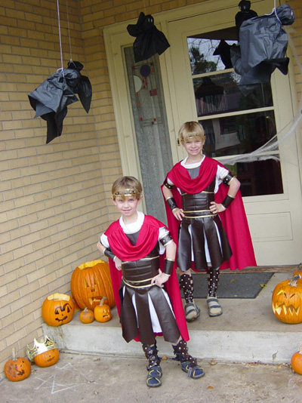
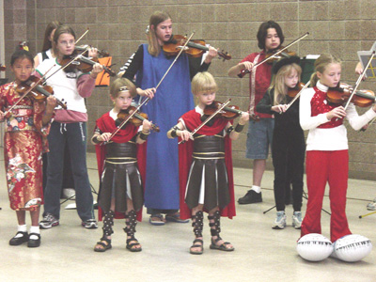
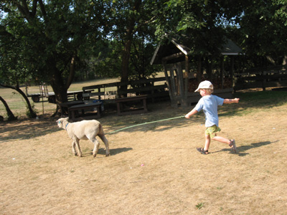
Jill Schwendeman '84 (Classics and English major) has sent adorable photos of sons Søren and Skyler Heise Schwendeman dressed for a school presentation on gladiators, then playing the violin, still in costume. Meanwhile a lamb takes son Julian for a run. Jill, married to Tiger Heise, is now youth director at White Bear Unitarian Universalist Church in Mahtomedi.

Slide 21
News from Stephanie Hill Simione '92 (Medieval Studies major):
October 2010: For the past four years, I've been a technical writer/software business analyst for US Bank's internal credit administration applications. This is not as dry as it sounds. Part of my job involves digging into old software code and teasing out the original logic so that it can be rewritten in more modern languages. Years of Latin actually greatly assisted my ability to translate programming languages. In addition, I also help develop new applications, mainly serving as the Rosetta Stone between developers and end users. I help with usability and design and also create the training and support materials. When I'm not being a software geek or parenting my kids, Zachary and Izzy, I teach BodyPump at the YMCA and dig in the garden. Until recently, I was married to Anthony Simione ('92, Theatre and Art History, and also a software geek) who died this fall after a 9 year battle with brain cancer.

Slide 22
News from Kate Reilly '98 (Medieval Studies major):
I was Kate Reilly when I attended St. Olaf, but have transitioned to Jake. I live in Saint Paul with my fiancée and work for the City of Saint Paul as a City Planner. I received a Masters in Urban and Regional Planning from the Humphrey School at the University of Minnesota in 2004.
Oddly enough, being a Medieval Studies major prepared me for planning school -- having a knowledge of city morphology stemming from studies of medieval cities helped me while studying the history of planning and planning theory. This particular career choice has taken me from working for the federal government in Washington, DC and Yuma, AZ to stints on the planning and economic development staffs at both of the "twin" cities, as well as a private planning firm.

Slide 23
Michelle Domondon '00 (Classics major), who is in her 8th year of teaching Latin and ancient Greek at the Episcopal Academy in Newtown Square, Pennsylvania, married Yashar Rafi, a doctoral student at the Jefferson School of Pharmacy in Philadelphia, on June 27, 2009. The photo shows Michelle when she visited St. Olaf on July 2, 2008, accompanied by Evan and Emily Moran and their mom, Jenny (Benson) Moran '00. Jenny is now pastor at Christ's Community Church in Maple Grove, MN; husband Paul Moran '00 (Classics major) is finishing up his dissertation for a Ph.D. in Classics (University of Virginia).

Slide 24
News from Carl Beckwith '95 (Ancient Studies major):
I finished my doctoral studies at Notre Dame two years ago. My major area of study was Greek and Latin Patristic theology and I decided to write my dissertation on Hilary of Poitiers' De Trinitate. I am presently teaching theology and Greek at Thiel College in western Pennsylvania. Greek had been off the books at Thiel for over ten years but I am slowly reviving interest in it. This year I had 24 students in first semester Greek! The number is a little smaller for second semester (19) but still quite good, I think. Next year Intermediate Greek will be offered. When I was at Yale, I took a year of Coptic and I joke with my department chairman that soon the students will be demanding Coptic.
I've also been busy spreading the good news about Hilary of Poitiers. I find that I really enjoy researching, writing, and translating. I have a hand full of articles published or in press on Hilary (Journal of Early Christian Studies, Journal of Ecclesiastical History, and the Scottish Journal of Theology) and am hoping to finish soon a monograph on his De Trinitate.
In other news, my wife and I have two beautiful little girls, Paige (3) and Madeleine (1). Paige can almost recite the Greek alphabet on her own and she knows a handful of Greek phrases!

Slide 25
Martha (Beck) Sandli '00 (Medieval Studies major) and Anders Sandli with their son Oliver came to campus for Homecoming 2010 and met up with Hadley Johnson '00 (Medieval Studies major). Here are Martha, Hadley, and Oliver on the couch in the Classics suite (photo taken by Anders).

Slide 26
Other Homecoming 2010 visitors: Jessica (Overbeck) Bergeron '05 (Ancient Studies and English Education major), husband Ryan, and three-year-old Joshua. Jessica is in charge of the Latin program at Eagle Ridge Academy in Eden Prairie, Minnesota.

Slide 27
Summer visitors in 2010 included Cory Holec '09 (Latin Education major, at right in photo) and Nathan O'Keefe '09 (Ancient Studies, Latin, and history major). Cory is now teaching Latin at Rosemont/Norview Middle School in Norfolk, VA. Nathan works at Half Price Books in Apple Valley, MN.

Slide 28
Look who was teaching a statistics course at St. Olaf in the summer of 2008! Peter Sprangers '03 (Latin and mathematics major) is now a Lecturer in the Department of Statistics at The Ohio State University, pursuing his Ph.D. there in his spare time. Here he is posing with a palm tree on July 29, 2008.

Slide 29
Majda Haznadar '05 (Ancient Studies major) received her Ph.D. in genetics from the University of Minnesota in July of 2010. Here she is with her parents from Sarajevo, visiting St. Olaf the week before she defended her dissertation. Since then, she has been a postdoctoral fellow at the National Cancer Institute in Bethesda, Maryland.

Slide 30
We had another surprise visit from John Kusske '00 (history major) and Kristie Kiesel '01 (Classics major) on August 26, 2008; here's proof that they still fit in the desks in Old Main 30!

Slide 31
News from Catherine Kusske Warren '97 (Classics and Medieval Studies major):
Hello, fellow Classicists! After getting an MA in China Studies at the University of Washington's Jackson School of International Studies, I got a job at GreaterGood.com, a network of websites raising money for charitable causes. I'm now a Senior Marketing Manager, working in project coordination, software testing, product launching, and on the company's Gifts That Give More program. Andrew Warren ('97) and I have two daughters: Vivian Joan, born April 2005, and Irina Elaine, born June 2007. I blog almost every day at http://catherinew.livejournal.com; drop in and leave a comment sometime!

Slide 32
Sergeant First Class Terrina Anderson '96 (Greek and clarinet performance major) flew from Virginia Beach, VA, to Northfield for Homecoming, 2010; she was the featured soloist in the St. Olaf Band's concert on October 2.

Slide 33
Corinna (Cory) Knepper Troth '96 (Latin and speech-theatre major) and her family relax on an ancient wall in Herculaneum during a trip to Italy in the summer of 2007.

Slide 34
Welcome to Edmund MacLeod Keister, born on July 29, 2007, to Lane Keister '00 (Greek and piano performance major) and his wife Sarah; Edmund has two older siblings, Ila Lorraine and James Mark Calvin. Lane is the pastor of not one but two Reformed churches in Hague, North Dakota.
To see a cute photo of Edmund as a newborn and to read a plethora of comments about him, go to Lane's blog:
http://greenbaggins.wordpress.com/2007/07/25/edmund-macleod-keister/

Slide 35
News from Christine DeLong '98 (Classics major):
After I graduated with my Classics major in 98, I loafed around Minneapolis for a year and was somehow accepted to Emory University School of Medicine (that one still puzzles me). It was a close one, but I graduated with my MD in 2003 and went on to complete an Internal Medicine Residency at the University of New Mexico in Albuquerque. I stayed on at UNM for a Chief Resident year as I couldn't resist the offer to hang around and become the Queen of resident scheduling. I arrived in Tucson about a month ago (June, 2007) to lovely 100F + weather to begin fellowship training in Cardiology.
As you can see, I'm on a clockwise tour of the US. Give me a few years and I'll either be in Seattle or perhaps Alaska; it's difficult even for me to predict where this doctoring business will take me. I haven't made it back to Italy or Greece since college, but am desperately trying to do so in the next year or so. No marriages or miraculous births to announce; at this point the career is quite enough, I suppose. "Quo Usque Tandem....": yes, I still recall some Cicero, and I believe it helped me gain entrance to Med School as I quoted that for the admissions committee when they asked me what I had learned as a Classics major.

