Slide 1
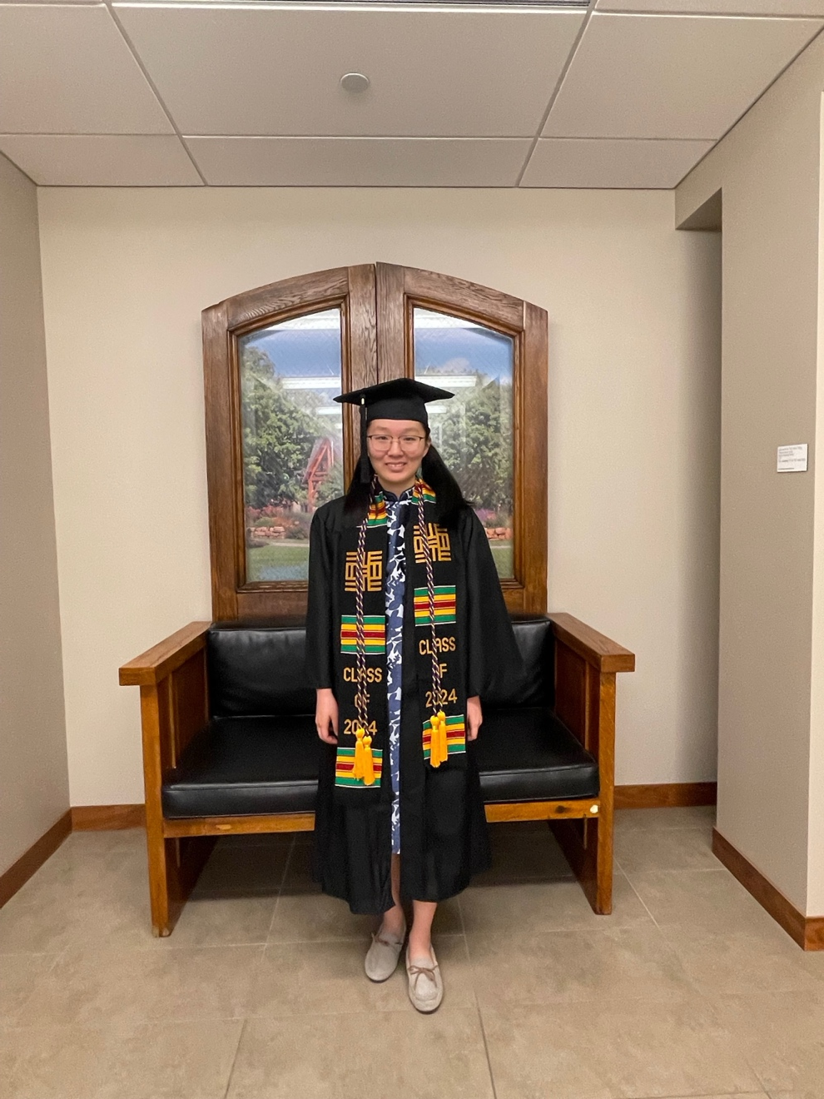
Commencement Day Reception – May 25, 2024
Tomson Hall Atrium
Vania Liang (Greek major)

Slide 2
Nick Braun (Medieval Studies major) with Profs. Helms, Groton, and Bouxsein

Slide 3
Nick Braun & Julia Steidl

Slide 4
Erica Collin (Classics major) with Profs. Helms, Bouxsein, and Groton

Slide 5
Erica Collin & family

Slide 6
Vania Liang (Greek major) with Profs. Helms, Bouxsein, and Groton

Slide 7
Sierra McGuire (Ancient Studies major) with Profs. Helms, Bouxsein, and Groton

Slide 8
Sierra McGuire & friends

Slide 9
Eli Moore (Classics major) with Profs. Helms, Groton, and Bouxsein

Slide 10
Eli Moore & family

Slide 11
Eli Moore & still more family

Slide 12
Nellie Phillips (Latin & Medieval Studies major) with Profs. Helms, Groton, and Bouxsein

Slide 13
Benjamin Reister (Latin major) with Profs. Helms, Groton, and Bouxsein

Slide 14
Benjamin Reister & family

Slide 15
Jacob Thompson (Ancient Studies major) with Profs. Groton, Helms, and Bouxsein

Slide 16
Jacob Thompson & family

Slide 17
Congratulations to the Class of MMXXIV!

