Slide 1
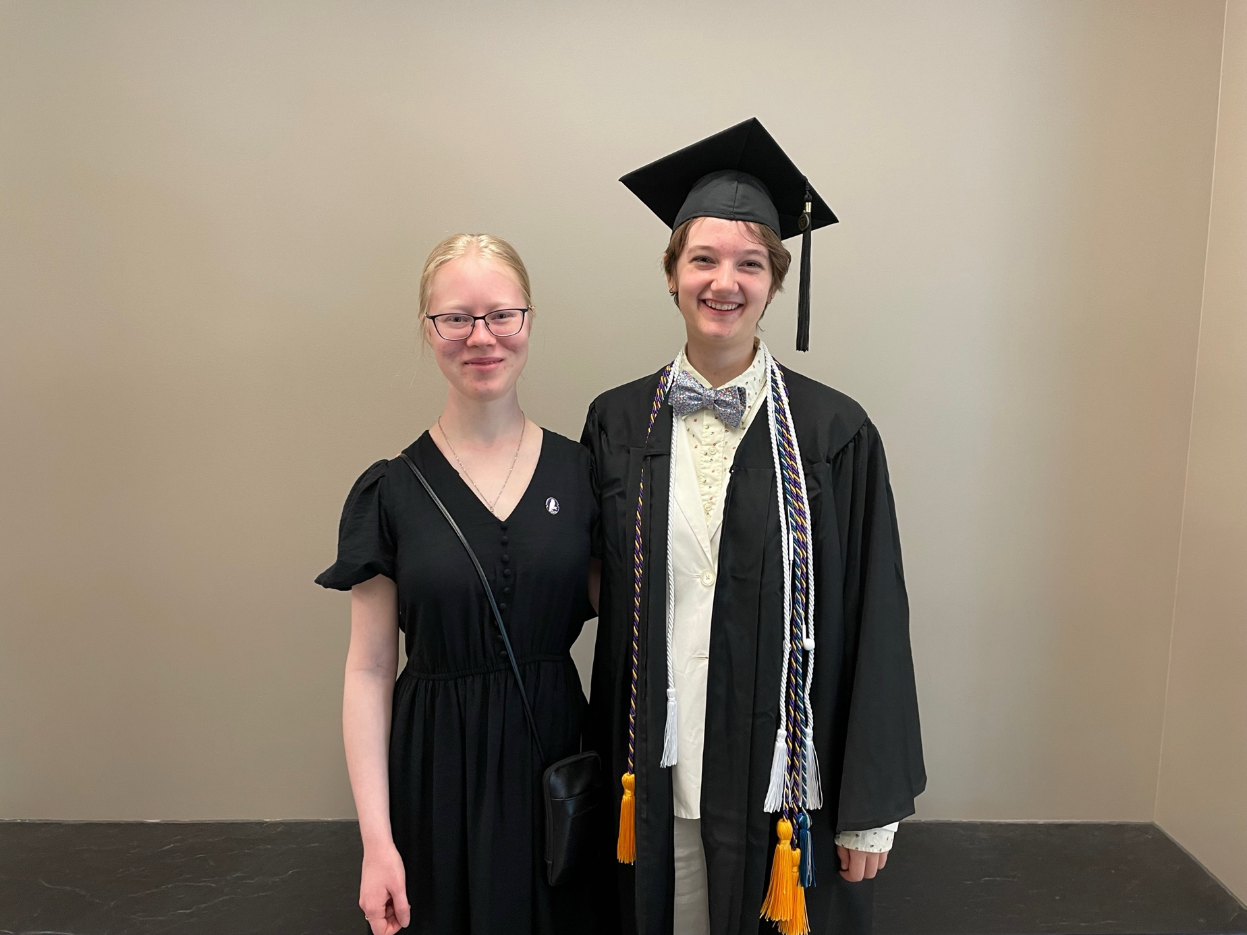
Commencement Day Reception – May 24, 2025 Tomson Hall Atrium
Anna Shapovalova & Lucia Iurino

Slide 2
Sofia Albrecht (Latin major) with Profs. Helms, Groton, and Moench

Slide 3
Sofia Albrecht & family

Slide 4
Charles Cole & family

Slide 5
Charles Cole with family and Prof. Groton

Slide 6
Mars Dall (Ancient Studies major) with Profs. Moench, Helms, and Groton

Slide 7
Em Haas (Greek major) with Profs. Moench, Groton, and Helms

Slide 8
Em Haas & family

Slide 9
Lucia Iurino (Classics major) with Profs. Moench, Groton, and Helms

Slide 10
Lucia Iurino & family

Slide 11
Liz Mills (Ancient Studies major) with Profs. Helms, Groton, and Moench

Slide 12
Liz Mills & family

Slide 13
Eli Moore ‘24 (Classics major) & family

Slide 14
Roger Quant (Ancient Studies major) with Profs. Groton, Moench, and Helms

Slide 15
Roger Quant & family

Slide 16
Lissi Reid with Prof. Helms

Slide 17
Lissi & Mari Reid with Prof. Helxms

Slide 18
Joey Richards (Classics major) with Profs. Moench, Helms, and Groton

Slide 19
Anna Shapovalova (Medieval Studies major) with family and Prof. Groton

Slide 20
Anna Shapovalova & family

Slide 21
Laura Smith (Latin & Ancient Studies major) with Profs. Groton, Moench, and Helms

Slide 22
Laura Smith & Lucia Iurino
Congratulations to the Class of MMXXV!

