Slide 1
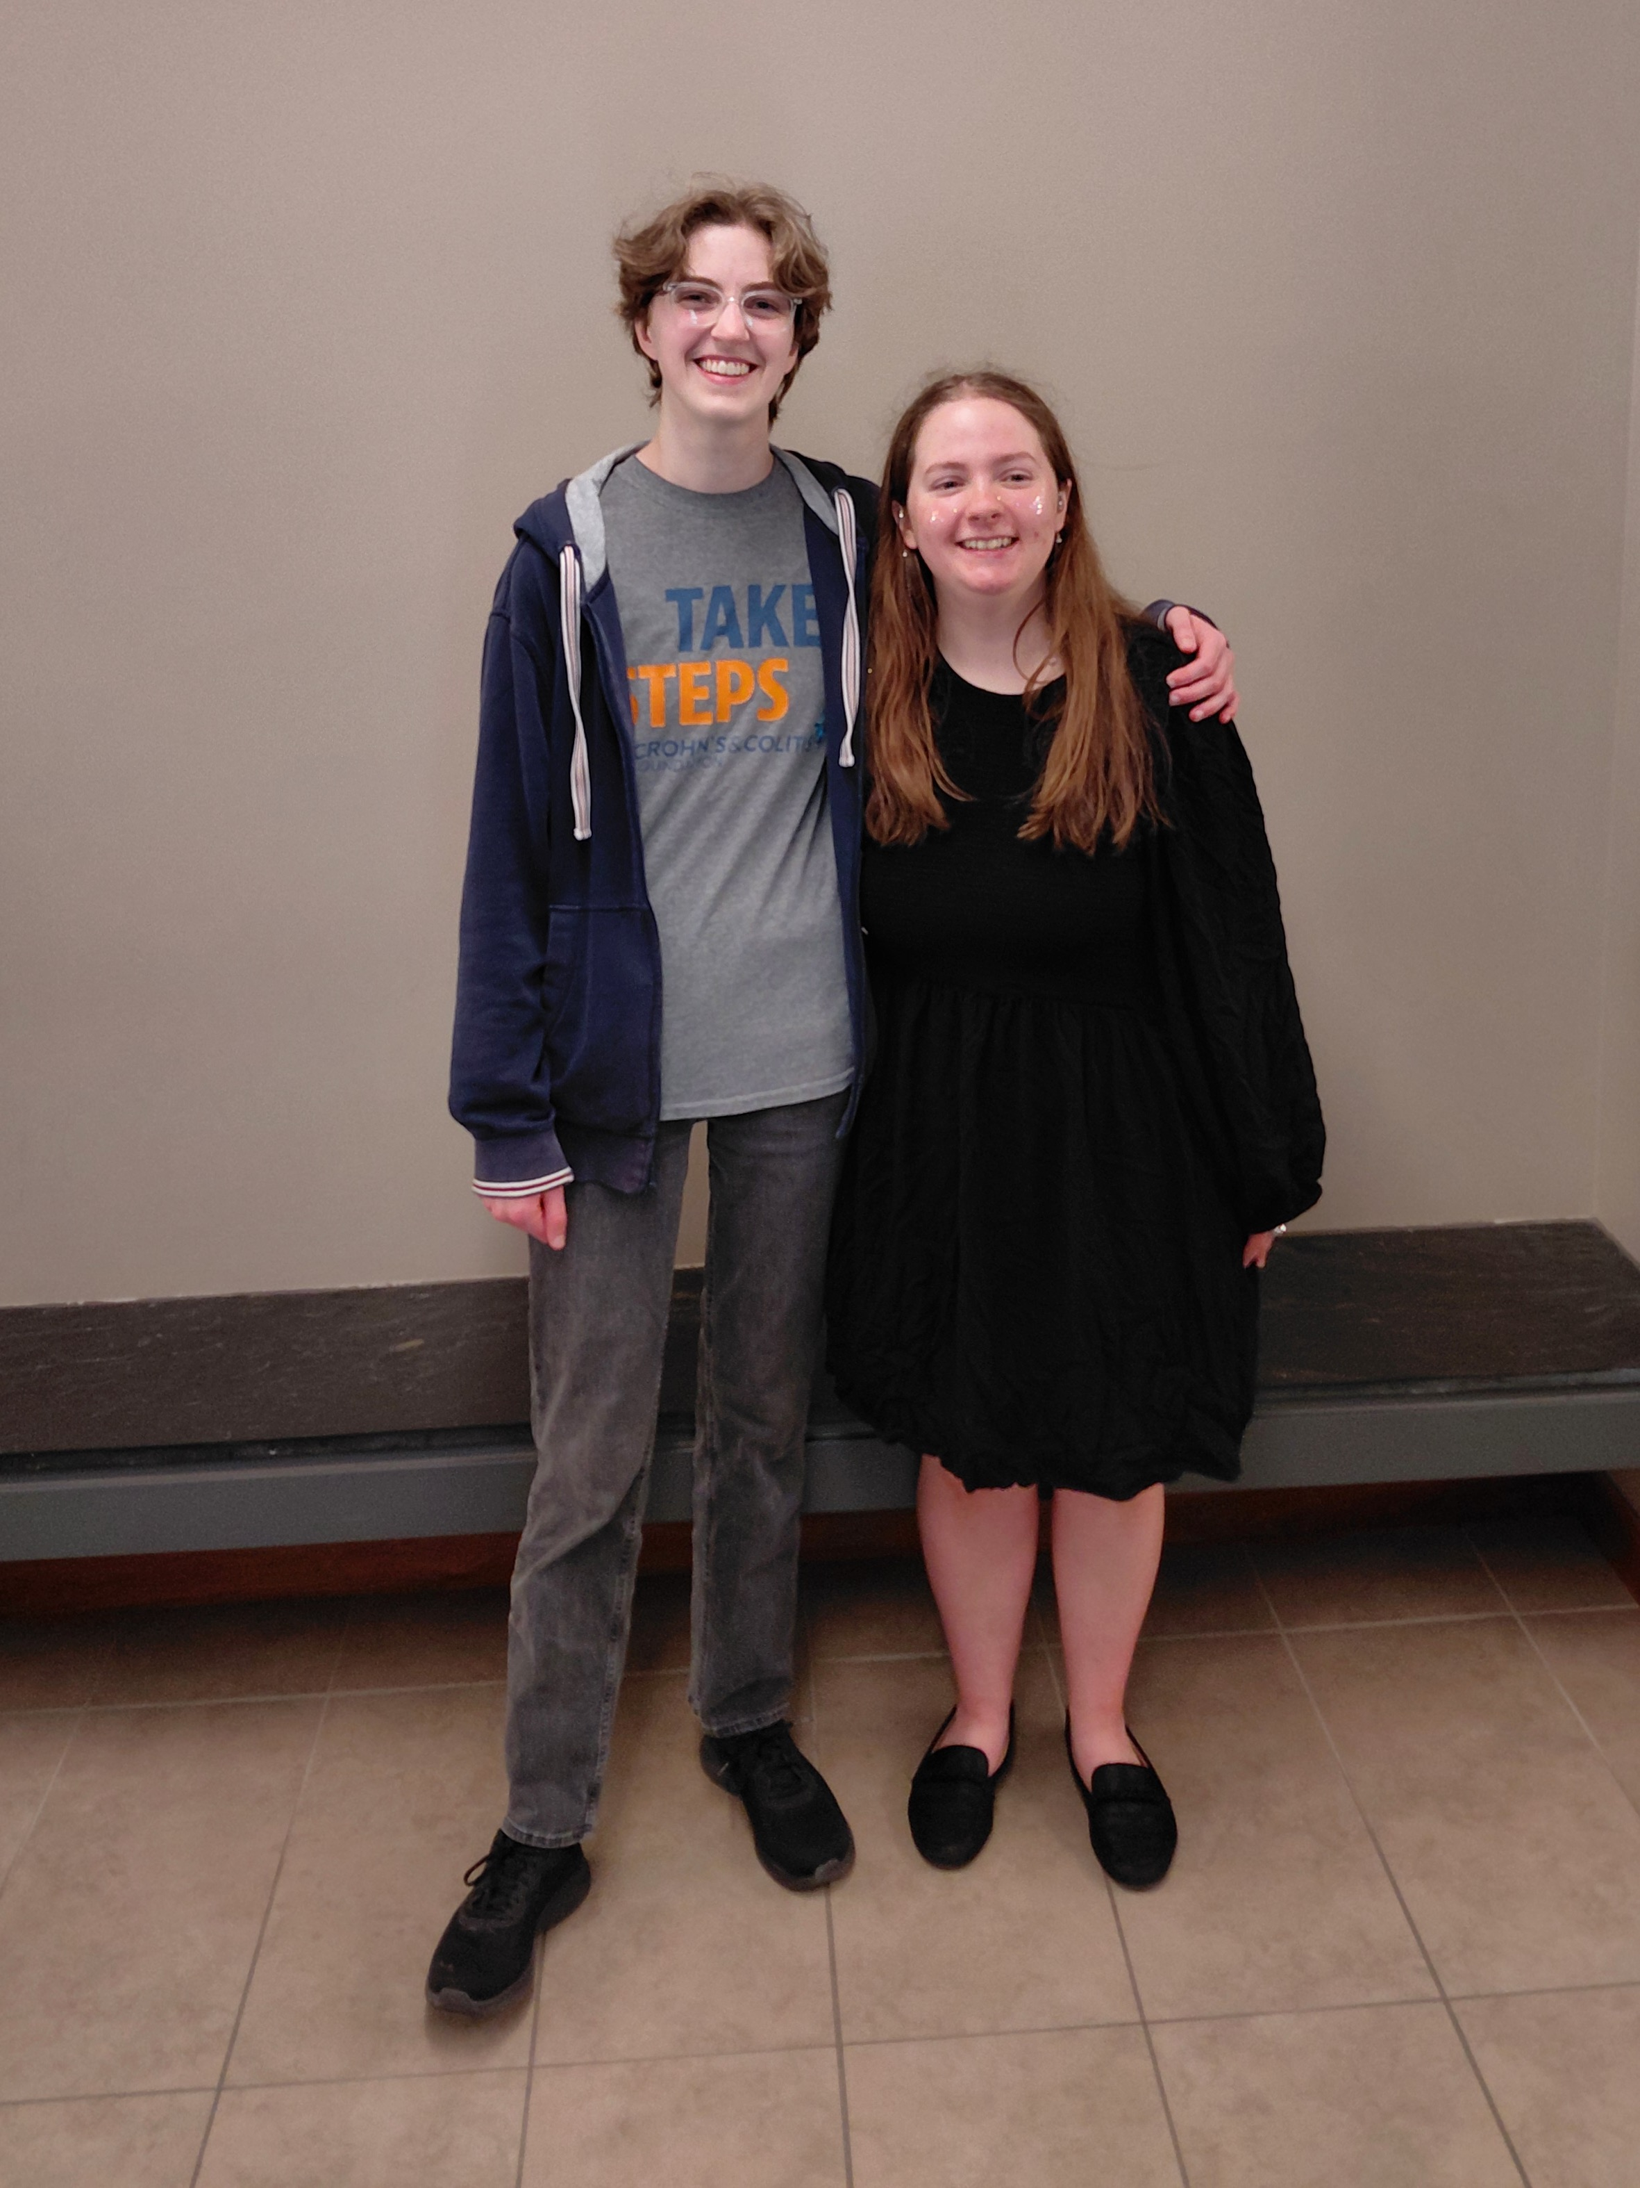
Commencement Day Reception
May 23, 2026
Tomson Hall Atrium
Pictured at left:
Rosemary Hartless & Jessica Schmidt

Slide 2
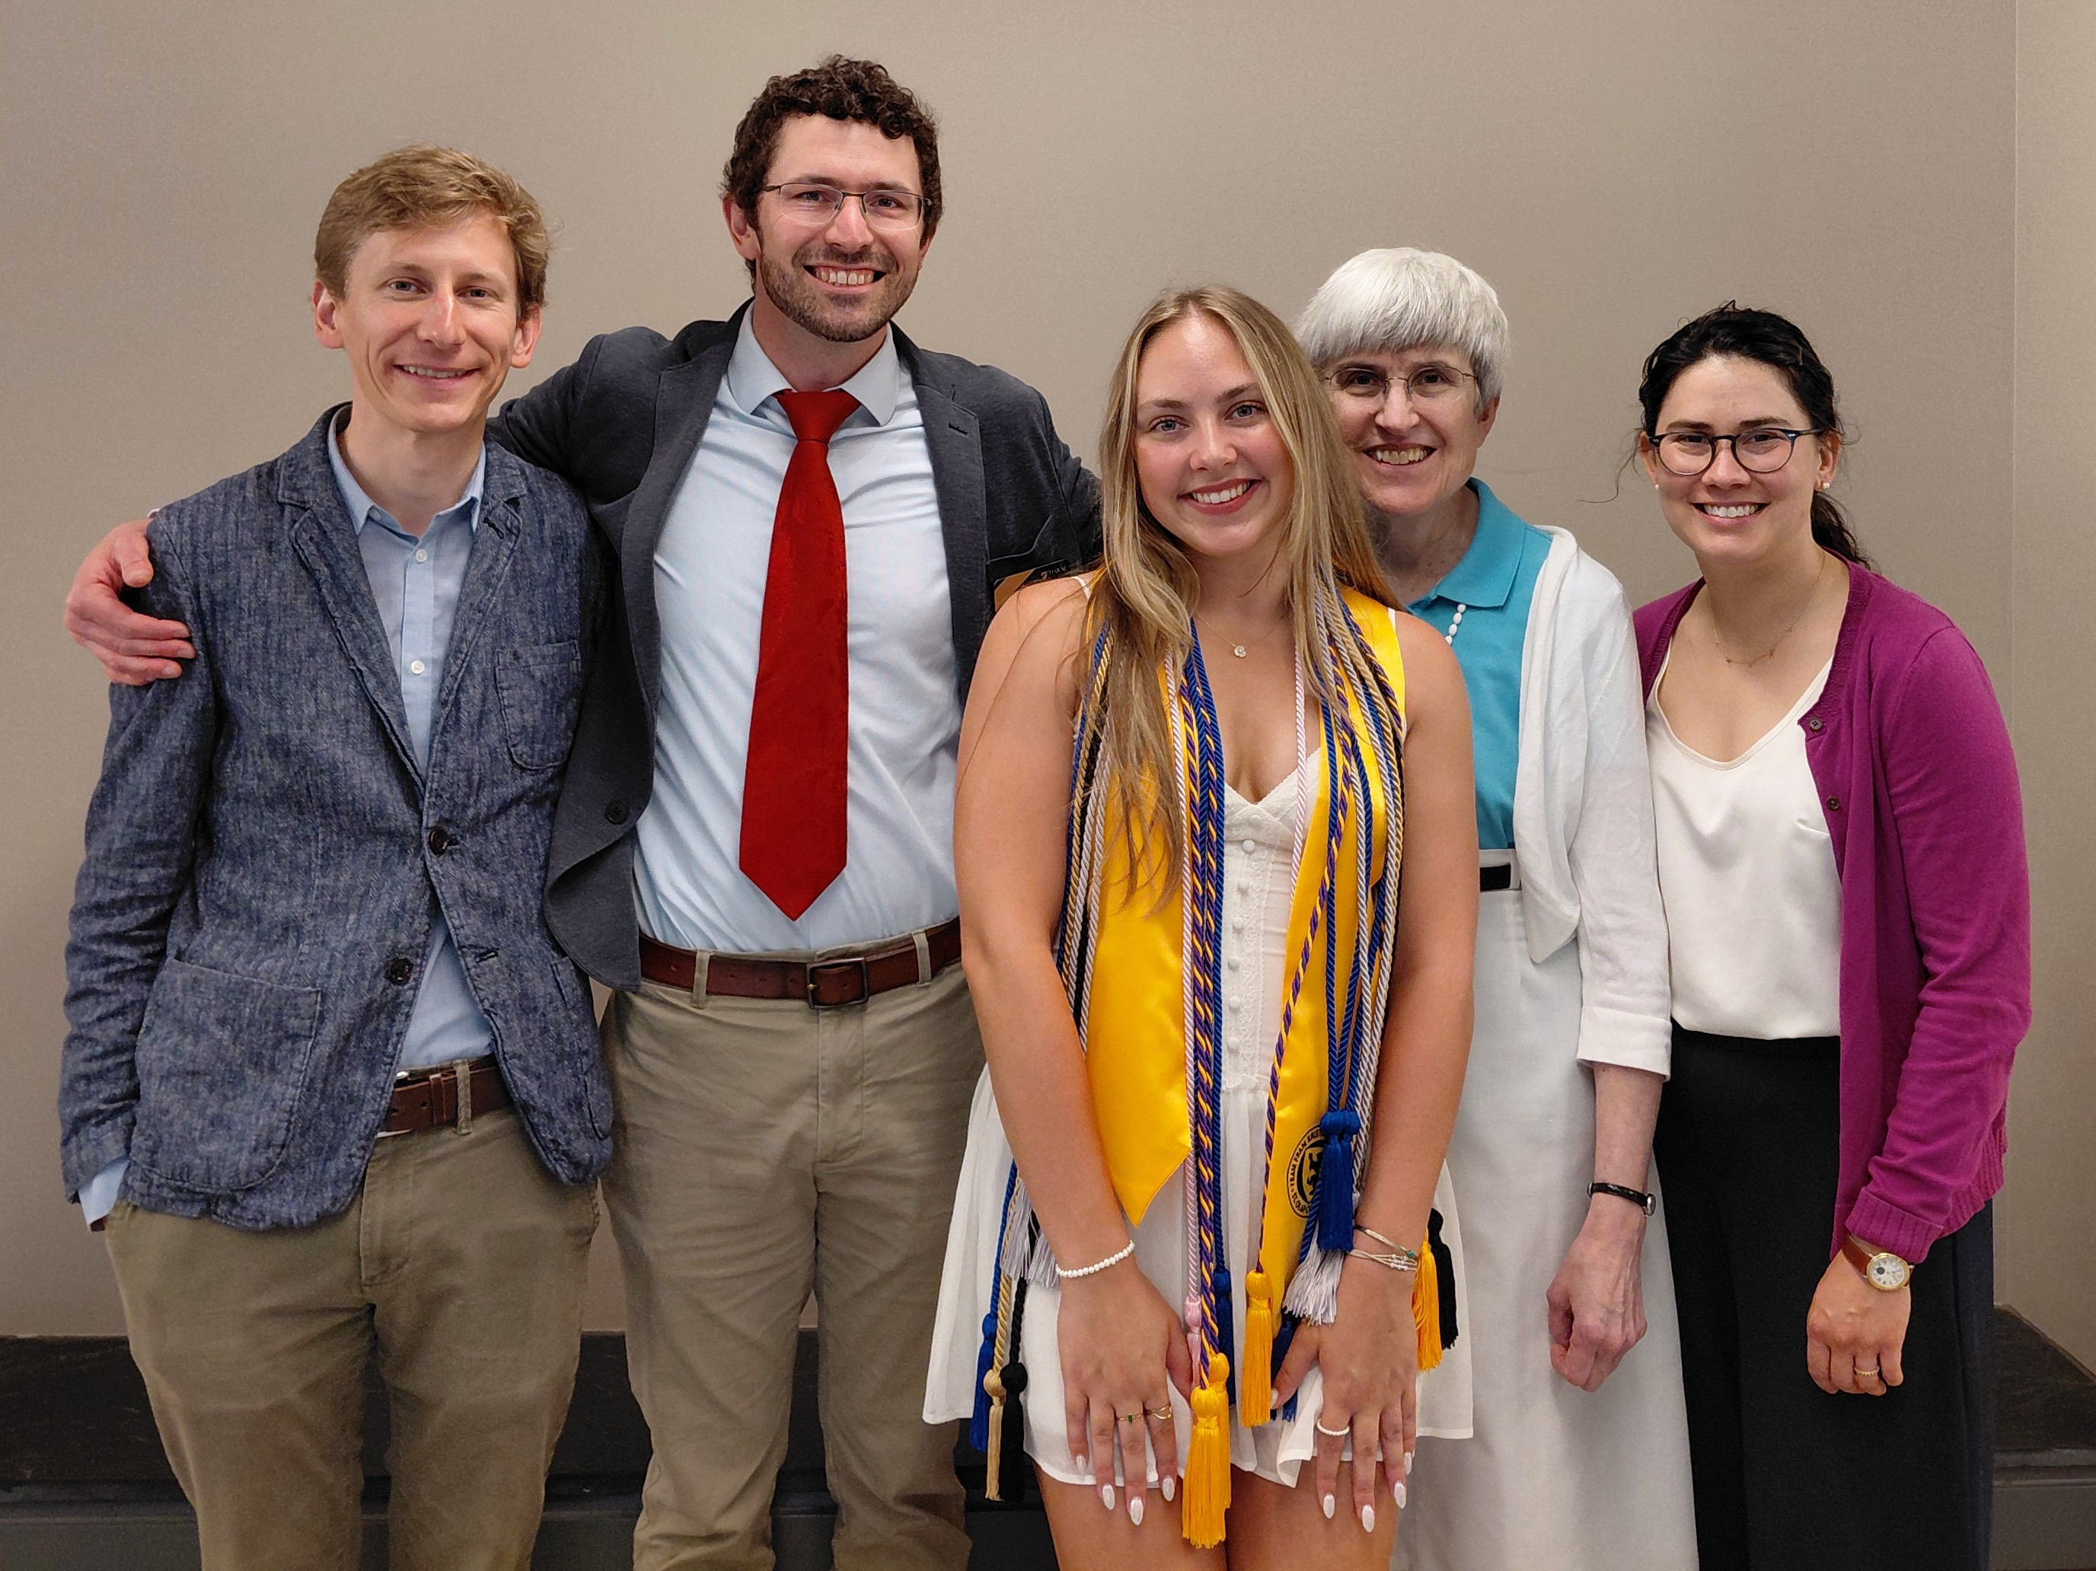
Isabella Baker (Classics major) + Profs. Moench, Helms, Groton, & Foxley

Slide 3
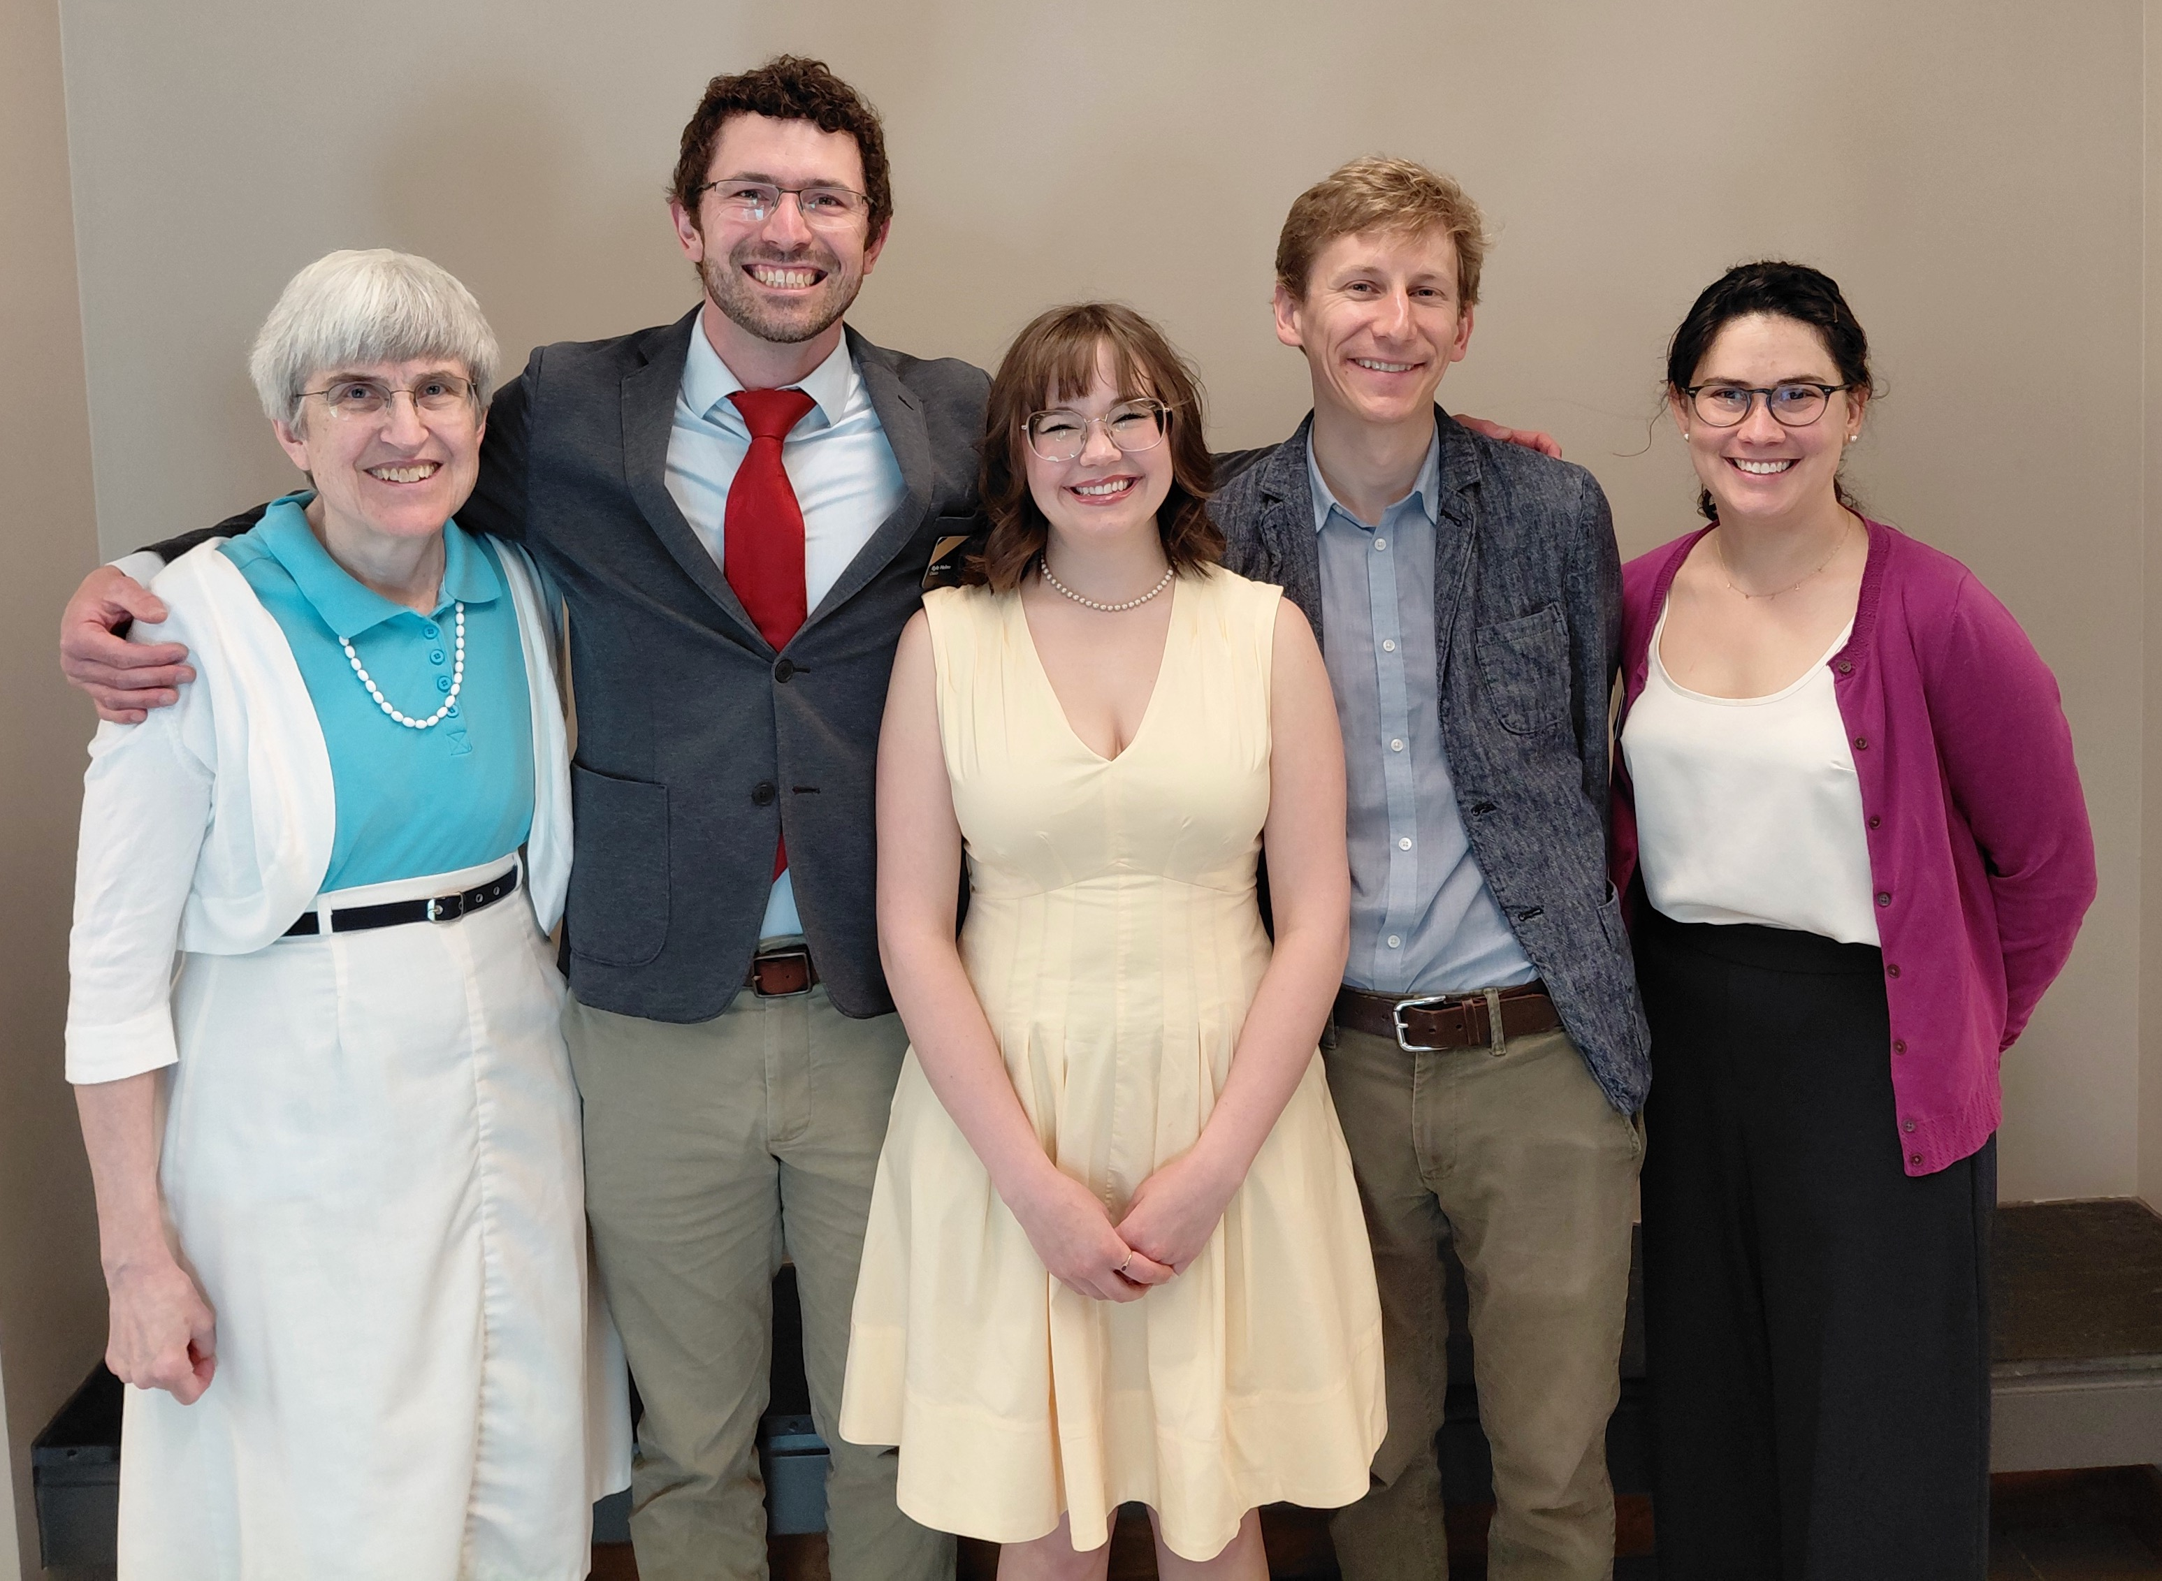
Violet Ecklund-Johnson (Latin major) + Profs. Groton, Helms,
Moench, & Foxley

Slide 4
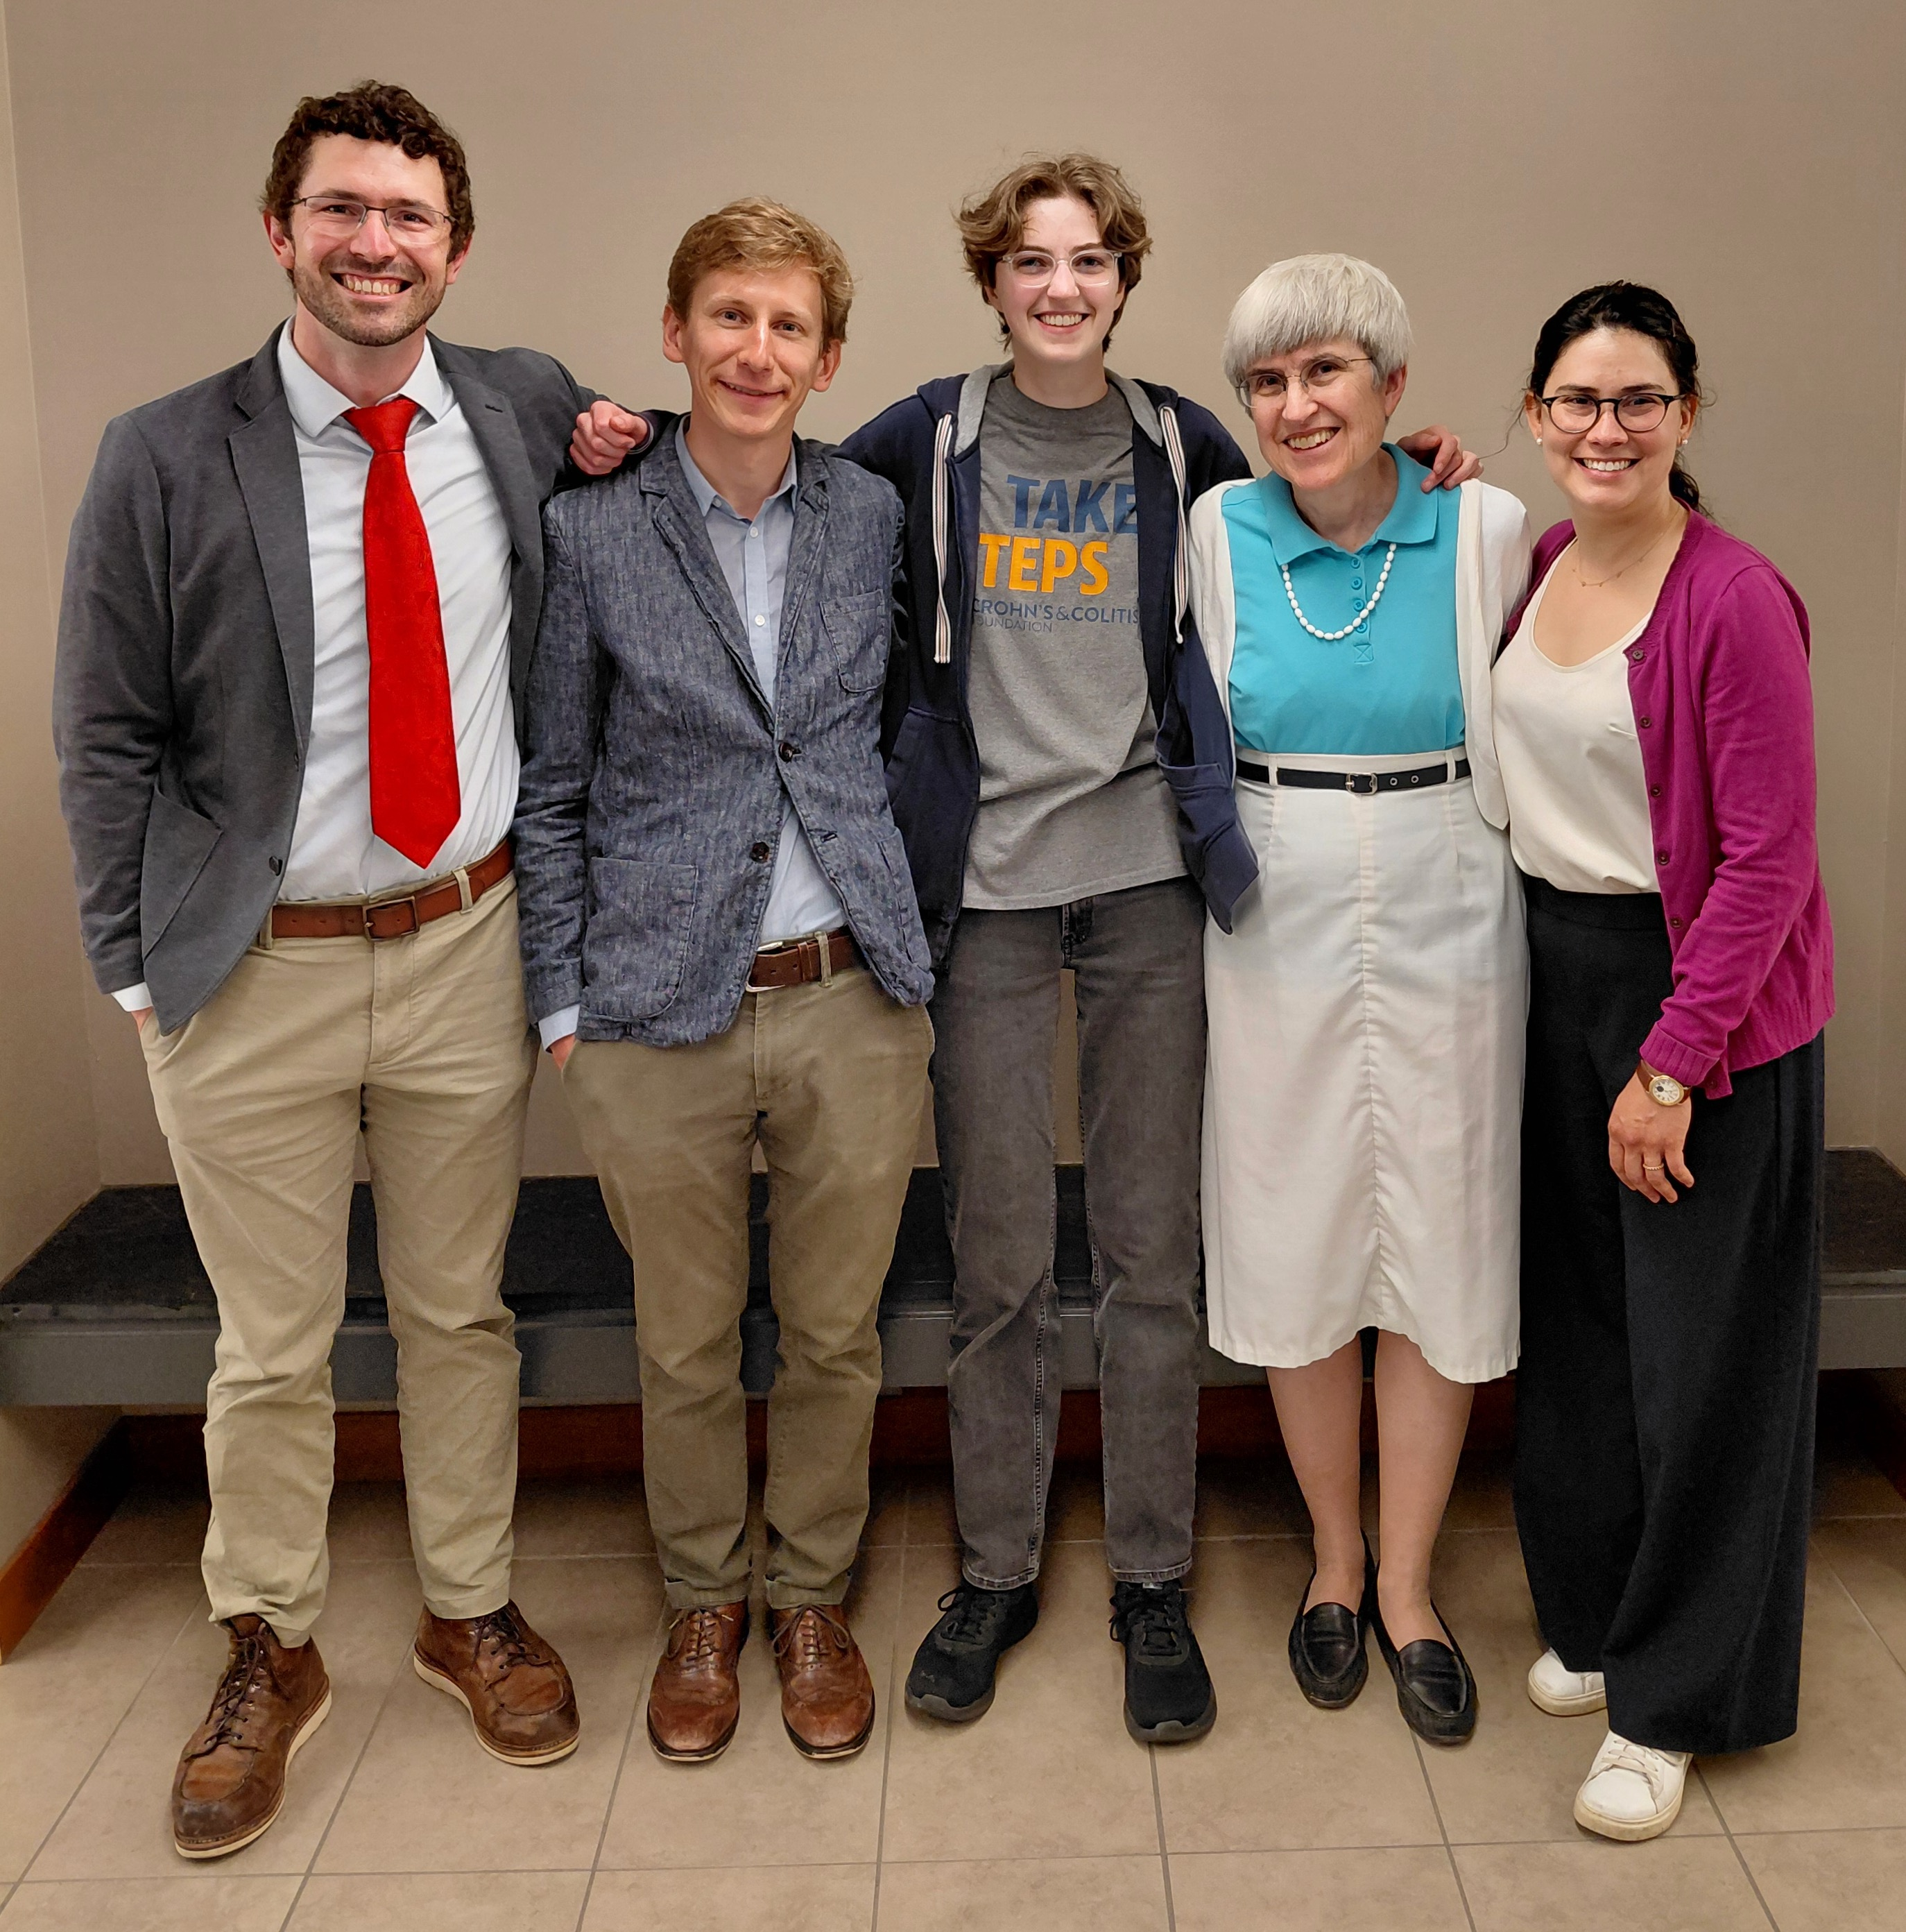
Rosemary Hartless (Latin major) + Profs. Helms, Moench, Groton, & Foxley

Slide 5
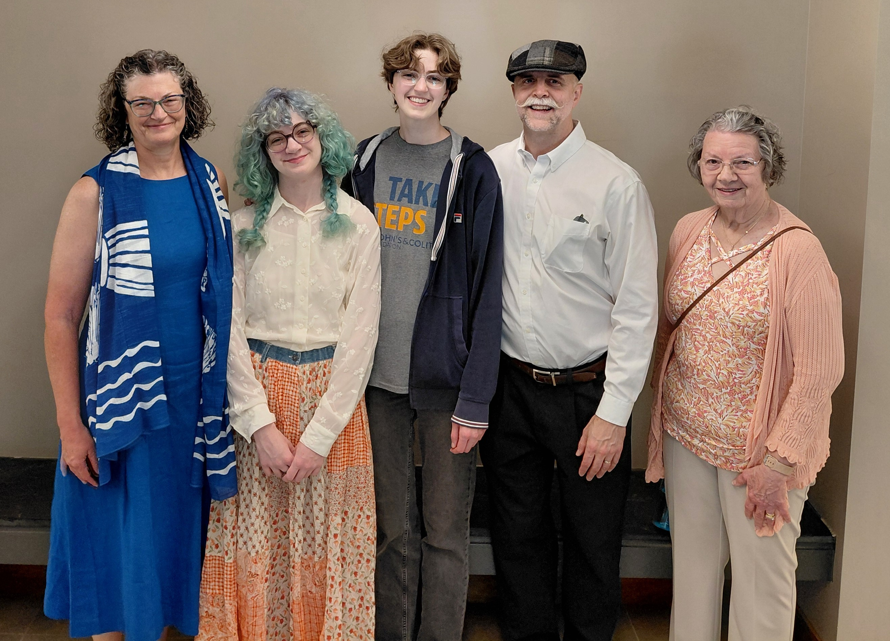
Rosemary Hartless (Latin major) + family

Slide 6
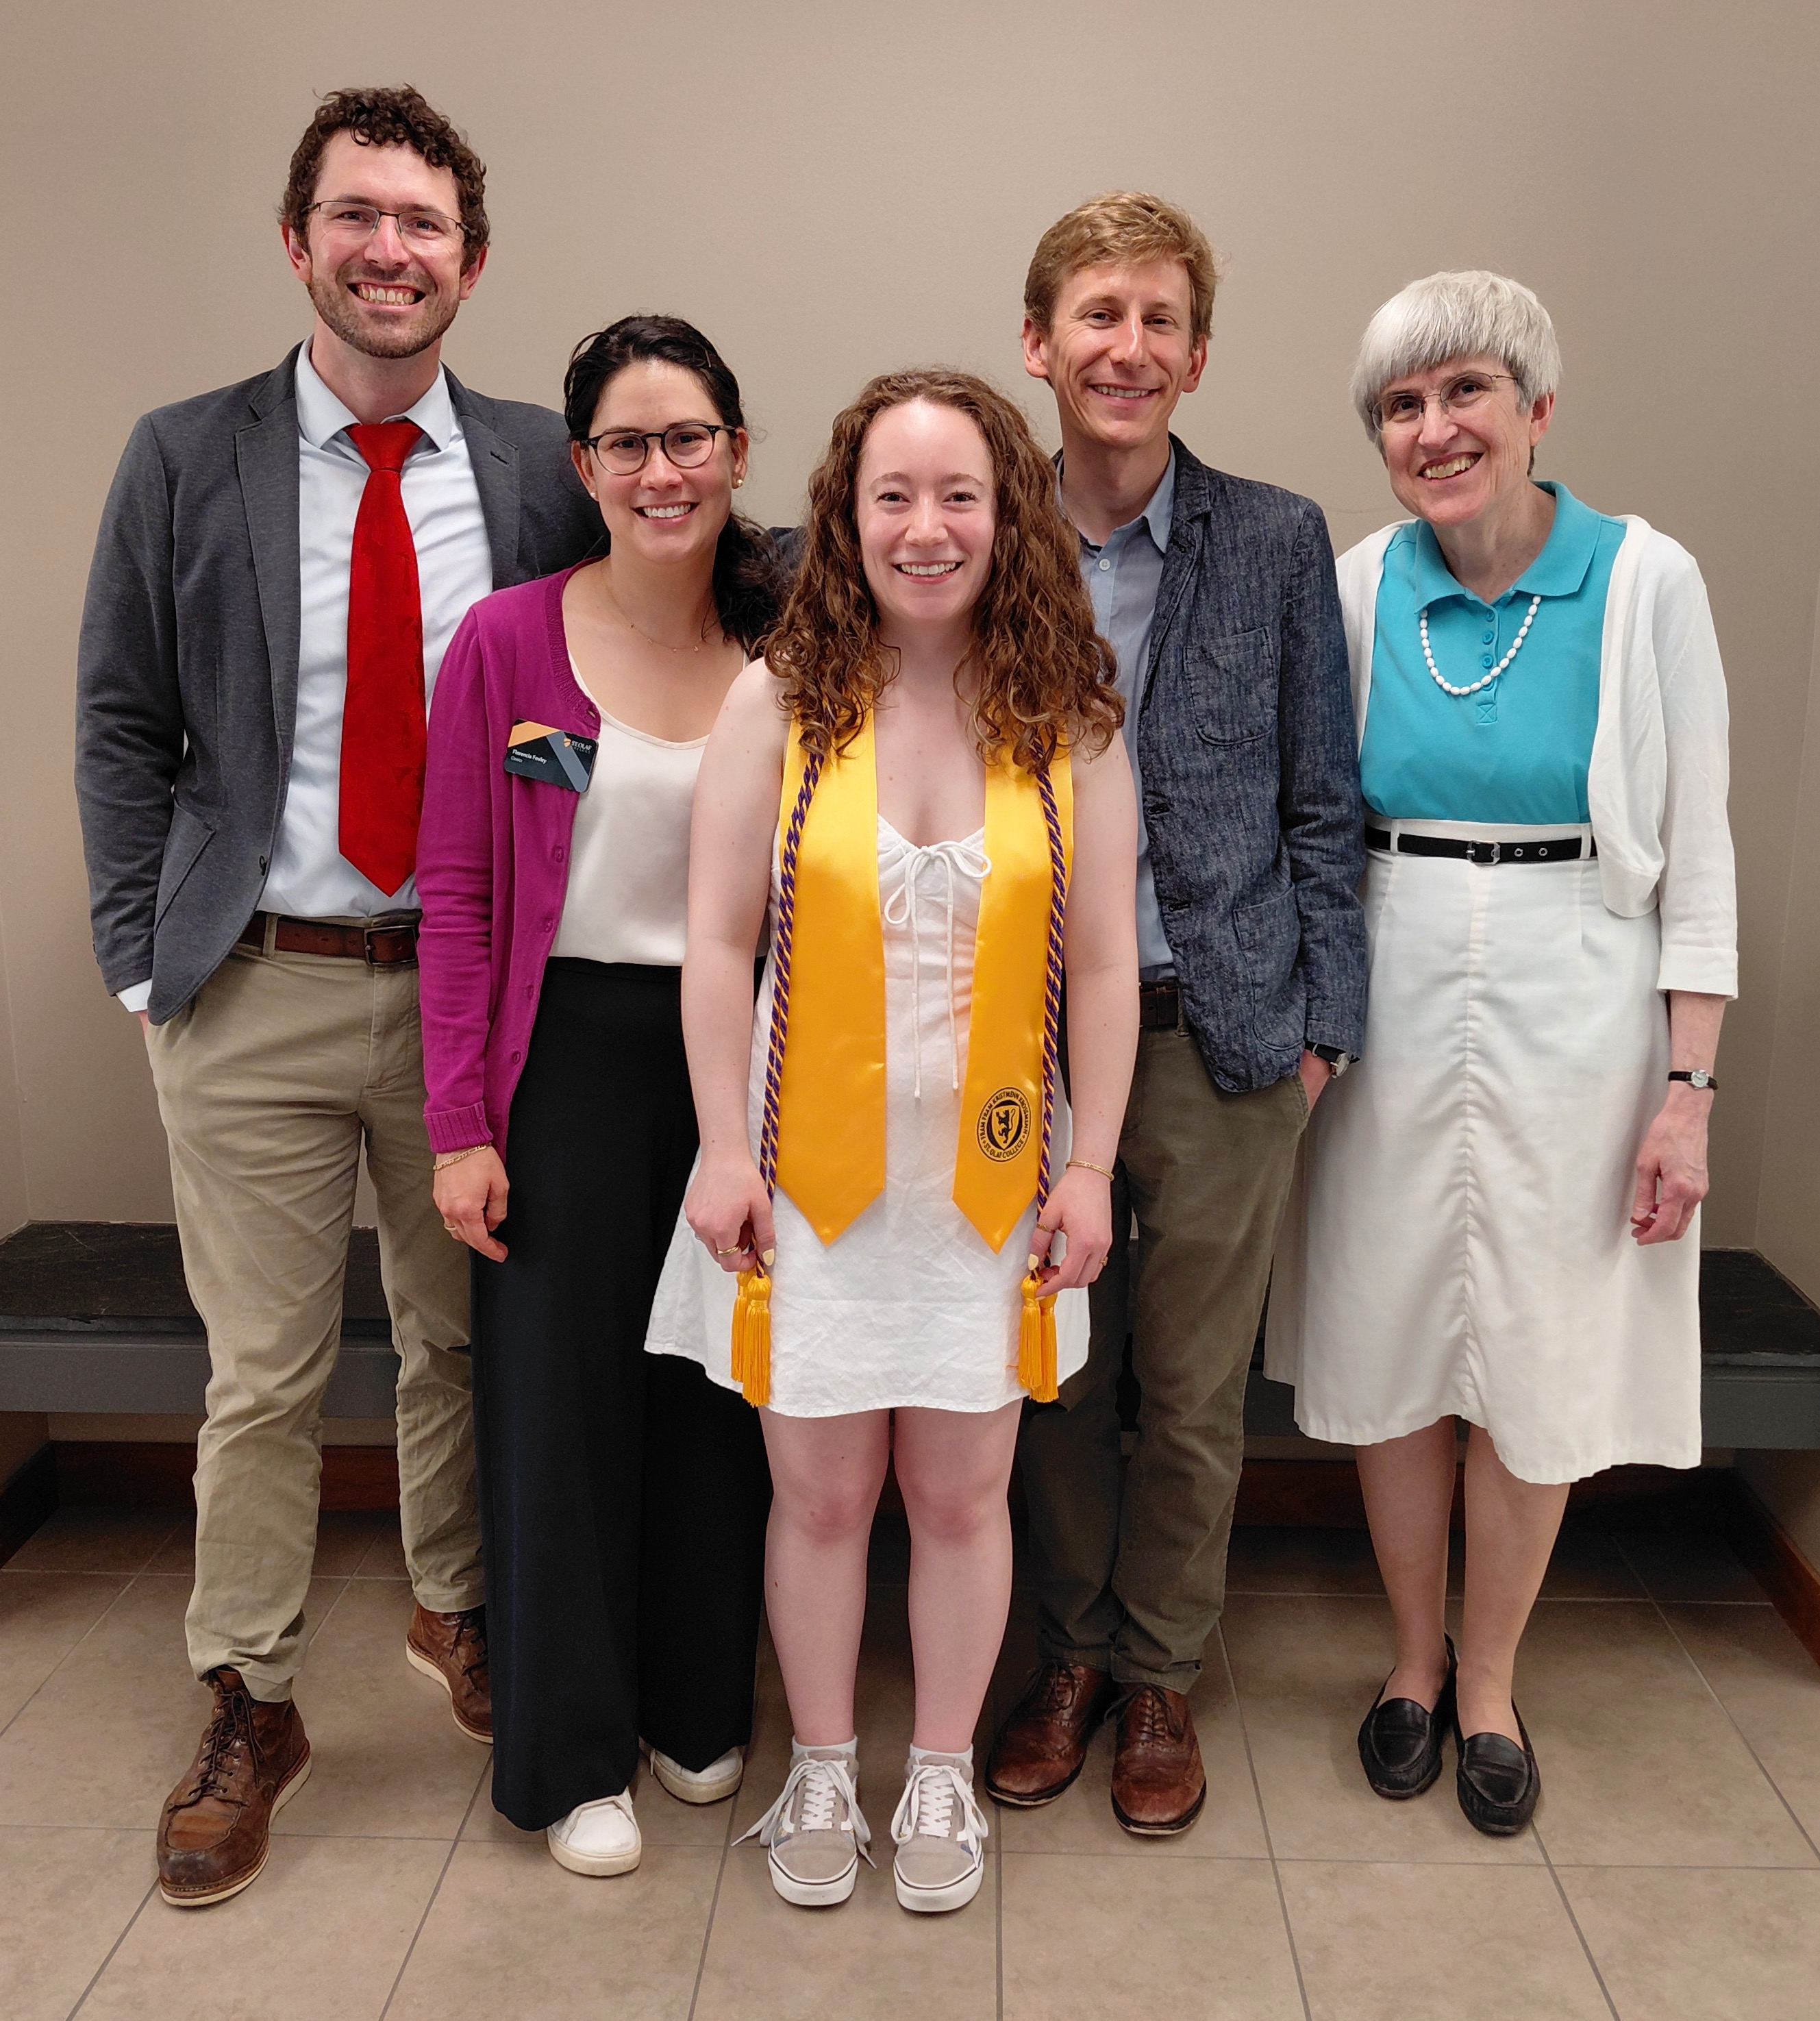
Emery Jansen (Ancient Studies major)
+ Profs. Helms, Foxley, Moench, & Groton

Slide 7
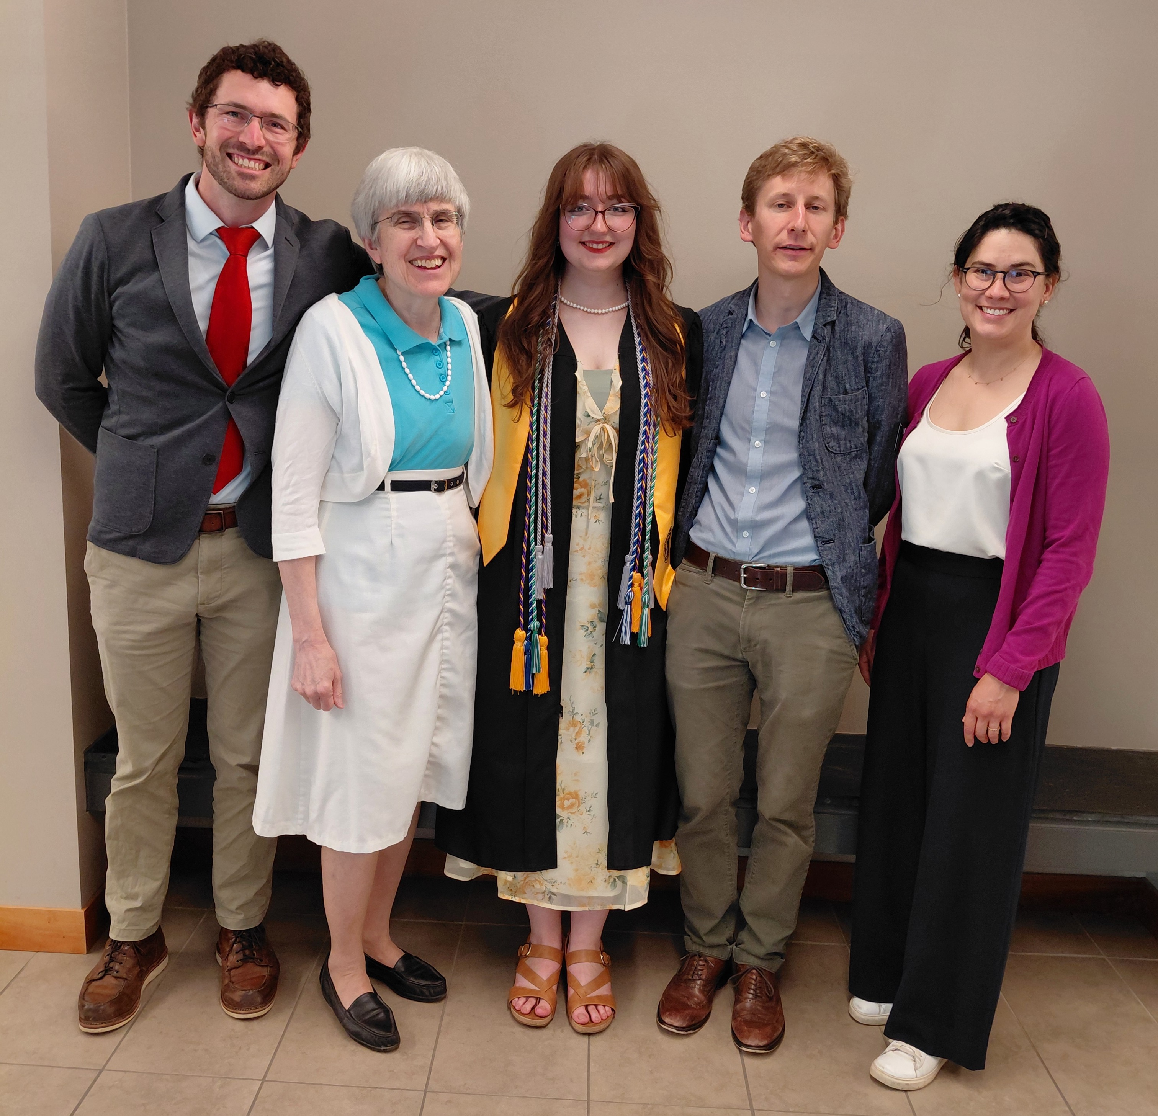
MaKenzie Kuckkan (Classics major)
+ Profs. Helms, Groton, Moench, & Foxley

Slide 8
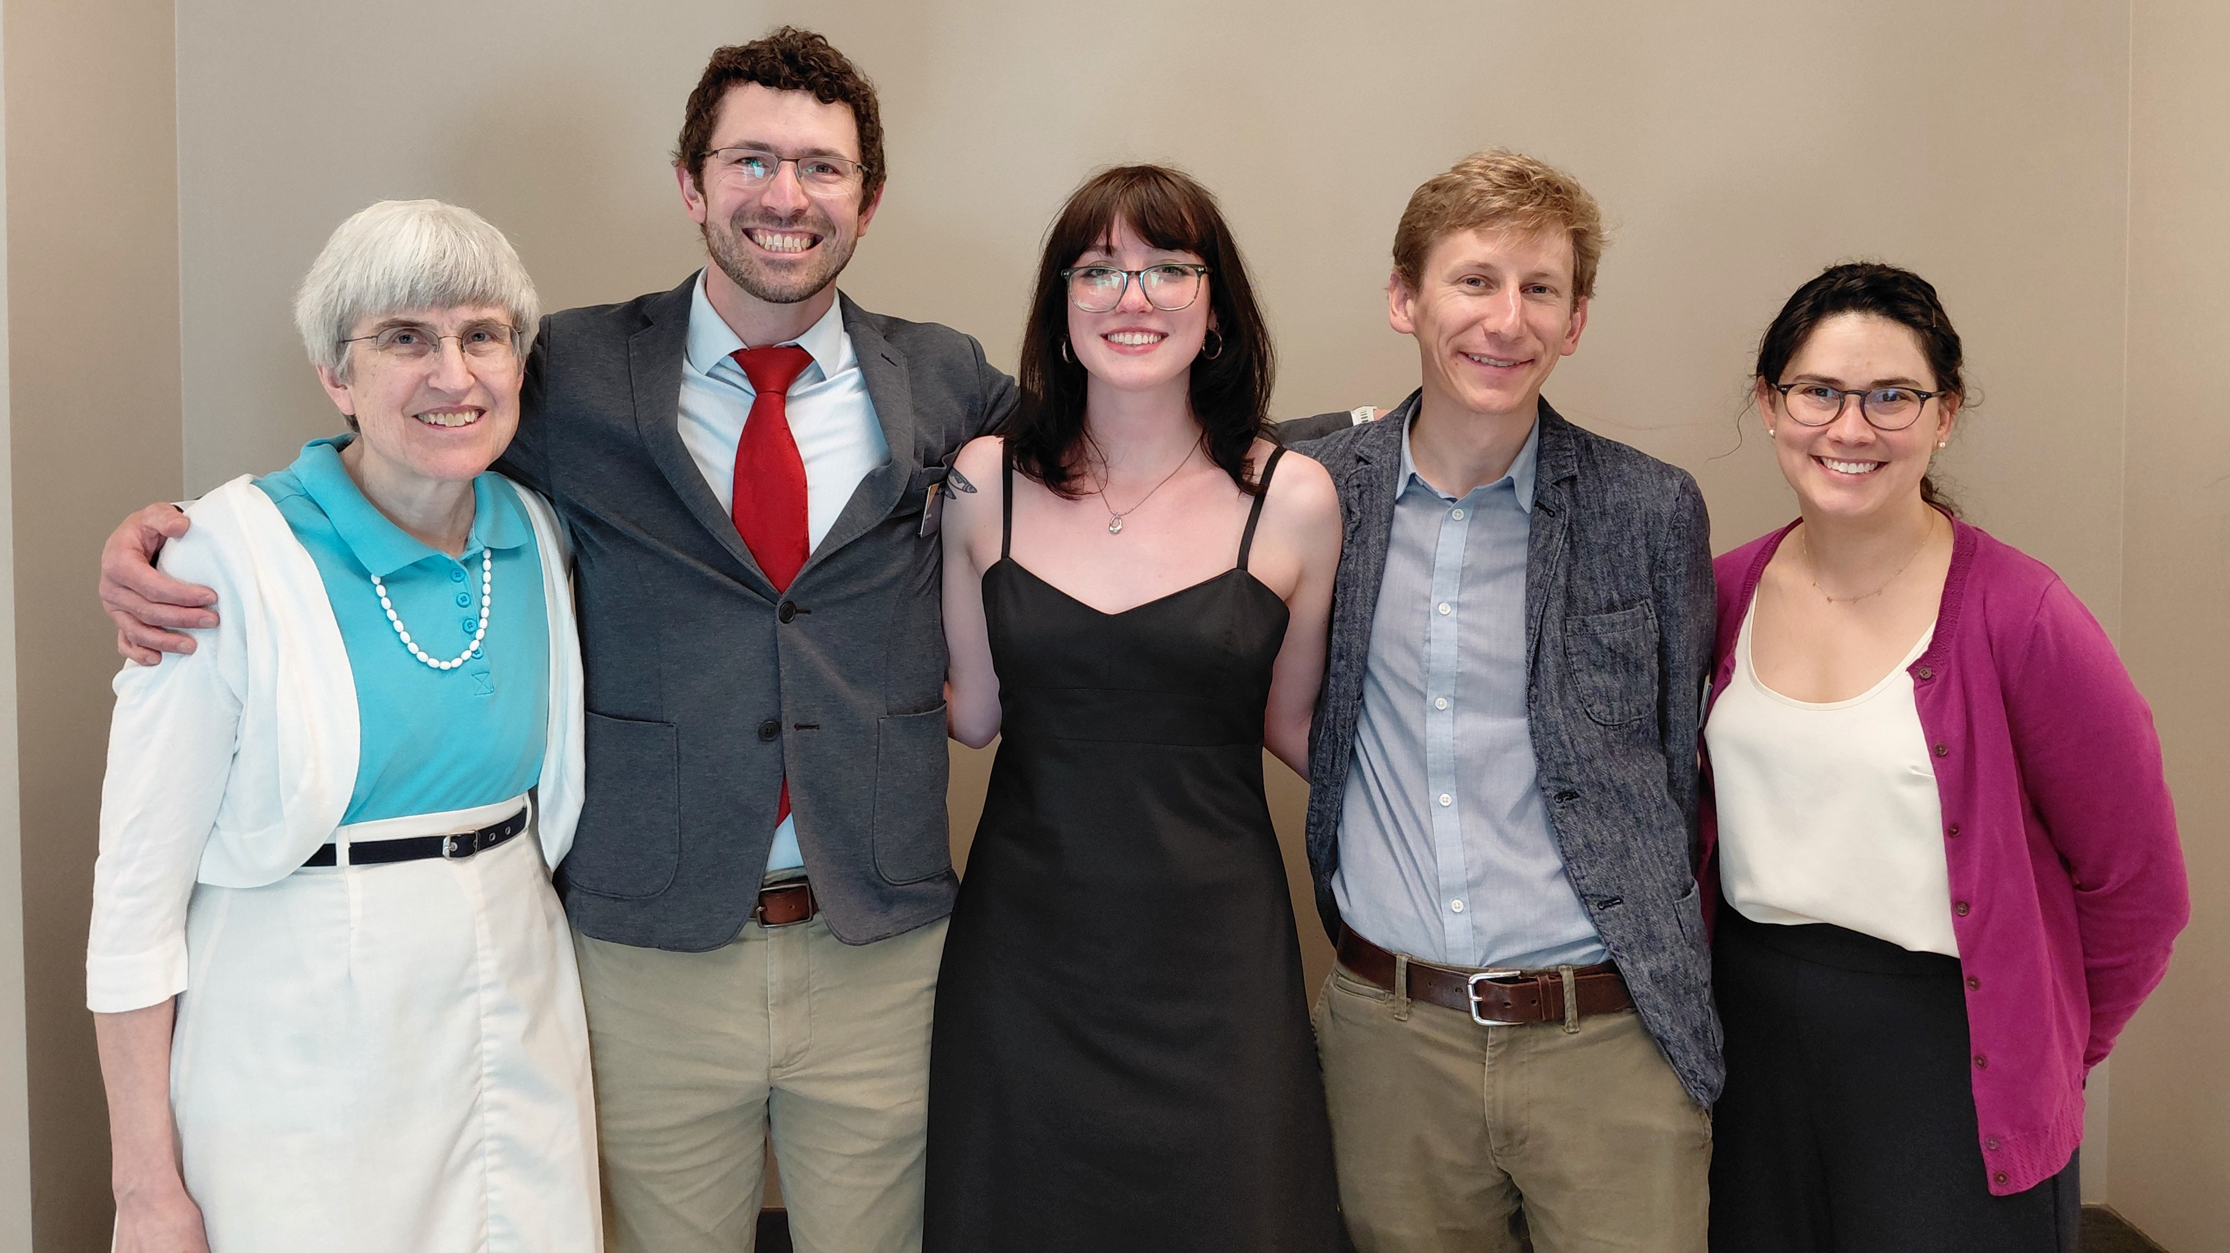
Grace Lindquist (Classics major) + Profs. Groton, Helms, Moench, & Foxley

Slide 9
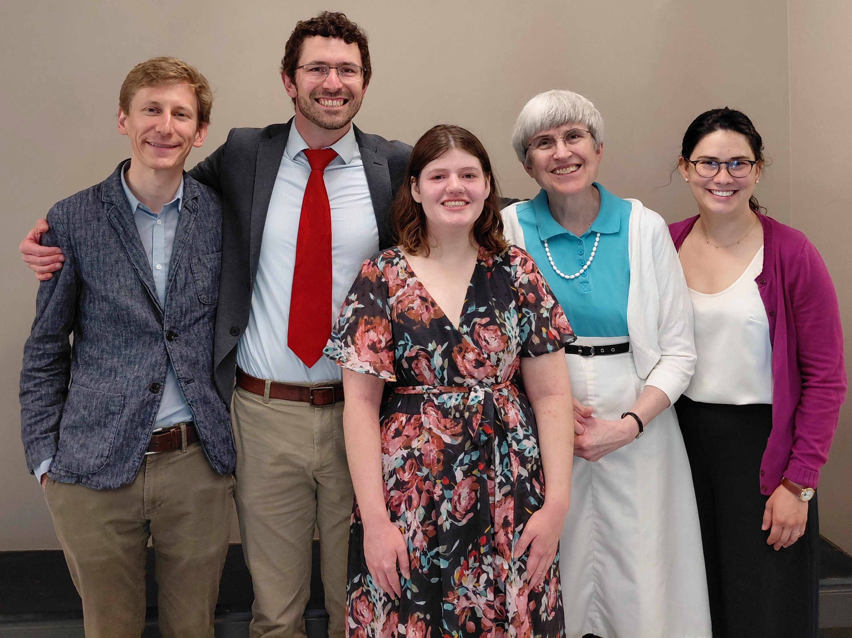
Elsie Olmstead (Classics major) + Profs. Moench, Helms, Groton, & Foxley

Slide 10
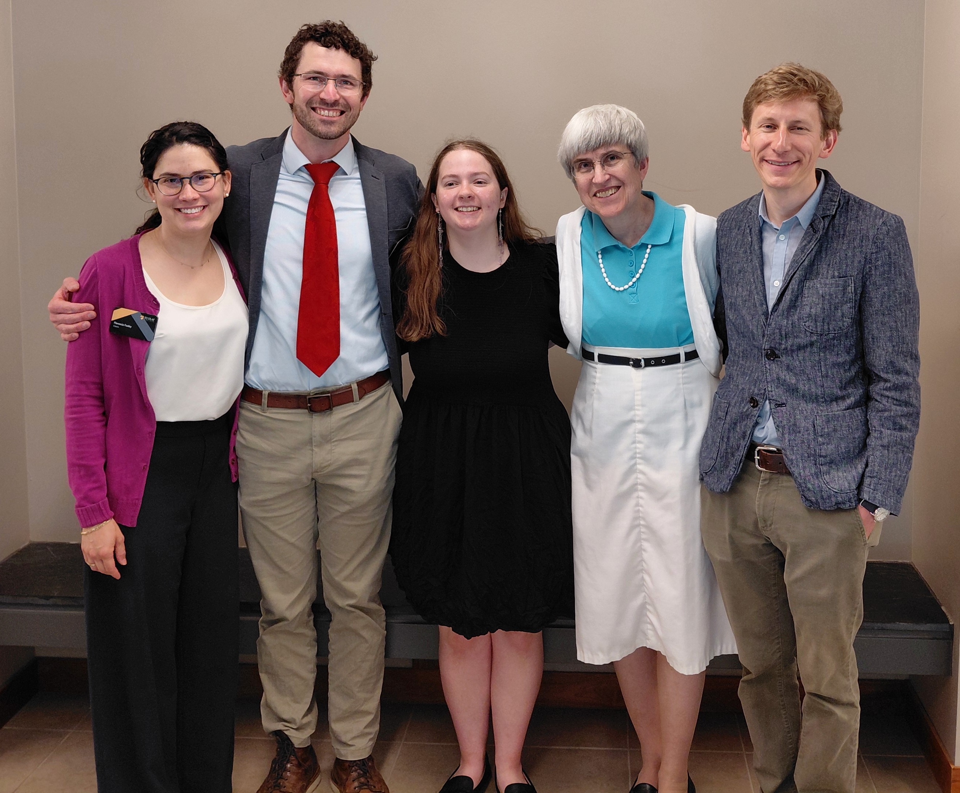
Jessica Schmidt (Eta Sigma Phi member) + Profs. Foxley, Helms, Groton, & Moench

Slide 11
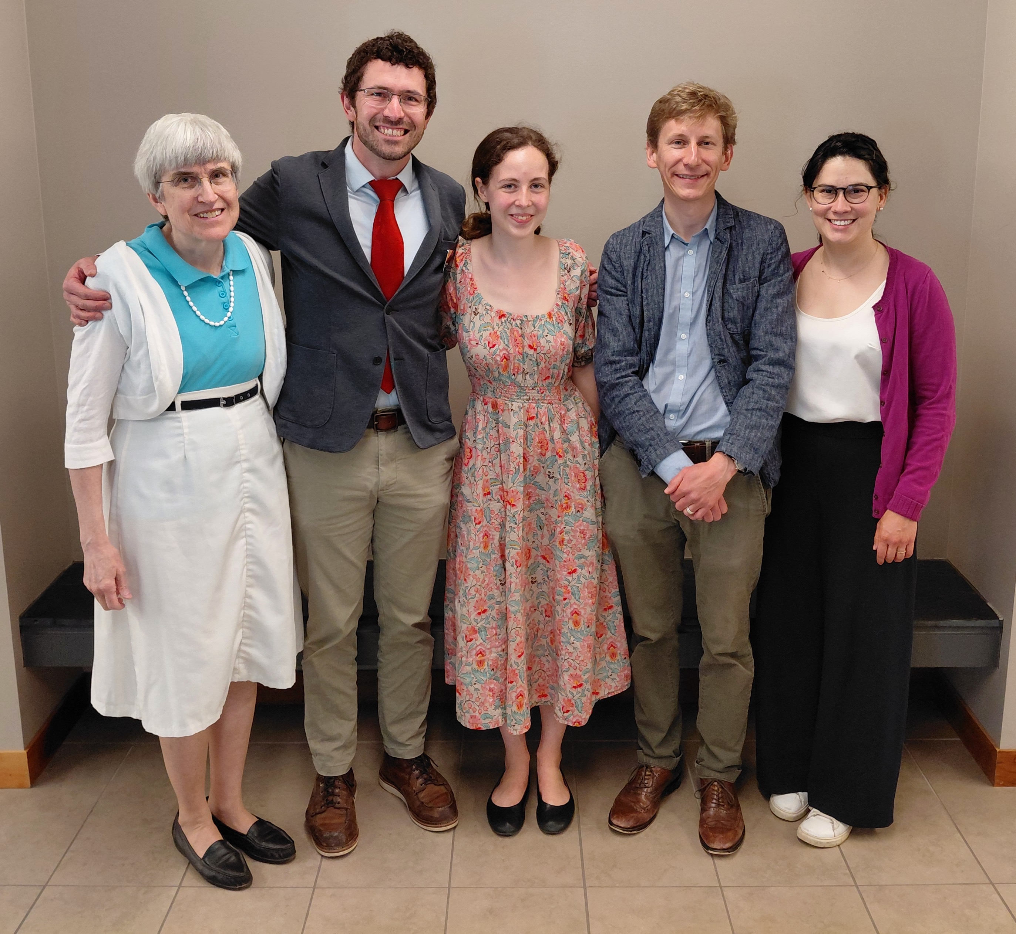
Emma Woodruff (Classics major) + Profs. Groton, Helms, Moench, & Foxley

Slide 12
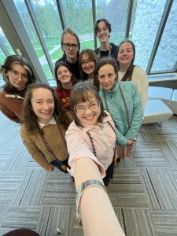
Senior Majors – May, 6, 2026

