Slide 1
Eta Sigma Phi Bacchanalia
May 14, 2016
Home of Steve & Rhonda Reece

Slide 2
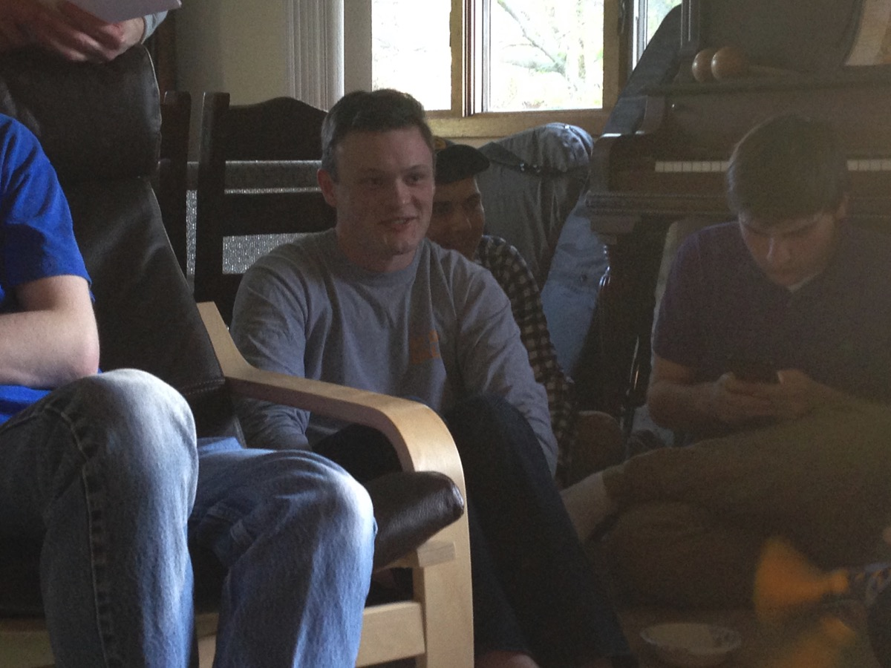
This is no time to be texting: the cording is about to begin!

Slide 3
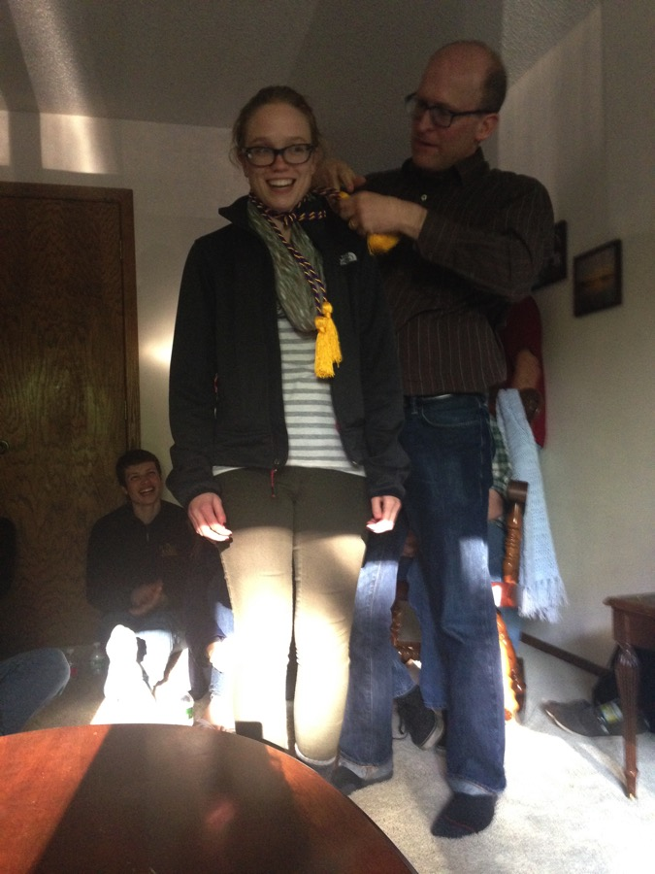
Kaitlan Bender

Slide 4
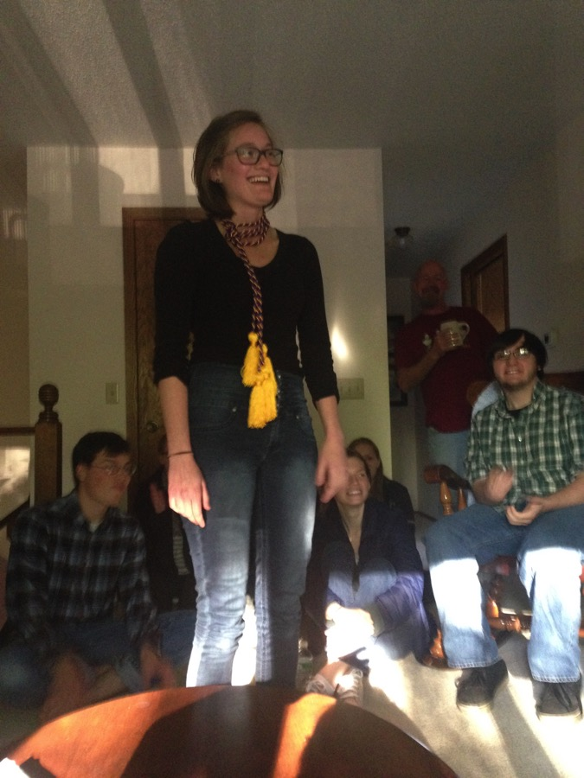
Taylor DeNaples

Slide 5
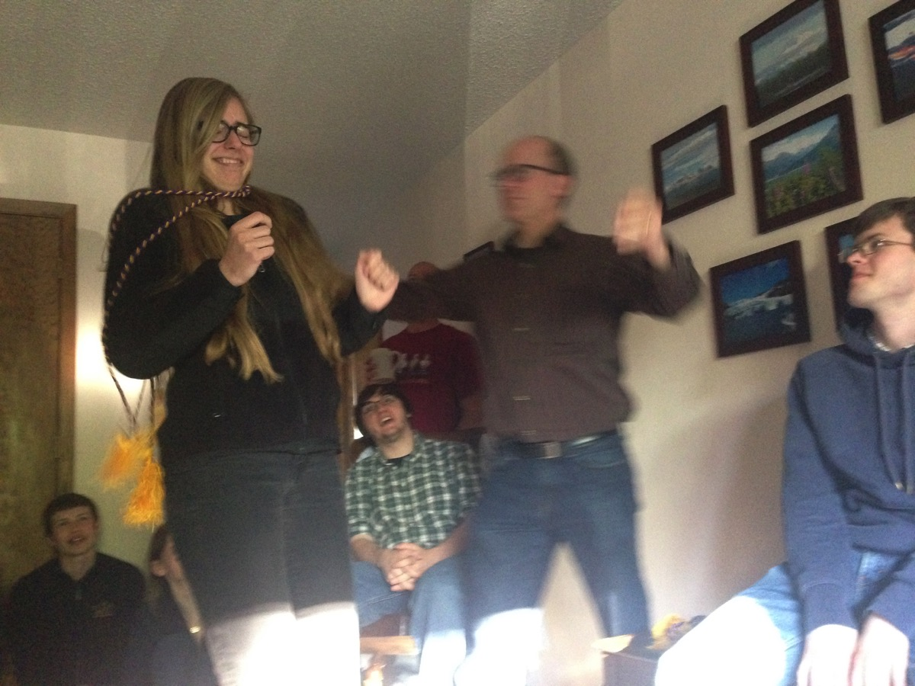
Emily Een

Slide 6
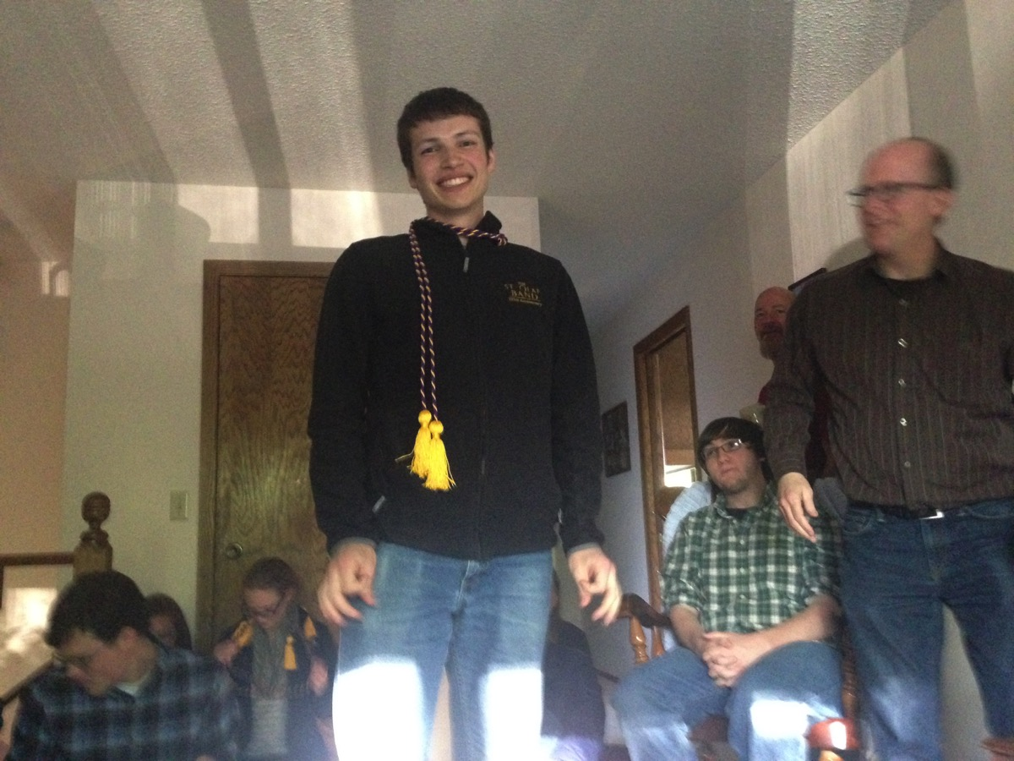
Daniel Hickox-Young

Slide 7
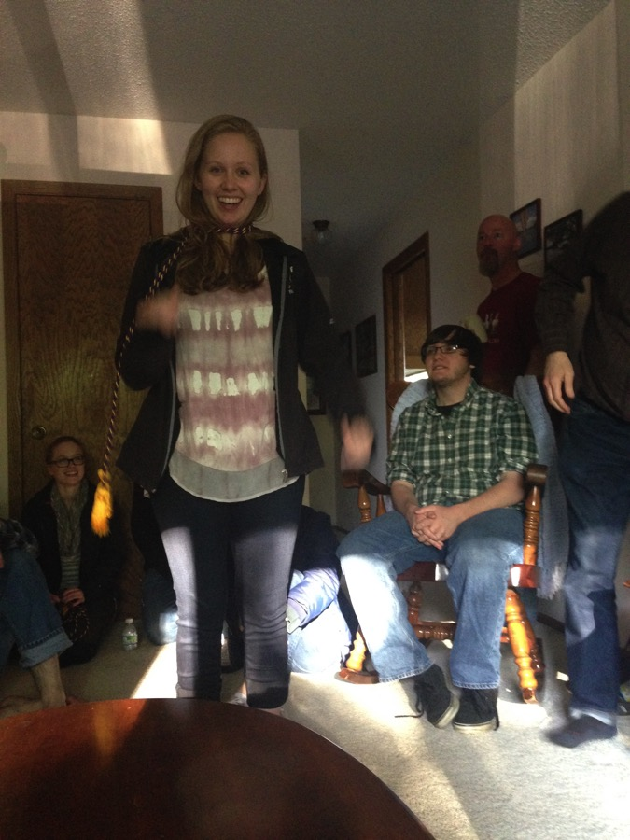
Emily Johnson

Slide 8
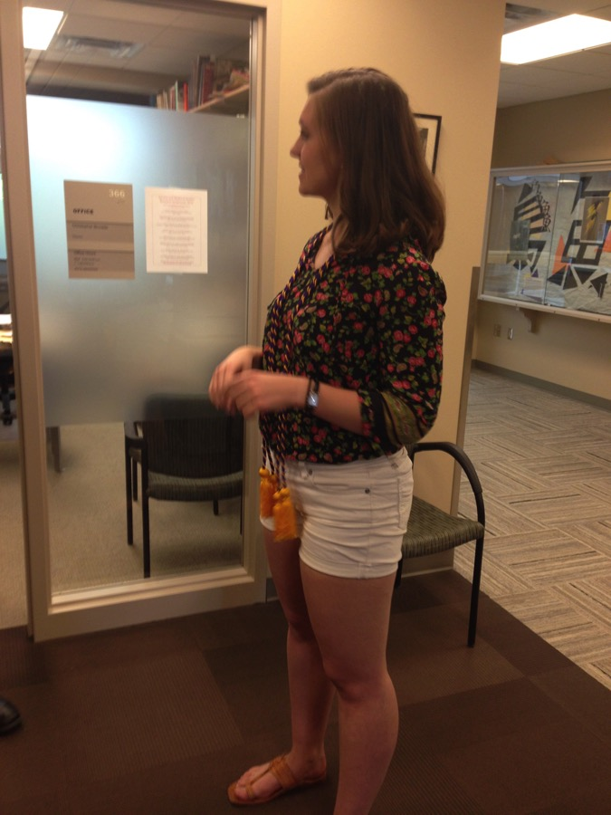
Vera Lochtefeld

Slide 9
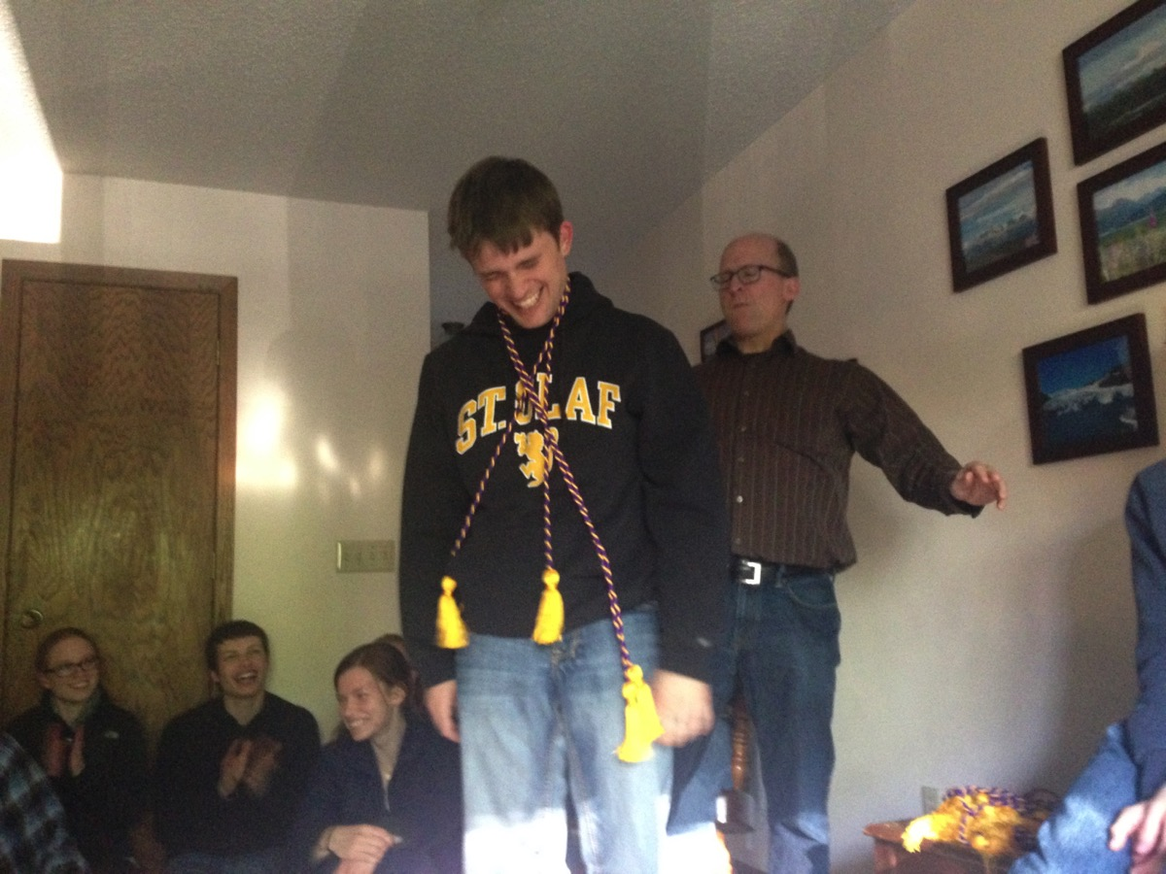
Ryan Mathison

Slide 10
Leif McLellan

Slide 11
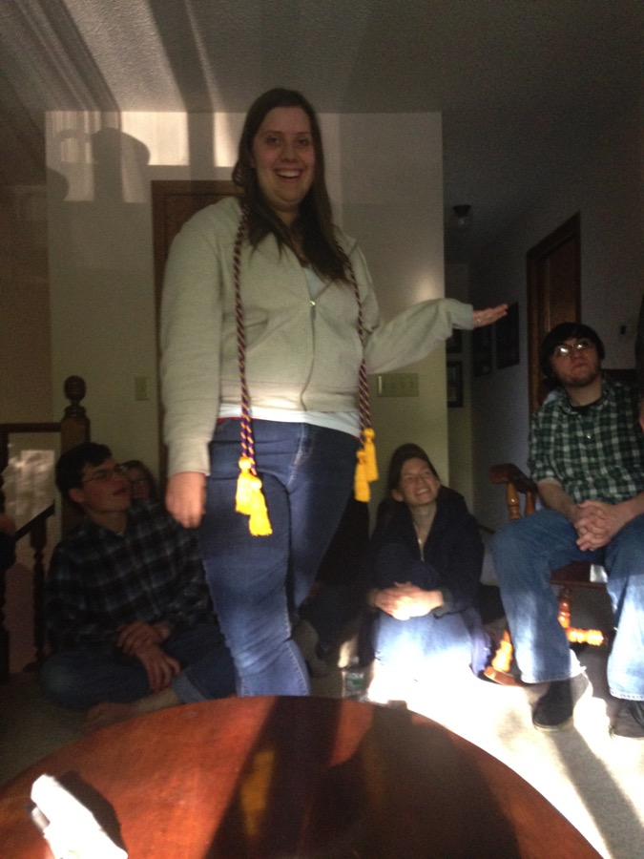
Becky Redelfs

Slide 12
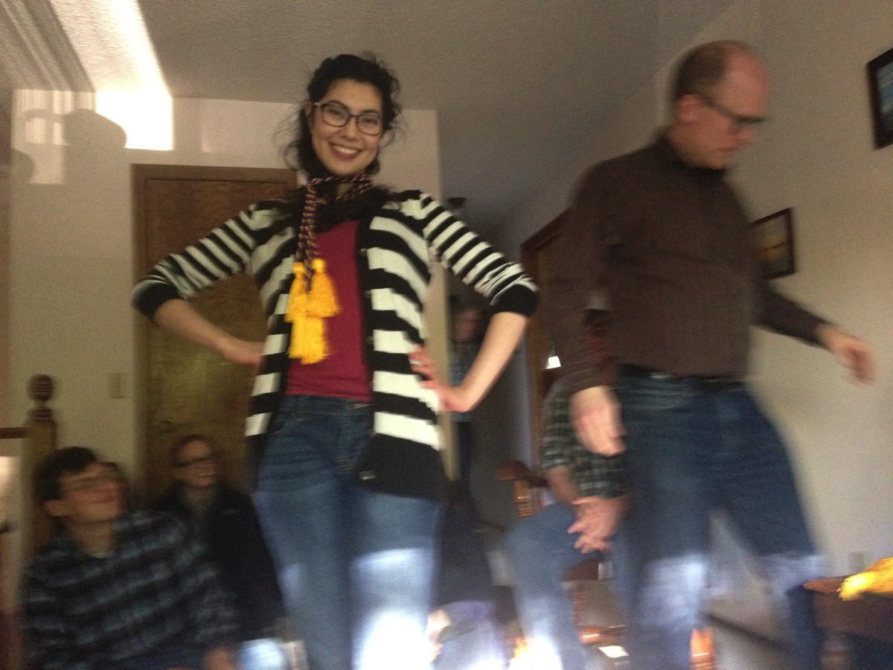
Vivian Williams

Slide 13
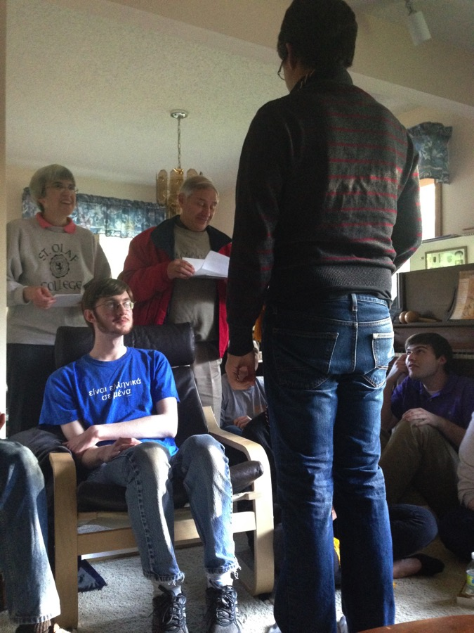
Translation awards

Slide 14
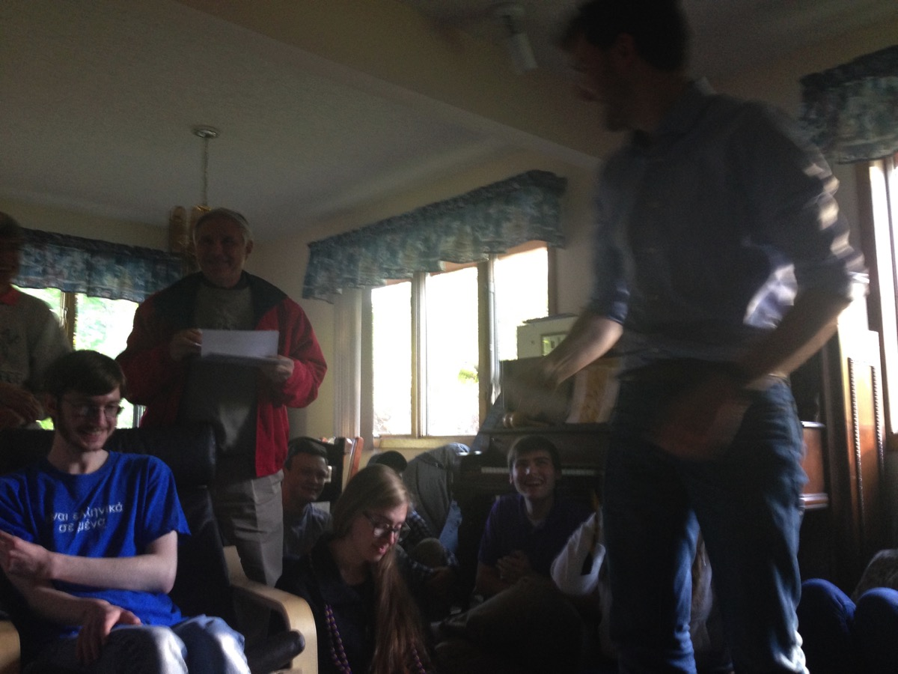
Another winner

Slide 15
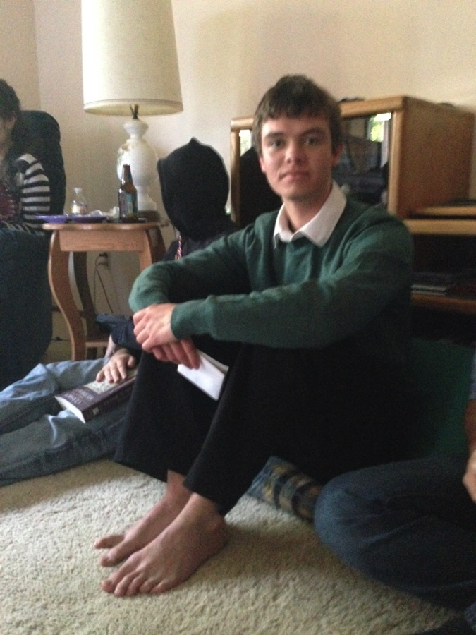
Joseph Burkhart

Slide 16
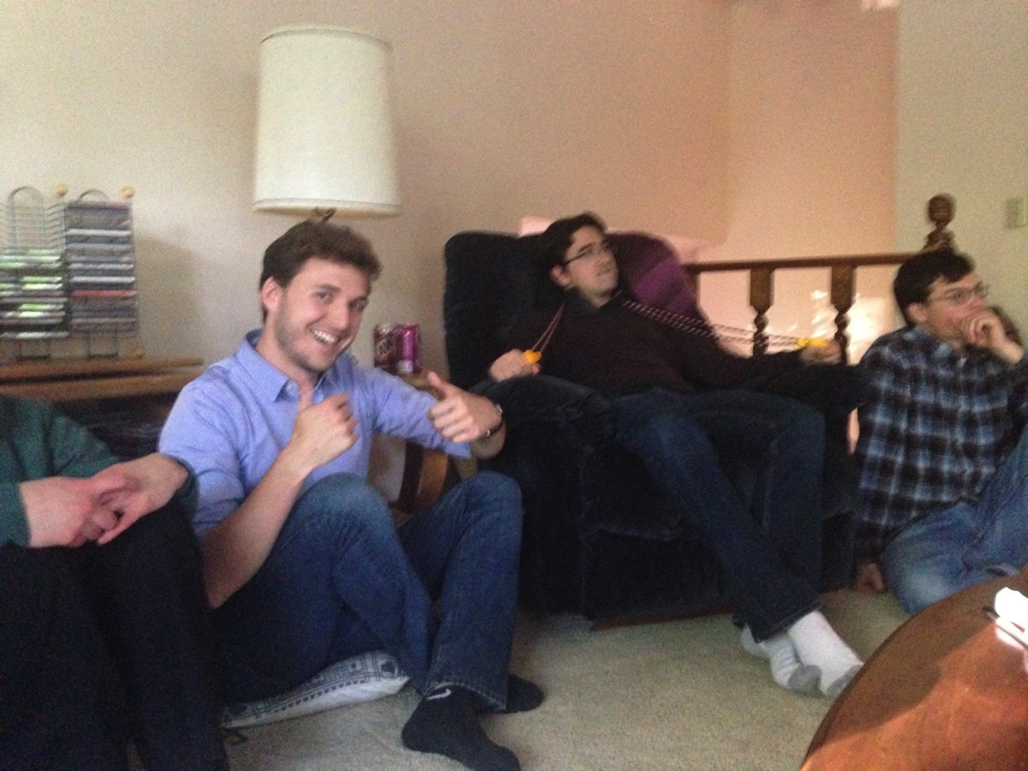
Kirby Schoephoerster

Slide 17
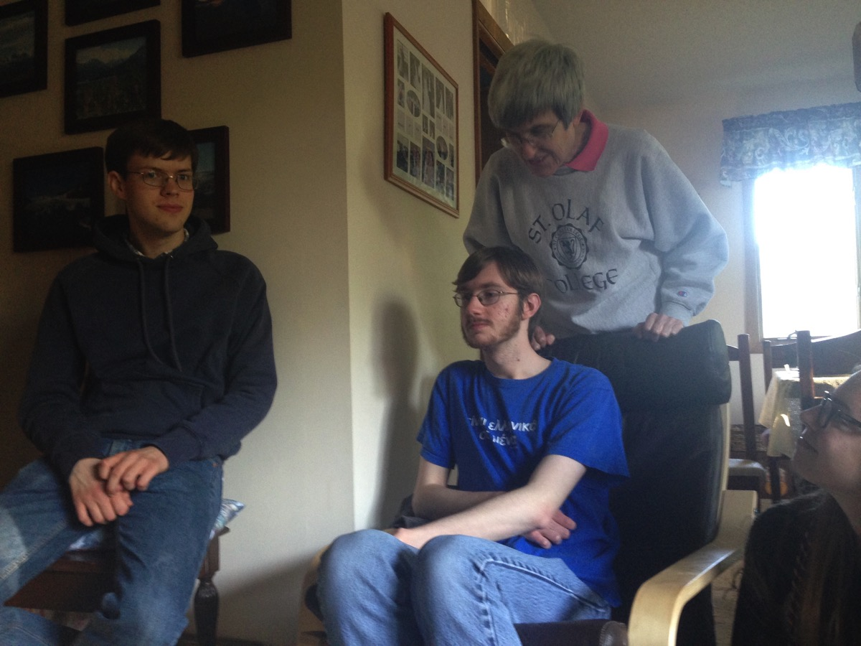
Look out behind you!

Slide 18
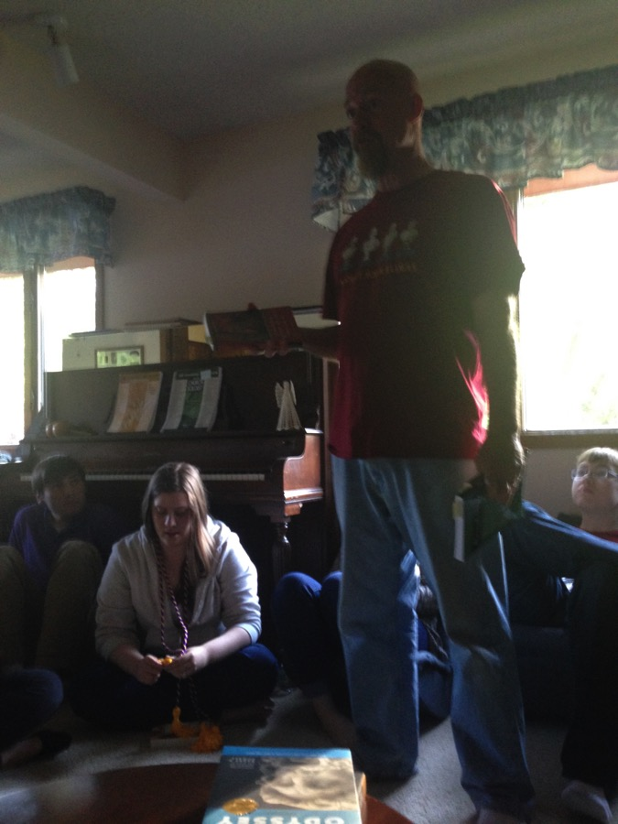
Books for the seniors

Slide 19
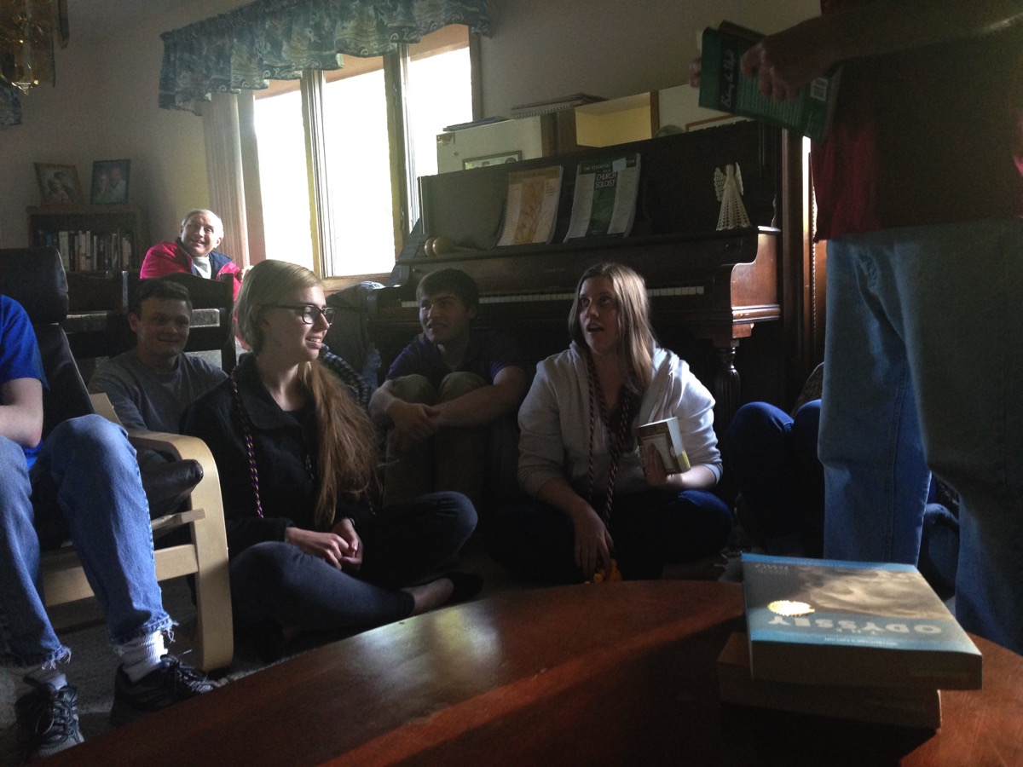
More books for the seniors

Slide 20
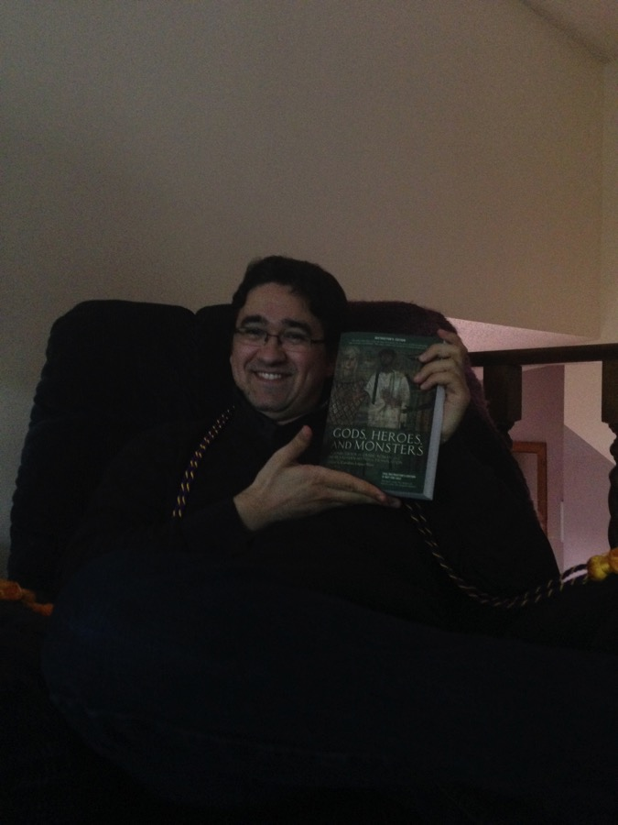
A real book

Slide 21
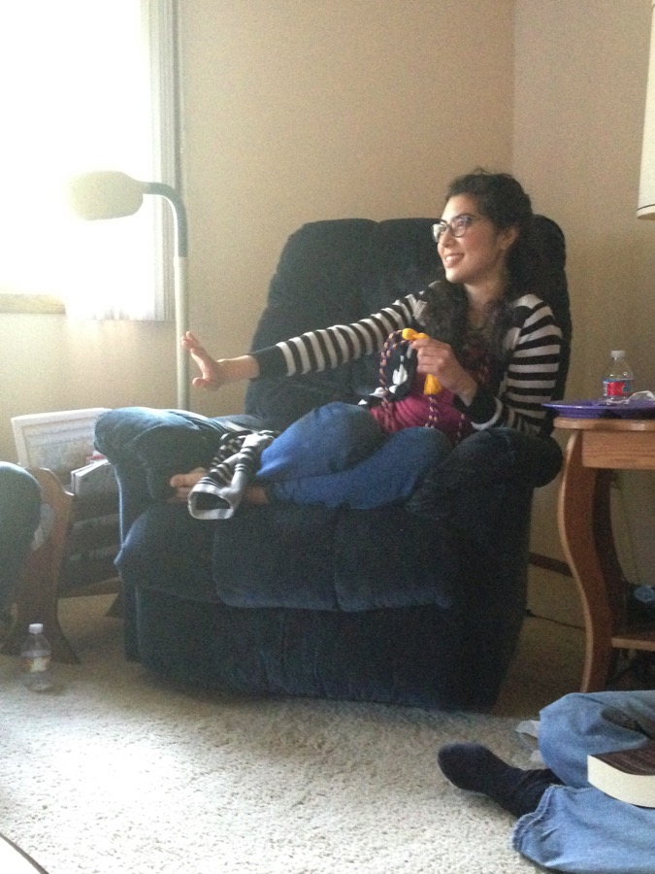
A comfy chair

Slide 22
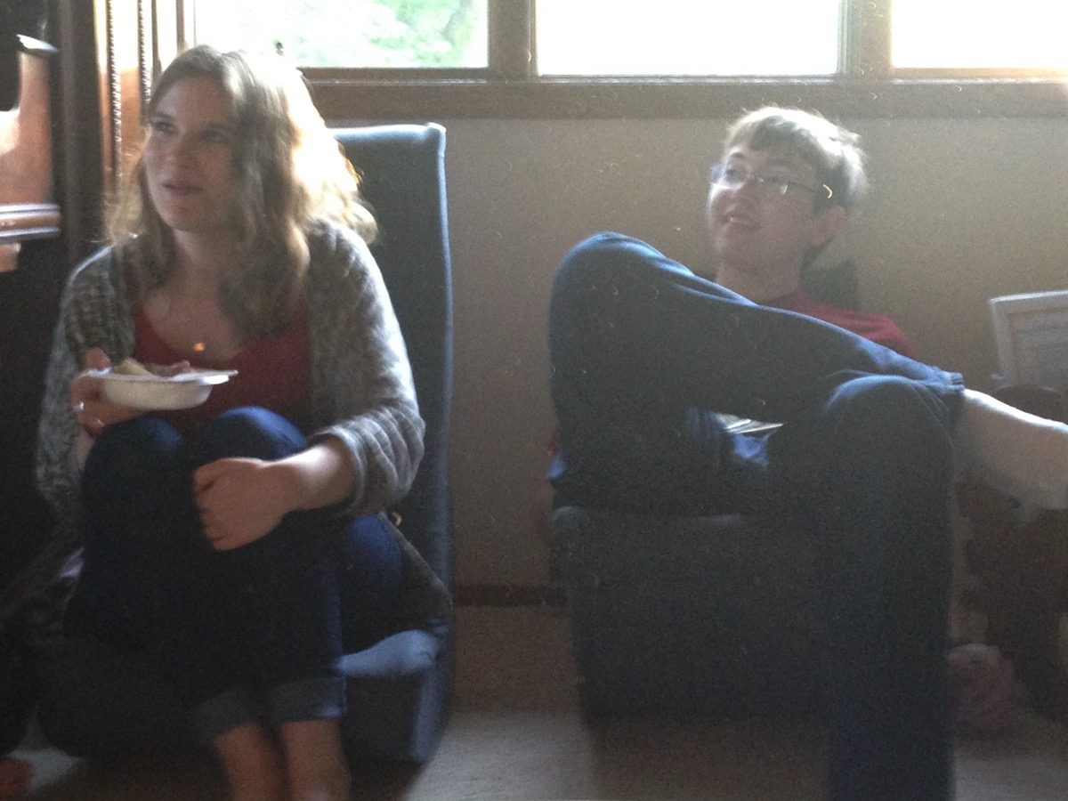
We finally made it to dessert!

Slide 23
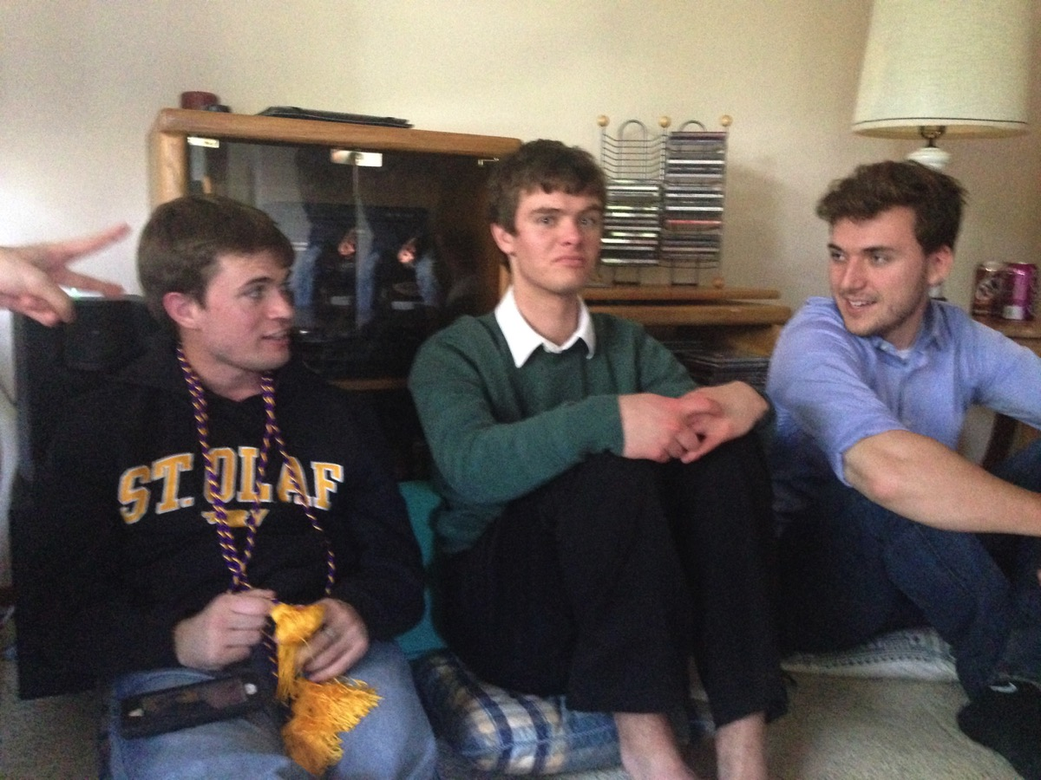
When shall we three meet again?

Slide 24
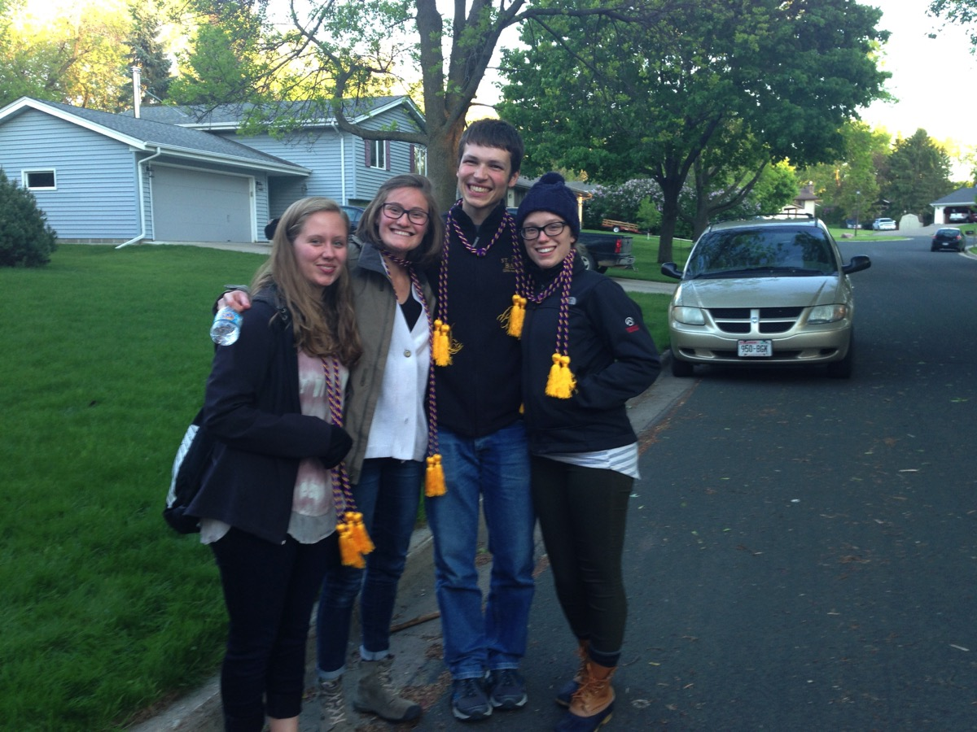
Four with their cords

Slide 25
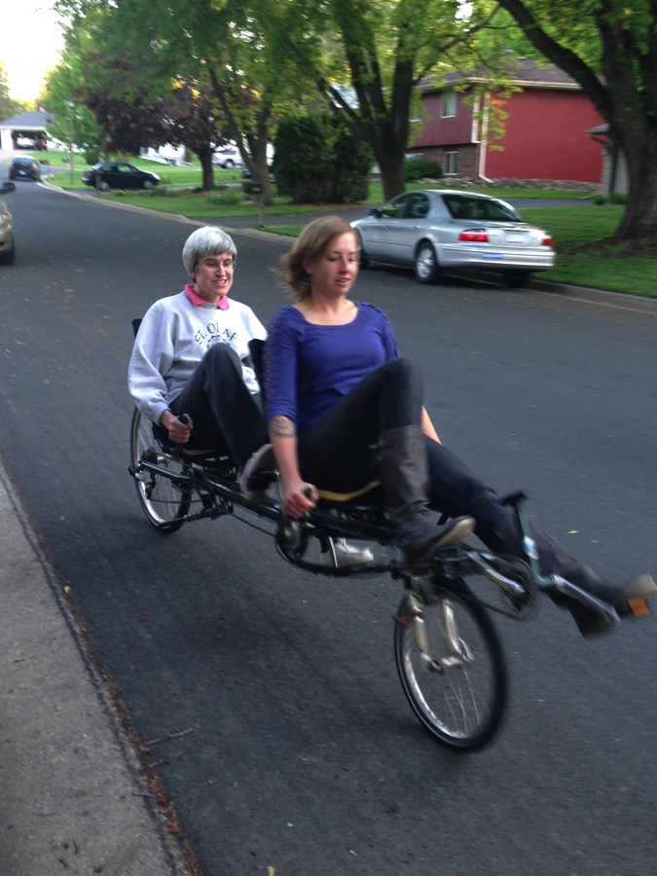
A bicycle built for two

