Slide 1
The OLE Core Presented by the GE Task Force Meeting of the Faculty of St. Olaf College
April 11, 2019

Slide 2
Overview
Why we are proposing changes to GE
What we are proposing: the OLE Core
Where we are in the design process

Slide 3
What are the challenges facing small liberal arts colleges?

Slide 4
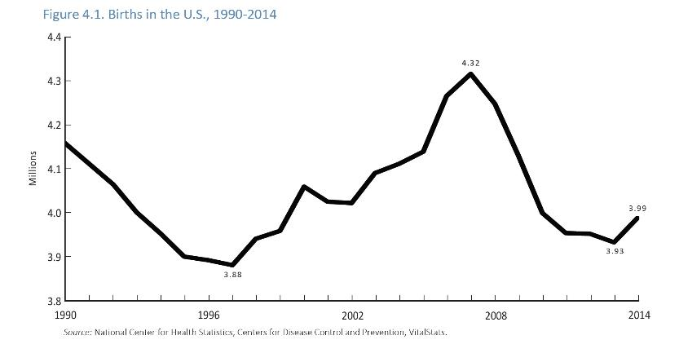
Challenges Ahead: Demographics
Due to a declining birth rate, the number of students applying to college today is decreasing with the bubble set to burst in 2026

Slide 5
The U.S. is running out of teenagers

Slide 6
Who are today’s students?
Today, 45% of college applicants are domestic students of color. Latinx students are the fastest growing demographic.
The vast majority of today’s students come from large urban areas and return to them after graduation.
AAC&U GE Conference (February 2019) – Creating a 21st Century General Education: Responding to
Seismic Shifts

Slide 7
High School Grads by Region
South
West
Midwest
Northeast
2000-01
2012-13
2024-25
2031-32
WICHE, Knocking at the Door (2016)

Slide 8
The Midwest: 2012 to 2032
WICHE, Knocking at the Door (2016)

Slide 9
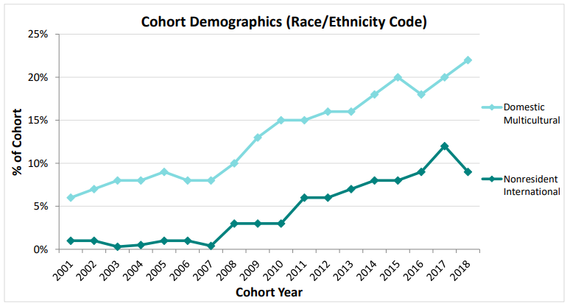
St. Olaf Student Demographics: 2001-2018
INSERT GRAPH FROM PDF, ENROLLMENT RATES PRIMER 2018

Slide 10
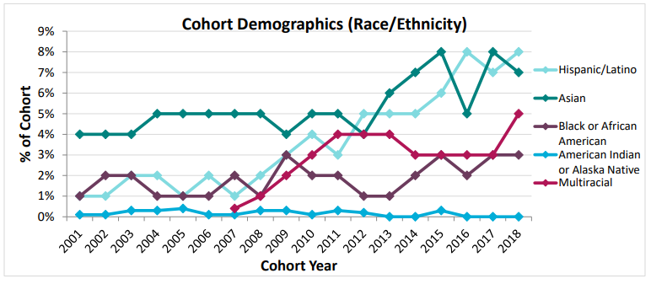
St. Olaf Student Demographics: 2001-2018
INSERT GRAPH FROM PDF, ENROLLMENT RATES PRIMER 2018

Slide 11
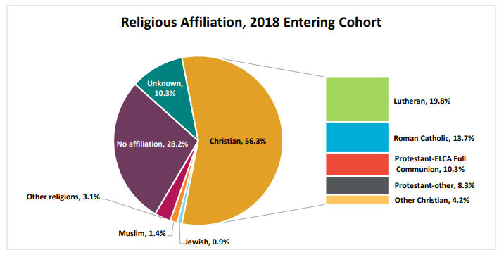
Student Demographic Cohorts: 2001-2018
INSERT GRAPH FROM PDF, ENROLLMENT RATES PRIMER 2018

Slide 12
What are small liberal arts colleges preparing students for in the 21st century?

Slide 13
AAC&U 2018 Employer Research Report
"The ability to apply knowledge/skills to the real world.”
87% of hiring managers think that this is a very important quality, but only
39% of hiring managers think that recent college grads are well prepared to do this

Slide 14
Our students’ futures involve doing what machines can’t
Creativity
Curiosity
Empathy
AAC&U Conference (Feb. 2019) Creating a 21st Century General Education: Responding to Seismic Shifts

Slide 15
How can the liberal arts uniquely prepare students?
Eager to tackle uncharted areas
First rate at gathering data and insights
Clever at solving complex problems
Highly skilled at reading the room
Able to persuade and inspire people
AAC&U Conference (Feb. 2019) Creating a 21st Century General Education: Responding to Seismic Shifts

Slide 16
Colleges & universities have been/are revising GE
A 2009 AAC&U survey found that:
89% of colleges and universities were engaged in GE revision.
More than two-thirds combine choice and integrative components such as learning communities.
Institutions are placing greater emphasis on HIPs:
off-campus study (71%), internships (62%), first year experiences (73%), and undergraduate research (78%).

Slide 17
How have our ACM peers responded?
Revised GE curricula emphasize
creative problem-solving
integrative components (e.g., a capstone requirement)
interdisciplinary study
HIPs
experiential learning
Luther College (2007)
Colorado College (2017)
Ripon College (2017)
Lake Forest (2018)

Slide 18
How does St. Olaf compare? ACM GE Comparisons:

Slide 19
Where is St. Olaf falling short?
Our recent-alumni give us low ratings in
Life skills
Quantitative reasoning
Relevance of their studies to the world of work
Skills in intercultural competence (source: HEDS)
Our current students give low/mediocre self-reports on
Interactions with diverse others (except different religious beliefs)
Student-faculty interactions (source: NSSE)

Slide 20
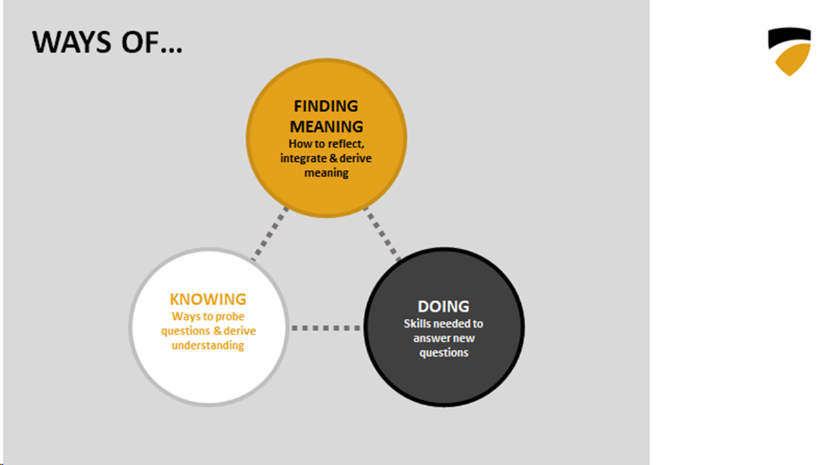
What are we proposing?

Slide 21
What are we proposing?

Slide 22
We have been guided by your input

Slide 23
Where are we in the design process?

Slide 24
A 21st Century OLE Core Curriculum
Welcomes all students, fosters belonging, and supports learning without presuming a particular student profile
Features collaboration, integration, and creative problem-solving
Is smaller, more flexible, and opens up space for enhanced student exploration, action, reflection, and interaction with faculty

Slide 25
OLE Core: First Year Seminar
First-Year Seminar (2 semesters, same cohort, different faculty)
Common entry experience to foster a sense of belonging and community
Discussion-based learning communities
Foundations in reading, writing, critical thinking, speaking-and-listening, and collaborating in a diverse group
Introduction to the OLE Questions and “college knowledge”

Slide 26
Core Curricular Design Example #1
Global Histories and Societies
Global in Scope and Intent
Does not privilege any discipline, tradition, region, period, or type of evidence
Focus on Histories and Societies in Context
Institutional contexts: political, economic, social, religious
Intellectual contexts: theology, philosophy, science, economic theory
Creative contexts: art, literature, music, dance, theater, film, digital media

Slide 27
Core Curricular Design Example #2
Ethics
Students may be introduced to ethics in the FY Seminar.
Departments and programs may include an ethics course or component in their majors.
Any department or program may recommend or require an EIN-style course for their major. We just don’t want to require that of departments and programs that approach ethics differently.

Slide 28
We’re Still Working On…
Deeper engagement with the core in the major
a major-specific writing course
a major-specific ethics course or component
a capstone experience that integrates the core curriculum for all students in the major
reflection

Slide 29
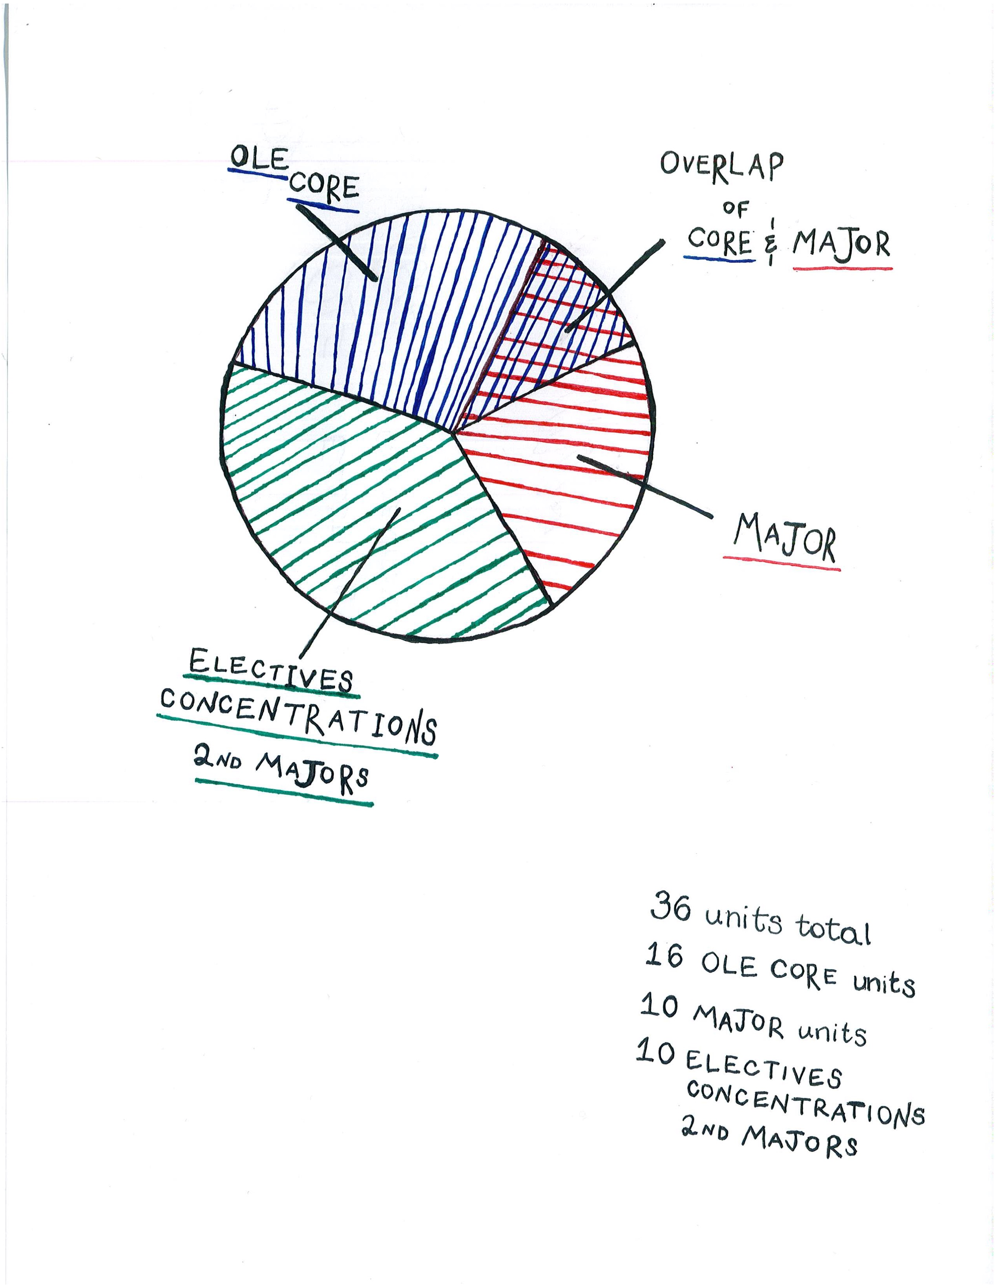
Sketching a
Student’s
Four-Year Plan

Slide 30
Opportunities for Students
Learning communities for all students
Experiential learning
Creative problem solving
More flexibility and pathways
Integrative learning
Reflection on OLE questions

Slide 31
Opportunities for Faculty
More meaningful interaction with students
More innovation in teaching and learning in majors
Reduce uncompensated faculty labor
In the last four years, faculty have taught 177, 251, 266, and 312 IS/IR (even with DUR).

Slide 32
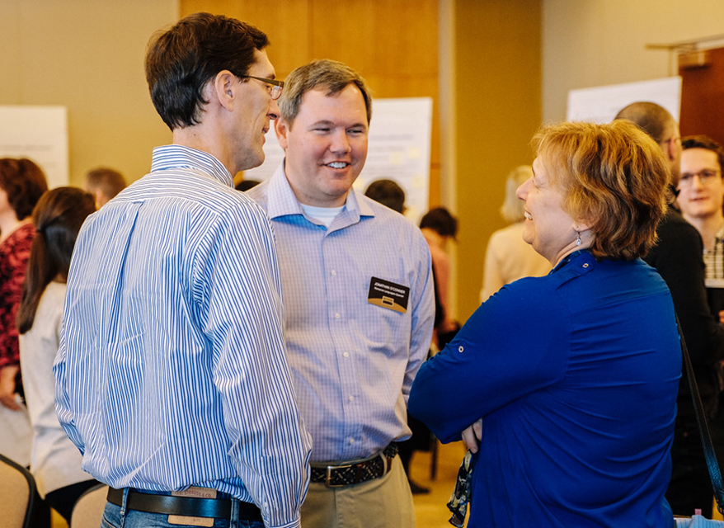
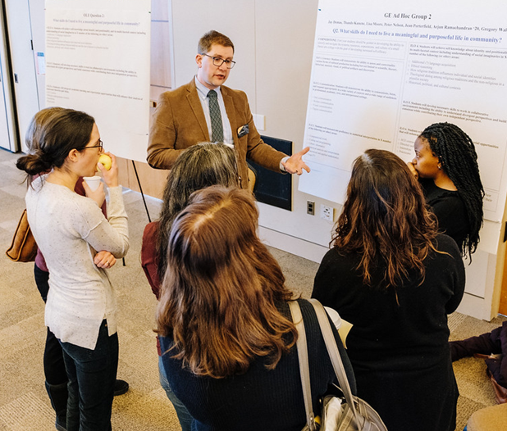
What’s next?
Academic Leadership, April 18
Faculty/Staff Forum, April 18
3:45-5:30, location TBA
Faculty Meeting, April 25
Board of Regents, Meeting May 2
Faculty Meeting, May 9

Slide 33
An Ole Haiku
April snow showers
won’t stop our core reflections.
Spring forth and renew!
THANK YOU

