Slide 1


2020 OPEN ENROLLMENT
Presented by: Associated Benefits and Risk Consulting

Slide 2
2020-21 Benefits Committee Members
Christopher Atzinger – Faculty in Music
Jacqueline Christensen – Human Resources
Myron Engle – Information Technology
Roseanne Galegher – AAA
Mike Goodson – Human Resources
Travis Grant – Human Resources
Nancy Paddleford – Faculty in Music; Piano; Latin American Studies
Jan Hanson – Finance
Angie Matthews – Finance
Mark Koktavy – Facilities
Steve O’Neill – Boe Counseling
Jeff Partington – Facilities
Judy Tegtmeyer – Faculty in Recreation, Exercise Science and Athletics
2

Slide 3
HISTORY OF PREMIUM INCREASES AT ST. OLAF
2014-15
+3.6%
2015-16
+7.5%
2016-17
+5%
2017-18
+15% Core
0% HDHP
2018-19
0% Core
0% HDHP
BCBS Recommended:
10% 17% 16% 17.8%
1.1%
2019-20 Plan Year:
BCBS Recommended: +10.8%
Actual Overall Increase: +5.9%
2020-21 Plan Year:
0% Core
0% HDHP
Unusual COVID-19 Year!

Slide 4


TODAY’S Agenda
DENTAL PLAN
MEDICAL
2020-21 Health Plan Options
Health Savings Account (HSA) reminders
Which plan is right for you?
OTHER BENEFITS
Flex plans
Basic life, voluntary life, & disability plans
Learn to Live
Vision
Legal/Identity Theft
Open Enrollment reminders

Slide 5
DENTAL PLAN

Slide 6
Dental Plan
available through Delta Dental Plan of MN
Change in Orthodontic Benefit
Current Benefit:
  Confusing and cumbersome for employees and providers
  The $1,000 plan year maximum applies to dental services (like preventive care, fillings, etc.) and orthodontics
  What does that mean? If you have a child in orthodontics, the entire plan year maximum could be used for orthodontics, leaving nothing for preventive care and other dental services.
NEW Benefit:
  Separate lifetime orthodontic benefit of $2,000 for children ages 8-18
  $1,000 annual plan year maximum for other dental services remains
ALL employees will receive new ID cards effective Sept. 1, 2020
No change in employee premiums!
  Single: $18.00 / Employee +1: $38.00 / Family: $57.00

Slide 7


2020 health insurance renewal
Renewal Process
St. Olaf went out to market this year
  Marketing efforts started before the COVID-19 pandemic
  Determined it was not the year for more change
  We were able to use the bids from other carriers to negotiate a competitive renewal with Blue Cross
What does that mean to you?
  NO change in employee premiums!

Slide 8
2020 health insurance renewal
Core Plan Premiums (Monthly)
2020-21 Rates (>0.75 FTE), Employee Contribution
2020-21 Rates (0.50 to 0.749 FTE), Employee Contribution
 | Current | Effective 9/1/20
Employee | $194.00 | $194.00
Employee +1 | $500.00 | $500.00
Family | $746.00 | $746.00
 | Current | Effective 9/1/20
Employee | $300.00 | $300.00
Employee +1 | $690.00 | $690.00
Family | $1,032.00 | $1,032.00
8

Slide 9
2020 health insurance renewal
HDHP/HSA Premiums (Monthly)
2020-21 Rates (>0.75), Employee Contribution
2020-21 Rates (0.50 to 0.749 FTE), Employee Contribution
 | Current | Effective 9/1/20
Employee | $144.00 | $144.00
Employee +1 | $380.00 | $380.00
Family | $570.00 | $570.00
 | Current | Effective 9/1/20
Employee | $144.00 | $144.00
Employee +1 | $590.00 | $590.00
Family | $869.00 | $869.00
9

Slide 10
Benefit changes as of Sept. 1, 2020
Both Plans
Core Health Plan
  - Insulin on the formulary drug list covered at 100%
HDHP/HSA
  - Increased in-network deductible of $100/single and $200/family due to
  IRS regulation change (Tier 1 providers only)
ALL employees will receive new ID cards effective Sept. 1, 2020
  - Your member ID and Rx info will remain the same
  - Please begin using your new ID card as of Sept. 1
Reminder: COVID-19 testing and the associated office visit, urgent care visit
or emergency visit is covered at 100% under both plans
10

Slide 11
Core Plan (In-Network)
In-Network | Tier 1 | Tier 2
Deductible Single/Family | $1,000/$2,000 | $1,500/$3,000
Coinsurance | 25% | 45%
Out-of-Pocket Maximum Single/Family | $3,500/$7,000 | $4,500/$9,000
Preventive Care | You pay $0 | You pay $0
Office Visits | 25% after deductible | 45% after deductible
Convenience Care Urgent Care, Emergency | 25% after deductible | 45% after deductible
Outpatient/Inpatient Hospital Care | 25% after deductible | 45% after deductible
Prescription Drugs | Gen Rx
Generic/Brand/Non-Formulary Specialty Drugs | $10/$50/$100 20% to a maximum of $200/script (Preferred) 40% up to Out-of-Pocket Maximum (Non-Preferred)
11

Slide 12
HDHP/HSA (In-Network)
In-Network | Tier 1 | Tier 2
Deductible Single/Family | $2,800/$5,600 | $3,000/$6,000
Coinsurance | 20% | 40%
Out-of-Pocket Maximum Single/Family | $3,500/$7,000 | $4,500/$9,000
Preventive Care | You pay $0 | You pay $0
Office Visits | 20% after deductible | 40% after deductible
Convenience Care Urgent Care, Emergency | 20% after deductible | 40% after deductible
Outpatient/Inpatient Hospital Care | 20% after deductible | 40% after deductible
Prescription Drugs | Gen Rx
Preventive Drugs Generic/Brand/Non-Formulary Specialty Drugs | You pay $0 20% after deductible up to Out-of-Pocket Maximum 20% after deductible up to Out-of-Pocket Maximum
12

Slide 13

Important Reminder!
Preventive Rx (applies to HDHP/HSA plan only)
Specific preventive prescription drugs paid at 100%
Includes preferred generic and brand name drugs
Treat conditions such as:
  High blood pressure
  High cholesterol
  Diabetes
  Asthma
  Contraceptives
  Breast cancer prevention
  And more!

Slide 14
Additional services
Doctors on Demand
Access a board-certified doctor, psychiatrist or psychologist from your phone or computer from 7 a.m.-11p.m., 365 days/year. Affordable and convenient!
  Can treat cold/flu, allergies, skin issues/rashes, sports injuries and much more. Cost = starting at $50/visit.
  Visits with psychologists and psychiatrists are available for help with depression, anxiety, addictions, etc. Cost varies, as low as $66/psychology visit, $266 for initial psychiatry visit/$115 for follow up
  Want the app? Search Doctor On Demand in the app store.
Blue Cross Member Portal
Find an in-network provider, help in finding out what your plan covers, review explanation of benefits, health and wellbeing support and much more!
  Want the app? Search BlueCrossMN in the app store.

Slide 15
WHAT IS A HEALTH SAVINGS ACCOUNT (HSA)?

Slide 16


WHAT IS A HSA?
Administered by Further
A health savings account (HSA) is an account that you can use to pay medical expenses.
Must be in conjunction with a high-deductible health plan (HDHP)
Tax-advantages: contribute pre-tax money, funds accrue tax-free and withdraw funds tax-free (if used for eligible medical expenses)
You own the account even if you separate service or retire
You are not eligible for a HSA if you’re:
Not covered by a HDHP
Enrolled in Medicare A, B or D
Covered under other health insurance (including a spouse’s full flex plan)
Another person’s dependent for tax purposes

Slide 17
HSA CONTRIBUTIONS

Slide 18
St. Olaf HSA CONTRIBUTION
St. Olaf will continue to contribute to the HSA for those enrolled in the HDHP
Contributions paid in two installments; Sept. 1 and Jan. 1
Tier of coverage | 2020-21
Employee | $1,000
Employee +1 | $1,500
Family | $2,000
18
Notes:
St. Olaf increased HSA contribution last plan year

Slide 19
HSA CONTRIBUTION LIMITS
Each year, the IRS sets contribution limits. The 2020 limits are:
$3,550 for individual coverage | $7,100 for family coverage
Age 55+ = Additional $1,000 catch-up contribution
You elect how much to contribute and can change election monthly
Elections do roll over from one year to the next
Don’t forget! Investment options available if you have a balance of $1,000+
 | 2020 IRS Max Contribution | St. Olaf Contribution | Your Max Annual Contribution
Employee only | $3,550 | $1,000 | $2,550
Employee +1 | $7,100 | $1,500 | $5,600
Family | $7,100 | $2,000 | $5,100
19

Slide 20
HSA DISTRIBUTION rules

Slide 21
HSA DISTRIBUTION RULES
Distributions from your HSA are tax-free if they are taken for “qualified medical expenses.”
Qualified medical expenses include:
Medical care subject to your deductible / coinsurance, Rx copays
Over-the-counter drugs, no prescription needed, effective 1/1/20
Menstrual hygiene products, effective 1/1/20
Dental & vision services
Select insurance premiums (COBRA, long term care, Medicare, etc.)
Non-qualified expenses include cosmetic surgery, teeth whitening, personal use items, etc.
If you use HSA funds for non-eligible expenses, you will be subject to income tax on the distribution and an additional 20% penalty.
If age 65+, will not incur the penalty but will pay taxes.
HSA distributions can be taken for qualified medical expenses for the following people:
The account holder (person covered by the HDHP)
Spouse of that individual (even if not covered by the HDHP)
Tax dependent children of that individual (even if not covered by the HDHP)

Slide 22

Did you know?
More employees are now covered under the HDHP/HSA than the Core Plan
More than half of those covered under the Core Plan did not meet their annual deductible
More than 85% of those covered under the Core Plan did not meet their out-of-pocket maximum

Slide 23
Employee only
Example
Employee Only Coverage | Core Plan Tier 1 | HDHP/HSA Tier 1 | Difference
Annual Premium | $2,328 | $1,728 | $600
Annual out-of-pocket maximum | $3,500 | $3,500 | $0
Annual Premium + Out-of-Pocket | $5,828 | $5,228
HSA Contribution | $0 | - ($1,000) | $1,000
Total Cost | $5,828 | $4,228 | $1,600
23

Slide 24
EMPLOYEE + 1
Example
Employee + 1 Coverage | Core Plan Tier 1 | HDHP/HSA Tier 1 | Difference
Annual Premium | $6,000 | $4,560 | $1,440
Annual out-of-pocket maximum | $7,000 | $7,000 | $0
Annual Premium + Out-of-Pocket | $13,828 | $11,560
HSA Contribution | $0 | - ($1,500) | $1,500
Total Cost | $13,828 | $10,060 | $3,268
24

Slide 25
family
Example
Family Coverage | Core Plan Tier 1 | HDHP/HSA Tier 1 | Difference
Annual Premium | $8,952 | $6,840 | $2,112
Annual out-of-pocket maximum | $7,000 | $7,000 | $0
Total Cost | $15,952 | $13,840
HSA Contribution | $0 | - ($2,000) | $2,000
Total Cost | $15,952 | $11,840 | $4,112
25

Slide 26
YOUR FURTHER ACCOUNT
HSA Administrator
Debit Card
You will automatically receive a debit card from Further.
  Once activated, your HSA debit card can be used for eligible expenses up to your available HSA balance.
  Existing debit cards will still apply if you switch from Core to HDHP
You can view account balances online, use our online planning tools, and view your past card transactions at www.hellofurther.com.
Questions about your account call:
1-800-859-2144
Beneficiary
It is important to assign a beneficiary who will receive your account at the time of your death.
Failure to name a beneficiary means:
  The assets in your account will be distributed to your estate, and
  Included on your final tax return

Slide 27
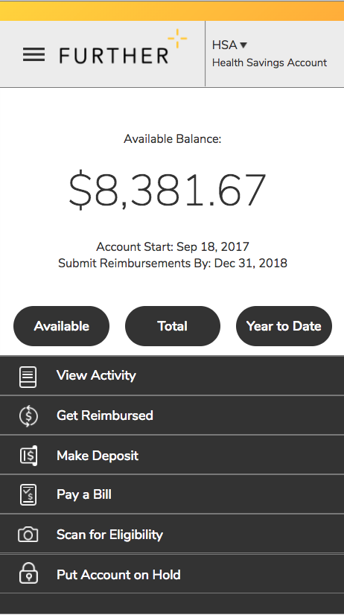
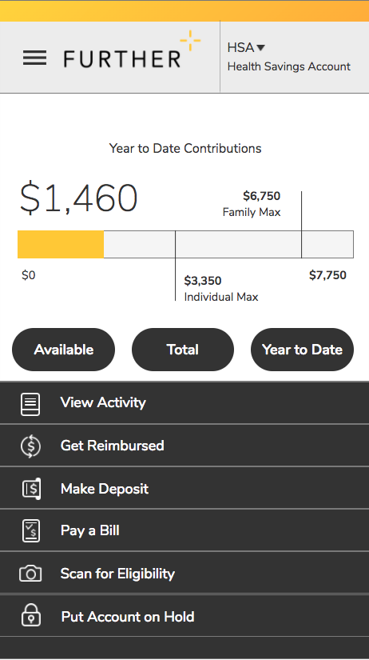
Mobile App
Features
Fingerprint unlock
Snap and save document photos
Barcode scanner to check eligibility
Mobile access to all primary actions
  View activity
  Pay bills
  Make deposits
  Get reimbursed

Slide 28
Which plan is right for you?

Slide 29
PLAN CONSIDERATIONS
Which medical plan option is best for you?
Compare Deductibles (Tier 1)
Core option - $1,000 single /$2,000 family
HDHP/HSA option - $2,800 single /$5,600 family
Compare out-of-pocket maximums (Tier 1)
Core option - $3,500 single/$7,000 family
HSA option - $3,500 single/$7,000 family
  $2,550 Employee Only, $5,600 Employee + 1 and $5,100 Family when you factor in the St. Olaf HSA contribution
Prescription drug coverage
Core plan has Rx copays
HSA plan subject to deductible with the exception of preventive drugs
Employee premium contribution
Calculate by adding your costs and out of pocket maximum

Slide 30
Health plan comparison Tool
Which medical plan option is best for you?
Health Plan Selector Tool
Online Cost Calculator
Model your estimated health care expenses
Analyze your net out-of-pocket costs
St. Olaf’s health plan options and premiums have been pre-loaded with Tier 1 benefits as well as premiums for FT employees
Instructions
Go to www.AssociatedBRC.com
Username: stolaf
Password: Benefits2020!
Security question response: stolaf
Please see step-by-step for additional instructions!
Want help with this tool? Schedule an appointment during Open Enrollment!

Slide 31
Flexible
Spending accounts

Slide 32
Flexible spending accounts (FSA)
General Purpose (Full) FSA
Available to those enrolled in the Core Plan
Deduct money pre-tax to pay for eligible medical expenses not covered by the medical plan such as deductible, coinsurance, prescription drug copays, dental and vision expenses
Over-the-counter drugs no prescription needed, effective 1/1/20
Menstrual hygiene products effective 1/1/20
Limited Purpose FSA
Available to those enrolled in the HDHP/HSA
Deduct money pre-tax to pay for eligible dental and vision expenses only until deductible is met, then can also be used for medical expenses from that date forward.
Both FSA’s
$2,750 maximum contribution
Plan year is 9/1 through 8/31
Use it or lose it
You must elect to participate in the plan. Elections do not roll over from one year to the next.

Slide 33
Flexible spending accounts (FSA)
Dependent Care FSA
Available to any eligible employee with an FTE of .50 or more regardless of health plan election
Deduct money pre-tax to pay for dependent care expenses
$5,000 maximum contribution
Plan year runs 9/1 through 8/31
Use it or lose it
You must elect to participate in the plan. Elections do not roll over from one year to the next.

Slide 34
VOLUNTARY
VISION INSURANCE

Slide 35
VISION BENEFIT SUMMARY
VSP
No change in benefits or premiums
Benefit | In-Network Benefit VSP Choice Network | Frequency
Eye Exam | $10 copay | Every 12 months
Prescription Glasses Frames | $25 copay $130 allowance $150 allowance for featured frames 20% savings over allowance | Every 24 months
Lenses | Single, bifocal, lined trifocal | Every 12 months
Lens enhancements | $0, Standard Progressive $95-$105, Premium Progressive $150-$175, Custom Progressive | Every 12 months
Contacts (instead of glasses) | $130 allowance; copay does not apply | Every 12 months
20% savings on additional glasses and sunglasses
No more than a $39 screening as an enhancement to a Eye Exam
Laser Vision Correction: 15% discount on regular price or 5% discount on promotional price
35

Slide 36


Learn to Live
St. Olaf will continue to offer an online therapy program through Learn to Live to all employees and their dependents.
Learn to Live provides online programs and clinical assessments for you and your family members (age 13 or older) struggling with stress, depression or social anxiety. Programs are based on the proven principles of Cognitive Behavioral Therapy
  100% private and confidential
  Based on clinical studies over 10+ years
  No cost to you or your family
  Coaching available
  Immediate, 24/7 access
  Current programs:
  Depression
  Stress, Anxiety & Worry
  Social Anxiety
  Insomnia
  Substance Use – NEW!
1. Hedman, Erik, et al. "Cognitive behavior therapy via the Internet: a systematic review of applications, clinical efficacy and cost-effectiveness." Expert Review of Pharmacoeconomics & Outcomes Research 12.6 (2012)

Slide 37
VOLUNTARY LEGAL AND IDENTITY THEFT PROTECTION

Slide 38
legalshield and idshield
No change in benefits or premiums
LegalShield
Consultation and advice on personal legal matters
Legal document review and preparation
Dedicated law firm
Letter/phone calls made on your behalf
Speeding ticket assistance
Will preparation
24/7 emergency access
LegalShield app
IDShield
Monitor information
Privacy and Security Monitoring
Comprehensive Source Monitoring
Unlimited Consultation
Identity Restoration
Enhanced Protection
  Cyberbullying
  Online Privacy
  Reputation Management
A recent reason to consider this benefit is Unemployment Fraud!

Slide 39
OTHER CHANGES

Slide 40
VEBA Plan change
EMERITI RETIREMENT HEALTH ACCOUNT
Current Plan:
  St. Olaf contributes $104 / month until employment ends
  Contributions begin at age 39
  3 year service vesting required after 1/1/2018
New Plan: Effective July 1, 2020
  St. Olaf contributes $104 / month until employment ends
  Contributions begin at age 40 (Those who are age 39 prior to 7/1/2020 will continue to receive contributions)
  3 year service vesting required after 1/1/2018
  St. Olaf contributions continue for a maximum of 25 years or until separation of employment, whichever is less

Slide 41
Life & LTD
Life
Employer Paid Life/AD&D
Benefit will remain unchanged - 2x annual earnings up to $600,000 or limit it to $50,000
Voluntary Life & AD&D
This coverage has been increased! You may purchase up to $200,000 for your spouse, based upon 50% of the employee’s voluntary life coverage amount
Completion of a health questionnaire will be required for any increase in coverage for approval by CIGNA
No other changes
Long Term Disability
St. Olaf college pays the premium on your behalf
Elect YES if you want to pay the small tax on the premiums, allowing any benefit to be paid tax-free
Elect NO if you do not want to pay the tax on the premiums, allowing any benefit to be taxed.
You can make this change only during open enrollment

Slide 42
Open Enrollment reminders
Changes must be made within 30 days of a qualifying event!
This is your open enrollment opportunity
Employees and their eligible dependents can come on and/or off the St. Olaf plans during this time
Can I make changes after open enrollment?
Not without a qualifying event such as:
Marriage
Divorce
Birth or adoption of a child
Change in employment status which causes a change in eligibility
Spouse’s open enrollment
Enrollment in Medicare Part B

Slide 43
questions
Open Enrollment: July 20th at noon to August 7th at noon!
Benefit Information Sessions
Session 1: June 24 at 9 a.m. This session will be recorded and linked on the Human Resources website.
Session 2: July 21 at 2:30 p.m.
Online Enrollment Help Sessions
July 21 at 3:30 p.m.* (immediately following the Information Session)
More Enrollment Help Sessions will be offered and announced before Open Enrollment begins.
* Indicates assistance available in navigating Blue Cross’ website and the health plan comparison tool offered through Associated Benefits and Risk Consulting.
* Indicates assistance available in navigating the health plan comparison tool offered through Associated Benefits and Risk Consulting.
43

Slide 44
Insurance products are offered by licensed agents of Associated Financial Group, LLC (d/b/a Associated BRC Insurance Solutions in California). The financial consultants at Associated Financial Group are registered representatives with, and securities and advisory services are offered through LPL Financial “LPL”, a registered investment advisor and member FINRA/SIPC. Associated Financial Group uses Associated Benefits and Risk Consulting (“ABRC”) as a marketing name. ABRC is a wholly-owned subsidiary of Associated Bank, N.A. (“AB”). AB is a wholly-owned subsidiary of Associated Banc-Corp (“AB-C”). LPL is NOT an affiliate of either AB or AB-C. AB-C and its subsidiaries do not provide tax, legal, or accounting advice. Please consult with your tax, legal, or accounting advisors regarding your individual situation. ABRC’s standard of care and legal duty to the insured in providing insurance products and services is to follow the instructions of the insured, in good faith.

