Slide 1
The OLE Core Presented by the GE Task Force FACULTY/STAFF FORUM St. Olaf College
April 18, 2019
Notes:
Shelly Dickinson, Dana Gross, Tim Howe, Karil Kucera, Jennifer Kwon Dobbs, Jonathan O’Conner, Tom Williamson, Ulises Jovel ’20, and Myrto Neamonitaki ’20

Slide 2
DISCUSSION
Please be considerate of your colleagues and take only TWO minutes to describe your concerns and/or questions.
We will be asking for thoughts from all before we return to any one speaker.

Slide 3
We’re Still Working On…
Deeper engagement with the core in the major
a major-specific writing course
a major-specific ethics course or component
a capstone experience that integrates the core curriculum for all students in the major
reflection
Notes:
The OLE Core envisions deeper engagement with general education in the major.

Slide 4
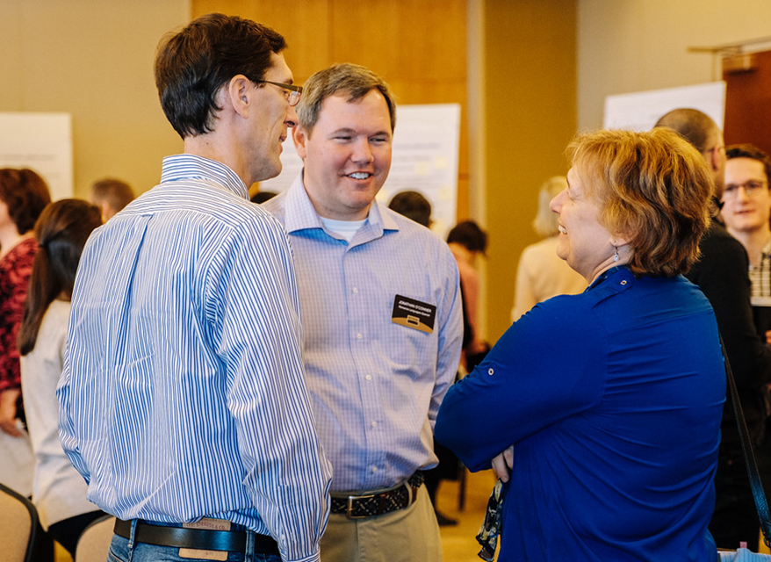
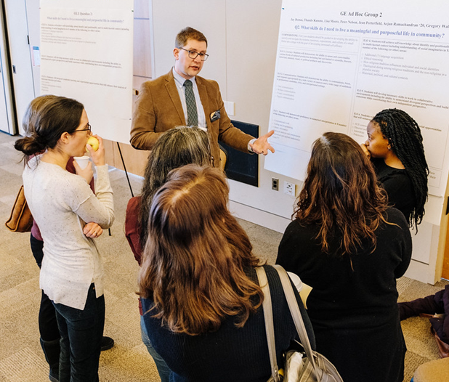
What’s next?
Faculty/Staff Forum, April 18
3:45-5:30, Gold Ballroom
Faculty Meeting, April 25
Board of Regents, Meeting May 2
Faculty Meeting, May 9
Summer revisions
Fall Vote
Notes:
Karil. We now invite individual faculty responses, as well as responses from the entire faculty. We know that some people love clicker polls and some don’t. We believe that they provide an additional way to gather information from all of you. We want to continue these conversations through a forum and other meetings coming up this spring.

