Slide 1
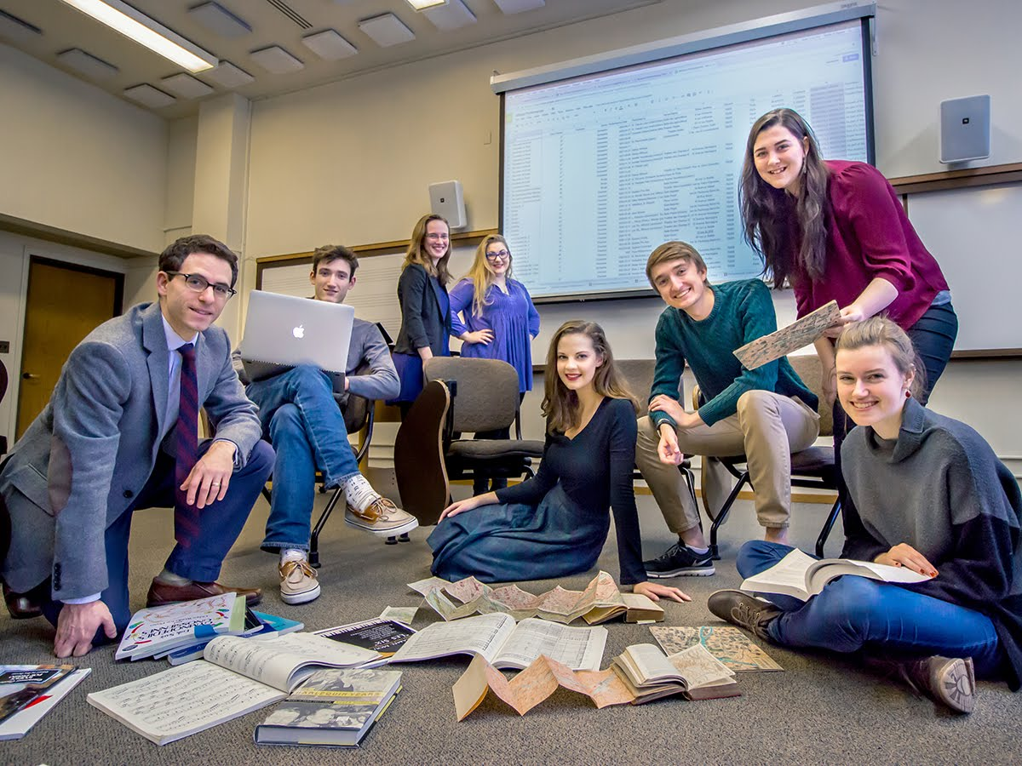
The Impact of Student/Faculty Interactions on Sophomore Thriving
Claire Chenoweth, Yael Estrada-Nava,
Charles Hamer, and Emily Rennhak
Notes:
Charles

Slide 2
Research Questions
Do sophomores feel supported by professors, staff, and class deans?
Do sophomore identities impact the reasons that sophomores meet with professors?
What kinds of professor interaction contribute to sophomore thriving?
Notes:
Charles

Slide 3
Which Staff do Students Feel Supported By?
 | Extremely Supported | Very Supported | Moderately Supported | A little supported | Not at all supported | Not Applicable
Academic Advisor | 35.9% | 28.2% | 17.7% | 9.3% | 2.0% | 1.2%
Non-student Work Boss/ Supervisor | 19.0% | 21.4% | 14.1% | 6.9% | 2.8% | 30.2%
64% of students said they feel at least very supported by their academic advisor
60-70% of students said “Not Applicable” for Faith Leaders, Sport Coaches, Class Dean, and Taylor Center Professional Staff
Notes:
Charles- Top Three Staff Support were Advisor, Work boss and faith leaders

Slide 4
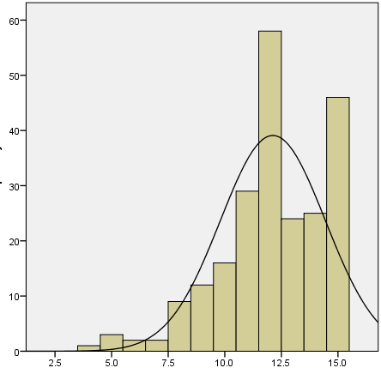
Index of Professor Relationship Quality
Index of Professor Relationship Quality
1. Do you feel supported by professors overall in your academic goals?
2. Do you feel supported by professors overall in your non-academic goals?
3. Do you feel respected by professors overall?
Using a 5 point scale from strongly agree to strongly disagree
Mean= 12.12
Standard Deviation= 2.316
Notes:
Emily

Slide 5
Sophomore Methods of Interacting with Professors
 | 0 times | 1-2 times | 3-4 times | 5+ times
Dropping in during office hours | 9.6% | 34.3% | 31.5% | 18.1%
Before or after class | 16.1% | 33.1% | 24.2% | 19.8%
During a scheduled meeting other than advising | 39.1% | 33.5% | 15.7% | 4.4%
Meeting by chance | 36.3% | 35.9% | 12.1% | 7.7%
Electronically | 3.2% | 18.1% | 23.8% | 47.6%
49.6% of sophomores have met with a professor during office hours at least 3 times.
Most popular method of communicating with professors was through e-mail with 71.4% having used this method at least 3 times.
Notes:
Emily

Slide 6
Self-Reported Barriers to Professor Interaction
Barrier to Professor Interaction | Number of Responses
Student feels intimidated, uncomfortable, anxious, shy, guilty, or embarrassed | 41
Office hours are too limited, hours and office location are not made clear | 34
Student feels they need a specific reason to come into office hours, they don’t know how to ask for help or what to say | 14
Professor has an unwelcoming demeanor or is not helpful | 11
Student is too busy | 10
Professor is too busy helping other students or is overbooked | 5
No barriers/ not applicable | 21
Notes:
Emily

Slide 7
Why Sophomores Met with their Class Dean
 | This semester | Last Year (First Year) | Both this semester and last year | Not at all
Academic Support or issue | 8 | 14 | 2 | 201
Mental Health or Support | 6 | 8 | 2 | 209
To arrange a leave of absence | 7 | 6 | 2 | 209
Due to a hospital Visit | 6 | 8 | 0 | 211
Needing leniency in class due to a personal/health/family problem | 7 | 13 | 3 | 201
To report bullying, hazing, bias, or harassment | 2 | 3 | 2 | 218
Code of conduct violation | 2 | 4 | 0 | 217
Responses from Open-ended Question:
“No. Who is the dean”
“I don’t even know who the class dean is”
n=225
Notes:
Yael- remind audience of sample size when pointing out not at all section

Slide 8
Difference in Approaching Professors with Questions in Sophomores of Color
Help with Question or Assignment
 | Students of Color | White Students
1-2 times | (46.4%) | (35.2%)
3-4 times | (17.9%) | (33.1%)
Sophomores of color initially visited professors 1-2 times for help with a question or assignment at a higher rate than white students.
That rate decreases drastically from 46% to 18% when moving from 1-2 times to 3-4 times
Help with question or assignment* Race/Ethnicity (grouped) Crosstabulation
Notes:
Yael

Slide 9
Dropping in During Office Hours and the Overall Thriving Index
There was a statistically significant relationship with students dropping in during office hours and a higher thriving score with a p-value of .043.
Notes:
Claire

Slide 10
Recommendations
Offer continued training and workshops on microaggressions, active listening and coaching for professors to increase student comfort in interactions.
Make the class dean more visible and more accessible, for example, using a system similar to office hours.
Find ways to reach out to students who do not take initiative to interact with professors on their own. For example, send invitations to struggling students to attend office hours.
Professors should consider having required office hours to break barriers to interaction.
Notes:
Claire

