Slide 1
Institutional Barriers
to Wellness Center Use
Lauren Peterson and Sabrina Wieczorek
Notes:
Fonts and spacing throughout - make a

Slide 2
Institutional Barriers
Factors of the WC that the institution controls such as hours of operation, location and staff training
-----------------
Interpersonal engagement with the Peer Educators
---------------
Promotion of WC events on campus
----------
Funding to promote WC event programming

Slide 3
Research Questions
What are the external barriers to Wellness Center use?
Which students tend to experience these barriers?
What is the impact do these external barriers have on Wellness Center use?
Notes:
Fix the wording of #3

Slide 4
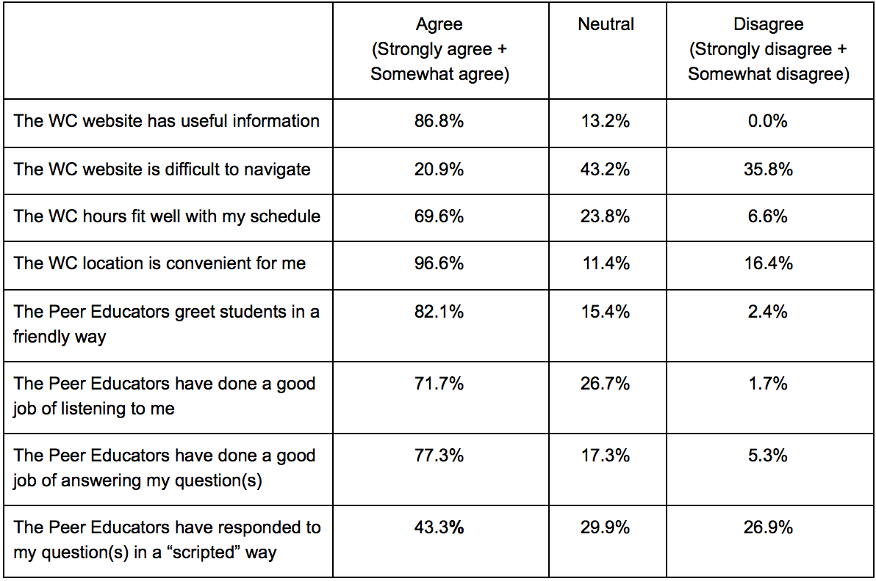
Possible Barriers with WC
Notes:
remove columns + add slide + add table
Past experiences with the WC Relatively positive 43.3% of respondents: PEs respond “scripted” manner
Importance of shared identity matched between student and Peer Educator
Gender identity: 27.8%
Sexual orientation: 21.1%
Race/ethnicity: 3.8%
Religious/faith: 2.9%

Slide 5
Shared Identity with PE
 | Very important to me | Somewhat important to me | A little important to me | Not important to me at all
Shared gender identity | 27.8% | 27.3% | 17.5% | 27.8%
Shared racial/ethnic identity | 3.8% | 9.6% | 20.7% | 65.9%
Shared sexual orientation | 21.1% | 22.2% | 21.3% | 44.4%
Shared religious/faith identity | 2.9% | 14.6% | 25.2% | 57.3%
“I only know about the sexual orientation of some Wellness Center Peer Educators because I know them personally. If I didn’t know them personally, this would be a problem for me.”
Notes:
Past experiences with the WC Relatively positive 43.3% of respondents: PEs respond “scripted” manner
Importance of shared identity matched between student and Peer Educator
Gender identity: 27.8%
Sexual orientation: 21.1%
Race/ethnicity: 3.8%
Religious/faith: 2.9%

Slide 6
Perception of WC Office Layout
 | Percent
Very welcoming | 0.0%
Somewhat welcoming | 75.9%
A little welcoming | 22.2%
Not at all welcoming | 1.9%
“It almost seems as if there is a fear of students stealing these items because they are behind a desk even though they are free for us to use.”
Notes:
Many focus group respondents have indicated that they feel unwelcomed when attempting to collect resources from the WC

Slide 7
Which students tend to experience barriers?
“Individuals who identify as racial, ethnic, or sexual minorities—or some combination of the three—often experience racialized and/or heteronormative oppression that can displace them from the resources and attention needed for health and wellness” (Collins and Rocco 2014)
Gender (5 categories -> binary)
Race/Ethnicity (9 categories -> binary)
Sexual Orientation (9 categories -> binary)
Notes:
FIX THIS + MORE SLIDES BETTER THAN LESS IF UNCLEAR
“um” use tables and space

Slide 8
Which students tend to experience barriers? (cont.)
Experiences with Peer Educators (listening, answering questions, friendliness) → No significant results
Event topic not of interest → No significant results
Shared student-PE identity when asking a health-related question
Significant relationship between sexual orientation and importance of shared student-PE sexual orientation
Perception that St. Olaf doesn’t care about student health (Index)
Students of color had a lower average index score than
white students
Notes:
Independent Variable
Gender (5 categories -> binary)
Race/Ethnicity (9 categories -> binary)
Sexual Orientation (9 categories -> binary)

Slide 9
What impact do these barriers have on WC usage?
We ran tests analyzing the frequency of WC use for Fall 2018 and:
Index of Peer Educator interactions (listening, answering questions, friendliness) → No significant results
----------------
Index of the perception that St. Olaf cares about student health and wellbeing → No significant results------------
----------------
Identity of respondents (gender, race/ethnicity, sexual orientation)
Significant relationship between race/ethnicity and WC F18 use (visit)
Significant relationship between gender and WC F18 use (total)
Notes:
Significant relationship between race/ethnicity and WC F18 use
Significant relationship between sexual orientation and WC F18 use

Slide 10
What impact do these barriers have on WC use? (cont.)
During Fall 2018 …
Students of color have a higher rate of WC visits than white students
Females have a higher rate of overall WC use than males

Slide 11
Strengths and Limitations of Study
Strengths:
Qualitative focus group followed by quantitative analysis
Generalizability to St. Olaf College
Fills a gap in the literature: institutional barriers that affect access to wellness programming in a college setting
Limitations:
Not all participants attended WC and/or its events
Possible institutional barriers may not have been listed as options
St. Olaf’s homogenous population made it difficult to analyze the complexities of identity (e.g., gender, race/ethnicity,
sexual orientation)

Slide 12
Recommendations for the Wellness Center
Provide easily accessible information about the PEs: photos, hours, interests (wellness-related, academic, and otherwise), and voluntarily-shared information about preferred gender pronouns and sexual orientation.
Create a repository for supplies that students can access discretely and inside and outside of WC hours.
Allocate more resources for wellness programming on the health and wellness issues that students of color face.

