Slide 1
Student Workers at St. Olaf College:
Student Experiences & Perspectives
Researchers in SOAN371 and Ryan Sheppard
Fall 2021
Notes:
https://www.istockphoto.com/photo/time-is-money-concept-gm1137169649-303138932

Slide 2
**We are recording.
Thank you to:
Our Client-collaborators
SOAN371 TAs: Anna Clements and Grace Cline
Student focus group participants
557 Student survey respondents

Slide 3
Background
Key topic & campus focus: Student Employment at St. Olaf College
8 sub-topics and 8 teams (27 researchers):
1. Job Search & Job Training
2. Student/Supervisor Relationships
3. Co-worker Relationships
4. Financial Aid & Work Hours
5. Academic Impacts of Work
6. Job Satisfaction
7. Careers and Graduate Education
8. Pre-Professional Training

Slide 4
Our Research Steps
Topic & Teams: Shared scholarly literature, topics & subtopics, broad research topic
Meet with client(s)
Each team’s process:
→ Review scholarly literature on team sub-topic
→ Develop tentative research questions
→ Conduct focus group
→ Refine research questions
→ Construct survey – consult with COLLABORATORS
→ Pre-test survey
→ Administer survey
→ Analyze data & Report results & recommendations (ALL)

Slide 5
Background & Terms
Research Method: Online anonymous survey, November 2021
2. Sample: Invited all 2,249 St. Olaf student workers → 557 = 25%
Sample demographics: Similar to St. Olaf student body
3. Measurement: Closed- & open-ended questions: Items & matrixes → Indexes (summary)
“Desired” scores: at ends
4. Statistical Analysis:
a. Univariate analysis: “Basic” results; central tendency and dispersion
b. Bivariate analysis:
* Tests: Chi-square, Cramer’s V, Mann-Whitney U-tests, etc.
* p-values: .05 (“significance value”)
* Statistical significance → Generalizable association or difference
“ Statistically significant differences by race and ethnicity, etc.: E&I Problem?
* Groupings for tests: Gender; Race and ethnicity – why; problematic; groupings

Slide 6
Today…
Session 1: 3 team presentations (6-7 mins. each)
Introduction + 1 team
→ Q & A
2 more teams
→ Q & A
Session 2: 5 team presentations (5-6 mins. each)
Introduction + 2 teams
→ Q & A
3 teams
→ Q & A

Slide 7
Financial Aid and Work Hours
Asi Sitinjak, Avery von Herrmann, Belem Gomez Vega,
and Hanane Idihoum
Notes:
https://www.istockphoto.com/photo/time-is-money-concept-gm1137169649-303138932

Slide 8
Research questions
How do St. Olaf students understand and feel about their financial aid and work award?
What factors influence students’ feelings about and understanding of the work award?
What is the relationship between financial aid, work hours, and student demographics?
Do some demographic categories of students experience more financial stress than others?

Slide 9
How well do students understand their Financial Aid Package?
Award Clarity Items | Strongly agree | Somewhat agree | Neutral | Somewhat disagree | Strongly disagree
I have a clear understanding of the work-study part of my financial aid package. | 36.6% | 39.7% | 6.4% | 14.9% | 2.4%
It was clear from the start that the work-study award is a potential amount to earn rather than an amount I am guaranteed to receive. | 48.0% | 26.7% | 7.1% | 12.7% | 5.6%
Before I enrolled at St. Olaf, I was aware that I might need to combine 2 or more jobs in order to complete my work award. | 24.9% | 17.8% | 10.9% | 22.7% | 23.8%
It was clear to me from the beginning that I might need to work a large number of hours to complete my work award by the end of the year. | 28.2% | 22.6% | 11.3% | 20.8% | 17.1%
It was clear to me from the beginning that some work-study jobs might involve mainly physical labor (such as at the cafeteria). | 7.6% | 11.3% | 17.3% | 11.3% | 7.6%
18.3%
46.5%
“I think it needs to be clear that accepting a work award and getting a job on campus does not mean that you will get all of the work award money.”
“I wish it was more clear in the beginning how the hiring process worked [and] that working multiple jobs is expected for the larger work studies”

Slide 10
Award clarity and demographics
Demographic and group | Group 1 Mean Index Score | Group 2 Mean Index Score | M-W test score | p-value
Generation: 1=First generation; 2=Continuing Gen. | 12.52 | 14.02 | 13928.500 | p < .05
Race and Ethnicity: 1=BIPOC; 2=White | 12.39 | 13.88 | 14625.000 | p < .05
International/Domestic Status: 1=International; 2=Domestic | 12.80 | 13.17 | 10272.000 | p > .05

Slide 11
Recommendations
When sending a financial aid award letter, add a separate document that defines the terms used and address Frequently Asked Questions
Provide resources specifically for first gen students and BIPOC students:
Informational sessions for work award planning
Separate informational documents sent in the language most used at home
Additional help from people properly trained to navigate and plan with different races and cultures

Slide 12
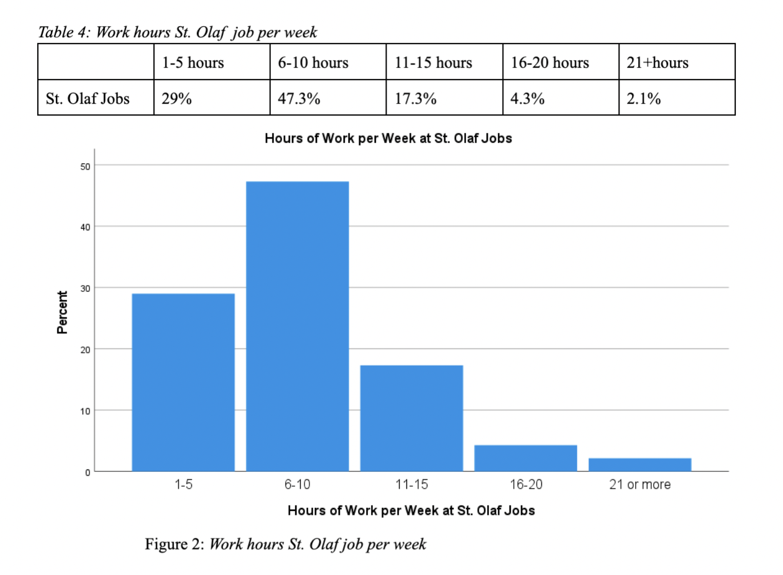
Work hours
 | 1-5 hours | 6-10 hours | 11-15 hours | 16-20 hours | 21+hours
St. Olaf Jobs | 29% | 47.3% | 17.3% | 4.3% | 2.1%

Slide 13
Work hours and demographics
We found a statistically significant relationship between work hours and race and ethnicity (aggregated):
X2(479)= 4.915 (p<.05)
 | 0-5 Hours/Week | 6-21+ Hours/Week
BIPOC students | 21.6 % | 78.0 %
White students | 31.9 % | 68.1 %
Notes:
Need to add table

Slide 14
How financially comfortable are St. Olaf student workers?
Financial need item | Strongly agree | Somewhat agree | Neutral | Somewhat disagree | Strongly disagree
I am comfortable financially at St. Olaf. | 13.0% | 30.8% | 18.7% | 25.8% | 11.7%
I struggle financially and worry about my expenses. | 23.2% | 35.8% | 15.0% | 18.1% | 7.9%
The amount of my work-study award satisfies my financial needs. | 9.5% | 27.3% | 19.7% | 29.0% | 14.4%
I need a larger work-study award than St. Olaf grants me. | 22.8% | 27.2% | 24.85 | 14.6% | 10.6%
I need to work at extra on-campus jobs beyond my work award (such as at Bon Appetit or the Bookstore) to meet my actual financial needs. | 12.5% | 13.4% | 25.2% | 21.0% | 27.9%
I need to work at extra off-campus jobs (such as Kwik Trip, Doordash, or Target) to meet my actual financial needs. | 15.8% | 11.6% | 21.9% | 21.2% | 29.5%
59.0%
50.0%
25.9 %
27.4 %

Slide 15
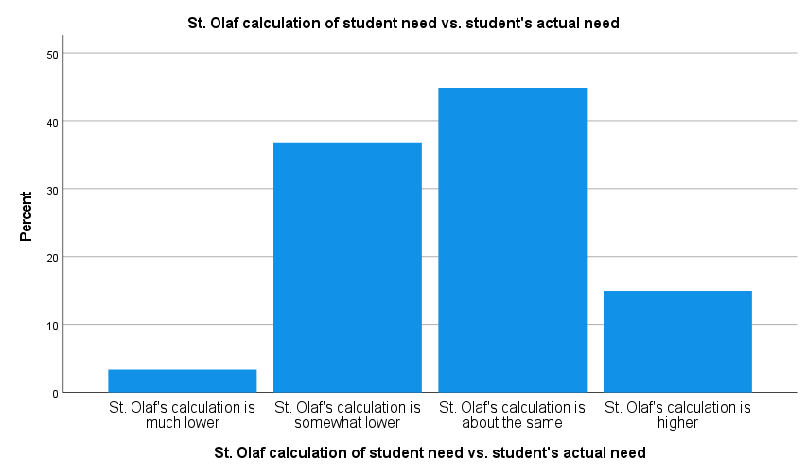
44.9%
36.8%
15%
3.3%
“Even if I have 3 jobs, I still experience financial difficulties”
“On-campus jobs do not pay enough per hour. Although I was given a needs-based work award, it would be much more effective to get an off-campus job that pays 5$ more per hour. Although I would love to not have to have that job, I simply cannot afford only working on-campus.”

Slide 16
Financial need and demographics
Demographic and group | Group 1 Mean Index Score | Group 2 Mean Index Score | T-test score | p-value
Gender (binarized): 1=female; 2=male | 12.55 | 11.30 | 1.865 | p >.05
Generation: 1=First generation; 2=Continuing Gen. | 13.86 | 11.64 | 3.392 | p <.05
Race and Ethnicity: 1=BIPOC; 2=White | 13.29 | 11.47 | 2.942 | p >.05
International/Domestic Status: 1=International; 2=Domestic | 12.93 | 12.01 | 1.092 | p >.05
No statistically significant differences across gender, international/domestic status, and race and ethnicity
The mean score for first-generation students was higher than for continuing generations.

Slide 17
Recommendations
Raise the minimum wage per hour for all jobs so that students do not work an increased number of hours at the expense of their academic success and health just to complete their work award.
Re-evaluate the Financial Aid Office’s definition and calculation of demonstrated needs and take into consideration students’ actual financial needs at St. Olaf (Medical bills, flight tickets home for international students, winter clothing, etc.)

Slide 18
Q & A Time!

Slide 19
Supervisor & Student Relationships at St. Olaf College
Leah Berdahl, Max Mayer, Sofi Serio

Slide 20
Our Research Questions:
To what extent do students have comfortable relationships with their supervisors, and how does this vary across job types student demographics?
How effectively are students’ work supervisors performing at St. Olaf College, and how does this vary across job categories?
To what extent do supervisors support students’ futures, and how does this vary across job types and student demographics?

Slide 21
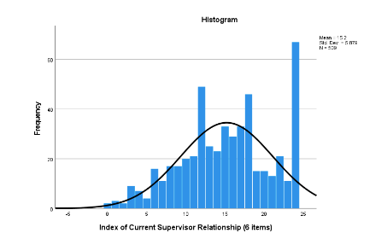
Current Supervisor Relationship with Students
This is a 6-item index of student comfort with asking supervisor for constructive feedback,
help to resolve an issue with a coworker or some other issue at work, help with a personal
issue, a letter of recommendation, and Interacting socially outside of work

Slide 22
Supervisor Relationship and Job Category
Job Category | Mean Comfort with Supervisor Index Score | s.d.
Educational | 14.31 | 5.314
Student Services | 16.71 | 5.967
Special Skills | 15.86 | 4.472
Administrative | 15.52 | 5.999
Food Services | 12.26 | 6.539

Slide 23
Supervisor Comfort/Relationship x Demographics and GROW at St. Olaf
Demographic and group | Group 1 Mean Score | Group 2 Mean Score | Mann Whitney U Score | p-value
Gender Binarized: 1=female; 2=male | 14.87 | 15.94 | 16923 | .103
Generation: 1=first gen; 2=continuing gen | 16.41 | 14.96 | 16660.5 | .034
Race and Ethnicity: 1=BIPOC; 2=white | 15.97 | 15.09 | 19662.5 | .149
International / domestic: 1=international; 2=domestic | 16.63 | 15.05 | 11204 | .078
GROW: 1=yes, 2=no | 18.50 | 14.78 | 8117.5 | <.001

Slide 24
Supervisor Performance
Item | Strongly Agree | Somewhat Agree | Neutral | Somewhat disagree | Strongly disagree
Has reasonable expectations for my job performance | 74.3% | 19.8% | 3.3% | 2.3% | 0.2%
Sees me as a student first and an employee second | 59.9% | 25.3% | 10.9% | 2.5% | 1.4%
Has asked about my academic interests or progress | 49.3% | 20.5% | 14.4% | 7.0% | 8.8%
Has encouraged me to reflect on the skills I’ve developed at work | 35.3% | 20.1% | 23.6% | 13.3% | 7.8%
Provides feedback on my skill development | 31.3% | 26.6% | 22.1% | 12.5% | 7.6%
Provides feedback on my job performance | 38.5% | 28.7% | 18.0% | 10.5% | 4.3%
Gives me feedback in a way that feels supportive rather than critical | 51.9% | 25.0% | 18.7% | 2.5% | 1.9%
Would be understanding if I needed to drop a shift because of an important deadline for a class. | 60.7% | 21.7% | 10.2% | 5.5% | 2.0%

Slide 25
Student Quotes
"My supervisor has made my job significantly more difficult due to poor communication and lack of organizational skills."
“A student gave negative feedback to a faculty member on one of our presentations and our supervisors handled it poorly, as they sent a very accusatory email. […] While the situation has been resolved, it was very stressful and emotionally taxing.”

Slide 26
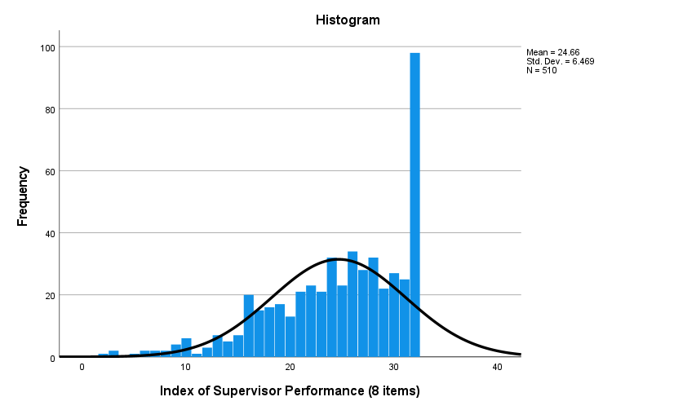
Supervisor Performance Index
This is a 6-item index of student comfort with asking supervisor for constructive feedback,
help to resolve an issue with a coworker or some other issue at work, help with a personal
issue, a letter of recommendation, and Interacting socially outside of work
8-item index of students’ evaluations of their supervisors: reasonable expectations, seeing students as students first and worker second, interest in students’ academic interests, encouraging reflection on skills, providing feedback, giving feedback that is supportive rather than critical, and being understanding if a student needs to drop a shift for academic purposes.

Slide 27
Supervisor Performance and Job Category
Job Category | Mean Supervisor Help & Reasonable Expectations Index Score | s.d.
Educational | 24.83 | 5.692
Student Services | 26.46 | 5.797
Special Skills | 26.95 | 4.589
Administrative | 24.54 | 6.497
Food Services | 19.71 | 7.472

Slide 28
Supervisor Performance x Demographics and GROW at St. Olaf
Demographic and group | Group 1 Mean Score | Group 2 Mean Score | Mann Whitney U Score | p-value
Gender Binarized: 1=female; 2=male | 24.4 | 25.38 | 17842.5 | 0.318
Generation: 1=first gen; 2=continuing gen | 25.43 | 24.56 | 16925.5 | 0.052
Race and Ethnicity: 1=BIPOC; 2=white | 24.84 | 24.72 | 20704.5 | 0.425
International / domestic: 1=international; 2=domestic | 25.05 | 24.66 | 12347.5 | 0.609
GROW: 1=yes, 2=no | 28.67 | 24.14 | 7546.5 | <0.001

Slide 29
Supervisor Support for Students’ Future
’ comfort with a supervisor?
How can supervisors help student workers develop transferable skills?
How effectively are students’ work supervisors performing at St. Olaf College?
Does supervisor performance vary across job categories?
How can the college help supervisors enhance performance?
Item | Strongly agree | Somewhat agree | Neutral | Somewhat disagree | Strongly disagree
My supervisor has asked me about (or shown interest in) my post-graduation plans. | 32.7% | 22.4% | 20.2% | 12.6% | 12.1%
My supervisor has helped me think about my future. | 24.9% | 19.8% | 24.5% | 15.6% | 15.2%
My supervisor has helped me think about how the skills I’m learning at my “focus job” apply to my post-college work life. | 26.5% | 21.5% | 24.4% | 15.4% | 12.3%
My supervisor has helped me develop and/or practice skills for my future career and graduate studies. | 27.0% | 25.6% | 24.1% | 12.9% | 10.4%

Slide 30
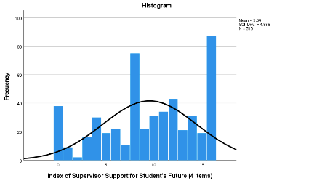
Supervisor Support for Student’s Future
4-item index of students’ evaluations of supervisors: asking about post-graduation plans, helping students think about their future, and helping students develop skills for their future and think about how those skills will apply in their future endeavors

Slide 31
Supervisor Support for the Future & Job Type
Job Category | Mean Supervisor Help for Future Index Score | s.d.
Educational | 10.27 | 4.694
Student Services | 11.81 | 3.573
Special Skills | 10.41 | 4.162
Administrative | 9.06 | 5.015
Food Services | 5.40 | 4.365

Slide 32
Supervisor Support for Student’s Future x Demographics and GROW at St. Olaf
Demographic and group | Group 1 Mean Score | Group 2 Mean Score | Mann Whitney U Score | p-value
Gender Binarized: 1=female; 2=male | 9.49 | 9.57 | 19110.0 | 0.972
Generation: 1=first gen; 2=continuing gen. | 10.0 | 9.48 | 17901.0 | 0.273
Race and Ethnicity: 1=BIPOC; 2=white | 9.4 | 9.69 | 21157.0 | 0.620
International / domestic: 1=international; 2=domestic | 9.05 | 9.63 | 12256.0 | 0.420
GROW: 1=yes, 2=no | 12.8 | 9.11 | 7197.0 | <0.001

Slide 33
Student Quote
While many supervisors provide student workers with support for skill growth and their post-St. Olaf futures and hold reasonable expectations, the College can and should improve supervision:
“I think that there needs to be a way for improvement to come immediately and directly, because as great as this survey is, these problems should be largely fixable through individual jobs or on a campus level quickly.”

Slide 34
Recommendations
Many supervisors are doing a good job, while others could be more effective in supervising and supporting student workers.
Improve student/supervisor relationships by providing training, encouragement, and perhaps incentives for supervisors across job types, especially for food services supervisors.
Enable and empower ongoing feedback from student workers regarding supervisor performance in order to make supervisors more aware of students’ experiences in their jobs and job relationships.
Institute GROW or a similar program across work-study jobs. Doing so can improve student relationships with their supervisors by increasing student/supervisor comfort, and it can enhance students’ future prospects by emphasizing transferable skills.

Slide 35
Supervisor Support for Student’s Future x Demographics and GROW at St. Olaf
Demographic and group | Group 1 Mean Score | Group 2 Mean Score | Mann Whitney U Score | p-value
Gender Binarized: 1=female; 2=male | 9.49 | 9.57 | 19110.0 | 0.972
Generation: 1=first gen; 2=continuing gen. | 10.0 | 9.48 | 17901.0 | 0.273
Race and Ethnicity: 1=BIPOC; 2=white | 9.4 | 9.69 | 21157.0 | 0.620
International / domestic: 1=international; 2=domestic | 9.05 | 9.63 | 12256.0 | 0.420
GROW: 1=yes, 2=no | 12.8 | 9.11 | 7197.0 | <0.001

Slide 36
Recommendations
For the College:
Work with Bon Appetit to promote high-quality co-worker relationships, partly through job training.
Standardize expectations for supervisors regarding worker job training and promoting co-worker relationships.
For Individual Supervisors:
When possible, conduct student training with groups of students and include opportunities for them to get to know each other.
Explicitly promote co-worker communication and relationships on the job: Enable and encourage students to work together and take breaks together (especially for longer work shifts)
Evenly distribute work among coworkers.

Slide 37
Co-worker Relationships in Student Employment
Abril Santos, Jimena Maida, and Larissa Rabelo

Slide 38
Research questions
What kinds of co-worker relationships do students have?
What do they gain from co-worker relationships?
How are co-worker relationships shaped by supervisors and the work environment?
Notes:
Here we have the research questions that we focused on for this study where we primarily asked students if they have co-worker relationships, what are a few things that affect these relationships and how can St. Olaf improve these experiences

Slide 39
Number of Co-workers in Focus Job
Number of Co-workers | Percent of Respondents
0 | 16.5%
1-2 | 17.5%
3-5 | 16.5%
6 or more | 49.3%
Notes:
Only doing the percentages, moving the explanation to Devon.
We asked students to state the number of co-workers they have in their St. Olaf focus job and this table shows us that almost half of the student body have 6 or more coworkers.

Slide 40
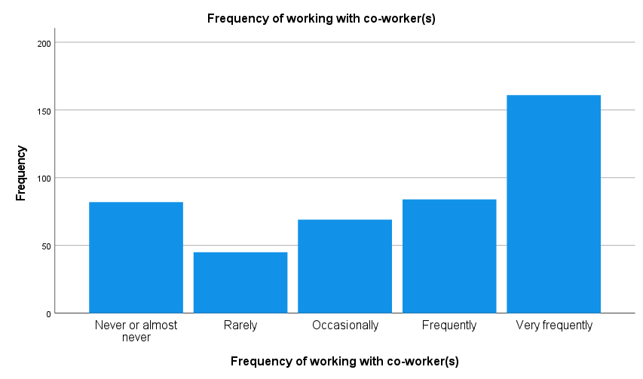
Frequency of co-workers working together *Frequently or Very frequently = half
Notes:
This graph shows us the frequency of students working together where more than half of the students report to frequently or very frequently.

Slide 41
Co-worker relationship matrix
Co-worker relations item | Strongly Agree | Somewhat Agree | Neutral | Somewhat Disagree | Strongly Disagree
*I trust my co-workers | 54.1% | 31.1% | 11.9% | 2.4% | 0.5%
*I have friendly relationships with my co-workers | 61.4% | 31.4% | 5.4% | 1.1% | 0.8%
*I feel respected by my co-workers | 66.7% | 25.5% | 6.2% | 1.1% | 0.5%
*My coworkers will help or support me if I need them | 60.2% | 28.5% | 8.9% | 1.1% | 1.4%
*I feel uncomfortable with my coworkers | 0.0% | 18.9% | 6.5% | 5.1% | 69.5%
*There is friction or anger among my co-workers | 0.0% | 12.6% | 6.3% | 3.0% | 78.1%
It is important to me to have friendly relationships with my co-workers | 57.6% | 30.3% | 9.2% | 2.2% | 0.8%
I am or would like to be friends with my co-workers | 44.8% | 30.7% | 19.0% | 3.8% | 1.6%
Notes:
This table also shows that students tended to agree that it is important to them to have friendly relationships with their co-workers (87.9%, or 57.6 + 30.3), but they are not quite as likely to agree that they want to an establish friendship with their co-workers
Students also tended to disagree (strongly or somewhat) that they feel uncomfortable with their co-workers (74.6%, or 69.5 + 5.1) and that there is friction or anger among them (81.1%, or 3.0 + 78.1). This can reflect some of the dynamics of student employees in their work environment between their co-workers. Students’ co-worker relationships tend to be positive overall.

Slide 42
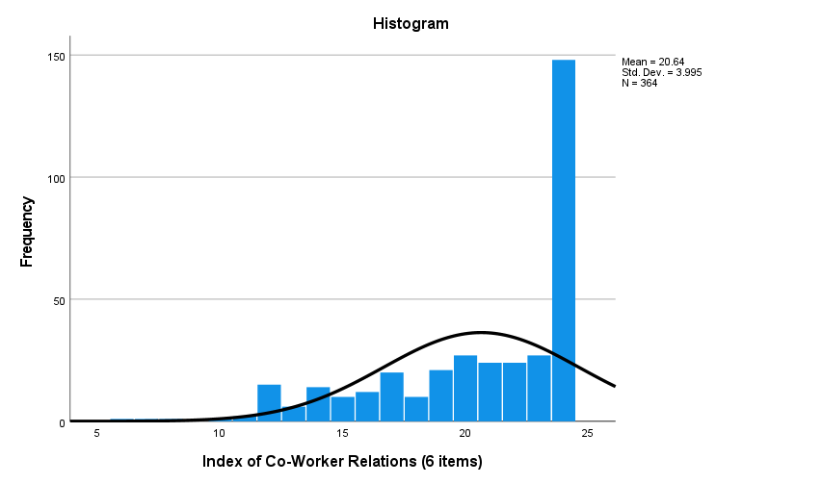
Co-Worker Relationships Index Scores *Very high cluster but too many low scores
Notes:
A plurality of respondents appears to be quite happy in their co-worker relationships, yet the figure also shows that many students are not having this positive experience. More than 40% of students having a maximum score of 24 yet, More than one-third (38.7%) have scores of 20 or below, with more than one in ten (11.3%) having scores of 14 or less. The range of the scores indicates disparate experiences in the co-worker relationships students are having on their focus jobs.

Slide 43
Index of Co-worker Relations x Binarized Demographics:
Mann Whitney U Test for 4 Items
Demographic and group | Group 1 Mean Index Score | Group 2 Mean Index Score | Mann-Whitney U Test | p-value
Generation: 1=First Generation; 2=Continuing Gen. | 21.40 | 20.48 | 9122.500 | 0.026
Race and Ethnicity: 1=White; 2=BIPOC | 20.68 | 20.82 | 11034.500 | 0.495
Domestic and International: 1=Domestic; 2=International. | 20.67 | 20.77 | 7349.000 | 0.830
Gender 1=Female; 2=Male | 21.40 | 20.49 | 9105.500 | 0.188
Index of Co-worker Relations (6 items) x Year in School: Spearman rho = -.21 (p<.05)
→ Students in younger years tend to have slightly better co-worker relationships
Notes:
Compares mean scores, and the only one that was statically different was first generation and continuing generation. However, the difference is too small and weak and it can be deemed as unimportant.

Slide 44
How do co-worker relationships impact students’ job satisfaction in their St. Olaf job?
*Job Satisfaction Index (6 items): feel satisfied overall, job enhances student experience, work is meaningful, rather do a different job, would quit if I could, would recommend job to another student
Positive moderate correlation: Spearman’s rho=0.583, p<.001
Students with higher scores on the Co-Worker Relationships Index tend to score higher in the Job Satisfaction Index.
Notes:
The top three stressors are: academics, friendships and relationships, and extracurriculars.
Inspired by literature which outlines a “good” friendship as communicative, making

Slide 45
Does the frequency of working with co-workers affect students’ gains in co-worker related skills?
Weak, positive correlation: Spearman’s rho=0.326, p<0.001
Students who report working with their co-workers more frequently tend to have higher scores in the index of co-worker-related skills gains.

Slide 46
How do co-worker relationships vary across job categories?
Job Category | Mean of Quality of Co-Worker Index (6 items) | s.d
Education | 21.22 | 3.826
Students Services | 21.52 | 3.594
Special Skills | 20.03 | 4.074
Administrative | 20.86 | 3.818
Food Services | 19.13 | 4.566

Slide 47
How do Co-Worker-Related Skills gains vary among the different job types?
Co-worker-related skills Index: collaboration, oral communication, managing conflict, leadership, teamwork, and ability to promote equity and inclusion
Job Category | Mean Co-Worker-Related Skills Index (6 items) score | s.d
Education | 13.18 | 5.436
Students Services | 18.85 | 4.487
Special Skills | 12.93 | 5.730
Administrative | 13.58 | 6.244
Food Services | 12.33 | 5.750

Slide 48
Frequency of Working with Co-Workers and Job Category
 | Never or almost never | Rarely | Occasionally | Frequently | Very Frequently | Total
Educational | 40.0% | 7.0% | 19.3% | 17.5% | 15.8% | 100%
Student Services | 6.3% | 7.6% | 15.2% | 32.9% | 38.0% | 100%
Special Skills | 6.6% | 14.8% | 9.8% | 19.7% | 49.2% | 100%
Administrative | 26.7% | 13.3% | 20.0% | 12.2% | 27.8% | 100%
Food | 0.0% | 2.1% | 4.3% | 23.4% | 70.0% | 100%
Total | 18.9% | 10.4% | 15.8% | 19.1% | 35.8% | 100%

Slide 49
Qualitative Analysis
Question 1: What is one thing your supervisor at your "focus job" does that supports your co-worker relationships?
Scheduling co-workers to work together
Regular group check-ins
Job training that includes getting to know co-workers
Outside-of-work activities for co-workers (picnic, holiday party, etc.)
Providing co-workers with each others’ contact information

Slide 50
Question 2: What is one thing your supervisor does that hinders your co-worker relationships?
Assigning too much work to only one person
Calling out mistakes in front of the staff team
Fostering unnecessary competition among co-workers
Lack of overlapping work periods
Assigning segmented work (co-workers are in the same location but doing individual work)

Slide 51
Question 3: If your St. Olaf "focus job" or another job has included meaningful connections with co-workers, how did the work environment (separate from the supervisor) affect the process of creating these relationships?
How did it help?
A positive environment enabled new friendships outside the student’s regular social circle
Workers were in close proximity working together
Students discovered similar interests
Workplace encouraged employees to get to know each other and create a friendly environment
How did it hurt?
Friendly interactions and encounters but not meaningful relationships between co-workers
Scheduling differences (working separate shifts)
Workers were focused on tasks to the detriment of relationships

Slide 52
Recommendations
For the College:
Work with Bon Appetit to promote high-quality co-worker relationships, partly through job training.
Standardize expectations for supervisors regarding worker job training and promoting co-worker relationships.
For Individual Supervisors:
When possible, conduct student training with groups of students and include opportunities for them to get to know each other.
Explicitly promote co-worker communication and relationships on the job: Enable and encourage students to work together and take breaks together (especially for longer work shifts)
Evenly distribute work among coworkers.

Slide 53
Q & A Time!

Slide 54
Thank you.
Research papers will be available in January.
Contact Ryan Sheppard for more information.

