Slide 1
Racial and Ethnic Equity and Inclusion at St. Olaf College: Student Attitudes & Experiences
Researchers in SOAN371 and Ryan Sheppard
Fall 2020

Slide 2
Welcome!
Thank you to…
Bruce King, Vice President for Equity and Inclusion
Our collaborators –
Mary Carlsen, TITE
Kathy Glampe and CAAS staff
Pamela McDowell, Joshua Lee, and Student Life
Leslie Moore, Kirsten Cahoon, and Piper Center staff
Maria Pabon Gautier, Taylor Center
Ryan Bowles, Athletics
Fred Behr, Public Safety
Tom Williamson
Carlo Veltri
Several St. Olaf College students
IT Staff
SOAN371 Teaching Assistants: Teresa Kayser and Bekah Reason
Student focus group participants
587 Student survey respondents

Slide 3
Background
Key issues & campus focus: Equity and Inclusion (see TITE Primer)
Inclusion: “creating opportunities for involvement and empowerment for underrepresented groups… feel respected, supported, valued, and enabled to fully participate in campus life”
Equity: “creating the conditions for all… to achieve the same learning outcomes as members of dominant groups”
Our focus: Racial and ethnic equity and inclusion for students
9 sub-topics and 9 teams (34 student researchers):
1. Advising, Mentoring, and CAAS Services
2. Student Services: The Piper Center, The Taylor Center, and Public Safety
3. Academic Thriving
4. High-Impact Practices
5. Microaggressions in Classes
6. Pedagogy and Curriculum
7. Student Housing and Peer Relationships
8. Students Organizations, Co-Curriculars, and On-Campus Employment
9. Social and Psychological Thriving

Slide 4
Our Research Process
Select topic and create research teams
Each team’s process:
Subtopic & “Starter” research questions/concepts
Meet with client
Review scholarly literature on sub-topic
Develop tentative research questions
→ Conduct focus group
→ Refine research questions
→ Construct survey – consult with collaborators
→ Pre-test survey
→ Administer survey
→ Analyze data & do reporting

Slide 5
Background & Terms
1. Research Method: Online anonymous survey (2), Oct. 21-28
2. Sample: Invited ~ half of St. Olaf students for each survey (random)
→ 305 + 282 responses: meets general rule for sample size
Demographics
3. Measurement: Closed-ended & open-ended questions
Items and Indexes/Matrixes
“Desired” scores: at ends (strongly agree/disagree; 0-12 → 0 or 12)
4. Statistical Analysis: Univariate, Bivariate, and some partials
a. Chi-square, Cramer’s V, Mann-Whitney U-tests
b. P-values
c. Statistical significance and statistically significant difference
d. Generalizability
“Statistically significant difference” = identifies a problem
“No statistically significant difference” = does NOT identify a problem
5. Groupings for tests: BIPOC & white students – problematic; varied groupings

Slide 6
Research teams are presenting highlights only
The teams have many more results beyond those provided here.
Their research papers and executive summaries are available.

Slide 7
Lean On Me: An Exploration of Mentorship and CAAS Resources in Relation to Race and Ethnicity Emmanuel Bioh, Adriana Sanchez, Ryan Schuna, and Emma Wallisch

Slide 8
Mentor Relationships
Do you have at least one advisor, professor, or other staff member at St. Olaf who does these things? | Percentage answering Yes | Percentage answering No
Takes time to get to know me as a person | 81.3 % | 18.7%
Provides a space where I can talk about personal struggles | 61.0% | 39.0%
Encourages me to pursue goals that advance my personal well-being | 63.3% | 36.7%
Helps to motivate me | 71.1% | 28.9%
Helps me connect with professionals in my areas (or possible areas) of career interest | 55.7% | 44.3%
Talks with me about topics related to job-seeking | 52.8% | 47.2%
Talks with me about options for education after graduation from St. Olaf | 60.7% | 39.3%

Slide 9
Advisor Quality and Relationships
Used 8 survey items
Compared results by race and ethnicity
I feel (or would feel) comfortable reaching out to my advisor about academic issues | BIPOC | White
Agree | 80.3% | 87.4%
Neutral | 12.1% | 3.7%
Disagree | 7.6% | 8.9%
Statistically significant difference: Cramer’s V= 0.158 (p=.041)

Slide 10
Accessibility of 8 CAAS Services: Hours & Locations
Supplemental Instruction
Tutoring
Writing Desk
The Speaking Space
Disability and Access Support
SOAR
Multilingual Student Support
Academic Coaching
50% - Somewhat easy to very easy

Slide 11
CAAS Levels of Use by BIPOC & White Students
No statistically significant differences between BIPOC and white students for most CAAS services.
Significant differences:
Tutoring: BIPOC students reported using tutoring services twice as much as white students
Academic Coaching (AC):
BIPOC students are more likely than white students to use AC
Comparing only students who have used AC:
White students are more likely to use it more than once.
BIPOC students are more likely to have used it only once.

Slide 12
Student Explanations for Not Using CAAS
Responses from 211 students
Lack of Need (67%) - No need or use other resources
Access and Time Issues (18%) - Not connected to CAAS and hours don’t fit their schedules
Eligibility and Knowledge Issues (12%)
Fear of Asking for Help (3%)

Slide 13
CAAS Service Satisfaction
 | Very Satisfied | Somewhat Satisfied | Neutral | Somewhat Dissatisfied | Very Dissatisfied
Supplemental Instruction | 33.5% | 47.3% | 11.7% | 5.4% | 2.1%
Tutoring | 26.2% | 38.1% | 23.8% | 10.7% | 1.2%
The Writing Desk | 26.8% | 35.6% | 22.8% | 12.8% | 2.0%
The Speaking Space | 17.2% | 43.8% | 32.8% | 6.3% | 0.0%
Disability and Access Support | 49.3% | 23.9% | 21.1% | 1.40% | 4.2%
SOAR | 11.7% | 28.3% | 45.0% | 10.0% | 5.0%
Multilingual Student Support | 0.0% | 10.0% | 90.0% | 0.0% | 0.0%
Academic Coaching | 30.9% | 34.5% | 34.5% | 0.0% | 0.0%
No statistically significant differences between BIPOC and White students

Slide 14
Recommendations for CAAS and Advisors
Increase Advertising
Emails/Posters
From a student worker in CAAS: "I've met so many people who would be super interested in having an accountability tutor, but aren't aware that it exists.“
Extend Hours
More evening hours
"I would extend to more hours in the evening and less in the morning.“
Offer Personalized Assistance
SI: Ask students what they want from an SI session
"Survey students about their satisfaction/dissatisfaction of SIs and change accordingly.“
For advisors: Foster personal relationships
Attention to BIPOC students: motivation, personal goals, personal struggles

Slide 15
Serving Which Students? Racial and Ethnic Equity & Inclusion in Student Services and Programming
Kaili Jacobsen, Anna Clements, Ch’aska Farber, and Ally Green
Our focus: Taylor Center for Equity and Inclusion, Piper Center for Vocation and
Career, Outside Speaker events, and Public Safety

Slide 16
Taylor Center – Welcoming & Convenience
Survey question: Please indicate your level of agreement or disagreement with each statement below.
 | Strongly agree | Somewhat Agree | Neutral | Somewhat disagree | Strongly disagree
TC is welcoming. | 52.2% | 23.3% | 17.8% | 6.7% | 0.0%
TC has convenient hours. | 38.2% | 27.0% | 31.5% | 3.4% | 0.0%
TC has convenient location. | 65.2% | 21.3% | 12.4% | 1.1% | 0.0%
MAIN FINDINGS
Univariate: Most students agreed (strongly or somewhat) that the Taylor Center is welcoming and convenient (in hours and location)
Bivariate: Statistical significance for convenient location only → BIPOC students more frequently agreed to some extent to this statement than white students

Slide 17
Taylor Center – Barriers to Use
Survey question: Have any of these factors deterred you from using the Taylor Center?
 | Yes | No
Lack of interest in TC | 22.3% | 77.7%
Lack of knowledge about TC | 54.3% | 45.7%
Lack of time to use TC | 32.3% | 67.7%
Student views TC as lacking resources that will help them | 25.9% | 74.1%
Student views TC as not inclusive for students of their racial, ethnic, or national identity | 6.4% | 93.6%
MAIN FINDINGS
Univariate: Over half of respondents indicated that a lack of knowledge about the TC was a barrier; few said a lack of racial/ethnic inclusivity was a barrier
Bivariate: Statistical significance for knowledge about TC only → white students were more likely to report a lack of knowledge than BIPOC students

Slide 18
Satisfaction with Piper Center Resources
Frequency of Satisfaction with Main Piper Center Resources
 | Extremely satisfied | Very satisfied | Somewhat satisfied | Slightly satisfied | Not at all satisfied
Meeting with Career Coach | 31.3% | 36.3% | 17.0% | 10.4% | 5.2%
Meeting with Peer Advisor | 21.6% | 43.2% | 19.8% | 10.8% | 4.5%
Piper Center Website | 21.8% | 31.4% | 31.4% | 14.1% | 1.3%
Workshops and Panels | 20.0% | 30.6% | 34.1% | 11.8% | 3.5%

Slide 19
Importance of Shared R&E Identity With PC Staff
Table 1. Importance of shared R&E with PC Peer Advisor
 | BIPOC Students | White Students
Not at all Important | 25.0% | 72.4%
Slightly or Somewhat Important | 39.3% | 17.1%
Very or Extremely Important | 35.7% | 10.5%
Bivariate Analysis: Importance of Shared Ethnicity with Peer Advisor (Cramer’s V=.405, p <.01)
Table 2. Importance of shared R&E with PC Career Coach
 | BIPOC Students | White students
Not at all Important | 23.3% | 74.3%
Slightly or Somewhat Important | 46.7% | 14.3%
Very or Extremely Important | 30.0% | 11.4%
Bivariate Analysis: Importance of Shared Ethnicity with Career Coach (Cramer’s V=.440, p <.01)
We recommend increasing the diversity of Piper Center Career Coaches and Peer Advisors.

Slide 20
Barriers to Attending Outside Speaker Events
Barriers to Attending Outside Speakers x Race and Ethnicity: No statistically significant differences
Barrier | Percentage Reporting this:
Schedule Conflict | 78.4%
Lack of Interest in the Topic | 73.5%
I disagreed with the speaker’s views. | 27.3%

Slide 21
Outside Speaker Events: Suggestions
73 participants provided suggestions.
1. Students suggested changing or varying the times at which outside speakers talk or allowing the event to be recorded/live streamed for those unable to attend the live event. (10)
2. Students suggested more publicity/advertisements and/or better communication regarding Outside Speakers. (14)
3. Students do not want to see departments or St. Olaf advocating for and supporting outside speakers whose ideology threatens students’ safety based on their identity. (17)
Recommendations:
1. Make it easier for groups to record outside speakers.
2. Be cautious about inviting threatening speakers.

Slide 22
Public Safety: Ratings & Problems
Table 1. Rating of Public Safety
Table 2. Problems experienced by students
Overall Rating | Percent
Very Good | 14.4%
Good | 32.6%
Fair | 36.4%
Poor | 16.7%
Problem | Frequency
Officer is rude, ignorant, or unwelcoming | 9
Unable to help in medical or mental health issue, or welfare check | 7
Jump-starting a car | 4
Unfair ticketing | 3
Unfair treatment of BIPOC/white students | 2
“…focus more on really helping students work through the challenges…and spend less time giving out parking tickets.”
“The demeanor needs to change. People are calling for help, and having a gruff or judgmental attitude towards the students requesting assistance doesn't inspire confidence.”

Slide 23
Public Safety: Suggestions
Suggestion | Frequency
Less [concern about] parking tickets/ make them cheaper | 14
Be clear, honest, and transparent with the services they provide (more info, better clarity, etc.) | 13
Have nicer officers/be less intimidating/don’t instill fear in students | 11
Diversity training | 8
Mental health training / make mental health more of a priority | 7
“Have them be less concerned with parking tickets and more with the general safety of students including masks and social distancing”
“More transparency between the department and students as to what their roles are so there isn't disconnect”
“They should get DEI training on their implicit biases and racial profiling. I have heard stories about them targeted stopping and check black students.”

Slide 24
Racial & Ethnic Equity and Inclusion and Academic Thriving
Veronica Bejm Franco, Mai Yer Moua, Cassandra Agyemang, Emma Purcell

Slide 25
Academic Thriving Definition
Engaged learning
“Meaningfully processing the material” (Schreiner 2010)
Students make connections between classroom material and their own interests, information learned in other courses, and life beyond the classroom.
Academic determination
An investment of effort and motivation to succeed
Students have educational goals and strategies to meet those goals.

Slide 26
Academics & RE Inclusion
Items in our Inclusion Index
My Professor uses a wide range of examples from different cultures
I feel included in the class
My Professor talks with me about a variety of topics
I feel comfortable talking about my racial, ethnic, or national identity in the class
My Professor underestimates my abilities
My Professor calls me by my name
My Professor has made an effort to pronounce students' names correctly
Mann-Whitney U-test Result
Mean score for White respondents: 22.86
Mean score for BIPOC respondents: 21.35
P-value <.05.

Slide 27
Academics & RE Equity
 | Strongly Agree | Somewhat Agree | Neutral | Somewhat Disagree | Strongly Disagree
My professor seems to treat students equally regardless of race, ethnicity, or nationality. | 73.0% | 18.5% | 6.0% | 1.4% | 1.1%
No statistically significant difference between BIPOC and White respondents (p=.756)
 | Strongly Agree | Somewhat Agree | Neutral | Somewhat Disagree | Strongly Disagree
St. Olaf provides the resources I need for success. | 41.1% | 33.9% | 14.6% | 8.6% | 1.8%
Statistical significance between BIPOC and White respondents (p=.031)
BIPOC students over 1.5x more likely to disagree or feel neutral

Slide 28
Academic Motivation and Engagement
 | Strongly Agree | Somewhat Agree | Neutral | Somewhat Disagree | Strongly Disagree
I feel motivated to do well in my class | 55.0% | 30.7% | 10.4% | 3.6% | 0.4%
Grades are one of my top priorities | 58.0% | 28.1% | 7.1% | 5.3% | 1.4%
I can perform well even when coursework becomes challenging ** | 32.0% | 45.6% | 12.5% | 8.2% | 1.8%
My academic goals are important to me | 68.2% | 26.1% | 3.6% | 2.1% | 0.0%
Academic Motivation Index and R&E: Mean score of White students =13.52
Mean score of BIPOC students =12.82 (p=0.007)
 | Strongly Agree | Somewhat Agree | Neutral | Somewhat Disagree | Strongly Disagree
I apply (or can apply) what I learn in my classes to other areas of my life | 73.6% | 18.6% | 6.8% | 0.7% | 0.4%
I think about what I’m learning in my classes even when I’m not in class or studying ** | 43.4% | 46.6% | 6.8% | 3.2% | 0.0%
I participate actively in my class | 47.5% | 40.0% | 7.5% | 3.9% | 1.1%
Academic Engagement Index and R&E: Mean score of White students= 10.34
Mean score of BIPOC students= 10.02 (p=0.162)

Slide 29
Barriers x Race & Ethnic Identity
***Statistically significent difference between BIPOC and white students
Mann-Whitney U-Test: Mean score for BIPOC students =2.41
Mean score for White students =1.62 (p value < 0.05)
Barriers | BIPOC Students | White Students
Social class/family income*** | 30.3% | 12.6%
Ole Culture*** | 31.8% | 15.8%
Family’s needs/issues*** | 28.8% | 14.7%
Mental Health*** | 80.3% | 64.2%

Slide 30
Recommendations
Improve student-faculty relationships. More concerned efforts to get to know each other, better communication about student’s performance in the class, increased appointment availability, “make asking for help normalized and encouraged.”
Re-define Ole Culture. Less emphasis around grades and perfectionism in order for students to move away from a culture characterized by competition into a culture of solidarity and mutual support.
“Ole Culture...is a performative way of measuring productivity.”
Increase mental health support. Acknowledgement of barriers faced by students (especially BIPOC), easier access to counseling services and resources, more appointment availability, better advertisement of current available resources.

Slide 31
Q & A Time

Slide 32
Racial Equity and Inclusion in High Impact Practices at St. Olaf College
Xia Xiong, Grace Peacore, Regina Vera Estrada, Wendy Garcia-Torres

Slide 33
What are High Impact Practices (HIPs) ?
A HIP is a program that enhances students’ mental, emotional, professional development; an active learning practice that promotes deep student engagement and leaves lasting impacts on those who participate.
 | Completed | Currently Enrolled | Started but did not complete (dropped) | Have not enrolled or done
Conversations Program | 21.0% | 14.8% | 3.6% | 57.0%
Off-campus Study | 26.6% | 0.7% | 1.0% | 67.5%
Internship | 17.7% | 2.0% | 0.7% | 4.6%
Mentored Undergraduate Research | 9.2% | 4.6% | 0.3% | 81.0%
Grouped Race/ethnicity variable to include all students, both domestic and international

Slide 34
Participation and Race and Ethnicity
Conversations Program Participation
 | BIPOC respondents | White respondents
Have not enrolled | 64.9% | 56.4%
Completed | 11.7% | 25.6%
Recommendations:
The college should provide “Information and Application Workshops” to help students apply for HIPs.
Advertise the workshops to marginalized and BIPOC communities on campus to encourage their involvement and increase their participation.

Slide 35
Inclusion
HIPS Inclusion
Inclusion Items | Strongly Agree | Somewhat Agree | Neutral | Somewhat Disagree | Strongly Disagree
I felt like my ideas were valued by my peers in my HIP* | 49.1% | 41.5% | 5.7% | 1.9% | 1.9%
I felt like my ideas were valued by my professor or supervisor in my HIP | 63.4% | 26.8% | 6.7% | 1.8% | 1.2%
I made close friends in my HIP* | 54.5% | 28.5% | 9.1% | 4.2% | 3.6%
I felt like I belonged in my HIP | 47.0% | 28.9% | 10.8% | 9.6% | 3.6%
I found support from at least one faculty member or mentor in my HIP | 59.9% | 25.7% | 10.2% | 2.4% | 1.8%
My peers viewed my appearance (such as hair or attire) as inappropriate for my HIP | 7.4% | 2.0% | 6.8% | 10.8% | 73.0%
My professor(s) or supervisor(s)viewed my appearance (such as hair or attire) as inappropriate for my HIP | 8.7% | 2.0% | 4.7% | 8.7% | 75.8%
I would recommend my HIP to my friends | 54.5% | 28.5% | 0.1% | 4.2% | 3.6%
Recommendation: Intentionally create spaces in or related to HIPS where students can create friendships and talk about their experiences.

Slide 36
HIPs Benefits
Percentage of students that did not gain the benefit
 | BIPOC Students | White Students
* Increased Self-Confidence | 77% | 64%
Better Clearer Ideas about Future Career Interests | 69% | 62%
Personal Development | 58% | 51%
New Friends | 65% | 60%
A reference or a letter of recommendation | 68% | 75%
A job or Internship | 94% | 98%
* indicates statistical significance
There is a deficit in the benefits BIPOC students gain but not a statistically significant difference except in increased self confidence.
Recommendation: Check in with students to assure they are empowered by their HIPs involvement, with a special focus on BIPOC students.

Slide 37
Barriers to Participating in HIPs
 | Very large barrier | Large barrier | Moderate barrier | Small barrier | Not a barrier at all
Your employment* | 1.8% | 4.4% | 16.1% | 14.6% | 63.1%
Participation in co-curriculars | 2.2% | 8.8% | 21.2% | 19.3% | 48.5%
Your academic commitments | 8.4% | 19.0% | 24.1% | 20.1% | 28.5%
Your finances* | 12.0% | 10.9% | 18.6% | 17.9% | 40.5%
Lack of personal connections* | 10.5% | 11.6% | 25.7% | 16.7% | 35.5%
Lack of awareness | 8.3% | 8.7% | 26.1% | 18.5% | 38.4%
Lack of transportation for the HIP* | 4.0% | 2.9% | 9.5% | 9.9% | 73.6%
Lack of inclusivity* | 1.5% | 3.3% | 6.9% | 10.2% | 78.1%
Recommendations:
Increase funding and student awareness opportunities
Create specialized guidance inside the Piper Center and other programs and departments that supervise HIPs for BIPOC students

Slide 38
Financial Assistance
Awareness of funding opportunities | Yes | No
Johnson Family Fund | 32.9% | 67.1%
Piper Center Grant | 43.7% | 56.3%
Other financial assistance from St. Olaf College | 41.3% | 58.7%
Funding opportunity from outside St. Olaf | 24.1% | 75.9%
First generation students are significantly more aware of funding opportunities than non-first generation students, perhaps due to learning about this through programs such as McNair Scholars.
Recommendation: Increase the diffusion of information about funding opportunities.

Slide 39
Microaggressions in College Classrooms: Experiences and Views of
BIPOC and White Students
Grace Cline, Rodrigo Escobar, and Aml Mohamed

Slide 40
What are Microaggressions?
They are common, daily indignities toward a person or group on the basis
of race, ethnicity, or nationality.
Verbal, behavioral, or environmental (part of the setting)
Intended or unintended
Obvious or subtle
The cumulative burden contributes to diminished well-being and academic performance.

Slide 41
Frequency of Microaggressions (MAs) in the Classroom
Table 1. This semester during your classes so far, how many times have these things occurred?
 | 0 times | 1 time | 2 times | 3/+ times
I was targeted (or my racial, ethnic, or nationality group was targeted) by a racial or ethnic microaggression from another student. | 94.1% | 3.6% | 1.2% | 1.2%
I was targeted (or my racial, ethnic, or nationality group was targeted) by a racial or ethnic microaggression from a professor. | 96.0% | 2.4% | 1.2% | 0.4%
I observed a racial or ethnic microaggression from a student to another student. | 82.2% | 7.9% | 5.1% | 4.7%
I observed a racial or ethnic microaggression from a professor to a student. | 85.3% | 7.9% | 4.0% | 2.8%
I enacted a racial or ethnic microaggression toward another student. | 96.8% | 2.4% | 0.8% | 0.0%
Being targeted 1/+ times:
~6% from another student
4% by a professor
Observing 1/+ times:
~18% from a student to another student
15% from a professor to a student

Slide 42
Student-to-Student Microaggressions in Classes
Table 2. So far this semester during your St. Olaf classes: How many times have you experienced or observed a fellow student do the following things towards you or another student?
 | 0 | 1 | 2 | 3 | 4 | 5/+
Minimized a student’s comments or contributions because of their race, ethnicity, or nationality | 78.7% | 8.2% | 7.8% | 3.4% | 1.5% | 0.4%
Stated or implied “I don’t see color” regarding race and ethnicity | 79.9% | 9.7% | 5.2% | 3.4% | 0.7% | 1.1%
Stated or implied that “racism doesn’t exist anymore” | 82.4% | 10.5% | 3.7% | 1.9% | 1.5% | 0.0%
Stated or implied a racial, ethnic, or national stereotype about a group of people | 56.4% | 18.0% | 10.9% | 6.8% | 2.3% | 5.6%
Focused uninvited attention on a student of color or an international student (such as asking for “the people of color perspective” or “the Chinese perspective”; looking to them to answer questions about race and racism; etc.) | 73.5% | 11.6% | 5.6% | 5.2% | 1.1% | 3.0%
Excluded or tried to exclude someone from a group project or activity, or didn’t welcome them, based on their race, ethnicity, or nationality | 92.5% | 4.9% | 0.4% | 1.1% | 0.4% | 0.7%
Mocked language styles or imitated accents | 77.1% | 12.4% | 4.9% | 2.3% | 0.4% | 3.0%
Told a joke that mocked or degraded a racial, ethnic, or nationality group(s) | 73.0% | 12.7% | 7.9% | 3.7% | 0.4% | 2.2%

Slide 43
A Closer Look at MAs in the Classroom
“The professor, of my extra curricular activity, made a comment "jokingly" about stepping on people's necks, which is an act of violence that was used against George Floyd, a black man, this summer and he died as a result.”
“The professor, in response to a colored student's worries about the racism of the modern world said, "That's an individual problem we all deal with differently" and changed the subject. That remark was never acknowledged”

Slide 44
Responses to MAs in Classes: Actual v. Ideal
Table 3. Student’s responses to racial and ethnic MAs in classes
 | Percentage
Confronted or called out the enactor forcefully (such as by calling their behavior racist) | 2.3%
Confronted or called out the enactor gently (such as by asking questions or explaining that the statement or behavior is a microaggression) | 8.9%
Reacted nonverbally (such as rolled your eyes, shook your head, sighed, gasped, etc.) | 12.1%
Stayed silent because you "froze" or didn't know what to say in the moment | 14.4%
Stayed silent for some other reason | 7.9%
Left the classroom (or turned off the camera or microphone, in the case of an online class) | 1.3%
Confronted the enactor of the microaggression later | 2.6%
Contacted another student in the class later to discuss the microaggression | 8.5%
Many of these responses contradict students’ reported ideal responses: Confrontation (gentle or otherwise), Conversation or dialogue, Reporting

Slide 45
Handling Microaggressions in the Classroom
Quotes from students:
“My anxiety prevents me from being directly confrontational… so I'd like to see them called out more forcefully by my peers (white folks need to be aware of these things and doing it gently usually doesn't do much in the long run). If other white peers are able to, they should be performing the confrontation - POC already spend enough emotional energy on the daily dealing with the world around them”
“My one professor handled this perfectly: a student in our class used the wrong terminology (that was outdated and offensive) to refer to a group of people, and my professor quickly jumped in, corrected them, and explained why the new term should be used instead. Then we moved on with class. It should be quick, corrective, productive, and gentle.”
“It's more complicated with a professor because there is such a power differential. The professor will be issuing grades. As a student, I would be less willing to intervene in the moment.”
“The professor should recognize their mistake and it should be allowed to be addressed by the class.”

Slide 46
Comparison of BIPOC and White Students’ Responses to Racial and RMAs in Their Classes
Table 4. Bivariate Test of Student Responses to MAs by Race and Ethnicity
 | BIPOC | White | P value
Confronted or called out the enactor forcefully (such as by calling their behavior racist) | 6.4% | 1.0% | N/A
Confronted or called out the enactor gently (such as by asking questions or explaining that the statement or behavior is a microaggression) | 17.9% | 5.6% | .001*
Reacted nonverbally (such as rolled your eyes, shook your head, sighed, gasped, etc.) | 20.5% | 10.7% | .031*
Stayed silent because you "froze" or didn't know what to say in the moment | 24.4% | 10.7% | .004*
Stayed silent for some other reason | 16.7% | 5.1% | .002*
Left the classroom (or turned off the camera or microphone, in the case of an online class) | 2.6% | 1.0% | N/A
Confronted the enactor of the microaggression later | 9.0% | 0.5% | N/A
Contacted another student in the class later to discuss the microaggression | 19.2% | 4.1% | .000*

Slide 47
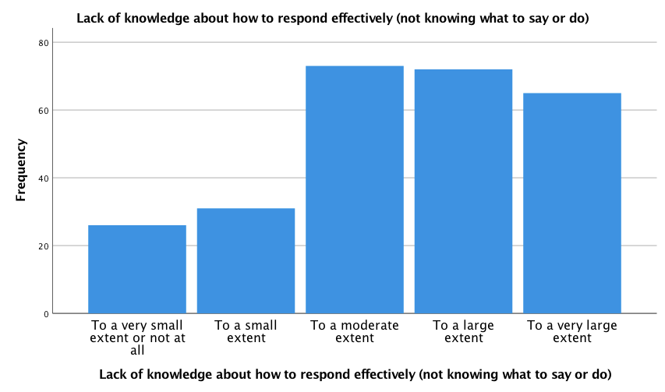
Barriers to Effective Responses
Figure 1. If a racial or ethnic microaggression occurs during class, to what extent do (or would) the following factors discourage you or stop you from responding?
Compared to white respondents, BIPOC respondents were more fearful of being singled out to a large extent (34.3% vs. 15.2%) and more fearful of disclosing parts of their own identities in class from a large extent to a very large extent (29.0% vs.7.1%).
BIPOC respondents reported being no more knowledgeable about how to respond effectively (what to say or do) when MAs occur than white respondents.

Slide 48
Main Other Factors that Discourage Students from Responding to a Racial and Ethnic MA in Classes
1. Felt they didn't know enough to step up/wasn't their place to speak up
“Feeling as though it may not be my place as a white student to speak on behalf of BIPOC students though I would always support their actions in response to said microaggression”
“I don't want to appear with the mindset of "white saviors" who act "woke" and think they are helping but they're making it worse. Essentially I'd want to talk with the affected student so that I didn't make them uncomfortable by addressing something.”
2. Fear extreme negative response from peer/perpetrator
“Fear that it would turn from a verbal conflict into a physical one”
“If it is done by my professor I would be scared that the rest of the class duration (for the year) would be difficult because I would be denied help and access to resources.”
“The class environment...in STEM classes, students are more annoyed when someone brings up race/ethnicity.”
3. Not having the ability/opportunity to speak up in class
“It’s difficult to respond/ approach microaggressions over zoom/ online classes where social relationships and the social scene is still unfamiliar and difficult to navigate.”

Slide 49
Recommendations
There is gap between students saying “I notice microaggressions and understand how harmful microaggressions are,” and “I see microaggressions happening in the classroom, yet I take no action against this violence.”
We need to bridge this gap.
1. Change the current “diversity” training. It is not working or is not working well enough.
Students need more training related to their specific communities and demographics, led by their community members.
More direct communication to specific student groups
2. Make the bias report process more known and transparent.
Professors should explain the bias report process at the beginning of the term to each of their classes.
3. Allow for more consistent anonymous feedback from students to faculty throughout the semester.
Professors could provide an anonymous survey after every class or ongoingly.

Slide 50
Curriculum and Pedagogy
Racial and Ethnic Equity and Inclusion
Maha Abadi, Lauren Kennedy, Sofia Moran, and Clare Wongwai

Slide 51
Professor Positives: Inclusive and Equitable
 | 0 Courses | 1 Course | 2 Courses | 3 Courses | 4 courses or more
Promoted discussion of racism | 2.5% | 12.1% | 27.4% | 36.3% | 21.7%
Directly addressed a microaggression that occurred in class | 73.1% | 16.5% | 6.1% | 1.4% | 2.9%
Made a verbal statement promoting inclusivity in the class | 4.3% | 10.7% | 19.3% | 26.4% | 39.3%
Discussed the connections between course materials and issues related to race and ethnicity | 5.4% | 17.9% | 26.8% | 30.7% | 19.3%
Shared their own experience(s) with microaggression(s) | 59.3% | 27.9% | 8.9% | 1.4% | 2.5%
Evaluated students using a variety of types of assessments (such as presentations, papers, participation, exams, etc.) | 3.6% | 6.1% | 18.8% | 30.7% | 40.8%
Used mostly or only course materials that are free (such as online text, articles, or handouts) | 23.2% | 26.4% | 26.8% | 12.9% | 10.7%
Asked a question in class and then called on multiple students to answer | 6.1% | 14.7% | 26.6% | 23.0% | 29.5%
Inclusive Practices
Equitable Practices

Slide 52
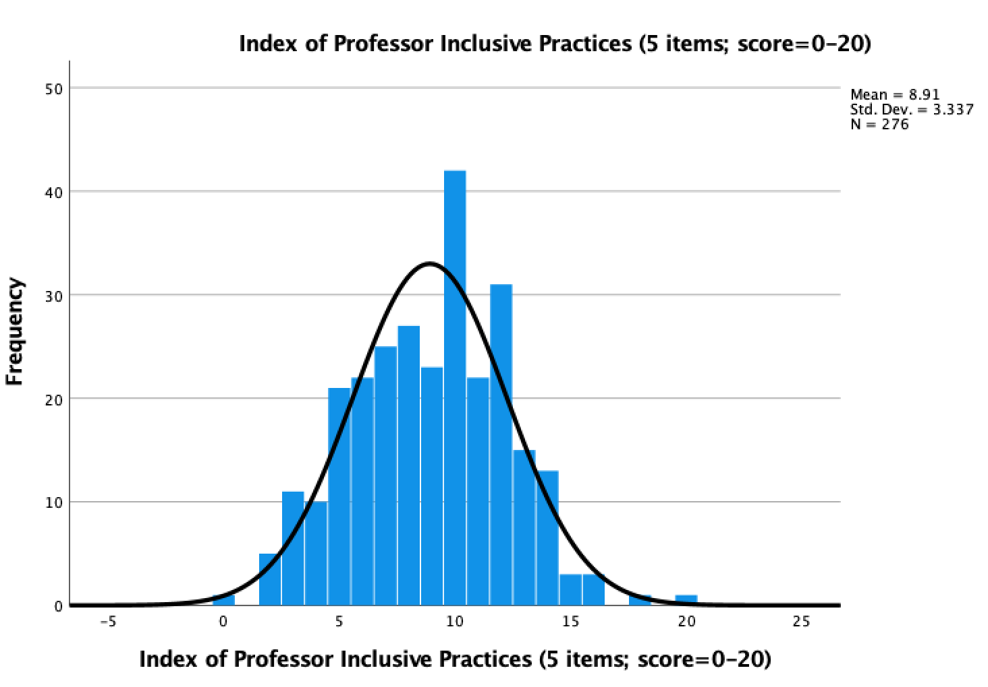
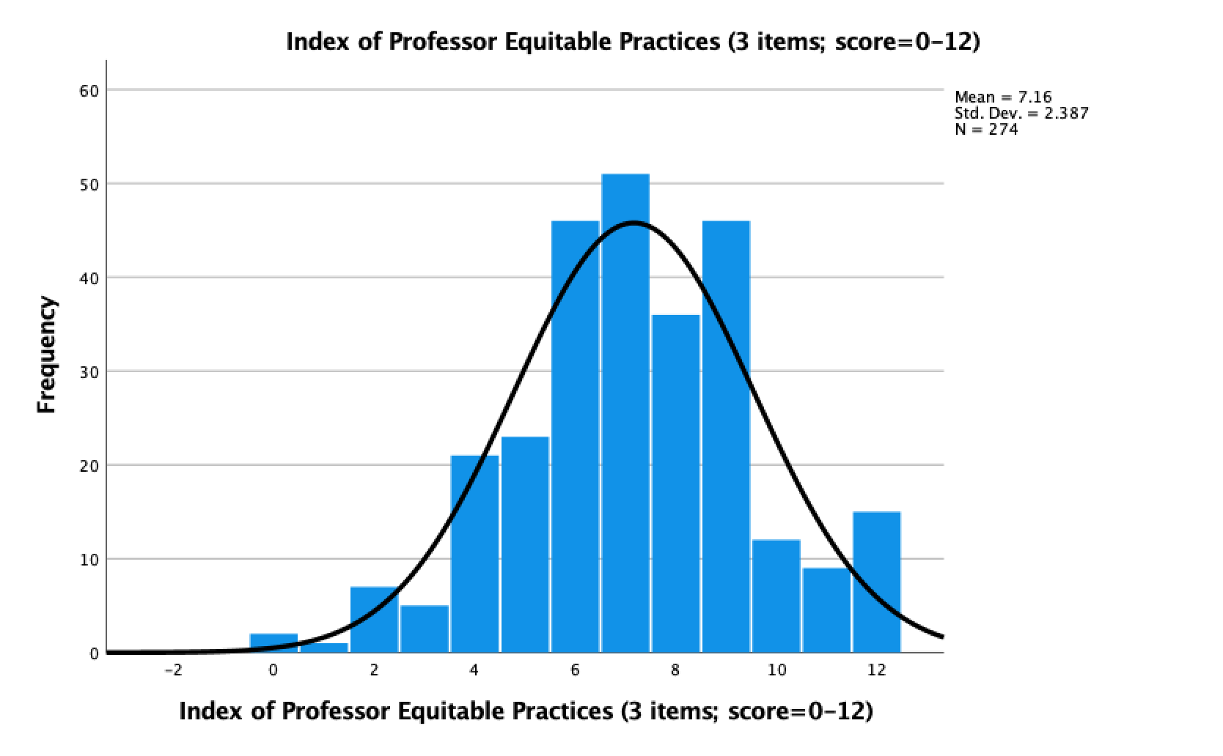
Inclusive and Equitable Indexes

Slide 53
Feelings of Inclusion Based on Curriculum
 | Domestic BIPOC + International students % agree (somewhat and strongly) | Domestic White students % agree (somewhat and strongly)
The course topics in my major make me feel included | 13.9% | 52.6%
The course readings in my major make me feel misrepresented | 22% | 17.5%
The discussions of race and/or ethnicity in the courses in my major isolate me from my classmates | 31.3% | 9.9%
*Statistical analysis includes responses from international students together with domestic BIPOC students
Statistical significant differences for all three items (Chi-squared tests)
Student responses point to the need for
1. Professors to be better equipped to facilitate conversations regarding race and/or ethnicity
2. Curriculum in all departments (including course topics, readings, and materials) be inclusive and representative of all students

Slide 54
Feelings of Inclusion based on Identity
Variables that contribute to feeling included in a classroom for participants
Department or program of course focuses on issues of race and ethnicity
Professor shares student’s racial and/or ethnic identity(ies)
At least one classmate shares student’s racial and/or ethnic identity(ies)
More than half of classmates share student’s racial and/or ethnic identity(ies)
BIPOC and international students’ sense of inclusion was positively affected by the identity-related conditions listed above.
 | White Domestic | BIPOC Domestic | BIPOC domestic + International
Yes | 40.1% | 53.7% | 55.1%
No | 58.9% | 46.2% | 44.9%

Slide 55
Professor Microaggressions
In your classes this semester, how many times have you experienced or observed a professor do the following things?
Question students’ abilities
English
Intelligence
Averages (rounded to the nearest decimal)
 | White Domestic | BIPOC Domestic | BIPOC and Inter'l
0 | 80.0% | 84.5% | 82.9%
1 | 4.8% | 8.5% | 10.1%
2 | 2.3% | 4.0% | 3.6%
3 | 1.4% | 3.1% | 2.5%
4 | 1.0% | 1.6% | 1.3%
5 or more | 0.8% | 1.6% | 1.8%
State or imply:
A racial, ethnic or national stereotype
“I do not see color”
“Racism does not exist anymore”
Deny the possibility of being racist
Include racist course material
Focus uninvited attention on student of color

Slide 56
Recommendations
St. Olaf College should require professors to participate in an ongoing anti-racism training program centered around group discussion, reflection, and collaboration with other faculty.
Professors should regularly allow and promote discussions that address racial issues that are directly and indirectly related to the course.
St. Olaf College should require professors to go through a multi-step process before the start of each semester where they evaluate (or reevaluate) their course topics and materials.
End-of-semester course evaluations should include questions that gauge the professor’s use of inclusive and equitable practices.

Slide 57
Q & A Time

Slide 58
Living with Racism:
Racial and Ethnic Equity and Inclusion in Student Housing and Peer Relationships
Danielle Croll, Victoria Gutierrez, Laurel Shanks, and Pajaie Thao

Slide 59
Feeling Welcome in Student Housing & Programming
BIPOC students: Higher rate of feeling unwelcome (overall and for joining events in housing)
Interracial roommates = a contested topic
No statistically significant difference in quantitative results, but qualitative results show difference:
“Putting bipoc with trump supporters for example is not good.”
“I would not room people based on their race, unless they specify that they would prefer that.”
~ 1/2 respondents feel underrepresented by Hall Council and ResLife programming in dorms
BIPOC students: 8 times more likely regarding HC events
BIPOC students: 5 times more likely regarding for ResLife events
Recommendations:
Revisit the purpose of Hall Council and increase student input on events, especially among BIPOC students.
Reduce the number of all-hall events and focus on floor and corridor programming to foster sense of community.

Slide 60
Residence Life Addressing Racism
Racism in and near student housing
BIPOC students 10x more likely to encounter and notice racism in or around student housing
Mean scores: BIPOC: 2.55; White: 0.24
ResLife’s approach to race and ethnicity: sufficient responses, discussions, policies, etc.
BIPOC students are no more likely to agree or disagree than White students.
Recommendations
Provide anti-racist training for all Residence Life staff
Conduct additional focus groups on how to meet the needs of BIPOC students in student housing

Slide 61
Peer Relationships
St. Olaf clique culture is an obstacle to interracial friendships
71.7% of respondents agreed somewhat or strongly
Statistically significant group differences:
BIPOC students are more than twice as likely to disagree that they have enough close friends
BIPOC: 28.0% and White: 13.7%
BIPOC students are far more likely to agree that they have close friends across racial/ethnic identity
BIPOC: 78.0% and White: 58.1%
Recommendations:
Create programs that will appeal to both BIPOC and White students
Encourage and assist BIPOC students’ participation in these programs and other opportunities
Create and advertise more social media spaces for students to meet one another

Slide 62
BIPOC Peer Relationships in Student Housing
“I feel comfortable talking with students in my dorm or honor house whose race, ethnicity, or nationality is different from my own”
BIPOC students were more likely than white students to disagree or feel neutral (BIPOC=4.8% vs White=16.3%).
Sources of Friendships
Living near other students in campus housing: 68.1% listed this as very or extremely important
Mutual Friends: 69.2% listed this as very or extremely important.
BIPOC students were 1.3x more likely to rate mutual friends as extremely important.
Programming in campus housing: 13.8% listed as very or extremely important.
Recommendations for equity and inclusion:
Establish more college-run organizations for BIPOC students (counterparts to mainly white organizations like Ole Choir)
Eliminate the housing component of conversations programs
Allow BIPOC first years the option of rooming with someone of their same race and ethnicity

Slide 63
Exploring Racial Equity
and Inclusion in Student
Organizations, Co-curriculars,
and On-campus Employment
Aubrey Sewell, Kiernan Bartlett, and Emma Boehm
SOAN 371: Foundations of Social Science Research – St. Olaf College, Fall 2020

Slide 64
Important Terms
Student Organizations: Student-led activities
Co-curriculars: Faculty-led activities
On-campus employment

Slide 65
How do barriers to participation compare across race and ethnicity?
Table 1. Barriers to Participation in Student Organizations and Co-Curriculars
*** = significant difference between BIPOC and White students | To a very large extent | To a large extent | To a moderate extent | To a small extent | Not at all
Time Commitment | 13.7% | 25.4% | 27.0% | 18.8% | 15.2%
Feel it's too late to join | 19.0% | 25.2% | 21.7% | 25.2% | 19.0%
Lack of inclusiveness for all racial and ethnic identities *** | 3.9% | 8.7% | 16.9% | 31.9% | 38.6%
Lack of inclusiveness for a student’s own racial and ethnic identity *** | 5.5% | 3.1% | 7.1% | 11.4% | 72.9%
BIPOC students were more likely to experience lack of inclusiveness as a barrier.
“I feel like there is an invisible barrier that keep (sic) BIPOC and white students away from each other… [M]ost of the cliques I see have no diversity....” (Anonymous)
Recommendations:
Promote the participation of all students on the “Presence” web platform, with an emphasis on reaching BIPOC students.
Require organizations’ leaders to reduce exclusive tendencies by addressing students’ feelings of belonging and exclusion.

Slide 66
How do barriers to attaining leadership compare across race and ethnicity?
Table 2. Barriers to Leadership in Student Organizations and Co-Curriculars
*** = Statistically significant difference | To a very large extent | To a large extent | To a moderate extent | To a small extent | Not at all
Time Commitment | 8.9% | 25.4% | 27.7% | 14.6% | 23.5%
Time Management | 6.1% | 13.1% | 21.6% | 23.0% | 36.2%
Anxiety about Leadership | 33.0% | 25.4% | 15.8% | 16.3% | 9.6%
Fear of Failing in Leadership positions | 12.3% | 13.3% | 20.4% | 24.2% | 29.9%
Lack of Inclusiveness for leaders of students’ racial or ethnic identity*** | 2.9% | 1.9% | 5.8% | 13.6% | 75.7%
BIPOC students were more likely than white students to experience lack of inclusiveness as a barrier to attaining leadership.
Recommendations:
Organize open discussions about REI between leaders and members to alleviate fear of judgment, failure and anxiety among members seeking leadership roles
Require mandatory training for all leaders of organizations about strategies to integrate and retain BIPOC student involvement

Slide 67
To what extent do students experience racial and ethnic inclusion and equity in their student organizations and co-curriculars?
Table 3: Perception of Racial Equity and Inclusion in Student Organizations and Co-curriculars by Percentage
 | Strongly Agree | Somewhat agree | Neutral | Somewhat disagree | Strongly Disagree
The official leaders encourage an inclusive environment. | 61.7% | 26.1% | 6.8% | 3.2% | 2.3%
The students in this activity are diverse in terms of race and ethnicity. | 15.3% | 25.2% | 12.6% | 30.6% | 16.2%
As a group, we talk about issues of inclusion (such as anti-racism and microaggressions). | 32.4% | 25.2% | 17.1% | 13.5% | 11.7%
Students' racial and ethnic identity has no impact on their ability to attain a leadership position. | 61.6% | 19.6% | 12.3% | 4.1% | 2.3%
I would feel comfortable talking to the leadership about the inclusivity of the group. | 52.0% | 27.1% | 10.9% | 6.8% | 3.2%
If racism happens in the group (such as a microaggression or racial insult), we address it as a group. | 36.4% | 27.7% | 25.5% | 7.3% | 3.2%

Slide 68
How do students experience racial and ethnic inclusion and equity in their student organizations and co-curriculars?
Leadership is crucial.
Quotes:
“St. Olaf is a very predominantly white school and even while there are members who have different racial or ethnic identities, usually leaders are white and it’s hard to have a dialogue when we’re predominantly white” (Anonymous)
“Specifically for student orgs that aren’t about racial/cultural groups, having an exec officer that is in charge of equity/inclusion could be helpful in promoting their groups” (Anonymous)
Recommendation:
1. We suggest that the administration facilitate the creation of a longstanding ‘Racial, Equity, and Inclusion Executive Officer’ student position within each student organization/co-curricular whose role is to actively address issues of REI.

Slide 69
To what extent do students form meaningful friendships, including across racial and ethnic identities, through their extracurriculars?
Table 4. Reported Friendships through Student Organizations and Co-curriculars
 | Strongly Agree | Somewhat agree | Neutral | Somewhat disagree | Strongly Disagree
Connections with others | 51.8% | 30.6% | 9.9% | 5.4% | 2.3%
Friendships across race & ethnicity | 38.1% | 32.1% | 15.1% | 8.3% | 6.4%
Table 5. Reported Friendships through Student Orgs. and Co-curriculars x Race/Ethnicity
 | Cramer’s V value | Sig.
Connections with others | .145 | .144
Friendships across race/ethnicity | .249 | *.025
BIPOC students were more likely than white students to forming friendships across race and ethnicity through their students organizations and co-curriculars.
What makes groups more inclusive is when] “Students of color or otherwise diverse background are able to achieve positions of leadership, which in turn makes the organizations they lead more inclusive and thoughtful.” (Anonymous)

Slide 70
To what extent does on-campus employment involve racial and ethnic inclusion & equity, and how does this compare across race & ethnicity?
Table 6. Inclusion and Equity in Student Employment
 | Strongly Agree | Somewhat agree | Neutral | Somewhat disagree | Strongly Disagree
Students are racial/ethnically diverse. | 40.8% | 36.2% | 9.9% | 11.2% | 2.0%
I would feel comfortable talking to my employer about inclusivity. | 46.7% | 26.6% | 11.8% | 8.3% | 6.5%
My employer takes actions to make the workplace inclusive. | 32.7% | 23.1% | 18.4% | 14.3% | 11.6%
My employer addresses racial and ethnic microaggressions. | 43.7% | 30.3% | 18.5% | 4.2% | 3.4%
My employer respects BIPOC students. | 74.0% | 18.8% | 6.5% | 0.0% | 0.6%
25.9% of students disagreed (strongly/somewhat) that their employer takes action to make the workplace inclusive.
Recommendations:
1. Require training for employers, providing examples of actions they can take to increase inclusivity
2. “Specific meeting times designated to talk about issues of equity and inclusion”
3. More data collection about which jobs encourage relationships across race and further data analysis of which jobs/activities are more inclusive to apply successful techniques across all on-campus employment

Slide 71
Psychological and Social Thriving at St. Olaf
Noah Root, Ben Searcy-Jorgensen, Claire Duchschere
and Julia Bishop

Slide 72
Social Inclusion
Survey Items | Chi-Square | Cramer’s V | p-value
St. Olaf provides enough opportunities for students to make friends | 8.94 | 0.063 | 0.199
A clique culture at St. Olaf prevents students from making friends across racial and ethnic identities | 3.69 | 0.127 | 0.454
St. Olaf provides enough opportunities for international and domestic students to connect with each other | 14.29 | 0.251 | 0.006*
I have enough close friends at St. Olaf | 12.80 | 0.239 | 0.012*
I have close friends at St. Olaf whose racial and/or ethnic identity is different than my own | 13.67 | 0.246 | 0.008*
I have close friends at St. Olaf whose domestic or international status is different than my own | 6.81 | 0.174 | 0.146
3 items showed significant differences between BIPOC and White students:
BIPOC students feel there are not enough opportunities for connections between domestic & international students.
Significantly more BIPOC students do not feel they have enough close friends at St. Olaf.
White students have fewer close friends at St. Olaf across racial and ethnic identity.
Recommendations: 1. Further investigate feelings of isolation among BIPOC students at St. Olaf.
2. Allocate more resources to supporting BIPOC students.

Slide 73
Student Voices: Importance of Support & Friends
“Study groups also gave me both social and academic support, and I'm still friends with many of the people I met in my Chem study group last year.”
“I met my best friend here on the first day of school when the community was extra open and I felt okay just going up to her and introducing myself. I wish that that open and welcoming atmosphere could last longer throughout the year.”

Slide 74
Friendships
Bivariate Tests: Friendship and Race & Ethnicity
We found no statistically significant differences between BIPOC and white students.
Friendship Items (from survey) | Chi-square | Cramer’s V | p-value
My friends support my academic goals | 2.212 | 0.099 | 0.331
I have fun with my friends | 4.320 | 0.138 | 0.115
My friends make me feel less lonely | 5.030 | 0.149 | 0.170
My friends make me feel less stressed | 2.388 | 0.103 | 0.496
I feel like I am being myself when I am around my friends | 6.967 | 0.176 | 0.073
I am happy with the friendships I have made | 1.450 | 0.080 | 0.694
I believe my St. Olaf friendships will last beyond college | 7.455 | 0.181 | 0.059

Slide 75
Meeting Friends
 | Chi-square | Cramer’s V | p-value
The importance of living near other students in campus housing for meeting friends | 5.599 | 0.157 | 0.231
The importance of programming in residence halls or other campus housing | 7.007 | 0.176 | 0.135
The importance of classes for meeting friends | 2.892 | 0.113 | 0.576
The importance of student organizations and / or co-curriculars for meeting friends | 7.694 | 0.185 | 0.103
The importance of mutual friends for meeting new friends | 15.342 | 0.261 | 0.004*
Bivariate meeting friends & R&E: The only significant difference: “the importance of mutual friends for meeting new friends”. BIPOC students are more likely to place high importance on mutual friends as a source for making new friends.
Recommendation: Investigate ways to help BIPOC students feel more involved and connected to the community and then implement changes based on the results of that research.

Slide 76
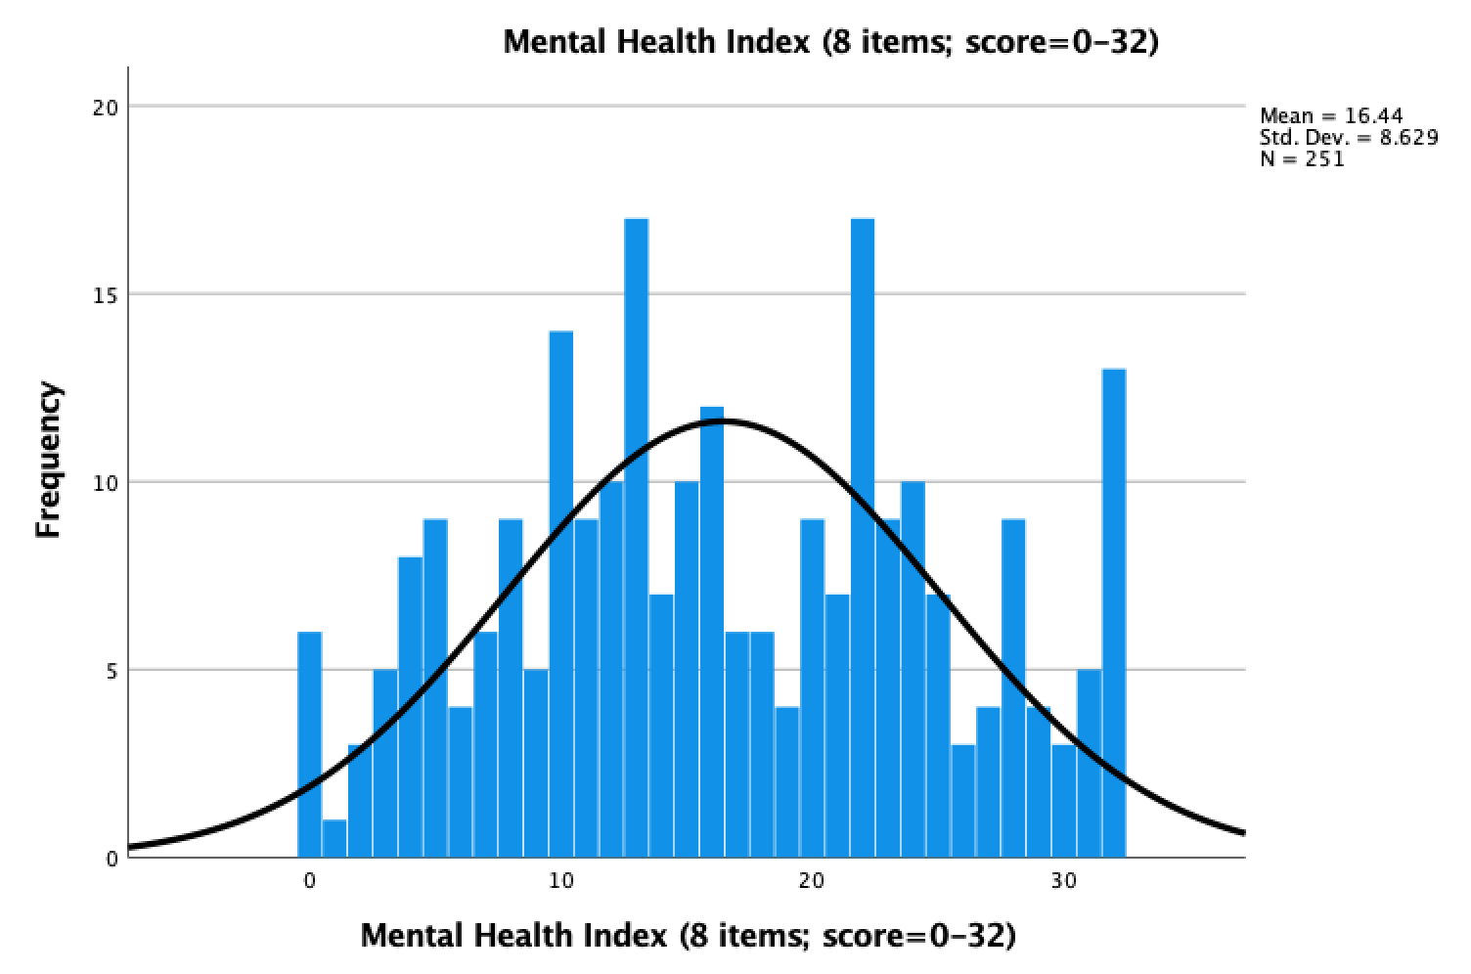
Mental Health and COVID-19
DASI Assessment Scores
COVID-19-Induced Stress:
80% of students feel more stress now than before the pandemic.
“Give students one weekend off of homework. Just one weekend. Please”
“[do] not have Boe House booked out weeks ahead. It's a joke.”
Average MH score = 16 out of 32
*Items measured stress, anxiety, depression
Recommendations:
Add a semi-annual mid-week mental health day.
Provide faculty members with more tools to better support their students’ mental health.

Slide 77
DASI and COVID-19 Stress: Race and Ethnicity
 | DASI Avg. | COVID Stress
BIPOC students | 17 | BIPOC students are significantly more likely to feel much more stressed.
White students | 16
First generation students | 20* | First gen. students are significantly more likely to feel much more stressed.
Non-first generation students | 17
* Statistically significant difference
Recommendations:
1. Increase mental health informational programming.
2. Increase COVID-specific mental health informational programming specifically at the Taylor Center.
3. Programming should provide a space for students to openly discuss their needs and develop self-care plans.

Slide 78
Coping Items
 | To a very large extent | To a large extent | To a moderate extent | To small extent | Not at at all
I use resources provided by St .Olaf (such as Wellness Center, Boe House, faith leaders, ResLife staff). | 7.1% | 3.6% | 11.5% | 14.7% | 63.1%
I talk to friends at St. Olaf. | 34.0% | 29.3% | 21.1% | 10.5% | 5.1%
I talk to people in my family. | 25.8% | 25.8% | 24.2% | 16.8% | 7.4%
I seek professional help outside of St Olaf | 7.5% | 6.0% | 5.2% | 4.8% | 76.6%
I use alcohol and/or drugs. | 2.0% | 2.0% | 7.5% | 14.7% | 73.8%
I try to stay positive. | 22.1% | 26.1% | 29.6% | 16.2% | 5.9%
I use physical methods (such as yoga, exercise, etc.). | 23.5% | 23.5% | 19.2% | 17.6% | 14.1%
I make time for self-care. | 20.6% | 20.6% | 30.4% | 22.9% | 5.5%
“I talk to friends at St Olaf”: 63.3% = to a large or very large extent
“I use resources provided by St. Olaf…”: Only 10.7% = to a large or very large extent (White > BIPOC)
Coping index and Race & Ethnicity: Slightly more BIPOC students gave the response of to a large or very large extent than white students.

Slide 79
Q & A Time

Slide 80
Thank you.
For more information or requests for more analysis of our data, please contact Prof. Ryan Sheppard at Sheppard@stolaf.edu.

