Slide 1
The Svoboda Center for Civic Engagement
Who we are, what we do, how we can connect!
Notes:
ALYSSA

Slide 2

Why at St. Olaf at this moment?
Long history & Lutheran heritage
Strategic Plan -> civic preparedness
Launch of the Svoboda Center for Civic Engagement
Thank you, Paul Svoboda ‘81!
Thank you, Buntrock Family Foundation!
Thank you, President Singer!
Current moment in our society
Notes:
ALYSSA
Lutheran heritage- service to and love of neighbor
Degrees for the public good -> licensure (nursing, education, social work)
Higher education & public purpose -> Campus Compact (1984)
Lilly Endowment grant in mid ‘00s -> Academic Civic Engagement
ACE -> Smith Center for Global Engagement (2017)

Slide 3
Purpose
The Svoboda Center for Civic Engagement aims to foster the College’s civic leadership and responsible community engagement.
It ensures that all St. Olaf students, staff, and faculty encounter abundant opportunities to discover and develop their vocations together through civically engaged courses, internships, volunteering, and research opportunities.
Notes:
ALYSSA
Still a work in progress!

Slide 4
Structure & Staffing
Buntrock Institute for Freedom & Community Svoboda Center
Director Assistant Director 7 Student Fellows
Campus partners Community Partners
Notes:
ALYSSA

Slide 5
Current Programming
Notes:
ALYSSA

Slide 6
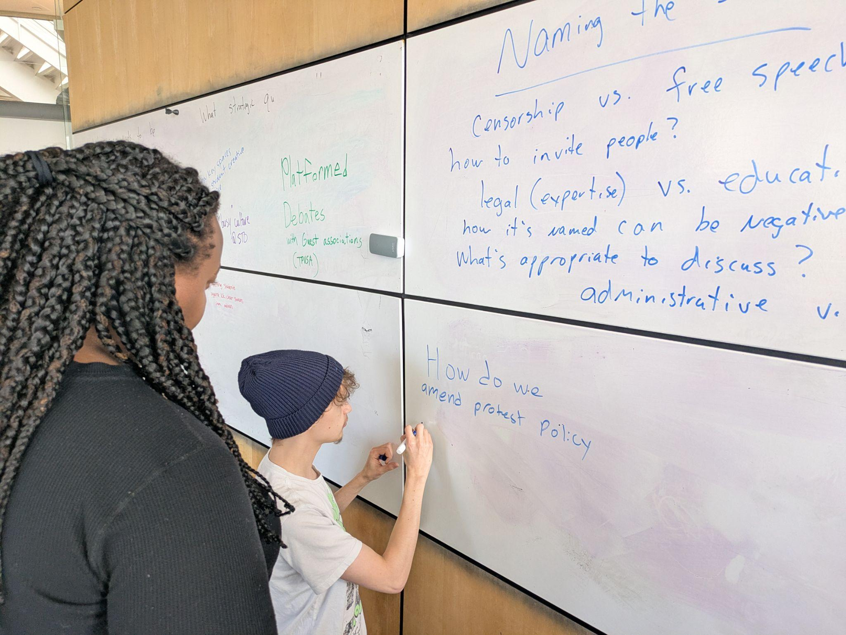
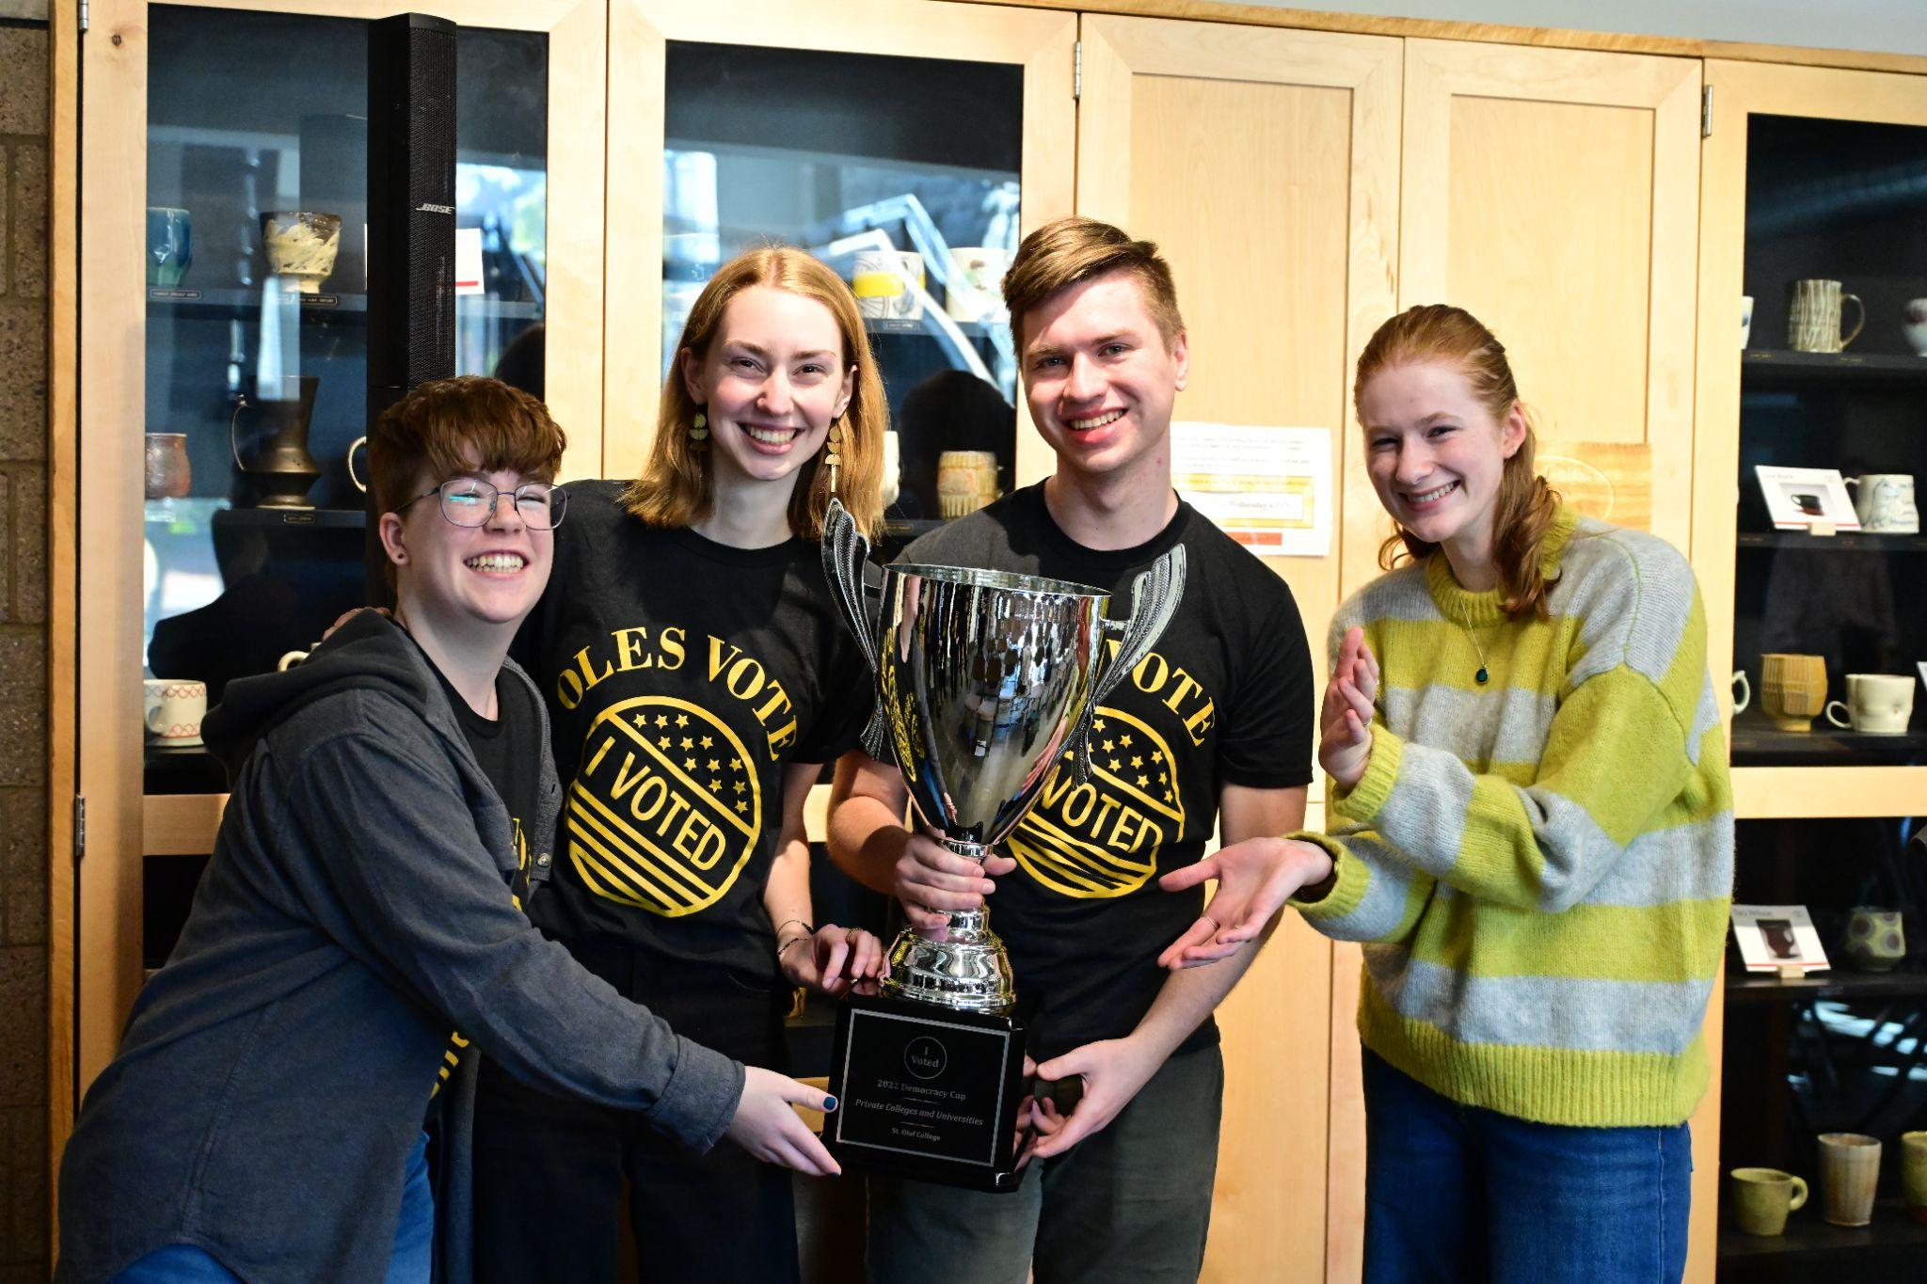
“Big C” Civic Engagement
Civic Dialogue w/IFC
STOVOTES Election Engagement
MPCC Day at the Capitol
Student Workshops
Notes:
ALYSSA

Slide 7
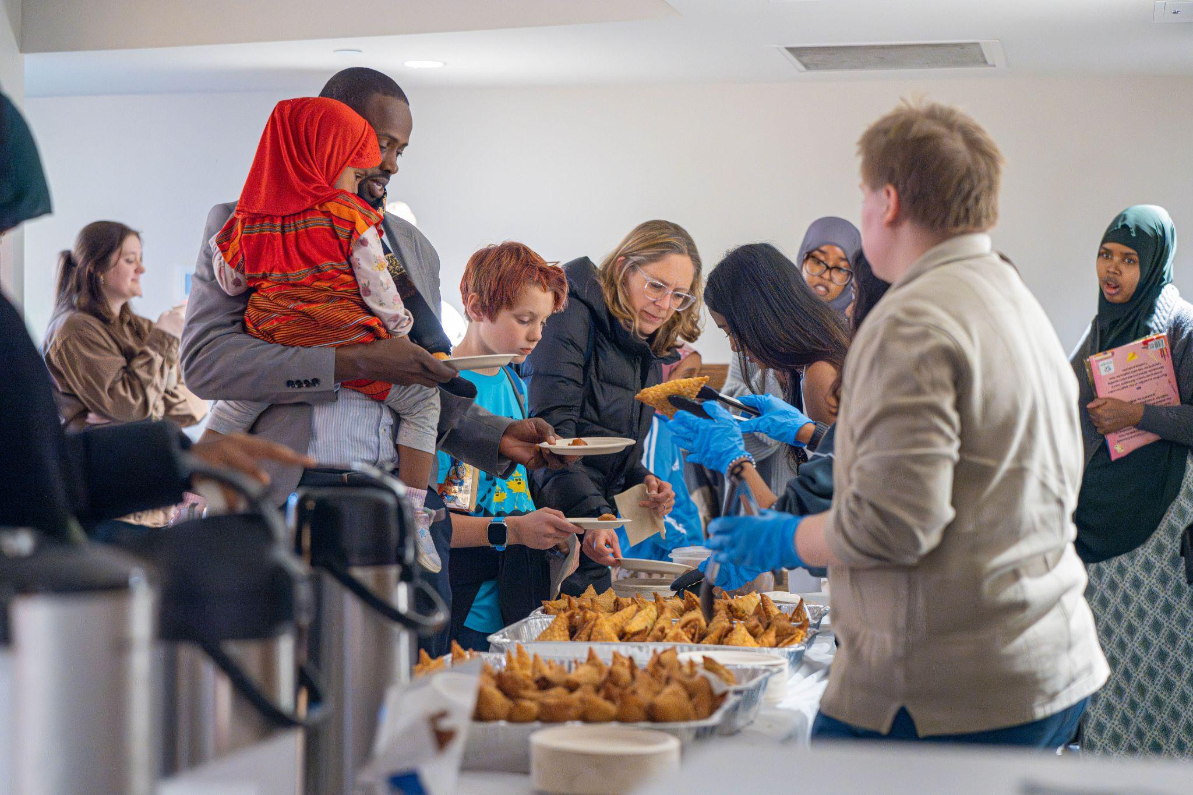
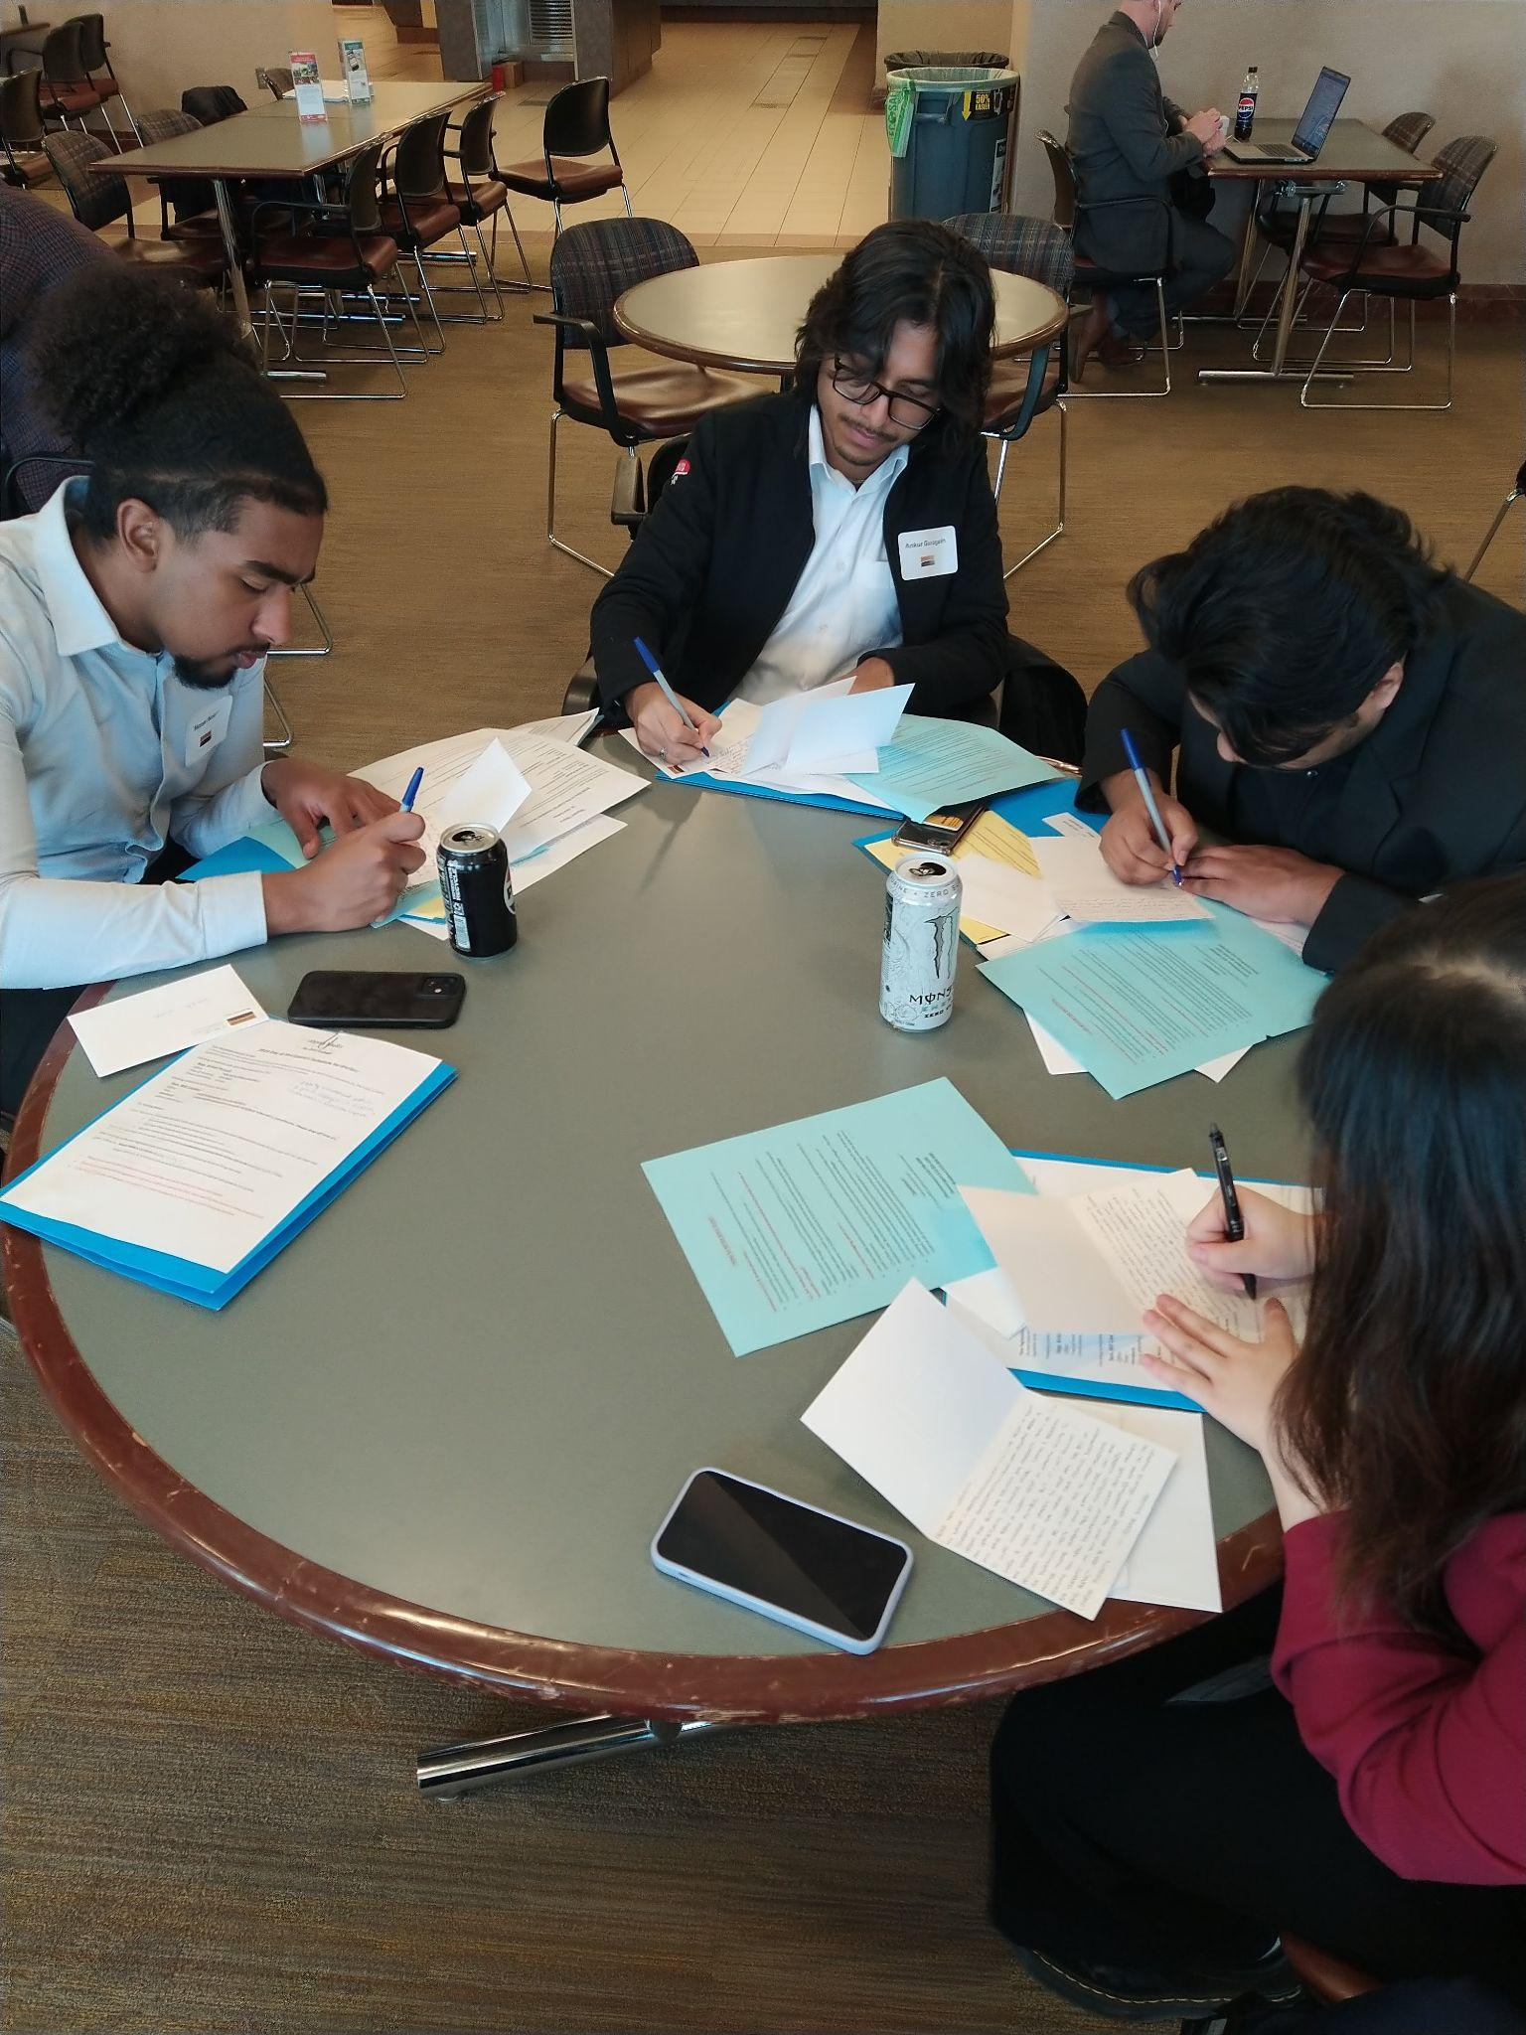
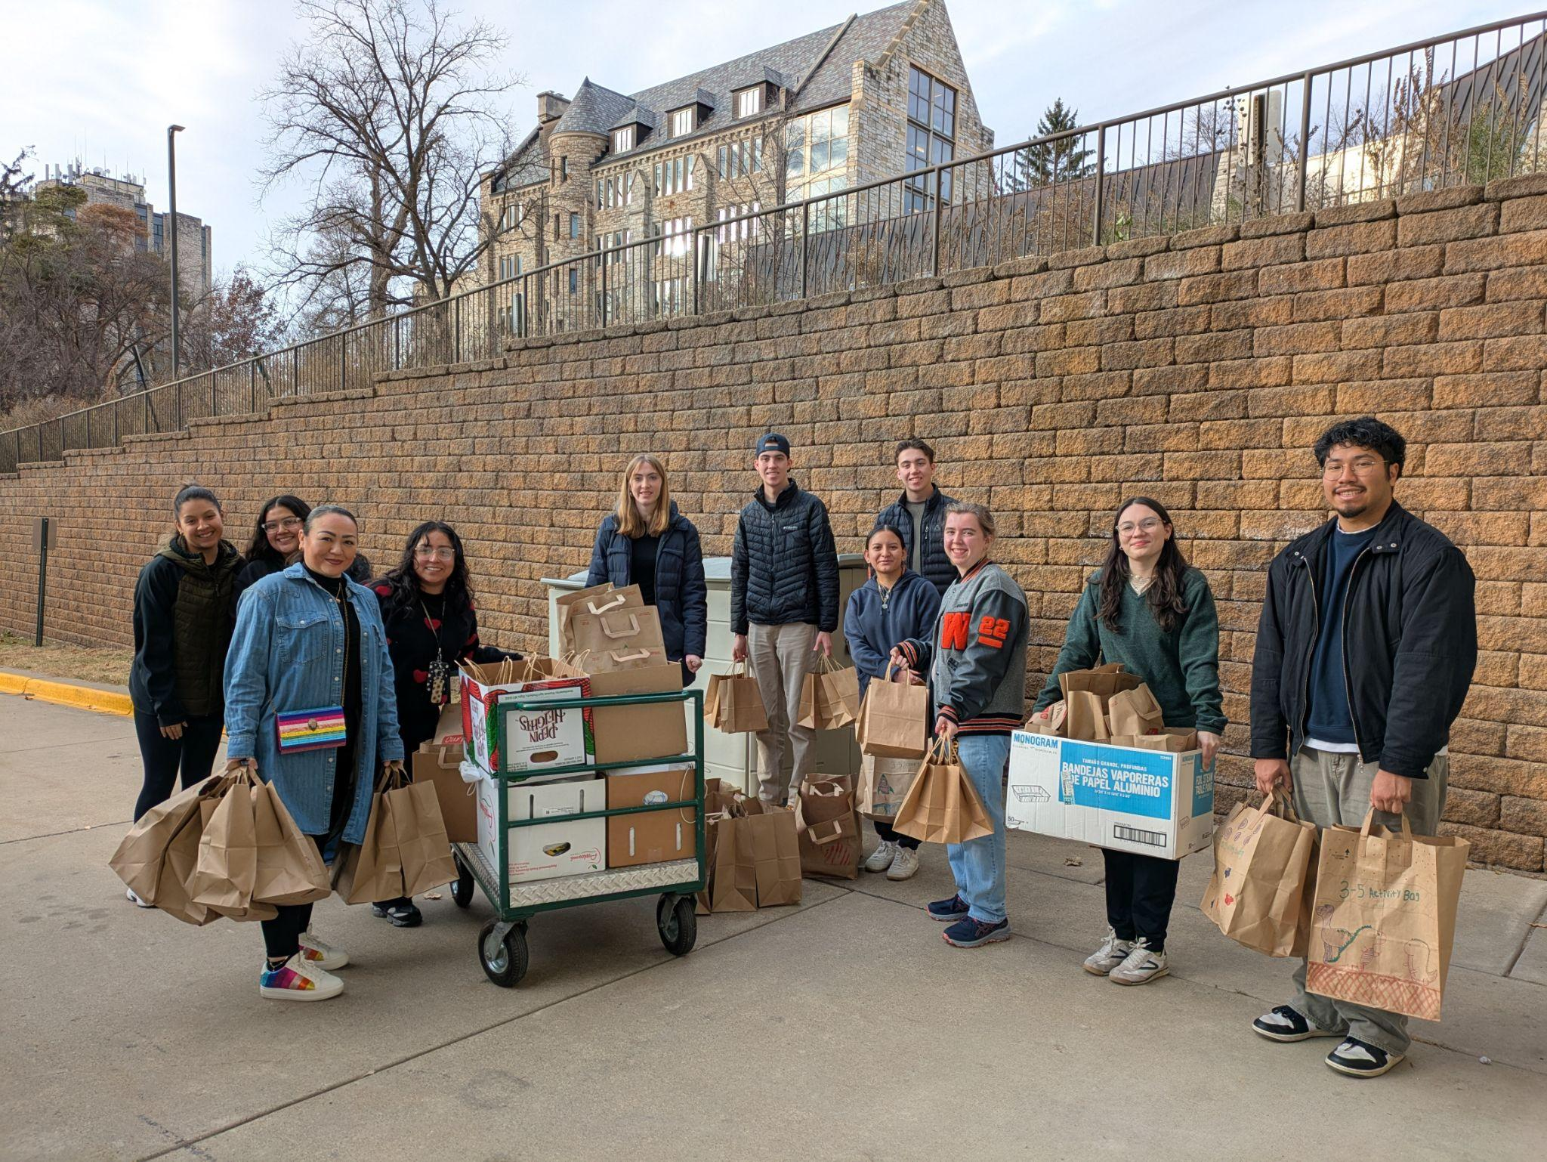
Curricular Programs
Academic Civic Engagement (ACE) classes
75--Most EVER this year!
2024-25 = over 1000 students!
Faculty development
Workshops and department work
Hiring, tenure, promotion, and department review (when asked!)
Notes:
ALYSSA

Slide 8
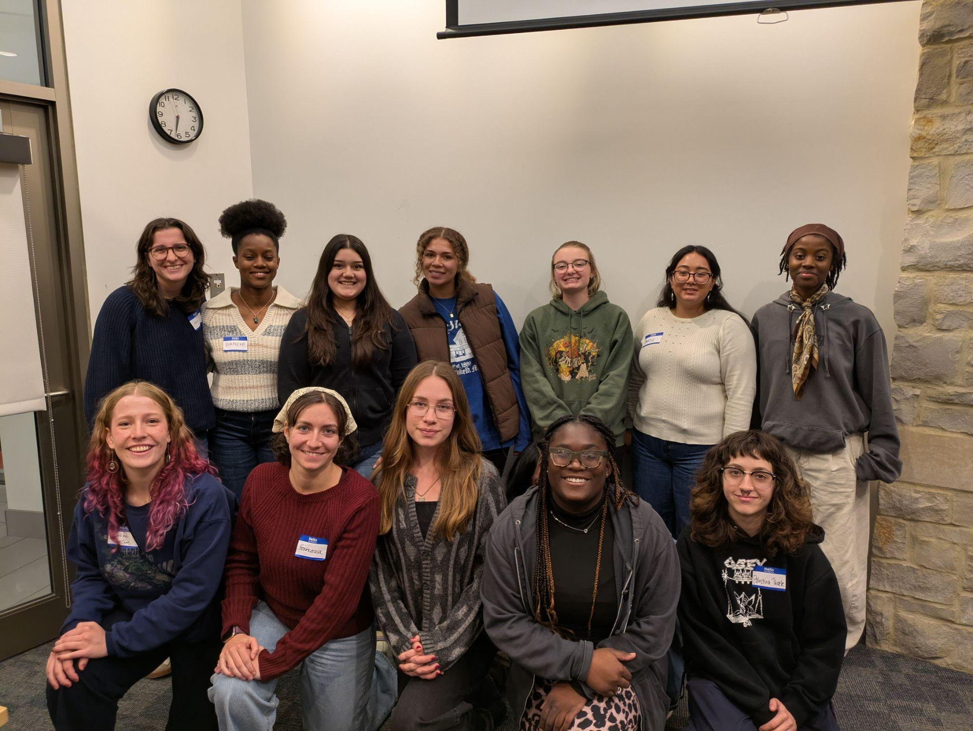
Co-Curricular Programs
Community Based Work Study
21 tutors at 6 different schools
34 students at 15 nonprofits
Common Good Fellows
Year-long, 13 student cohort
Example projects
ALL OLES Service Saturday (April 25)
Notes:
ERIN
Community Based Work Study is actually a requirement for all colleges and universities receiving federal work study dollars - and it’s a good thing! Our students are out around Rice County, getting real workplace experiences at places ranging from local schools to City Hall to the Community Action Center, Northfield Arts Guild and Rice County Historical Society. I’ve spent the last two weeks meeting with each of them and hearing their pretty inspiring reflections on how this work has helped build confidence in their skills, prompted thoughtful consideration about careers and service – and perhaps above all, made them feel far more connected to the broader community.
Common Good Fellows: year long project identifying a community need and partnering with groups or individuals in Rice County. Examples: setting up art workshops at the Key, recruiting talented musical Oles to teach music lessons at community school, establishing a well-attended series of intergenerational dialogues for the LGBTQIA+ community
Service Saturday; sites across Rice County, student organized, students should sign up by today!
CBWS:
At least 7% of federal work study dollars
Only federal or state work study eligible
Robust learning & reflection components

Slide 9
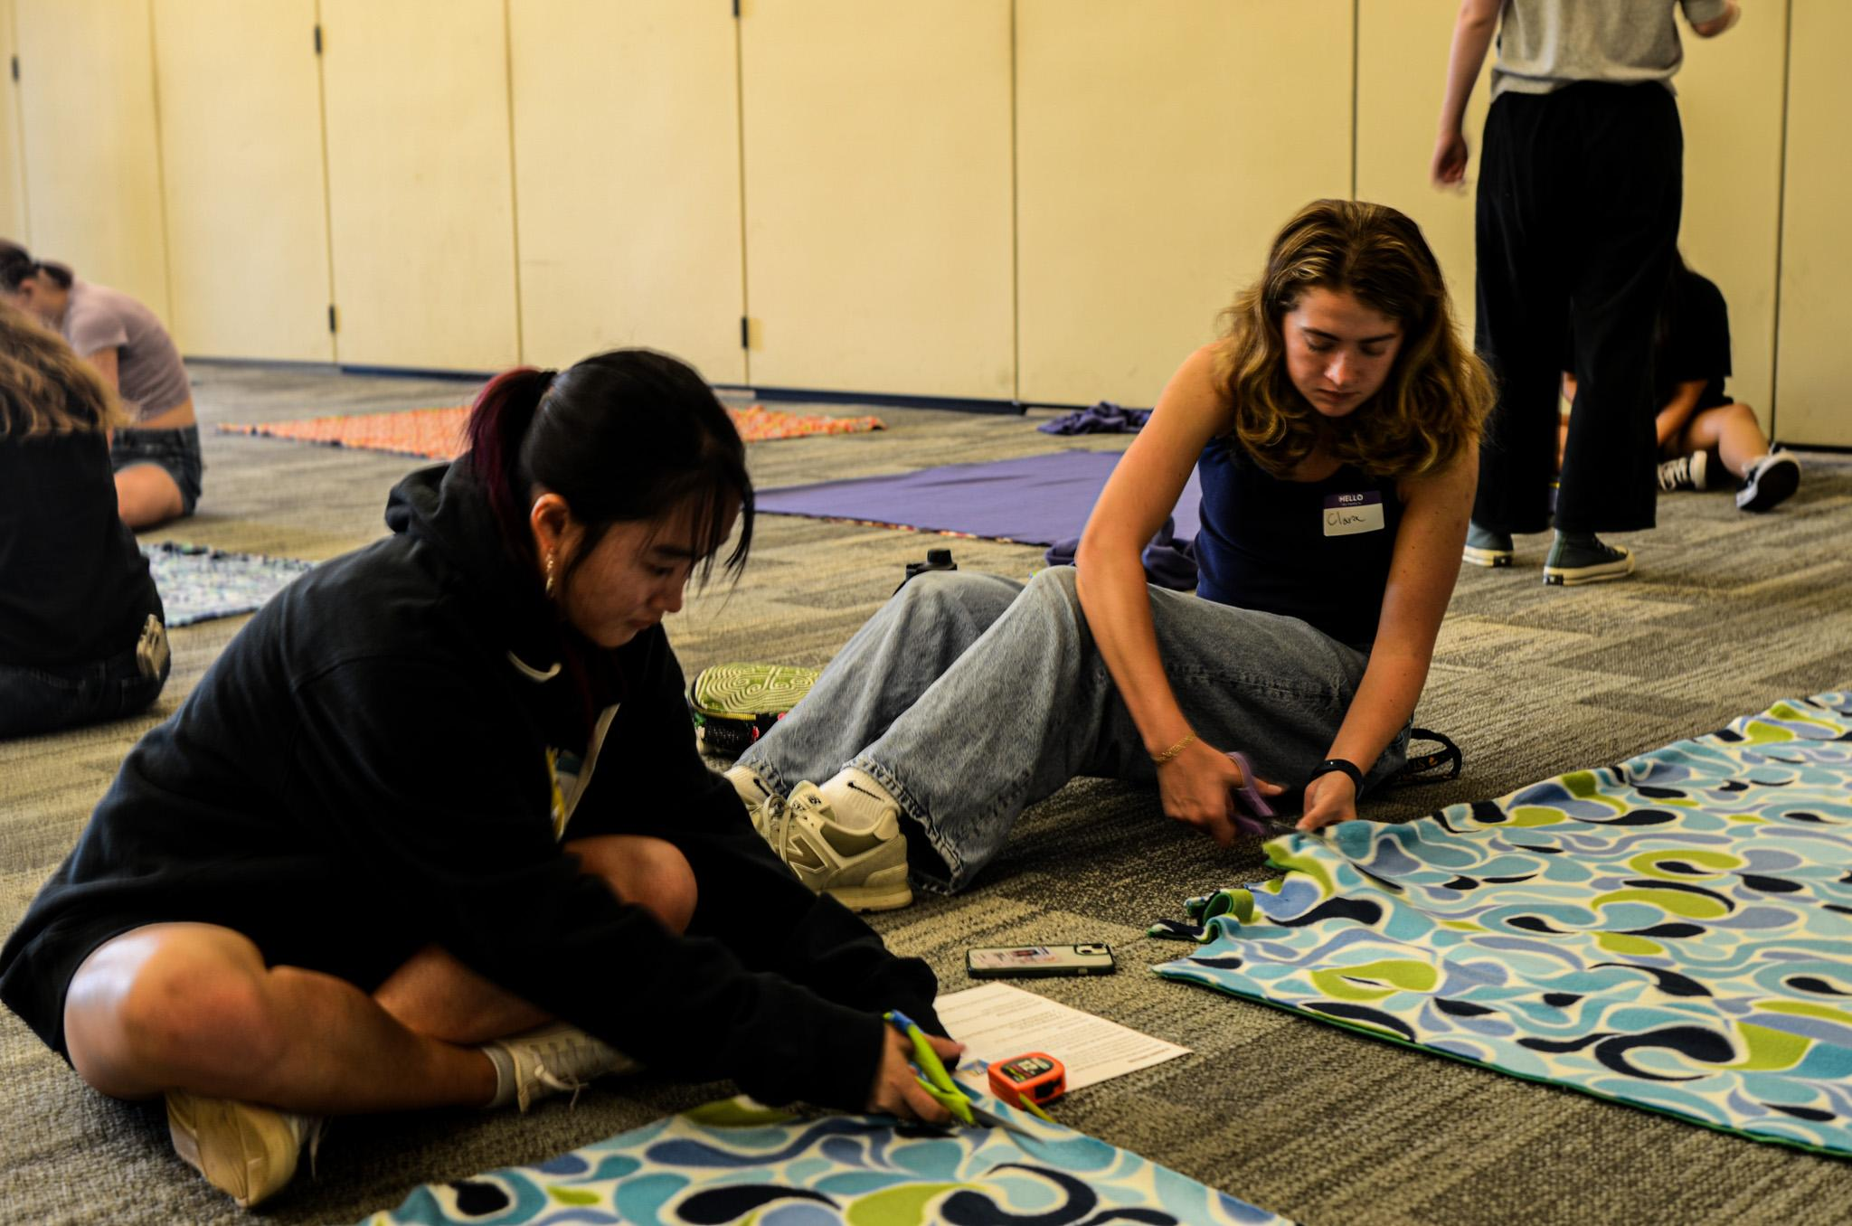
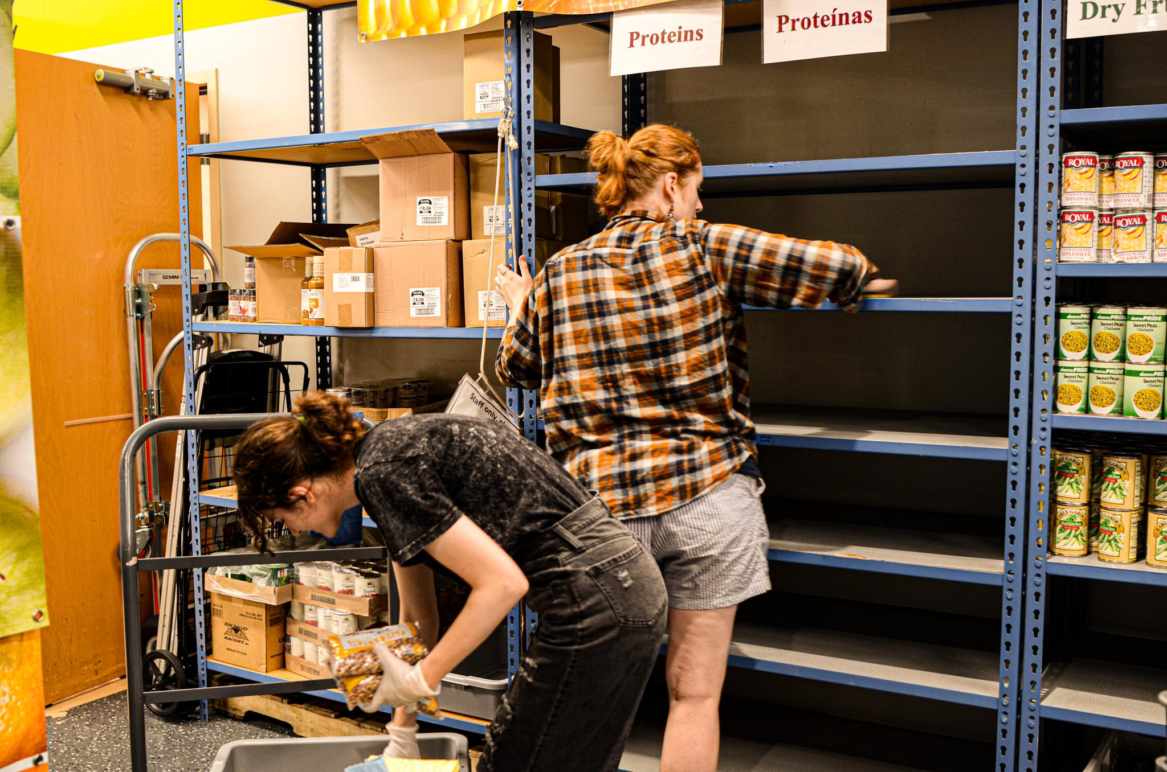
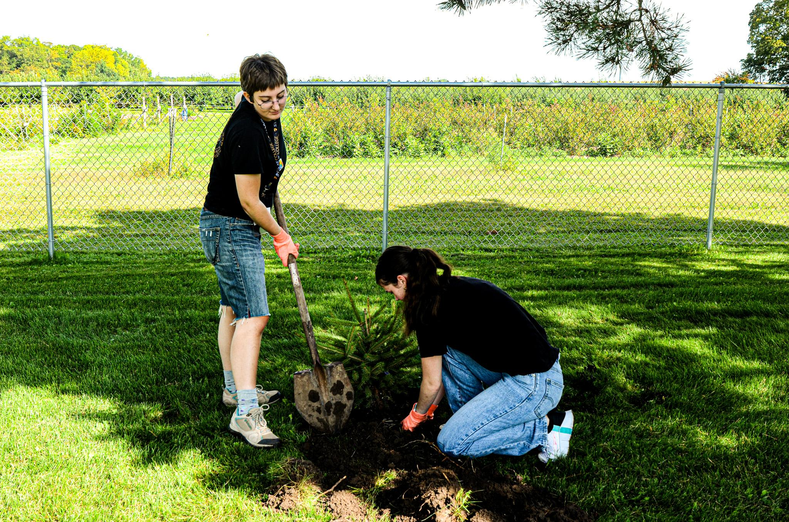
Co-Curricular Collaborations
Neighbors with Neighbors (Res Life)
Students living off campus must complete 32 hours of service
X# of hours this year
% more connected to the community
Service Saturday (NSO)
150 participants at eight sites this year!
Career Connections (Piper)
Notes:
ERIN
NwN: New program for students who wish to live off campus and commit to regular service in Rice County. So far, this grop has completed a combined 1,412 hours of service. They’ve helped stock shelves at the CAC, run afterschool programs at the Y and staffed respite events for Laura Baker Services, just to name a few. One particularly great partnership I’ve discovered through Neightbors with Neighbors is the Men’s Cross Country team’s student-led (and now long-lasting) partnership with Northfield Retirement Community. They go every week to play cards, drink coffee, and as i’m now meeting younger team members they just see it as a feature of the team: it’s just what they do.
Career Connections; Because we work so closely with so many community partners, we are better able to quickly identify and partner with the Piper Center on potential internship and career development opporutniteis in civic engagmenet. A great example: our partners at Northfield Hospital + Clinics, where we have a work study student, reached out about an exciting potential internship that didn’t fit neatly into what we do at the Svoboda Center. But I was able to turn around and send Bryan Shealer my favorite email subject line of the year: Colonoscopy Internship Opportunity – and hopefully get started on what actually does sound like a pretty fantastic internship for a pre-health student.

Slide 10

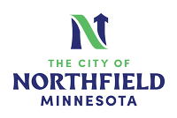









Community Partnership Management
Driving Questions:
How can we be good neighbors?
How can we utilize our assets to support community efforts?
Numerous connections -> One St. Olaf!
Notes:
ERIN: We greatly value our partnerships with each community organizaiton, and a common theme for our students in all of our programs is to approach each opportunity with consideration for these two key questions.

Slide 11
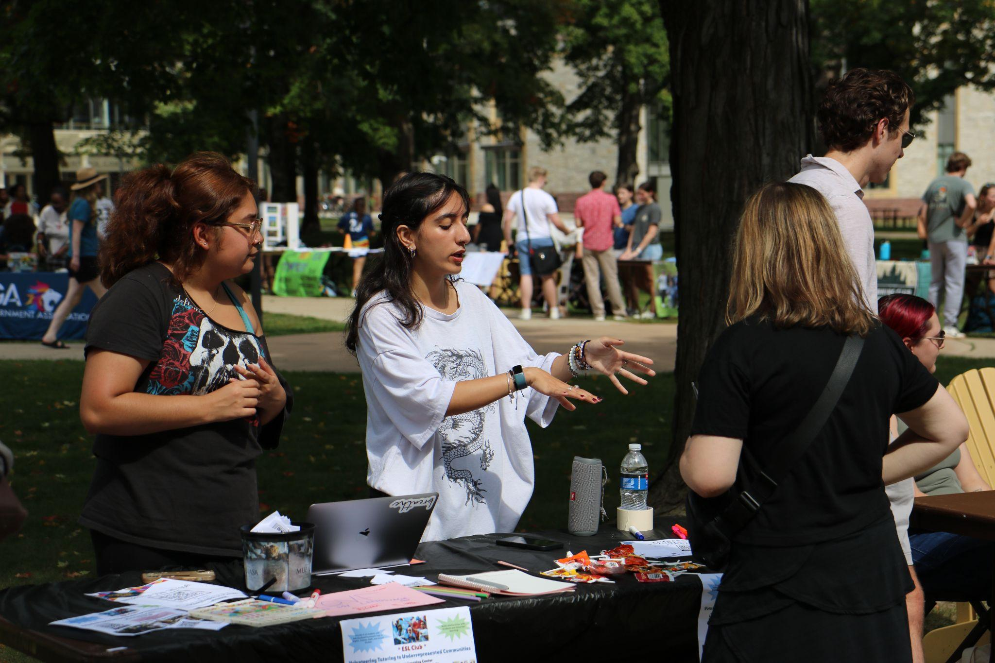
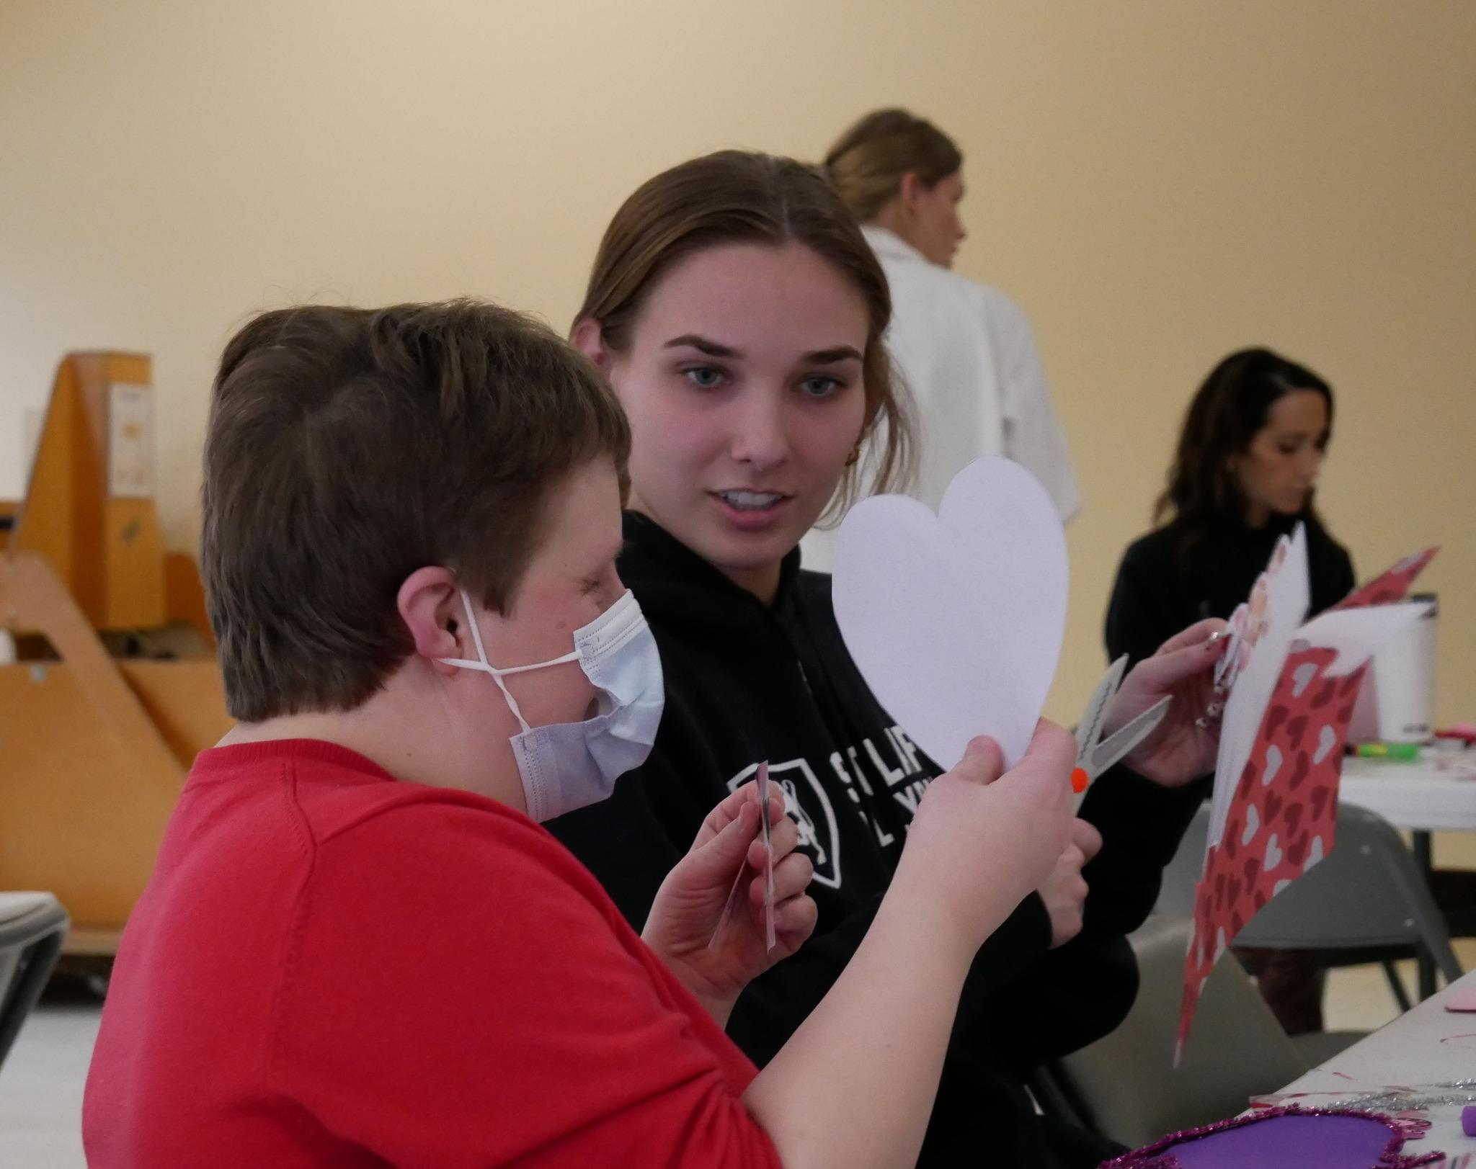
Near future goals
Folding in student service organizations next year, like the ESL Club
Conversations with Athletics on how to support the service priority in their strategic plan
Peer advising with new Student Service Connector positions
Notes:
ERIN
We have big goals and some exciting work in progress!

Slide 12
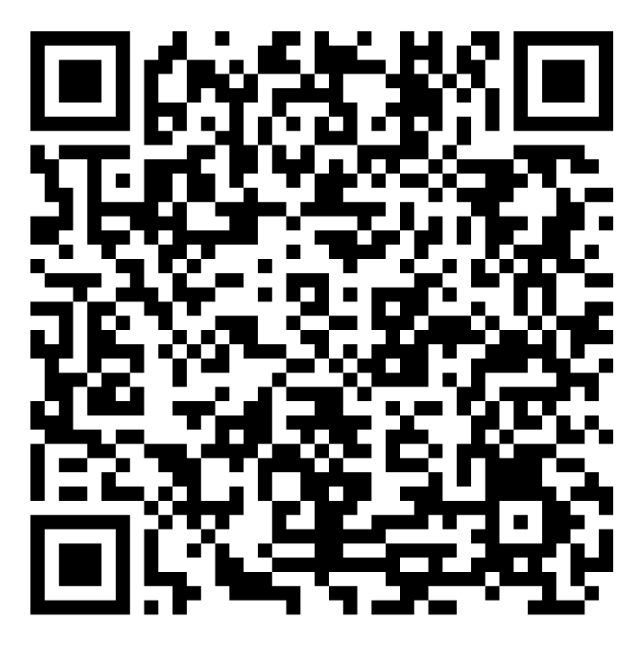
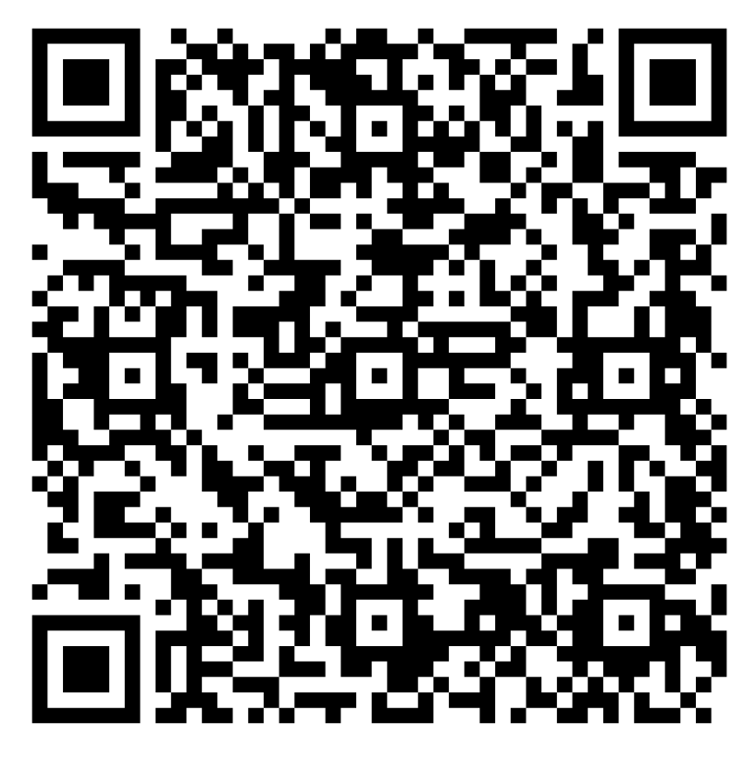
Ways to Connect
Sign up for the Svoboda Center Newsletter
Tell us about your local board or committee work!
Notes:
ALYSSA
Volunteer form--highlight connective examples--Highlight opportunities--Nfld Hospital Foundation (intern
Chamber has had interns
Talk to team--i.e. Admissions--messaging for incoming students, answering questions to help them talk about the work. IT--how to leverage existing systems to capture data about this work, ethical uses of AI in CE, etc. How do you student workers want to engage with the world beyond campus, connect with relevant community issues, with the skills and knowledge they have to share?

Slide 13
Ways to Connect
Join us @ the Civic Engagement Showcase, May 8, 3-5 pm in TOH
Have students interested in civic and community engagement? Send them our way!
Invite us to talk with your team and students
Notes:
ALYSSA
Volunteer form--highlight connective examples--Highlight opportunities--Nfld Hospital Foundation (intern
Chamber has had interns
Talk to team--i.e. Admissions--messaging for incoming students, answering questions to help them talk about the work. IT--how to leverage existing systems to capture data about this work, ethical uses of AI in CE, etc. How do you student workers want to engage with the world beyond campus, connect with relevant community issues, with the skills and knowledge they have to share?

Slide 14
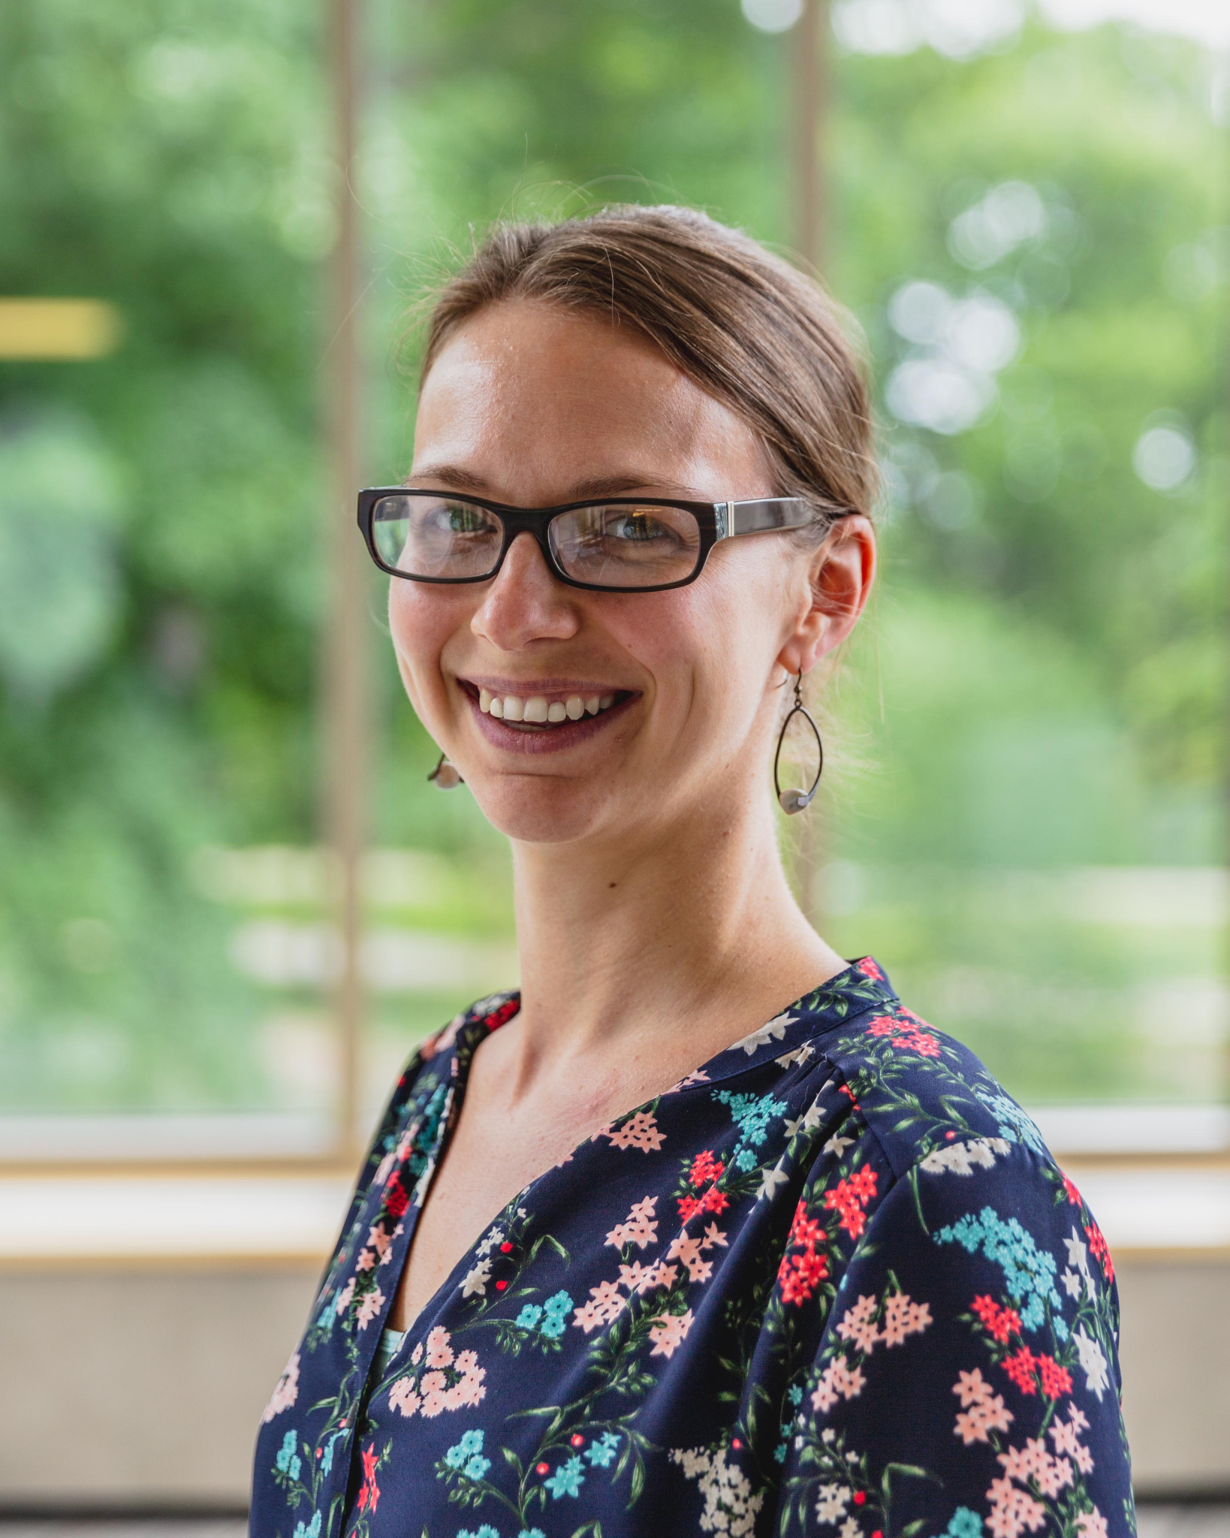
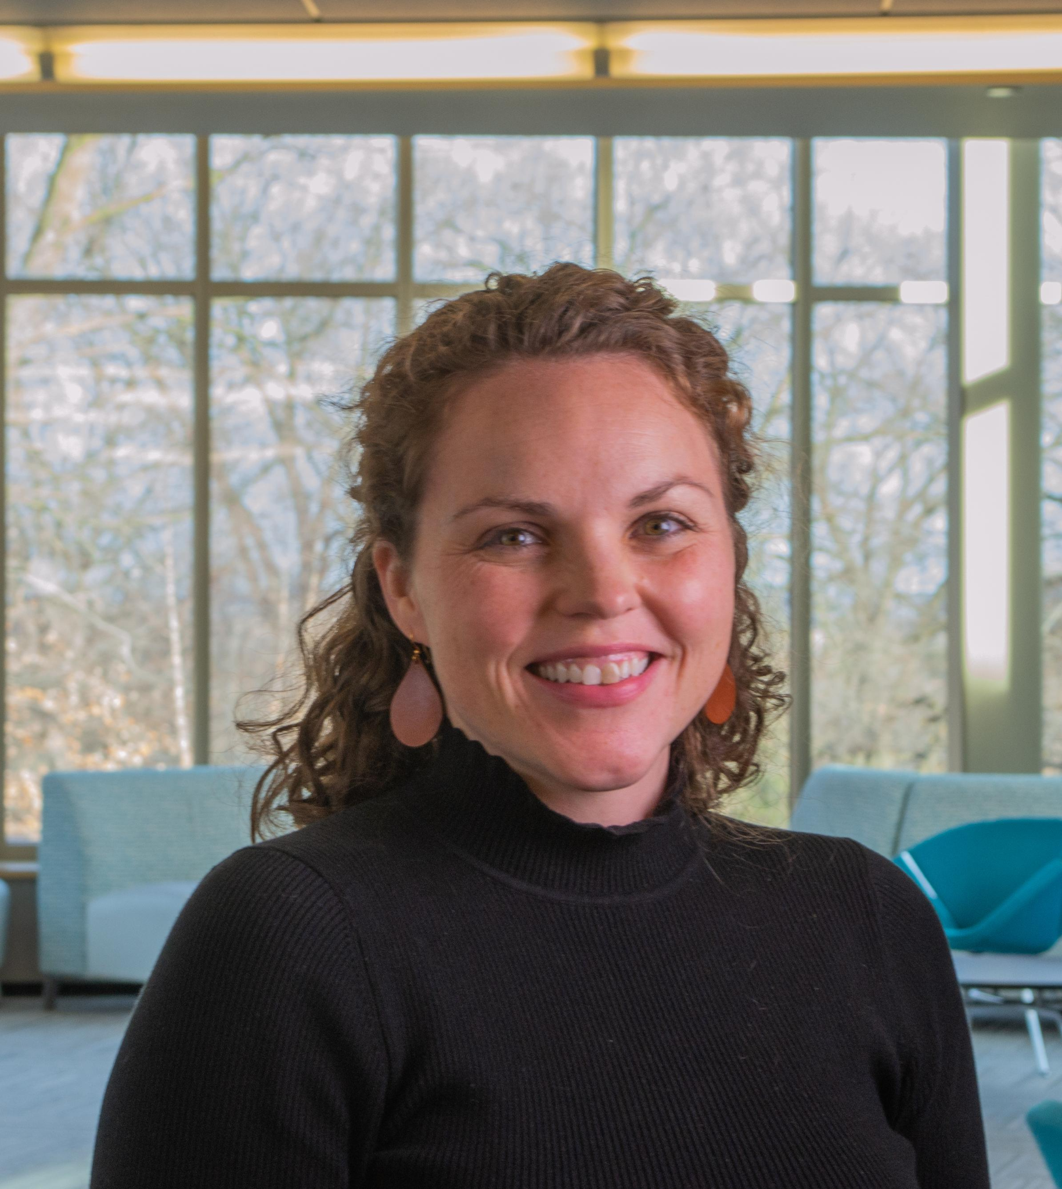
Svoboda Center Staff
Alyssa Melby
Director
melby1
Erin Golden Zimmerman
Assistant Director
golden8
Find us in the Smith Center suite (Tomson 380). Stay tuned for next year!
Notes:
ALYSSA

