Slide 1

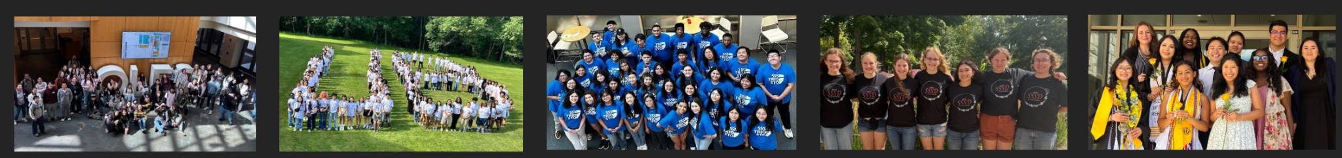
TRIO Update &
Current Challenges
Melissa Melgar
Director, TRIO McNair Scholars Program

Slide 2
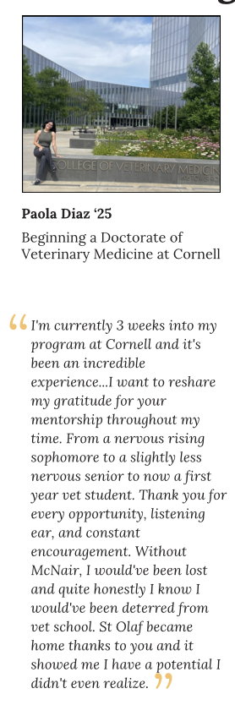
What is TRIO?
Federal-funded grant programs that support first-gen, low-income, and students with disabilities in exploring and succeeding in higher education
St. Olaf TRIO programs serve over 1,300 students annually (300 college and 1,000 pre-college students)

Slide 3
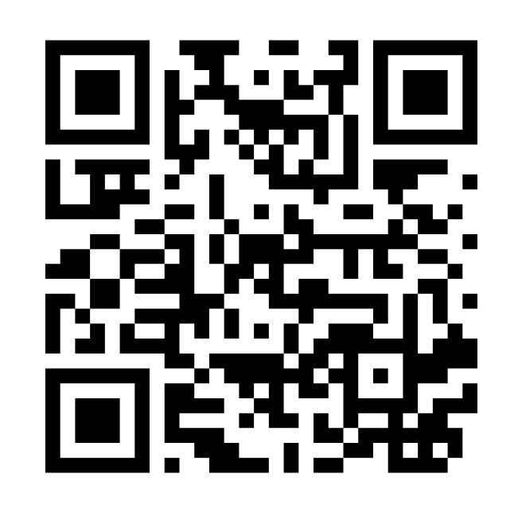
TRIO Programs at St. Olaf College wp.stolaf.edu/trio/
TRIO Educational Talent Search (ETS) Students in grades 6-12 receive information about college and career exploration, advising, and college and financial aid application assistance.
TRIO Upward Bound (UB) Students in grades 9-12 prepare for college, receiving instruction on Saturdays and during the summer. Students receive weekly tutoring and advising.
TRIO Student Support Services (SSS) Works to retain St. Olaf College students to graduation. Participants receive tutoring, advising and instruction. Summer Bridge Program for incoming first years.
TRIO Student Support Services for Student with Disabilities (SSSD) St. Olaf College students develop skills to successfully complete college. Students receive advising on academic & personal development.
TRIO McNair Scholars Program Graduate school preparatory program. Goal is to diversify the professoriate. Students participate in McNair summer research and internship opportunities.

Slide 4

Why TRIO Works
TRIO programs help students:
Overcome barriers to higher education
Increase their access to advising support, financial aid guidance & resources
Build academic confidence and community
Improve retention and graduation rates
Expand first-gen student engagement in research, internships, and other high-impact opportunities

Slide 5
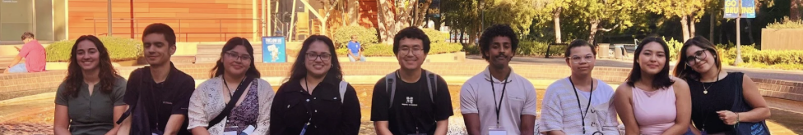
Current Challenges
TRIO grants renew every 5 years through a competitive process
ETS Request for Proposal (RFP) shifts focus away from college access toward employment training (reduce ETS programs by ⅔)
Move toward block grants could eliminate TRIO services in entire regions
If RFP is not rescinded and revised, similar attacks will come for all TRIO
FY27 federal budget again proposes eliminating TRIO programs
Bottom line: TRIO’s future—and the students it serves—is at risk

Slide 6
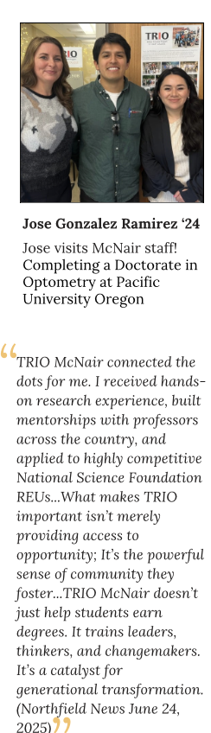
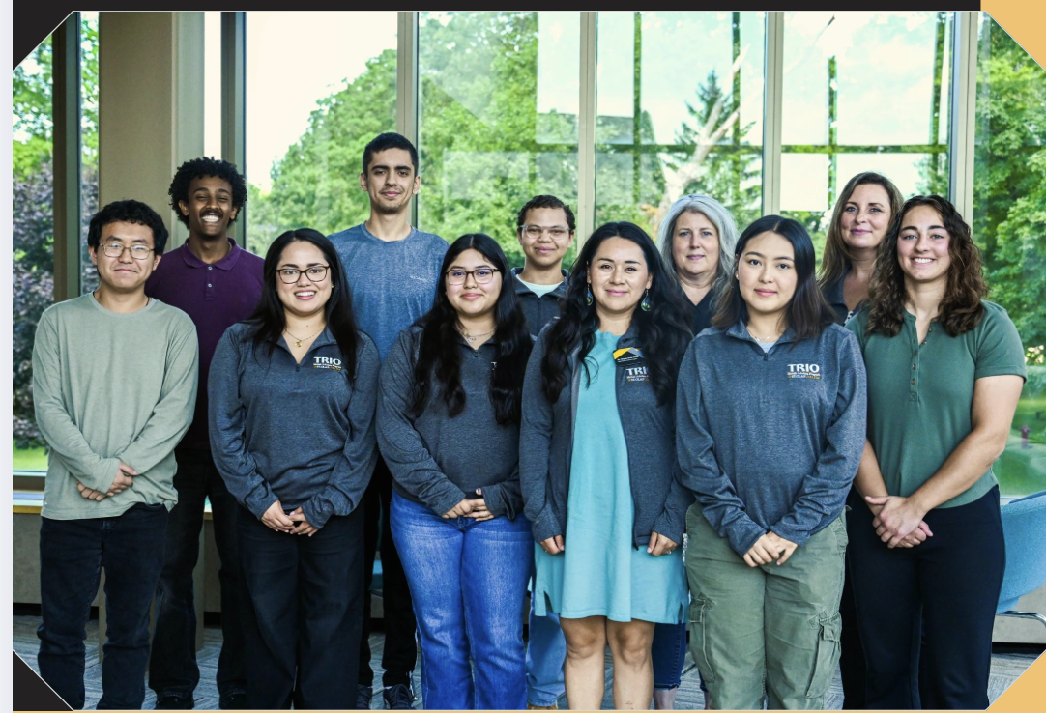
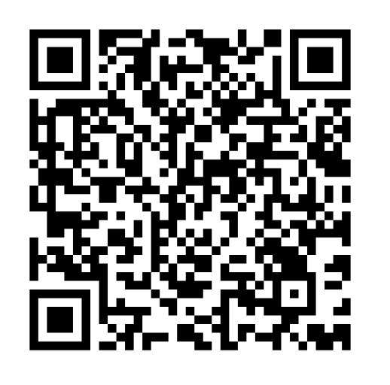
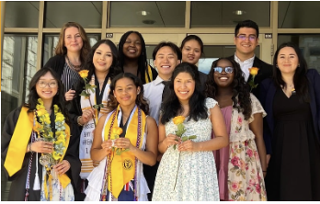
TRIO Needs YOU!
Additional questions about TRIO?
Email Melissa Melgar at melgar@stolaf.edu

